Slide 1
WP2.4 Semantic Web Services
Knowledge Web Review
13-14 March, 2006
Amsterdam, Netherlands

Slide 2
Overview
Presentations
  Research: Data Mediation for SWS
  Technology-Transfer: SWS Challenge
  Standardization: OASIS and W3C
Management Report
Notes:
Over the past year WP2.4 contributed to the research in the area of SWS while at the same time making sure that research results are properly exploited and disseminated. For this purpose, WP2.4 contributed to the transfer from the research to industry with active participation in standardization processes. With this respect, we have selected three presentations representing the work done over the past year. For the research we have selected the data mediation in SWS covering the research results of deliverable D2.4.12 and presenting design-time and run-time stages of data mediation in SWS execution process. For the technology-transfer we will give an overview of the SWS challenge – an initiative organized by DERI – which main aim is to provide test bed and standard methodology for evaluation of the SWS and organization of series of workshops where particular semantic service technologies can be evaluated. For the standardization we will give an overview of efforts in OASIS SEE TC and W3C SAWSDL WG – one of the first steps in standardization bodies towards standardization of semantic service technologies.

Slide 3
Data Mediation in Semantic
Web Services
Adrian Mocan
adrian.mocan@deri.org
KnowledgeWeb EU Review,
Amsterdam, March 13th – 14th 2006

Slide 4
Overview
Context
Ontology Perspectives
    Examples and motivation
    Abstract Elements
Contexts and Decomposition
Mappings
Grounding the Model to Ontologies
Implementation (DEMO)
Summary and Conclusions

Slide 5
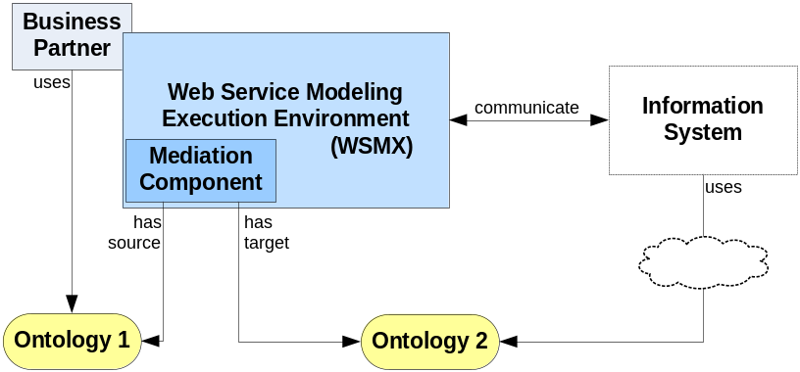
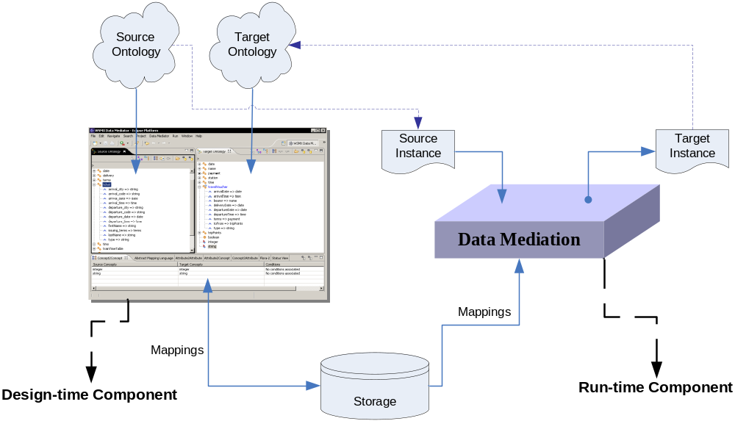
Context and Mediation Scenario
Scenario:
Context
  Web Service Modeling Ontology (WSMO)
  Web Service Modeling Language (WSML)
  Web Service Execution Environment (WSMX)
Approach:
Design-time
  Semi-automatic approach for Ontology Mapping
Run-time
  Automatic instance transformation
Formal Model

Slide 6
Examples and Motivation
Source Ontology
Target Ontology
concept person name ofType _string age ofType _integer hasGender ofType gender hasChild ofType person marriedTo ofType person concept gender value ofType _string instance male memberOf gender value hasValue "male“ instance female memberOf gender value hasValue "female"
concept human name ofType _string age ofType _integer noOfChildren ofType _integer concept man subConceptOf human concept woman subConceptOf human concept marriage hasParticipant ofType human date ofType _date
Depending on how ontologies are displayed different mismatches can be easier identified
Different users can have different expertise in mapping creation
  Different Perspectives

Slide 7
Ontology Perspectives
Examples and Motivation
Source Ontology
Target Ontology
string
integer
person
  name → string
  age → integer
  hasGender → gender
  hasChild → person
  marriedTo → person
gender
  value → string
string
integer
human
  name → string
  age → integer
  noOfChildren → integer
man
  name → string
  age → integer
  noOfChildren → integer
woman
  name → string
  age → integer
  noOfChildren → integer
marriage
  hasParticipant → human
  date → date
PartOf
PartOf

Slide 8
Ontology Perspectives
Examples and Motivation
Source Ontology
Target Ontology
string
integer
person
  name → string
  age → integer
  hasGender → gender
  hasChild → person
  marriedTo → person
gender
  value → string
string
integer
human
  name → string
  age → integer
  noOfChildren → integer
man
  name → string
  age → integer
  noOfChildren → integer
woman
  name → string
  age → integer
  noOfChildren → integer
marriage
  hasParticipant → human
  date → date
PartOf
PartOf

Slide 9
Ontology Perspectives
Examples and Motivation
Source Ontology
Target Ontology
string
integer
person
  name → string
  age → integer
  hasGender → gender
  hasChild → person
  marriedTo → person
gender
  value → string
string
integer
human
  name → string
  age → integer
  noOfChildren → integer
man
  name → string
  age → integer
  noOfChildren → integer
woman
  name → string
  age → integer
  noOfChildren → integer
marriage
  hasParticipant → human
  date → date
PartOf
PartOf

Slide 10
Ontology Perspectives
Examples and Motivation
Source Ontology
Target Ontology
string
integer
person
  hasGender → male:gender
  hasGender → female:gender
gender
string
integer
human
man
woman
marriage
InstanceOf
InstanceOf

Slide 11
Ontology Perspectives
Examples and Motivation
Source Ontology
Target Ontology
string
integer
person
  hasGender → male:gender
  hasGender → female:gender
gender
string
integer
human
man
woman
marriage
InstanceOf
InstanceOf

Slide 12
Ontology Perspectives
Examples and Motivation
Source Ontology
Target Ontology
string
integer
person
  name → string
  age → integer
  hasGender → gender
  hasChild → person
  marriedTo → person
gender
  value → string
string
integer
human
  name → string
  age → integer
  noOfChildren → integer
man
  name → string
  age → integer
  noOfChildren → integer
woman
  name → string
  age → integer
  noOfChildren → integer
marriage
  hasParticipant → human
  date → date
PartOf
PartOf

Slide 13
Ontology Perspectives
Examples and Motivation
Source Ontology
Target Ontology
name
  hasDomain → person
  hasRange → string
age
  hasDomain → person
  hasRange → integer
hasGender
  hasDomain → person
  hasRange → gender
hasChild
  hasDomain → person
  hasRange → person
marriedTo
  hasDomain → person
  hasRange → person
value
  hasDomain → gender
  hasRange → string
string
integer
human
  name → string
  age → integer
  noOfChildren → integer
man
  name → string
  age → integer
  noOfChildren → integer
woman
  name → string
  age → integer
  noOfChildren → integer
marriage
  hasParticipant → human
  date → date
PartOf
RelatedBy

Slide 14
Ontology Perspectives
Examples and Motivation
Source Ontology
Target Ontology
name
  hasDomain → person
  hasRange → string
age
  hasDomain → person
  hasRange → integer
hasGender
  hasDomain → person
  hasRange → gender
hasChild
  hasDomain → person
  hasRange → person
marriedTo
  hasDomain → person
  hasRange → person
value
  hasDomain → gender
  hasRange → string
string
integer
human
  name → string
  age → integer
  noOfChildren → integer
man
  name → string
  age → integer
  noOfChildren → integer
woman
  name → string
  age → integer
  noOfChildren → integer
marriage
  hasParticipant → human
  date → date
PartOf
RelatedBy

Slide 15
Abstract Elements
Common meta-level for all the perspectives
  Entities described by the means of other entities
Items
  Primitive items
  Compound Items
Relationships
  describes
    Description Item
  successor
    Successor Item
      Primitive Item
      Compound Item
Primitive Item
Compound Item
describes
Description Item
successor
Item

Slide 16
Abstract Elements
Common meta-level for all the perspectives
  Entities described by the means of other entities
Items
  Primitive items
  Compound Items
Relationships
  describes
    Description Item
  successor
    Successor Item
      Primitive Item
      Compound Item
Primitive Item
Compound Item
describes
Description Item
successor
Item
∀x.(ci(x) <=> ∃y.(di(y) ٨٧ describes(y, x))) (1)
∀x.∀y.(describe(x, y) => ci(y) ٨ di(x)) (2)
∀x.(di(x) <=> ∃y.(si(y) ٨ successor(y, x))) (3)
∀x.∀y.(successor(x, y) => di(y) ٨ si(x)) (4)
∀x.(si(x) => pi(x) ∨ ci(x))) (5)
∀x.(¬(ci(x) ٨ pi(x))) (6)
∀x.(¬(ci(x) ٨ di(x))) (7)
∀x.(¬(pi(x) ٨ di(x))) (8)

Slide 17
Decomposition and Contexts
Algorithms and mechanisms defined over the abstract elements
E.g.:
CI_1
describes
CI_2
DI_11
successor
Item
describes
DI_21
successor
PI_2
describes
CI_3
DI_22
successor
Item
describes
DI_31
successor
PI_1

Slide 18
Decomposition and Contexts
Context 0
PI_1
PI_2
CI_1
describes
DI_11
successor
CI_2
CI_2
describes
DI_21
successor
PI_2
describes
DI_22
successor
CI_3
CI_3
describes
DI_31
successor
PI_1

Slide 19
Decomposition and Contexts
Context 0
PI_1
PI_2
CI_1
Decomposition
describes
DI_11
successor
CI_2
CI_2
describes
DI_21
successor
PI_2
describes
DI_22
successor
CI_3
CI_3
describes
DI_31
successor
PI_1

Slide 20
Decomposition and Contexts
Context 0
PI_1
PI_2
CI_1
Decomposition
Context 1
describes
CI_2
DI_11
successor
CI_2
CI_2
describes
DI_21
successor
PI_2
describes
describes
DI_21
successor
PI_2
DI_22
successor
CI_3
describes
DI_22
successor
CI_3
CI_3
describes
DI_31
successor
PI_1

Slide 21
Decomposition and Contexts
Context 0
PI_1
PI_2
CI_1
Decomposition
Context 1
describes
CI_2
DI_11
successor
CI_2
CI_2
describes
DI_21
successor
PI_2
describes
describes
DI_21
successor
PI_2
DI_22
successor
CI_3
describes
DI_22
successor
CI_3
Decomposition
CI_3
describes
DI_31
successor
PI_1

Slide 22
Decomposition and Contexts
Context 0
PI_1
PI_2
CI_1
Context 1
Context 2
CI_2
Decomposition
describes
DI_11
CI_2
CI_3
describes
successor
CI_2
DI_21
successor
PI_2
describes
describes
DI_22
CI_3
DI_31
successor
PI_1
describes
successor
DI_21
successor
PI_2
Decomposition
describes
DI_22
successor
CI_3
CI_3
describes
DI_31
successor
PI_1

Slide 23
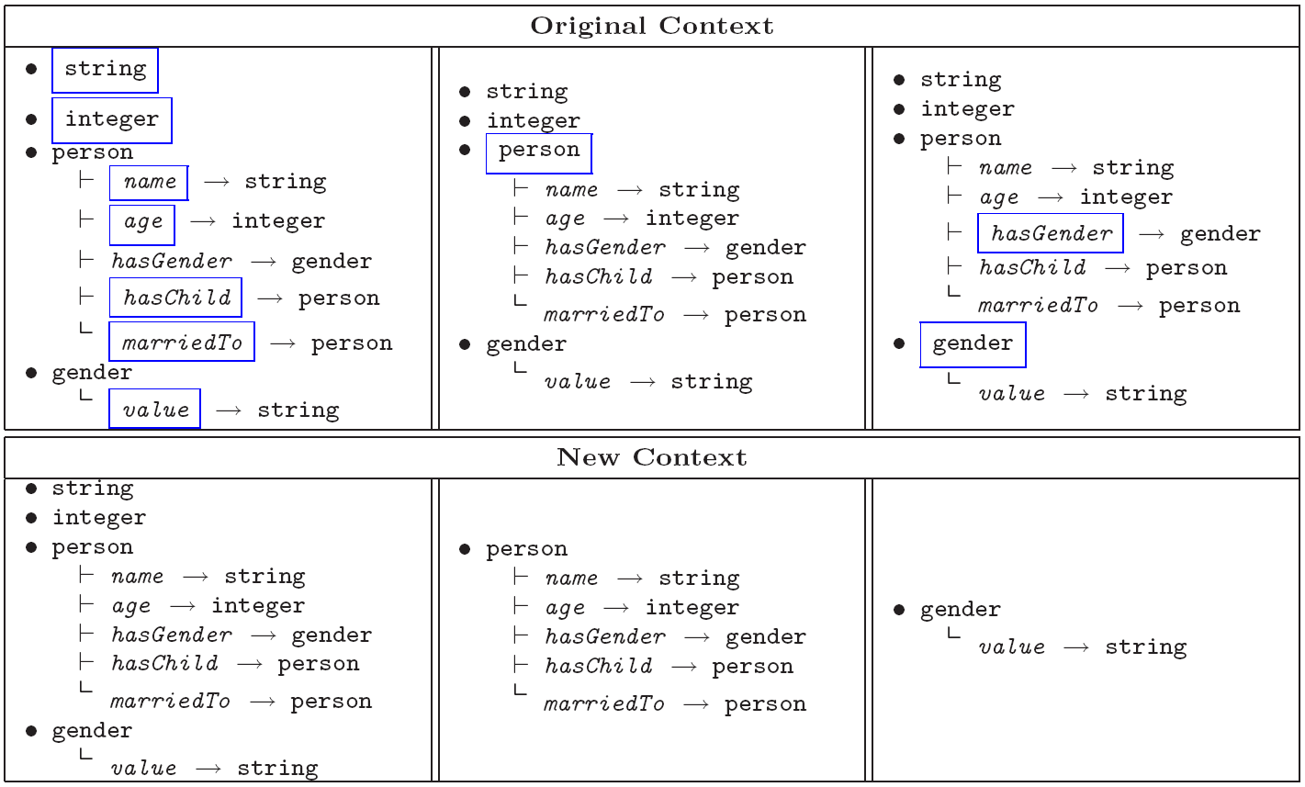
Decomposition and Contexts

Slide 24


Mappings
Mapping Context:
Operation:
  Contexts update
  Creation of mappings
    Depends of the chosen x and y
    Depends on the perspectives
    Depends on the initial and on the new context

Slide 25
PartOf Perspective
primitive_item
compound_item
  hasDescription1 → primitive_item
  hasDescription2 → compound_item
primitive_item
compound_item
  hasDescription1 → primitive_item
  hasDescription2 → compound_item
primitive_concept (data type)
compound_concept
  attribute1 → primitive_concept
  attribute2 → compound_concept
primitive_concept (data type)
compound_concept
  attribute1 → primitive_concept
  attribute2 → compound_concept

Slide 26
PartOf to PartOf Mappings
primitive_item
compound_item
  hasDescription1 → primitive_item
  hasDescription2 → compound_item
primitive_item
compound_item
  hasDescription1 → primitive_item
  hasDescription2 → compound_item
primitive_concept (data type)
compound_concept
  attribute1 → primitive_concept
  attribute2 → compound_concept
primitive_concept (data type)
compound_concept
  attribute1 → primitive_concept
  attribute2 → compound_concept
class to class mapping (classMapping)

Slide 27
PartOf to PartOf Mappings
primitive_item
compound_item
  hasDescription1 → primitive_item
  hasDescription2 → compound_item
primitive_item
compound_item
  hasDescription1 → primitive_item
  hasDescription2 → compound_item
primitive_concept (data type)
compound_concept
  attribute1 → primitive_concept
  attribute2 → compound_concept
primitive_concept (data type)
compound_concept
  attribute1 → primitive_concept
  attribute2 → compound_concept
class to class mapping (classMapping)
attribute to attribute mapping (attributeMapping)

Slide 28
PartOf to PartOf Mappings
primitive_item
compound_item
  hasDescription1 → primitive_item
  hasDescription2 → compound_item
primitive_item
compound_item
  hasDescription1 → primitive_item
  hasDescription2 → compound_item
primitive_concept (data type)
compound_concept
  attribute1 → primitive_concept
  attribute2 → compound_concept
primitive_concept (data type)
compound_concept
  attribute1 → primitive_concept
  attribute2 → compound_concept
class to class mapping (classMapping)
class to class mapping (classMapping)
class to attribute mapping (classAttributeMapping)

Slide 29
PartOf to PartOf Mappings
primitive_item
compound_item
  hasDescription1 → primitive_item
  hasDescription2 → compound_item
primitive_item
compound_item
  hasDescription1 → primitive_item
  hasDescription2 → compound_item
primitive_concept (data type)
compound_concept
  attribute1 → primitive_concept
  attribute2 → compound_concept
primitive_concept (data type)
compound_concept
  attribute1 → primitive_concept
  attribute2 → compound_concept
class to class mapping (classMapping)
class to class mapping (classMapping)
class to attribute mapping (classAttributeMapping)

Slide 30
InstanceOf Perspective
primitive_item
compound_item
  hasDescription1 → primitive_item
  hasDescription2 → compound_item
primitive_item
compound_item
  hasDescription1 → primitive_item
  hasDescription2 → compound_item
regular_concept
instance_concept
  attribute1 → regular_concept
  attribute2 → instance_concept
regular_concept
instance_concept
  attribute1 → regular_concept
  attribute2 → instance_concept

Slide 31
InstanceOf to InstanceOf Mappings
primitive_item
compound_item
  hasDescription1 → primitive_item
  hasDescription2 → compound_item
primitive_item
compound_item
  hasDescription1 → primitive_item
  hasDescription2 → compound_item
regular_concept
instance_concept
  attribute1 → regular_concept
  attribute2 → instance_concept
regular_concept
instance_concept
  attribute1 → regular_concept
  attribute2 → instance_concept
class to class mapping (classMapping)

Slide 32
InstanceOf to InstanceOf Mappings
primitive_item
compound_item
  hasDescription1 → primitive_item
  hasDescription2 → compound_item
primitive_item
compound_item
  hasDescription1 → primitive_item
  hasDescription2 → compound_item
regular_concept
instance_concept
  attribute1 → regular_concept
  attribute2 → instance_concept
regular_concept
instance_concept
  attribute1 → regular_concept
  attribute2 → instance_concept
class to class mapping (classMapping)
attribute to attribute mapping (attributeMapping)
  2*attributeValueCondition(valueCondition)

Slide 33
InstanceOf to InstanceOf Mappings
primitive_item
compound_item
  hasDescription1 → primitive_item
  hasDescription2 → compound_item
primitive_item
compound_item
  hasDescription1 → primitive_item
  hasDescription2 → compound_item
regular_concept
instance_concept
  attribute1 → regular_concept
  attribute2 → instance_concept
regular_concept
instance_concept
  attribute1 → regular_concept
  attribute2 → instance_concept
class to class mapping (classMapping)
class to class mapping (classMapping)
class to attribute mapping (classAttributeMapping)
  AttributeTypeCondition

Slide 34
RelatedBy Perspective
primitive_item
compound_item
  hasDescription1 → primitive_item
  hasDescription2 → compound_item
primitive_item
compound_item
  hasDescription1 → primitive_item
  hasDescription2 → compound_item
-
attribute
  hasDomain → concept
  hasRange → concept
-
attribute
  hasDomain → concept
  hasRange → concept

Slide 35
RelatedBy to RelatedBy Mappings
primitive_item
compound_item
  hasDescription1 → primitive_item
  hasDescription2 → compound_item
primitive_item
compound_item
  hasDescription1 → primitive_item
  hasDescription2 → compound_item
-
attribute
  hasDomain → concept
  hasRange → concept
-
attribute
  hasDomain → concept
  hasRange → concept
attribute to attribute mapping (attributeMapping)

Slide 36
RelatedBy to RelatedBy Mappings
primitive_item
compound_item
  hasDescription1 → primitive_item
  hasDescription2 → compound_item
primitive_item
compound_item
  hasDescription1 → primitive_item
  hasDescription2 → compound_item
-
attribute
  hasDomain → concept
  hasRange → concept
-
attribute
  hasDomain → concept
  hasRange → concept
attribute to attribute mapping (attributeMapping)
class to class mapping (classMapping)

Slide 37
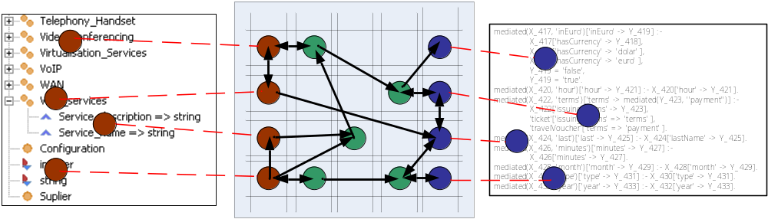
Formal Model for Mappings Creation
(Formal) Model
Ontology Alignment
(logical language)
Graphical Interface
Top-Down vs Bottom-Up
Suggestion Algorithms
Roles
Perspectives
Contexts
Decomposition
Mappings
Roles
Perspectives
Contexts
Decomposition
(Abstract) Mapping language -> WP2.2
Roles
Perspectives
Contexts
Decomposition
Mappings

Slide 38
Implementation and Prototypes

Slide 39
Implementation and Prototypes
http://sourceforge.net/projects/wsmt/
http://sourceforge.net/projects/wsmx/
http://sourceforge.net/projects/mediation/

Slide 40
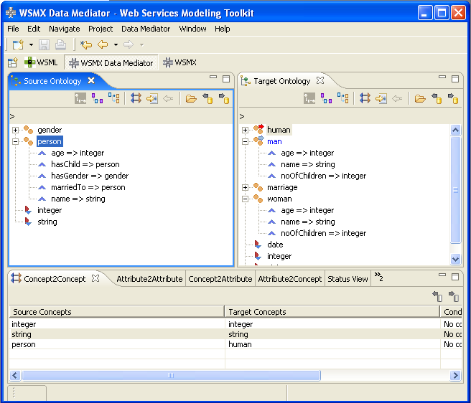
Design-Time Phase (I)
Inputs
  Source Ontology and Target Ontology
Goals
  Graphical interface
  Set of mechanisms towards semi-automatic creation of mappings
  Capturing the semantic relationships identified in the process
  Storing these mappings in a persistent storage
Output
  Abstract representation of the mappings
    Alignment Format -> WP2.2

Slide 41
Design-Time Phase (II)
Most important features:
  Perspectives
    Different view-points on the ontology
    Allows to identify different types of mismatches
  Bottom-up approach
    Training set
  Top-down approach
    Decomposition, Contexts
  Suggestions
    Lexical algorithms (not the main focus)
    Structural algorithms
      Consider the structure
      Use the already creating mappings to improve the quality of suggestions
Aim
  To abstract the user from the burden on mappings creation process

Slide 42
DEMO

Slide 43
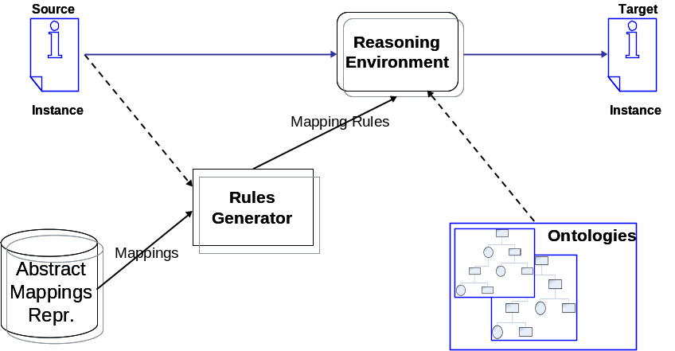
Run-time Phase (I)
Main Mediation Scenario: Instance Transformation
Inputs
  Incoming data
    Source ontology instances
Features
  Completely automatic process
  Grounding of the abstract mappings to a concrete language
    WSML
  Uses a reasoner to evaluate the mapping rules
Outputs
  Mediated data
    Target ontology instances
Alignment Format -> WP2.2

Slide 44
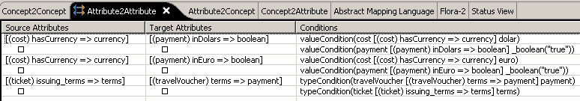

Run-time Phase (II)
Grounding the abstract mappings
Associate a formal semantics to the mappings
  Obtain rules in a concrete language
Why not during design time?
  Offers a grater flexibility
  Different groundings for the same mappings set
  Different execution environments for the grounded mappings
  Easier to maintain the abstract mappings
  Important point of alignment
Caching mechanism can be used

Slide 45
Summary and Future Work
Perspectives based mapping approach
  Different perspectives suited for different mappings
  Allow for mappings creation of users with different levels of expertise
Formal model
  Defines and links the design-time with the run-time phase
Future work
  Investigate other types of perspectives
    Is-a perspective
  Include Instance Transformation scenario in the alignments evaluation methods
    WP2.2
  Evaluation
    Which perspectives are better for certain kind of mismatches
    Which perspectives require what level of expertise

Slide 46
Questions and Answers

Slide 47
Semantic Web Services Challenge
Michal Zaremba
UIBK, DERI Innsbruck
michal.zaremba@deri.org

Slide 48
SWS Challenge Overview
SWS Challenge develops a set of testbeds based initially on RosettaNet specification to demonstrate, compare and evaluate various technologies which aim to facilitate the automation of service-based systems integration
What’s wrong with RosettaNet?
  B2B integration even when using an XML-based standard, such as RosettaNet can easily take several months to set up
  We believe that if a business partner gives a more formal description of how to interact with it, it is possible to use mediation technologies to adapt the interaction of the other business partner to be interoperable
On top of this we have various levels, each corresponding to a general kind of problem, and each with sublevels of complexity e.g. level 2 adds discovery
  http://www.sws-challenge.org

Slide 49
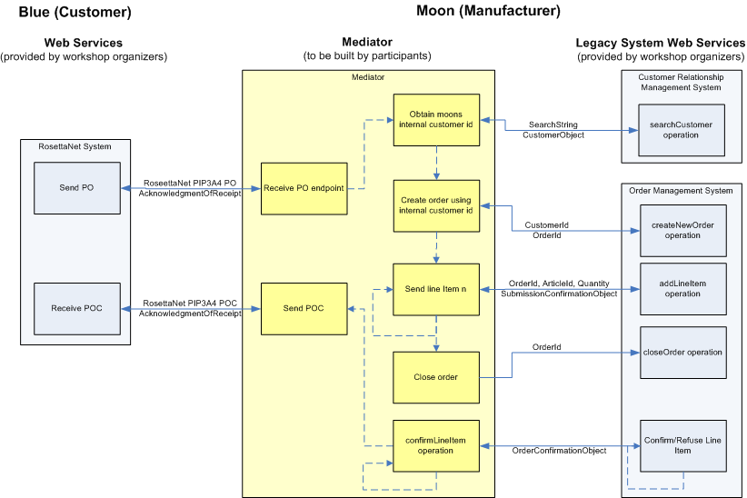
Mediation Scenario

Slide 50
SWS Challenge Levels
We provide a set of challenge problems
  Initial problems provided by challenge organizers
  Now it is no longer a case
The initial was a static mediation problem–level 0.
Next we have mediation scenario, where organizers have to adopt to changes in system–level 1
On top of this we have various levels, each corresponding to a general kind of problem, and each with sublevels of complexity e.g. level 2 adds discovery
level 3 adds a different kind of discovery as well as some composition with the system of level 2.
Subsequent levels extend the supply chain, mixing mediation and discovery.

Slide 51
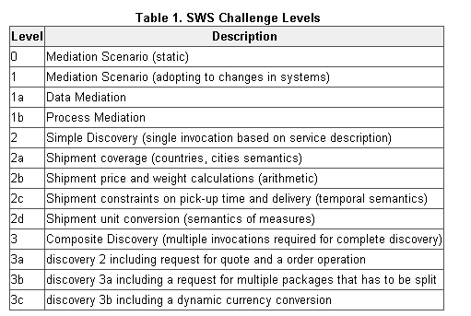
SWS Challenge Levels

Slide 52
Evaluation Criteria
Evaluation Success Level 0:The evaluation has a minimal criterion that the participating system adequately invokes the requisite web services, measured by the legality of the messages exchanged. Participants self-declare what part of their solution is executable code and what part is “data”:
  declarations that describe the semantics of the problem and can be easily changed to adapt to new problem levels.
Evaluation Success Level 1: Success Level 1 is achieved whether the code had to be changed (the compiler or interpreter would execute different instructions.)
Evaluation Success Level 2: Success Level 2 is achieved if only data had to be changed: no execution code had to be changed.
Evaluation Success Level 3: Success Level 3 is achieved if there were no change to the system at all.

Slide 53
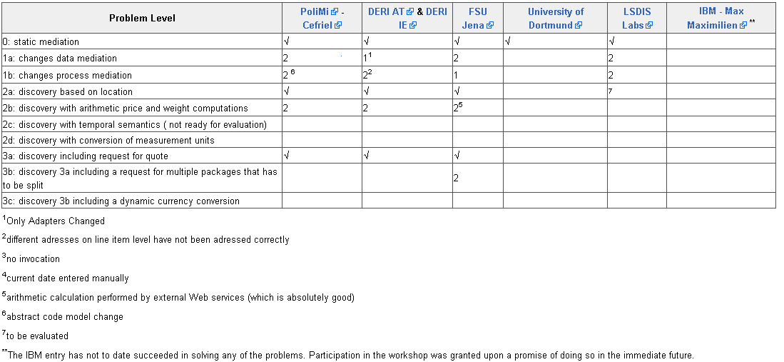
Results after Athens Meeting

Slide 54
Workshops so far and our Future Plans
The SWS Challenge is organized in a serious of workshops:
  Workshop Stanford (March 2006)
  Workshop Budva (June 2006)
  Workshop Athens (November 2006)
  Innsbruck (June 2007)

Slide 55
Future
Applying to be W3C Incubator
Book being negotiated
Part of new project proposals (or even the new project proposal on its own)

Slide 56
Standardization Efforts
Tomas Vitvar, Michal Zaremba, Jacek Kopecky
NUIG & UIBK
firstname.lastname@deri.org

Slide 57
Overview
W3C Semantic Annotations for WSDL (W3C SAWSDL WG)
OASIS Semantic Execution Environment Technical Committee (OASIS SEE TC)

Slide 58
W3C SAWSDL WG
Started: April 2006
  After several W3C SWS submissions (WSMO, OWL-S, WSDL-S)
Currently: 10 months
Chair: Jacek Kopecky (UIBK DERI Innsbruck)
Members
  UIBK, NUIG, OU, IBM, ILOG, Wayne State University, University of Georgia, Telecom Italia, CA, Scapa Technologies
Notes:
SAWSDL is the first step towards semantic web services in W3C. It defines hooks in WSDL in order to annotate WSDL elements – schema types, interfaces, operations, services (it does not define any semantics but only hooks which can be used for annotation of WSDL elements). SAWSDL thus allows to link semantic information with non-semantic WSDL description, e.g. classification of a service from classification ontology, pre- and post- conditions on service interface or operation, behavioural semantics attached to interfaces or operations, etc.

Slide 59
SAWSDL Overview
SAWSDL is part of Web Service Activity in W3C
Charter at
  http://www.w3.org/2005/10/sa-ws-charter.html
Based on WSDL-S
  http://www.w3.org/Submission/WSDL-S/
Taking WSDL as basis for SWS description
  Adding hooks for (pointers to) semantics

Slide 60
SAWSDL Overview
Goal
  Introduce extensions to WSDL in order to annotate WSDL elements using semantic descriptions
  Enable automation of service discovery, mediation, selection, negotiation using semantic descriptions

Slide 61
SAWSDL Attribute Extensions
Attribute Extensions
  modelReference
    Linking WSDL elements with concepts from ontology (WSDL elements: XML Schema types, interfaces, operations, messages and services)
  loweringSchemaMapping and liftingSchemaMapping
    Transformations of XML data to/from ontology representation (only on XML Schema types)

Slide 62
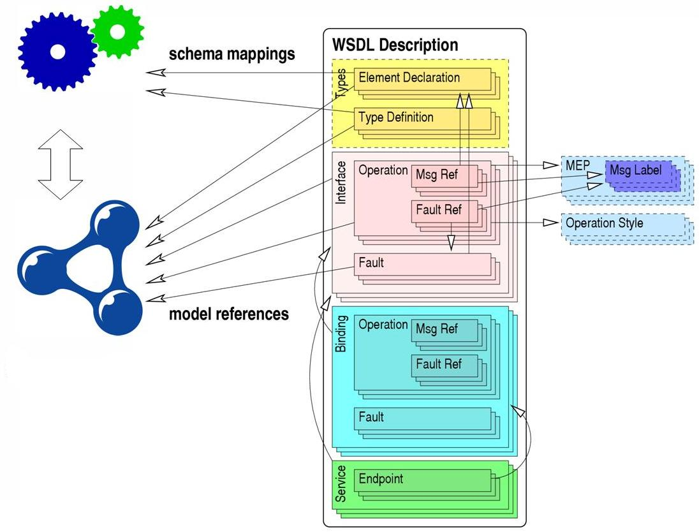
SAWSDL Attribute Extensions

Slide 63
SAWSDL Attribute Extensions
SAWSDL gives a flexibility
  Semantics: ontology concepts for discovery, selection, composition; lifting/lowering mapping for mediation, invocation; classifications for discovery; …
More specialized usage of SAWSDL could be specified as a follow up work
  e.g. WSMO Grounding using SAWSDL

Slide 64
OASIS SEE TC
Started: November 2005
  After successful tutorial on SWS at OASIS Symposium in San Francisco, USA
Currently: 14 months
Chairs:
  Michal Zaremba (UIBK DERI Innsbruck)
  John Domingue (OU)
Members
  UIBK, NUIG, OU, SAP AG, National Information Society Agency, CEFRIEL, CA Labs

Slide 65
OASIS SEE TC
SEE Mission
  provide reference architecture and guidelines for an execution environment capable of managing all the aspects related to semantically enhanced Web Services, to enable their discovery, selection, mediation and execution
SEE envisions…
  easy access to various systems
  seamless integration of heterogeneous services
  ad-hoc cooperation between business parties
  dynamic collaborations on the Web

Slide 66
OASIS SEE TC
SEE is originally based on idea of WSMO conceptual model
OASIS SEE TC has evolved from the WSMX WG
OASIS SEE TC – conceptual architecture
WSMX WG – reference implementation

Slide 67
OASIS SEE TC
SEE is aligned with OASIS SOA-RM
SEE Governance Principles
  Service Orientation Principles
  Semantic Principle
  Problem Solving Principle
  Distributed Principle

Slide 68
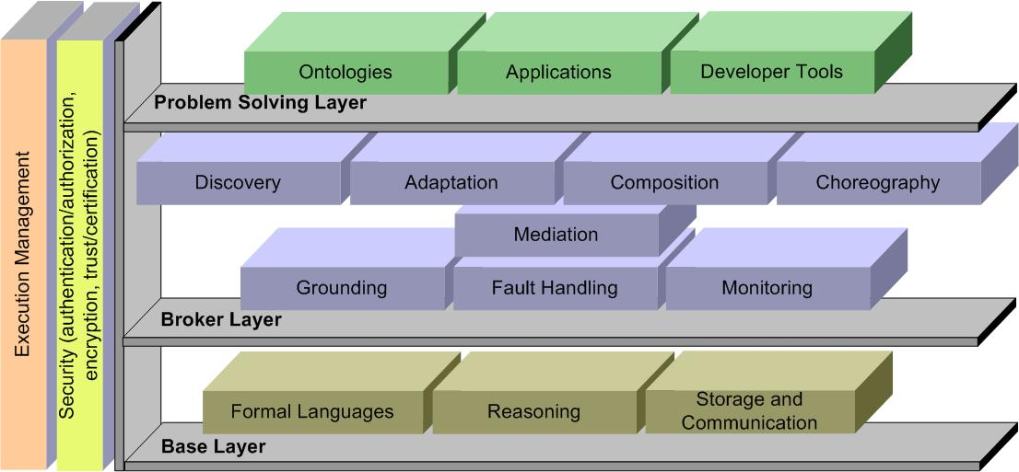
SEE Architecture Overview

Slide 69
Management Report
Tomas Vitvar
NUIG, DERI Galway
tomas.vitvar@deri.org

Slide 70
Activities within the network
Link to Research
  WP2.2 Heterogeneity – Joint work on ontology mapping language
    Results in D2.4.12 Data Mediation in SWS
Link to Industry
  Use Case: Dynamic B2B Integration
    Integration of B2B Standards with SWS technology
Link to Education
  Providing education materials (WSMO Tutorial)
  Knowledge Web PhD symposium
Notes:
Apart from contributing to the core research in the semantic web services as it is happening as part of WP2.4, we have also established links to other research activities within the network, to the industry and education. Regarding the link to other research areas within the network, we jointly contributed to the ontology mapping language from WP2.2 which results are described in D2.4.13 Data Mediation in SWS and which has been presented in the presentation before. Regarding the link to industry, we have contributed to the technology transfer through organization of the SWS challenge and defined the use case for SWS in the area of semantic B2B integration. This work has been delivered as part of the deliverable D2.4.7 Interoperation and Invocation of Web Services where we have developed a prototype too. This use case is the use case defined by the SWS challenge. Regarding the link to education we actively participate in KW PhD symposium as PC members (Tomas Vitvar) and also provide education materials to REASE (repository of learning resources) in a form of SWS (WSMO) tutorials developed as part of WP2.4 dissemination activities.
There might be also a question regarding the contribution to WP2.5 (languages). If asked, you can answer as follows: “WP2.4 does not explicitly work on joint activities with WP2.5 however there are efforts in SWS area in languages area. These efforts are mainly happening in DERI Innsbruck when we participate in WP2.5 on combination of rules and ontologies using expressive nonmonotonic logic (first-order autoepistemic logic). This work can be reused in the context of WSML (ontology language for SWS) but this integration has not happened so far.” You can also ask Stijn to clarify such questions as he should be there.

Slide 71
Cross Work Package Relationship
Use Case on B2B Integration (part of SWS challenge)
Alignment of mapping language for SWS mediation
Providing education materials and contributing to Knowledge Web PhD symposium (PC)
industry
WP2.1
WP2.2
WP2.4
education
Notes:
These are graphical representation of links to research, industry and education.

Slide 72
Dissemination
Publications
  Conference papers: 8
  Workshop papers: 2
  Tutorials: 4
Standards & Working Groups:
  SAWSDL WG – chaired by DERI
    Started in March 2006
  OASIS Semantic Execution Environment Technical Committee (aim to standardize architecture for SWS) – co-chaired by DERI
    Started in November 2005
SWS Challenge

Slide 73
PMs per finished and ongoing deliverables
 | UIBK | EPFL | FU Berl. | NUIG | LivUni | VUM | FT | UniTn | Total
Planned Spent | 11.33 8.50 | 7.71 6.52 | 2.00 0.70 | 4.67 7.30 | 2.29 1.50 | 1.63 0.00 | 1.33 2.84 | 1.61 0.70 | 32.57 28.06
D2.4.6 – Prototype for the Integration of Web Service Discovery and Composition (final version)
Planned Spent |  | 1.00 1.00 |  |  |  |  |  | 1.61 0.70 | 3.94 4.54
D2.4.7 – Interoperation and Invocation of Web Services (final version)
Planned Spent |  |  |  | 2.00 5.00 | 2.29 1.50 | 1.63 0.00 |  |  | 5.92 6.50
D2.4.8 – Semantic Tupple Space Computing (final version)
Planned Spent | 5.00 3.20 |  | 2.00 0.70 |  |  |  |  |  | 8.50 5.70
D2.4.10 – Architecture for Semantic Web Services (1st version)
Planned Spent |  |  |  | 2.67 2.30 |  |  | 1.33 2.84 |  | 2.67 2.30
D2.4.11 – Reputation-based Service Level Agreements and Decentralized orch.of SWS (1st version)
Planned Spent |  | 6.71 5.52 |  |  |  |  |  |  | 6.71 5.52
D2.4.12 – Data Mediation in Semantic Web Services (final version)
Planned Spent | 6.33 5.30 |  |  |  |  |  |  |  | 3.88 3.50
Notes:
Michal and Adrian, please note, that overall numbers have been provided by Alice and some adjustments of man-months per deliverable had to be done by me. Regarding the comments on spent/planned MM as described below, please only use them only if they will ask. I think that particular questions about spending from particular partners could be redirected to those partners too.
In Year 3 of the project, following deliverables were active or finalized:
D2.4.6: Prototype for the Integration of Web Service Discovery and Composition. This work was led by University of Trento and has been finalized in month 30 (June 2006). The prototype has been successfully presented too in Budva, Montenegro. Partners who contributed to this work was University of Trento, EPFL and France Telecom.
D2.4.7: Interoperation and Invocation of Web Services. This work was led by NUIG and was finalized in month 30 (June 2006). The prototype has been also presented. This work implements the use case from the SWS challenge in the area of B2B integration which became also the industry use case for WP2.4. In this deliverable we originally planned that VUM (Manchester university) will provide some data and services from bio-medical domain on which the interoperation and invocation of SWS could be presented and evaluated. This was discussed in a meeting in Crete in 2005 however we later agreed that in order to strengthen links between research, industry and efforts in SWS challenge we will unify approach to industry use cases used in WP2.4 and defined by industry area. From this reason we choose the use case from B2B integration defined by SWS challenge and VUM did not contributed to this work.
D2.4.8: Semantic Tupple Space Computing. This work has been delivered in month 36 (December 2006) and it was led by UIBK. FU Berlin also contributed to this deliverable. (more information should be provided by Stijn)
D2.4.10: Architecture for Semantic Web Services. This work is led by NUIG and aims at definition of the architecture for SWS overarching some work done in KW project over the past 3 years. This first version of this architecture was delivered in month 36 (December 2006) defining the architecture for SWS as perceived by WP2.4 researchers. The next step will be to align this work with standardization efforts in OASIS SEE TC and define a roadmap for SWS. This work is related to D2.4.12 and D2.4.7 and with SWS challenge and standardization efforts in OASIS SEE TC.
D2.4.11: Reputation-based SLA and Decentralized orchestration of SWS. The first version of this deliverable was purely targeted to reputation-based SLA which was led by EPFL. This work is related to service discovery/selection component of the architecture but it is not explicitly integrated with the architecture in D2.4.10. Also, there was two topics in this deliverable which were originally defined: reputation-based SLA and decentralized orchestration of SWS. These topics are unrelated and they were defined in one deliverable in order to limit the number of deliverables in WP as per PO request in the last year. In the new JPA (37-48) there will be new deliverable created D2.4.11 Decentralized Orchestration of SWS. The reputation-based SLA was finished in M36.
D2.4.12: Data Mediation in SWS. The final version of this deliverable was finished in M36 (December 2006). It was led by UIBK establishing the link with WP2.5. …

Slide 74
Tasks and Deliverables
TODAY
JPA 37-48
D2.4.13 Data Mediation in SWS
M36 Demo
D2.4.7 WS Invocation and Interoperation
M30 Demo
D2.4.11 Reputation-based Service
Level Agreements
D2.4.12 Decentralized orchestration
of composite Web Services
D2.4.6 Integration of Discovery and Comp.
M30 Demo
D2.4.8 Tupple Space Computing
D2.4.10 Architecture and execution semantics for SWS
18
24
30
36
42
48
Notes:
In green, these are deliverables defined in JPA25-42 and in blue there are deliverables defined in the new JPA37-48 (green deliverables are described in previous slide). There are three demos which have been delivered and presented. The first demo of data mediation in SWS available in M36 was presented in separated presentation earlier done by UIBK. The second demo was available in M30 as part of deliverable D2.4.7 done by NUIG. This demo implements the use case from the SWS challenge and was also presented in SWS challenge workshop in Budva, Montenegro. The third demo available as part of D2.4.6 was presented in KW GA WP2.4 session in Budva Montenegro done by University of Trento.
In the new JPA we have defined two major deliverables: D2.4.12 Decentralized orchestration of composite WS. This work will be done by EPFL with contribution from UniTrento and will be finalized by M48. The second deliverable is the continuation of D2.4.10 Architecture and Execution Semantics for SWS which will be finalized by M48. In this deliverable, the final alignment with OASIS SEE TC and other standardization activities will be done. Apart from these deliverables we will continue in our efforts in SWS challenge, OASIS SEE TC standardization and W3C SAWSDL standardization. We also plan to start other standardization activities, i.e. SWS-testbed as the W3C incubator group where we want to work on SWS test bed for the SWS challenge.

Slide 75
Thanks for your attention!

