Slide 1

<WP3: Design of National and European Semantic Web Services Architecture>
Tomas Vitvar, Sanaullah Nazir
firstname.lastname@deri.org
SemanticGov 2nd Planetary Meeting
27-28 April 2006, Thessaloniki

Slide 2
Overview
Tasks and Deliverables
Dependencies
Architecture Components
Technology

Slide 3
Overview
Design of Semantic Web Service architecture for National and Pan European eGovernment services.
  Conceptual and technical architecture for SemanticGov
Start: M6 (June 2006)
Finish: M16 (April 2007)
Total effort: 66MM
CERTH | NUIG | LFUI | UOR | CAPGEMINI | SOFTWARE AG | ONTO | ALTEC S.A. | MOI | RCM | Citta Di Torino
7 | 6 | 11 | 15 | 6 | 3 | 9 | 5 | 1 | 1 | 1

Slide 4
Tasks
Tasks 3.1/3.3: Application of WSMF to Semantic Government services
    WSMO/L/X for SemanticGov architecture
    … + softwareAG technology + WS, BPEL, UniRoma composition tools, IDABC PEGS Architecture, GEA PA model
Deliverables:
    SemanticGov Architecture version 1, total effort: 10MM
    SemanticGov Architecture version 2, total effort: 20MM
Milestones:
    M12 (December 2006): SemanticGov Architecture version 1
    M16 (April 2007): SemanticGov Architecture version 2

Slide 5
Tasks
Tasks 3.2/3.4: Development of Mediator Support
    Design of WSMO mediator to address the issue of interoperability in the overall framework.
      Technical – adapters, lifting on non-semantic messages to semantic level, integration with existing standards and systems
      Data – Data Mediator to achieve semantic interoperability
      Process level – Process Mediator to achieve interoperability of processes if different communication patterns are used (choreographies)
Deliverables:
    Analysis of Mediator Requirements and Mediator Implementation : 36MM
Milestones:
    M16: Analysis of Mediator Requirement and Mediator Implementation

Slide 6
SemanticGov Architecture Dependencies
Relations with other WPs
  WP1: Overall Conceptual Analysis
    SemanticGov architecture should be conceptually inline with WP1 results
    Infrastructure elements: N2S, common PA service directory, process orchestrator
  WP2: Requirements Analysis
    SemanticGov architecture should support requirements from WP2
Basis – technology, existing know-how and concepts
  DERI: WSMO, WSML, WSMX
  Software AG: SOA technology, Web Services, BPEL, …
  UniRoma: Composition Tools
  CERTH: GEA model, GEA PA Service Model
  CapGemini: IDABC PEGS Architecture

Slide 7
SemanticGov Architecture Dependencies – Relations with other WPs
WP1: Overall conceptual analysis
WP2: Requirement Analysis for NEGS & PEGS
Requirements Gathering Phase
WP3: Design of National and European Semantic Web Services Architecture
Design Phase
WP5: Development of SWS Execution Environment For NEGS & PEGS
Implementation Phase

Slide 8
SemanticGov Architecture Dependencies – technology, existing know-how and concepts
PA
Service Model
WSMO
Service Model
WP4: PA Domain Ontology
WSMO-PA
IDABC–PEGS
Architecture
WSMX
Software AG
Technology
UniRoma
Composition
SemanticGov
Architecture
WP3: SemanticGov Architecture

Slide 9
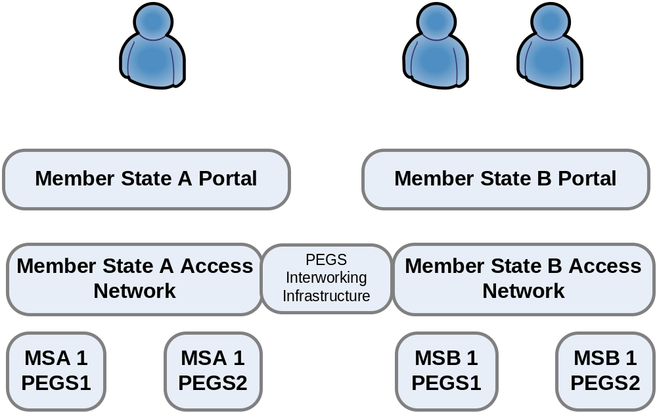
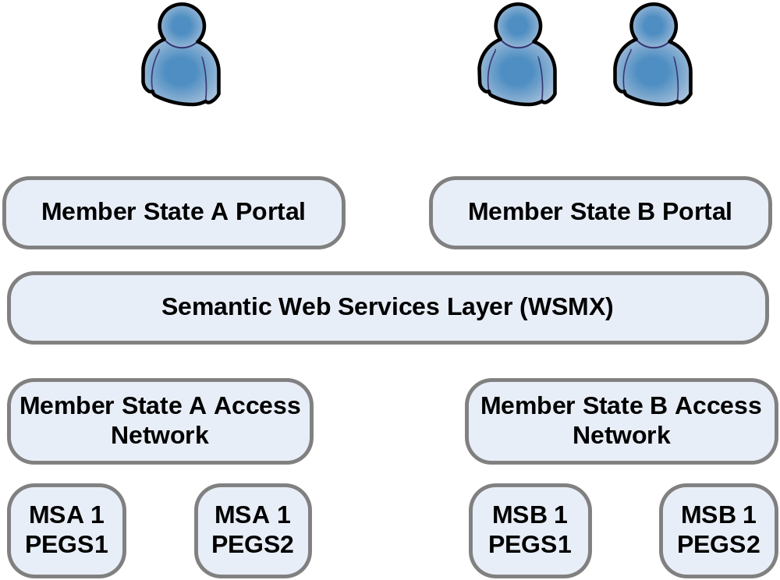
IDABC PEGS and SemanticGov Architecture

Slide 10
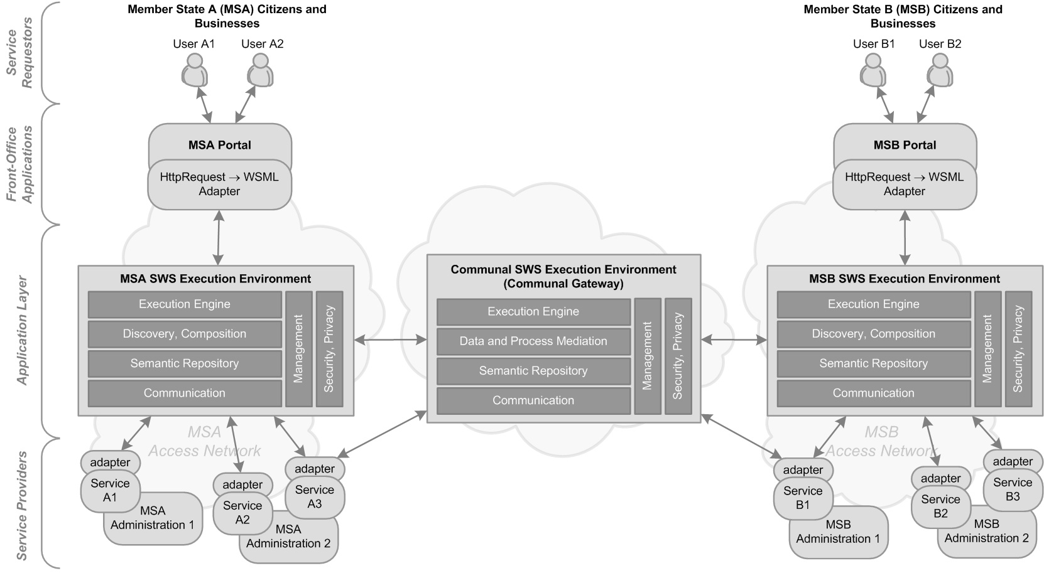
Conceptual SemanticGov Architecture

Slide 11
NEGS SemanticGov Architecture Components
Needs2Services (N2S) Facilitator
  Level of front-office application
    Part of Member State Portal
  “Transforming” client’s needs to services
  On result -> WSMO Goal
  Next: discovery and composition to find actual services satisfying goal

Slide 12
NEGS SemanticGov Architecture Components
Discovery, Composition, Service Registry
  Central/Common registry at National Level
  One registry at Public Administration Level
    Distributed discovery across PA service registries
    Requester requires service from another member state
    Distributed Discovery
PA2
Discovery request
Discovery
PA1
Discovery request
Discovery
Discovery request
PA4
Discovery
Discovery request
PA3
Discovery
Discovery request

Slide 13
NEGS SemanticGov Architecture Components
Service Creation
  Semantic PA service creation using WSMO-PA
  Ontologizing of non-semantic messages
  (e.g. XSD Schema)
    Manual creation of ontologies (integration/domain ontology)
Adapters
    Transformation from non-semantic messages (e.g. XSD schema) to ontological level
      Rules for lifting and lowering
    Technical interoperability: Interoperability at the level of communication protocols (e.g. ftp, http, soap, …)

Slide 14
NEGS SemanticGov Architecture Components
Data and Process Mediation
No need at national level
  Data/process interoperability achieved through
  common standards
  e.g. birth certificate is the same throughout the country but not across countries

Slide 15
PEGS SemanticGov Architecture Components
Communal Semantic Gateway
  Data Mediation
    Interoperability achieved through mapping of ontologies and executing mapping rules and conversions
  Process Mediation?
    Processes should be compatible
      SemanticGov will not deal with “procedural interoperability”
      Compatible processes could need process mediation (process mediation is possible whereas if procedural interoperability is not achieved, process mediation might not be possible)

Slide 16
SemanticGov Architecture Dependencies – technology, existing know-how and concepts
PA
Service Model
WSMO
Service Model
WP4: PA Domain Ontology
WSMO-PA
IDABC–PEGS
Architecture
WSMX
Software AG
Technology
UniRoma
Composition
SemanticGov
Architecture
WP3: SemanticGov Architecture

Slide 17
DERI WSMO/L/X, Software AG SOA, UniRoma Composition
Adapters, service creation
  Legacy Integrator -> WS -> WSMO-PA Service Creation
Discovery, Service Registry
  UDDI Registry/Repository -> WSMO-PA Services
  Discovery?
Composition, Orchestration
  (1) WSMO Orchestration -> UniRoma composition on WSMO-PA services (WSML)?
    WSMX execution environment
  (2) BPEL -> WSDL-S -> WSMO grounding
    Software AG SOA execution environment

Slide 18
DERI WSMO/L/X, Software AG SOA, UniRoma Composition
Data Mediation
  (1) WSMT Data Mapping Tool
  (2) Software AG mapping tool

Slide 19
Next Steps, Actions
Tight interaction
  DERI, Software AG, UniRoma
  Visit Software AG in Darmstadt (June 2006)
  Agreement on tools/technology and integration
Schedule
  M10 – SemanticGov Architecture v1
  M10-M12 Internal Review of architecture v1 by consortium
  M14 – SemanticGov Architecture v2
  M14 – review, comments addressed, version amended
  M16 – submission of architecture to PO

Slide 20
Question and Answers
</WP3: Design of National and European Semantic Web Services Architecture>

