Slide 1
Device Detection in PHP
Using the IdMyGadget Adapter API for Device Detection in PHP

Slide 2
In the Beginning
I was discovering how great O'Reilly E-books are, and was reading Building Android Apps, with HTML, CSS, and JavaScript by Jonathan Stark, thinking it might be cool to do that (using Phone Gap).
At some point the book referred me to the Appendix, and I thought it was pretty cool.

Slide 3

Stark Book - Cover

Slide 4

Stark Book - Appendix

Slide 5
What is Device Detection?
Software packages that identify the device being used to access a web site
These packages differ greatly in their capabilities and the license under which they are released
I have been focusing on three very different packages, but many others exist
I have not delved deeply into how they work, but it appears they all use the User Agent string to identify the device

Slide 6
Why Use Device Detection?
I feel media queries are limited in functionality, non-intuitive (4000 line css files? Really?) and that CSS lacks the rich history and best practices that writing code has
Spend resources serving only content that is relevant for that device.
  Why deliver content and markup then hide it?
Who thinks that a site should look the same on all devices?
Mobile bloat is a thing: http://www.soasta.com/blog/mobile-web-performance-page-bloat-july-2015/?imm_mid=0d5b72&cmp=em-webops-na-na-newsltr_20150724

Slide 7
Why Use Device Detection?
Should a site's menus have the same options on all devices?
SpotXChange uses device detection to determine which type of video to deliver

Slide 8
What is an Adapter API?
The packages I have found differ greatly in capability and license
An Adapter API allows switching between these without having to change any code
Show Joomla administration option in joomoowebsites.com: Extensions → Template Manager → Choose Template → IdMyGadget
Show Wordpress administration option in tomwhartung.com: Appearance → Choose Theme → Customize

Slide 9
Why use an an Adapter API?
Using an Adapter API allows switching between these without having to change any code
As mentioned, the capabilities and licensing differs
Also, I would expect these packages to come and go, like everything else in this industry

Slide 10
How does the Adapter API Work?
I decided to use inheritance; the base class is abstract
Recently read that we should rarely use inheritance and that often interfaces are better (see #1 in link below)
What do you think?
Show code: idMyGadget/php
http://www.huffingtonpost.com/quora/39-best-kept-secrets-of-g_b_7812864.html?imm_mid=0d5494&cmp=em-prog-na-na-newsltr_20150718

Slide 11
Supported Device Detectors
detect_mobile_browsers - the simplest and most open license, but does not detect tablets
mobile_detect - more functionality, mostly in the form of booleans
tera_wurfl - offers hundreds of details about the device, but requires setting up a database (this is the one that got me started)
Maybe others in the future?

Slide 12
Raw Demos and Code
Access: http://joomoowebsites.com/idMyGadget
For each detector:
  see README.md (leave tab open for comparison)
  list files in gadget_detectors/[detector]
  explain license a bit
  explain installation and updating (see README.md)
  see rawDemo.php

Slide 13
IdMyGadget Demos
Access: http://joomoowebsites.com/idMyGadget
For each detector:
  run the idMyGadgetDemo.php
detect_mobile_browsers - not much to see
mobile_detect - extra demo:
Mobile-Detect/examples/demo.php
tera_wurfl - several extra demos; warning: time-sink!

Slide 14
If Time Permits: Example 1
Review resume
  Resume is complete and totally interactive
  Looks massively different on different devices but as jobs come and go I only need to add them in one place
  I.e., only need to update Resume.js and ProfessionalExperience.js, because all resume data is in javascript
Markup, handlebars templates, in php
Tests gadget type against class constants

Slide 15
If Time Permits: Example 2
Review Joomla code
  Most of this is complete, refining site (joomoowebsites.com)
  jmws_protostar_idMyGadget/index.php
  I like the protostar template better than beez3 (because it is a bit simpler)
Uses isPhone() and isTablet() methods

Slide 16
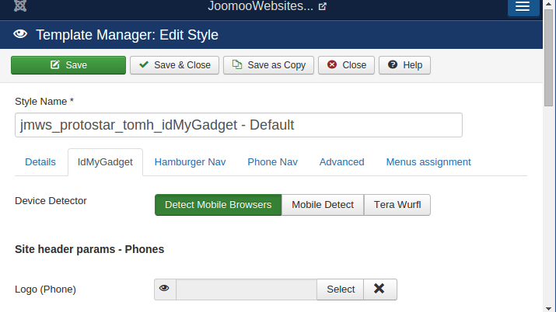
Joomla - Set Device Detector

Slide 17
If Time Permits: Example 3
Review Wordpress Code
  Just starting on this
  Site is up (tomwhartung.com) but will be undergoing changes as time permits
Uses isPhone() and isTablet() methods

Slide 18
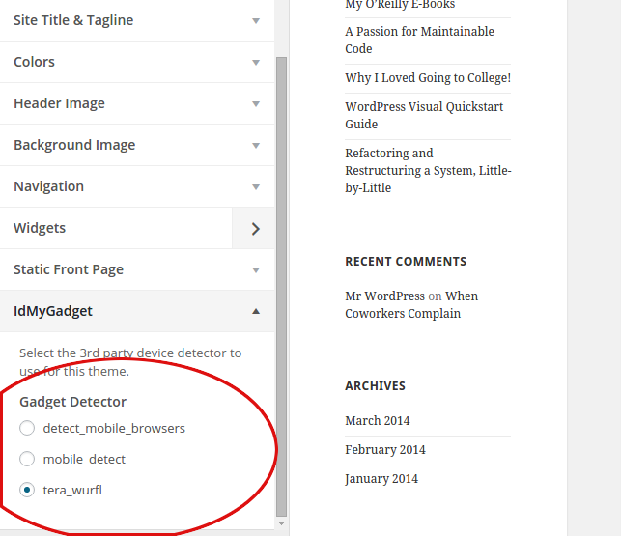
Wordpress - Set Device Detector

Slide 19
Summary of Examples
Note that each of the examples uses a slightly different version (different repo) of IdMyGadget
This is because:
  they can reside in different directories:
  libraries/vendor/ for joomla vs.
  wp-content/plugins for wordpress
  plus I don't want to have to regression-test all the joomla extensions if I make a tweak for the wordpress themes, and vice versa

Slide 20
Conclusion
Be careful! I was actually rejected for a job for having “a strong opinion about device detection.”

Slide 21
Questions?
Default answer: “42”

