Slide 1
Adaptive Web Design (AWD) in Drupal, Joomla, WordPress
Using the IdMyGadget Adapter API for
Device Detection in the
Three Popular LAMP CMSes
July 27th, 2016
Tom W. Hartung
@tomwhartung

Slide 2
Who?
My first programming job was using Assembler, in 1976.
I have an Interdisciplinary Masters Degree, and have been running several websites out of my home for many years.
I am a language-agnostic polyglot, life-long learner, “comb shaped person.”
Grew up in Virginia but have been living in Denver for over 25 years.
New to giving presentations.
Proud of my year-long github streak.

Slide 3
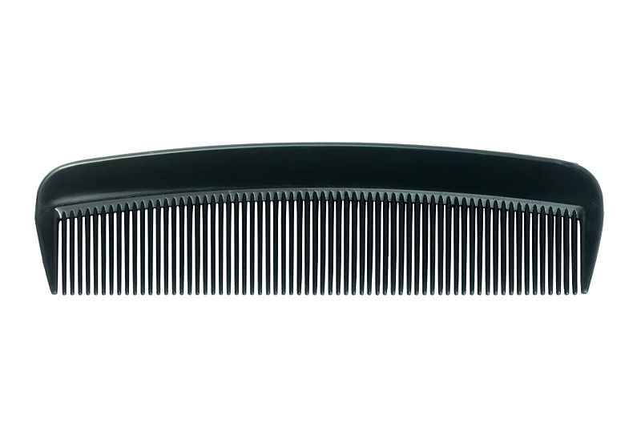
Comb-Shaped Person http://TomWHartung.com/resume

Slide 4
What?
Device Detectors: Third-party software packages that use the use the User Agent string, which is sent by browsers to the server, to identify the device being used to access a web site
  Adaptive Web Design (ADW): serving slightly different content to different devices
  Responsive Design with Server Side Components (RESS): combining Adaptive and Responsive techniques
IdMyGadget PHP Adapter API: A set of classes I wrote to provide a common interface to three
LAMP CMSes: Drupal, Joomla!, and WordPress
jQuery Mobile: http://jquerymobile.com/
  supplies widgets for fat fingers, added only when the device is a phone

Slide 5
What: Device Detectors
Detect_Mobile_Browsers: http://detectmobilebrowsers.com/
  Single (long) line of code (copy, paste, and tweak)
  Detects phones only; last update: 8/2014
  Wide open license (apparently)
Mobile_Detect: http://mobiledetect.net/
  45 files, mostly tests (https://github.com/serbanghita/Mobile-Detect)
  Mostly functions that return booleans; last update: 3/2016
  MIT license (standard open source)
Wurfl DbApi (Tera Wurfl): http://dbapi.scientiamobile.com/
  140 files, requires setting up a database (MySql, MsSql, MongoDb)
  Detects hundreds of details about the device, but requires creating an account to download the code
  GNU Affero license (more restrictive than standard GLP, MIT, Apache, etc.)

Slide 6
What: LAMP CMSes
WordPress: https://wordpress.org/
  6.8M download, 1,350 files, 12 DB tables, initial release: May 27, 2003
  GNU GPLv2+; plugins and themes; documentation plentiful
Joomla!: https://www.joomla.org/
  11.0M download, 4,692 files, 67 DB tables, initial release: August 17, 2005
  GNU GPL; modules, templates, components, and plugins; documentation plentiful
Drupal 7: https://www.drupal.org/
  3.2M download, 1,086 files, 76 DB tables, initial release: January, 2001
  GNU GPLv2 or later; modules and themes; documentation plentiful
Drupal 8: https://www.drupal.org/
  12.0M download, 14,387 files, 187 DB tables (*), initial release: January, 2001
    (*) after automatic conversion
  GNU GPLv2 or later; modules and themes; documentation scarce

Slide 7
Why Did I Pick This Project?
Heard a hiring manager at a previous HTML5 roundtable say that having a personal site that looks different on different devices is “huge”
Most people are focused on Responsive Design, which I find counter-intuitive and “old news”
Increase my personal web presence and have something to present at meetups
Believe these techniques will be helpful when working with the Internet of Things
Learn more about these CMSes and demonstrate the potential of this technique
  First CMS work was with PHP Nuke over ten years ago
  Interested in freelancing and side project opportunities

Slide 8
Why Use AWD and RESS?
The current state of the art is responsive design: relying on CSS media queries to modify what the site looks like based on device characteristics, such as screen size and orientation
CSS is intended to control presentation, and I believe serving content only to hide it is cheating
CSS lacks the rich history and techniques for organizing complex code that we see in programming languages
It makes sense to spend resources (on both the servers and clients) serving only content that is relevant for that device
Mobile bloat is increasingly a concern, especially for those of us on phones that are not on unlimited data plans:
https://www.soasta.com/blog/mobile-web-performance-page-bloat-july-2015/
  The average page served in 2011 (390K) is 3X bigger than 2015 (1180K)
We should not serve content only to hide it

Slide 9
How Does the Content Change?
For all three CMSes, updated default templates to use IdMyGadget to serve the same site content except:
  Customize look of header to the device type
  Use jQuery Mobile on phones to implement phone header and footer navigation
  Use Hamburger Menu Icons on one, two, or all three devicet types
  Site administrators use the CMSes' admin panels to set parameters that control all this

Slide 10
How Could the Content Change?
Device-specific menus are the key to device-specific content
  I keep the menu options, which are set up in the administration panel, consistent
  If you'd like to have specific menu options for specific device types, the code is already there
My latest idea: target ads
  None of my sites serve ads – yet
  If you'd like to target ads on your WordPress, Joomla, or Drupal site, talk to me afterwards
  I've already done much of the work, writing a module or updating a template to do this would be pretty easy - at least if I do it
What is your idea?

Slide 11
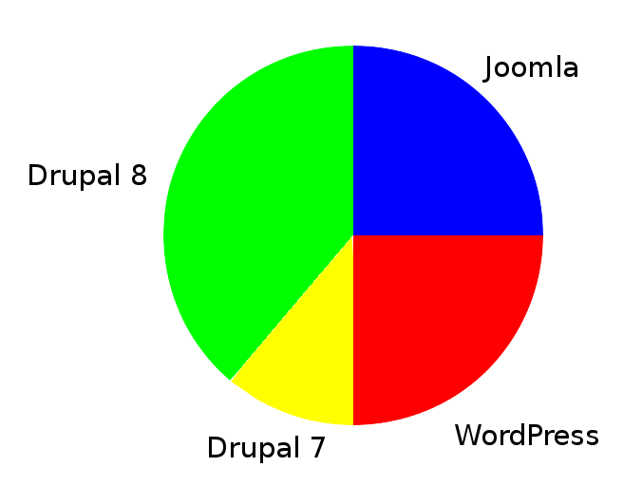
When: Time Spent by CMS

Slide 12
When: Time Spent by Activity
40% Learning
  May seem high but my actually be low, especially considering the time spent learning Drupal 8
20% Coding
  Work visible on github is only the tip of the iceberg
20% Experimenting
  Testing and tweaking code
20% Maintenance
  Download and install updates, deployment, writing content, etc.

Slide 13
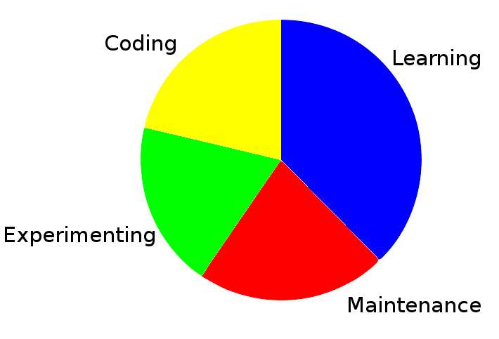
When: Time Spent by Activity

Slide 14

Sites & Github: Tip of the Iceberg
(And I am Totally Cool With This...)
By Created by Uwe Kils (iceberg) and User:Wiska Bodo (sky). - (Work by Uwe Kils) http://www.ecoscope.com/iceberg/, CC BY-SA 3.0, https://commons.wikimedia.org/w/index.php?curid=209674

Slide 15
Results: The Sites
TomHartung.com – Drupal 8 site
  Drupal 7 work is not online (but code is on github)
  Drupal 8 work is still in progress (and kind of on hold while due to the documentation not being available)
JooMooWebSites.com – Joomla site
TomWHartung.com – WordPress site

Slide 16
Conclusions: Lessons Learned
Learned why more people are not doing this – because it is complicated and difficult
Learned that this is much easier to do with single page sites, such as my resume
Learned that I am more of a backend person
Learned it is possible to find information on youtube and even twitter
Learned why people who work with Drupal really don't have time to work with other CMSes

Slide 17
Conclusions: Opinions
Still convinced that sending the same content to all device types is not the best solution to the opportunities posed by the proliferation of devices
Regret somewhat spending so much time with Drupal 8 and having so little to show for it (curiosity killed the cat) …
Glad that I did take the time to learn a bit about it, and look forward to building on that knowledge and experience … (satisfaction brought me back)
Still believe that knowledge about device detection will be useful when working with the IoT, but still unsure exactly how

Slide 18
Conclusions - Downsides
Things can get complicated, and time can be wasted, especially when used with a site that is already responsive
  Learned the hard way that this technique does not work well with the TwentyFifteen WordPress theme, due to its responsiveness
Have already been rejected for one job, for having a “strong opinion of device detection”
The “Bleeding Edge” is very real: spent a lot of time on some things that just will not work, at least not yet
  For example, using JavaScript to draw Hamburger Menu Icons works fine in browsers but does not work on phones

Slide 19
Conclusions - Upsides
I learned a lot, which is one of my favorite things in life
Learned that although I like full stack work, I would be fine with doing only back end work, but would no doubt tire of only front end work after a few months
  Some JS is ok, but I wouldn't want to do it 24/7/365, and although it is good to know some HTML and CSS, they are not my favorites
  I used to play bass in a Bluegrass band, and have no desire to be a Rock Star
  In today's job market it is extremely important to know this
It is great to have something original to present at meetups!

Slide 20
Conclusions - Future
I think there is a huge amount of potential here:
  Web-enabled TVs
  Virtual Reality - I think it would be really nice, if not essential, to know if someone is visiting your site wearing the goggles
  Internet of Things – going to the Intel Roadshow Hack-a-thon this weekend!
Having already done most of the heavy lifting, it would be fairly easy for me to take on a part-time side project – such as targeting ad to specific device types – that entails using this technology on your WordPress, Joomla, Drupal, or single-page site

Slide 21

Questions?

Slide 22

Stark Book - Cover

Slide 23

Stark Book - Appendix

