Slide 1
Adaptive Web Design (AWD) in Drupal, Joomla, WordPress
Using the IdMyGadget Adapter API for
Device Detection in the
Three Popular LAMP CMSes
July 27th, 2016
Tom W. Hartung
@tomwhartung

Slide 2
Who?
My first programming job was using Assembler, in 1976.
I have an Interdisciplinary Masters Degree, in Computer Science and Art.
I have been running several LAMP websites out of my home for many years, but consider myself to be a language-agnostic polyglot, life-long learner, “comb shaped person.”
Proud of my year-long github streak
  https://github.com/tomwhartung
New to giving presentations, so I appreciate this opportunity to practice.

Slide 3
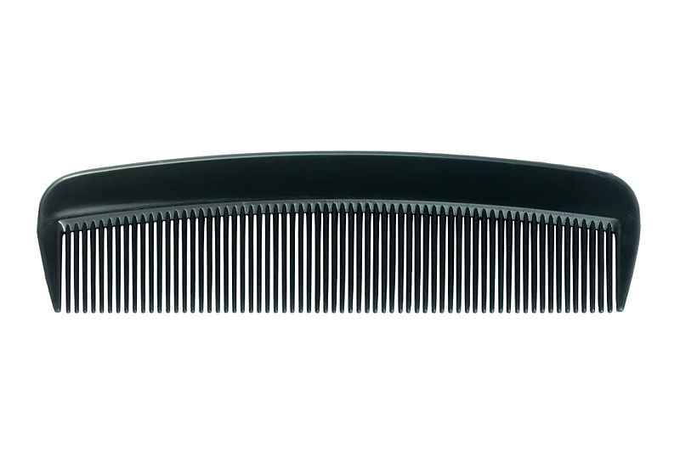
Comb-Shaped Person http://TomWHartung.com/resume

Slide 4

Why: The Main Reason
The main reason I did this was to:
  Satisfy my curiosity about Drupal, jQuery Mobile, and Mobile Development, and to learn more about Joomla and Wordpress

Slide 5
Why: Additional Reasons
It seems counter-intuitive to me to send the same content to all devices ...
  But it has become apparent I am more of a backend person, so maybe my intuition is biased
Noticed that very few people were doing this sort of work ...
  So it seemed like an opportunity to do something unique
CMS selection for Groja/SeeOurMinds.com …
  Still undecided as to whether a LAMP CMS or even a CMS is appropriate for that project

Slide 6
Why: Side Goals
Increase my personal web presence and have something to present at meetups
Intuitively it seems to me that knowing about LAMP CMSes would be a good start to getting possible freelance work
Believe these techniques could be helpful when working with the Internet of Things

Slide 7
Where I Got the Idea
O’Reilly e-books!
A colleague suggested looking at jQuery Mobile, so I got jQuery Mobile: Up and Running by Maximiliano Firtman
  This is the best source for information about jQuery Mobile
  I do not understand why jQuery Mobile is not more popular, but that may be because it does not look good on the desktop
Another book I found was Mobile JavaScript Application Development by Adrian Kosmaczewski
  In addition to reviewing some HTML5 and JavaScript, this covers jQuery Mobile, Sencha Touch, and Phone Gap
  I decided to go with jQuery Mobile

Slide 8



Slide 9
Additional Sources
I also looked at some books on Android development, but
  Decided that sticking to adapting what I know about the web to mobile devices was a better idea than writing code that runs on only one type of mobile device (Android or Apple)
Using something like Adobe PhoneGap/Apache Cordova seemed appealing, so I got both of Jonathan Stark’s books
  Building iPhone Apps With HTML, CSS, and JavaScript
  Building Android Apps With HTML, CSS, and JavaScript
  The Appendix of the second one mentions WURFL, which I thought was intriguing, so I downloaded it and started playing around with it

Slide 10


Where I Found WURFL

Slide 11
What I Have Done With All This
Device Detectors: Third-party software packages that use the use the User Agent string, which is sent by browsers to the server, to identify the device being used to access a web site
IdMyGadget PHP Adapter API: A set of classes I wrote to provide a common interface to three
  My code is currently only “interested in” whether it is a phone, tablet, or desktop
When it detects a phone, it adds jQuery Mobile: http://jquerymobile.com/
  supplies widgets for fat fingers, added only when the device is a phone
LAMP CMSes: Drupal, Joomla, and WordPress

Slide 12
Important Terms
Progressive Enhancement: serving the same basic content to all devices and giving a better experience to users with more up-to-date browsers
Responsive Web Design (RWD): using CSS Media Queries to adjust the layout of elements on the page based on the screen size and orientation
Adaptive Web Design (AWD): serving slightly different content to different devices (although you might find sources that disagree with my use of this term)
Responsive Design With Server Side Components (RESS): combining these two techniques
Progressive Web Apps (PWA): something entirely different that I am just starting to learn about…

Slide 13
Device Detectors Used
Detect_Mobile_Browsers: http://detectmobilebrowsers.com/
  Single (long) line of code (copy, paste, and tweak)
  Detects phones only
  Wide open license (apparently)
Mobile_Detect: http://mobiledetect.net/
  45 files, mostly tests (https://github.com/serbanghita/Mobile-Detect)
  Mostly functions that return booleans
  MIT license (standard open source)
Wurfl DbApi (Tera Wurfl): http://dbapi.scientiamobile.com/
  140 files, requires setting up a database (MySql, MsSql, MongoDb)
  Detects hundreds of details about the device, but requires creating an account to download the code
  GNU Affero license (more restrictive than standard GLP, MIT, Apache, etc.)

Slide 14
LAMP CMSes
Drupal 8: https://www.drupal.org/
  12.0M download, 14,387 files, 187 DB tables (*), initial release: January, 2001
    (*) after automatic conversion
  GNU GPLv2 or later; modules and themes
Drupal 7: https://www.drupal.org/
  3.2M download, 1,086 files, 76 DB tables, initial release: January, 2001
  GNU GPLv2 or later; modules and themes
Joomla!: https://www.joomla.org/
  11.0M download, 4,692 files, 67 DB tables, initial release: August 17, 2005
  GNU GPL; modules, templates, components, and plugins
WordPress: https://wordpress.org/
  6.8M download, 1,350 files, 12 DB tables, initial release: May 27, 2003
  GNU GPLv2+; plugins and themes
PHP Nuke: https://www.phpnuke.org/

Slide 15
Use Cases:
How Could the Content Change?
Device-specific menus are the key to device-specific content
  I keep the menu options, which are set up in the administration panel, consistent
  If you'd like to have specific menu options for specific device types, the code is already there
One possibility: target ads
  None of my sites serve ads, but
  I've already done much of the work, writing a module or updating a template to do this would be pretty easy - at least if I do it
My latest idea: use it to make a Progressive Web App?
  Is it even necessary? I will find out soon!
Open to hearing about other use cases

Slide 16
How: Step 1
First integrated the Device Detection into the CMS core
  Joomla: created a library for the code in libraries/vendor/jmws_idMyGadget_for_joomla/
    https://github.com/tomwhartung/jmws_idMyGadget_for_joomla
  WordPress: created a plugin for the code in
  wp-content/plugins/idMyGadget/
    https://github.com/tomwhartung/jmws_idMyGadget_for_wordpress
  Drupal 7 & 8: created a module for the code in sites/all/modules/jmws/idmygadget/ and
  modules/jmws/idmygadget/
    https://github.com/tomwhartung/jmws_idMyGadget_for_drupal-d7
    https://github.com/tomwhartung/jmws_idMyGadget_for_drupal-d8

Slide 17
How: Step 2
Created options in each CMS’s administration panel to allow:
  Selecting which device detector to use
  Customizing the look based on the device
Some of these options, such as which device detector to use, are specific to the library/plugin/module
Some of these options, such as which header image (if any) to display, are specific to the theme or template

Slide 18
How: Step 3
Added code to allow overriding the device type, so that I could see what content was being sent for each type of device in my desktop browser
Updated the themes and templates (as appropriate) to use the device detection code
  Soon found out that this was much easier to do with the simpler themes
  Also learned that in some cases existing responsiveness in the code did not play well with device detection
Found that working in parallel on a simple and more complex theme or template was very helpful (and kind of fun)

Slide 19
How - Overall
Started with Joomla, because I have more experience with it than the others
Once I got most of that work done, I started with WordPress, because I was interested in how it would compare
Once I got some of the WordPress work done, I started doing the same thing with Drupal7
Once I discovered the version of jQuery Mobile I was using was incompatible with the version of jQuery used in Drupal7, I switched to the just-released Drupal8
Once I got to the stage where I was updating themes and templates, I was able to do some work on different CMSes in parallel
  This was extremely cool, but I was not able to do much of it

Slide 20
How Does the Content Change?
For all three CMSes, updated default templates to use IdMyGadget to serve the same site content except:
  Customize look of header to the device type
  Use jQuery Mobile on phones to implement phone header and footer navigation
  Use Hamburger Menu Icons on one, two, or all three device types
  Site administrators use the CMSes' admin panels to set parameters that control all this

Slide 21
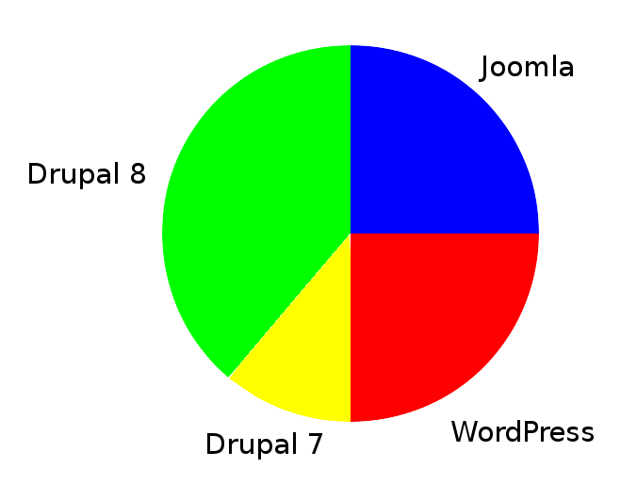
Time Spent by CMS

Slide 22
Time Spent by Activity
40% Learning
  May seem high but my actually be low, especially considering the time spent learning Drupal 8
20% Coding
  Work visible on github is only the tip of the iceberg
20% Experimenting
  Testing and tweaking code
20% Maintenance
  Download and install updates, deployment, writing content, etc.

Slide 23
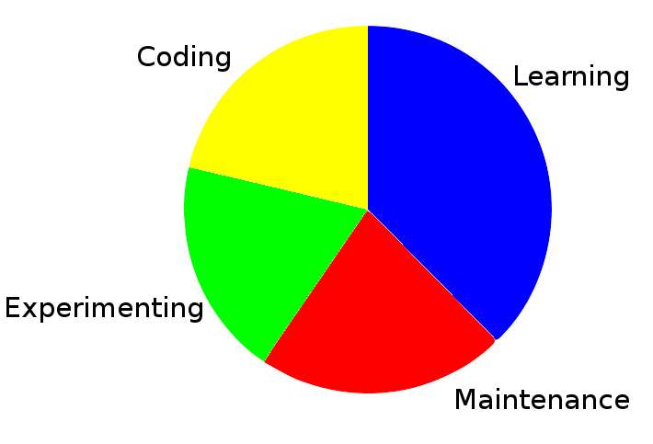
Time Spent by Activity

Slide 24

Sites & Github: Tip of the Iceberg
(And I am Totally Cool With This...)
By Created by Uwe Kils (iceberg) and User:Wiska Bodo (sky). - (Work by Uwe Kils) http://www.ecoscope.com/iceberg/, CC BY-SA 3.0, https://commons.wikimedia.org/w/index.php?curid=209674

Slide 25
Results: The Sites
All of these are due for a revamping (*)
TomHartung.com – Drupal 8 site
  Drupal 7 work is not online (but code is on github)
  Drupal 8 work is still in progress (but pretty much on hold for now...)
JooMooWebSites.com – Joomla site
TomWHartung.com – WordPress site
(*) I have come to believe that, because things are changing so fast, completion is a fantasy

Slide 26
Advantages of RESS
The current state of the art is responsive design: relying on CSS media queries to modify what the site looks like based on device characteristics, such as screen size and orientation
CSS is intended to control presentation, and I believe serving content only to hide it is cheating
CSS lacks the rich history and techniques for organizing complex code that we see in programming languages
It makes sense to spend resources (on both the servers and clients) serving only content that is relevant for that device
Mobile bloat is increasingly a concern, especially for those of us on phones that are not on unlimited data plans:
https://www.soasta.com/blog/mobile-web-performance-page-bloat-july-2015/
  The average page served in 2015 (1180K) was 3X bigger than that in 2011 (390K)
We should not serve content only to hide it

Slide 27
Conclusions - Downsides
It doesn’t work with caching!
It is difficult to show off
  People need to access the site on different devices to see the results of my efforts
Things can get complicated, and time can be wasted, especially when used with a site that is already responsive
  Learned the hard way that this technique does not work well with the TwentyFifteen WordPress theme, due to its responsiveness
The “Bleeding Edge” is very real: spent a lot of time on some things that just will not work, at least not yet
  For example, using JavaScript to draw Hamburger Menu Icons works fine in browsers but does not work on phones

Slide 28
Conclusions: Lessons Learned
Learned why more people are not doing this – because it is complicated and difficult
Learned that this is much easier to do with single page sites, such as my resume
Learned that I am more of a backend person
Learned it is possible to find information about newly released software (e.g., Drupal 8) on youtube and even twitter
Learned why people who work with Drupal really don't have time to work with other CMSes (it is more complicated than the others and changes rapidly)

Slide 29
Conclusions - Upsides
I learned a lot, and am still learning, so I consider the work successful
  Actually learned some things while working on the Drupal project that I would like to roll back into the Joomla and WordPress versions
  (Specifically the Drupal work forced me to be a bit more object-oriented, which is cool.)
It is great to have something original and unique to present at meetups!

Slide 30
Conclusions: Opinions
Unless it’s a Single Page App, I don’t think it should be an either/or thing, but rather that using a combination of techniques would be best
Still convinced that sending the same content to all device types is not the best solution to the opportunities posed by the proliferation of devices
Glad that I did take the time to learn a bit about it, and look forward to building on that knowledge and experience
Still believe that knowledge about device detection will be useful when working with the IoT, but unsure exactly how

Slide 31
The Future of Device Detection
I think there is a huge amount of potential in identifying:
  Web-enabled TVs
  Virtual Reality
  Internet of Things
Having already done most of the heavy lifting, it would be fairly easy for me to take on a part-time side project – such as targeting ad to specific device types – that entails using this technology on your WordPress, Joomla, Drupal, or single-page site
I would enjoy doing something similar with JavaScript (e.g., MEAN stack) or Python (e.g, django or flask)

Slide 32

Questions?

