Slide 1
Adaptive Web Design (AWD) in Joomla, WordPress, and Drupal
Using the IdMyGadget Adapter API for
Device Detection in the
Three Popular LAMP CMSes:
Joomla, WordPress, and Drupal

Slide 2
How I Got Started
I bought a new Kindle and was buying a lot of O'Reilly E-books for it
One of the books I got was Building Android Apps, with HTML, CSS, and JavaScript by Jonathan Stark, because I thought it might be cool to do that (using Phone Gap/Apache Cordova)
At some point the book referred me to the Appendix, which is about WURFL
I downloaded and started playing around with it, and thought it was pretty cool

Slide 3

Stark Book - Cover

Slide 4

Stark Book - Appendix

Slide 5
What Is Device Detection?
Software packages that identify the device being used to access a web site
These packages differ greatly in their capabilities and the license under which they are released
I have been focusing on three very different packages, but many others exist
I have not delved deeply into how they work, but (it appears) they all use the User Agent string to identify the device

Slide 6
Why Use Device Detection?
The current state of the art is responsive design: relying on CSS media queries to modify what the site looks like based on device characteristics, such as screen size and orientation
CSS is intended to control presentation, the view
  Serving content only to hide it is cheating
  Device detection allows us to serve only content relevant to the device
Reliance on media queries can lead to massive, non-intuitive, spaghetti-like files that are difficult to maintain
  See Appendix
CSS lacks the rich history and best practices of organizing complex code that writing programs has
Spend resources serving only content that is relevant for that device.
  Why deliver content and markup then hide it?

Slide 7
Why Use Device Detection?
Who thinks that a site should look the same on all devices?
Should a site's menus have the same options on all devices?
Rather than get into too many details, just say:
  Media queries are extremely limited in function
  Responsive design is a hack!
  Device detection gives the programmer complete control over the content served to any given device
Mobile bloat is a very real concern: www.soasta.com/blog/mobile-web-performance-page-bloat-july-2015/
SpotXChange uses device detection to determine which type of video to deliver

Slide 8
Why Should You Use It?
It's Free!
Easy to change look of header when using a template like protostar tomh idmygadget!
Easy to create a custom Hamburger Menu Icon!
Device-specific menus are the key to device-specific content
I am really not a salesman, but do enjoy creating and eating my own dog food

Slide 9
Why I Use It
I want to preserve the organization and content of the site on all devices
I want to change specific characteristics of the content based on the type of device
  Menus and other widgets - i.e., Joomla positions
  Control of the menus means control of the content
I do not want to serve content only to use CSS to hide it
  That is wasteful and irresponsible
  It is a violation of the purpose of CSS, which is to control the style and appearance of the site, not the content

Slide 10
Why Should You Use It?
Think about it during the presentation, and we will come back to this
  I'd like to know your ideas!

Slide 11
Supported Device Detectors
detect_mobile_browsers - the simplest and most open license, but does not detect tablets
mobile_detect - more functionality, mostly in the form of booleans
tera_wurfl - offers hundreds of details about the device, but requires setting up a database (this is the one that got me started)
Maybe others in the future?
Want to see some code?
I could do a whole presentation just on these

Slide 12
Adding Device Detection to Joomla!
I took a look at my fresh Joomla! site on my phone and did not like the menu
So most of my work in this area has been focused on
  Adding Device Detection code to the default templates
  Playing around with navigation, using jQuery Mobile and a custom Hamburger Menu Icon
Once you have device-specific menus, it is easy to have as little or as much device-specific content as you want
That is extremely important, and I only just fully realized it recently

Slide 13
jmws_idMyGadget_for_joomla
jmws_idMyGadget_for_joomla is the name of the github repository (aka. “repo”) containing this code
  github.com/tomwhartung/jmws_idMyGadget_for_joomla
Interface between Joomla! and the IdMyGadget Adapter API I am using for my resume
Provides a common interface between Joomla! and the three supported device detectors
See screenshot on next slide

Slide 14
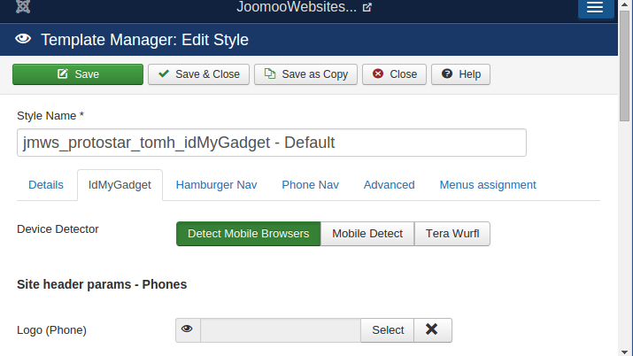
Select Device Detector

Slide 15
Beez3 and Protostar
My initial goal was to make minimal changes to both of these, specifically to support different types of menus on mobile devices
Both are responsive, so should require minimal changes
I quickly realized that Beez3 is considerably more complex than protostar
  Beez3: 48 php, 5 js, 14 css, 145 files total
  Protostar: 5 php, 3 js, 1 css, 25 files total
After awhile I realized I wanted to have some fun and make more than minimal changes to protostar
  So I created a third template, and it's the one I use now on my site
We will go through all three

Slide 16
jmws_beez3_idMyGadget
Github Repo:
  github.com/tomwhartung/jmws_beez3_idMyGadget
Still a Work in Progress (WiP)
  At this time I have no real definition of “complete” and no real incentive to define or do it
  You could change that!
I am not using it but will go through the administrator options

Slide 17
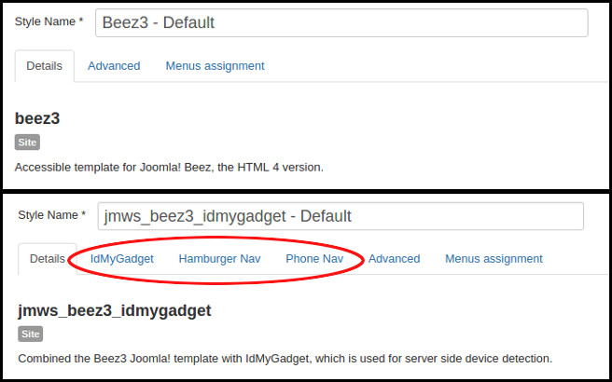
Beez3-IdMyGadget Admin 1

Slide 18
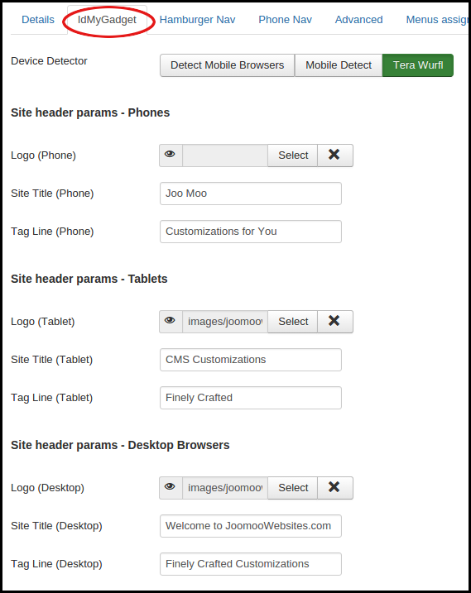

Slide 19
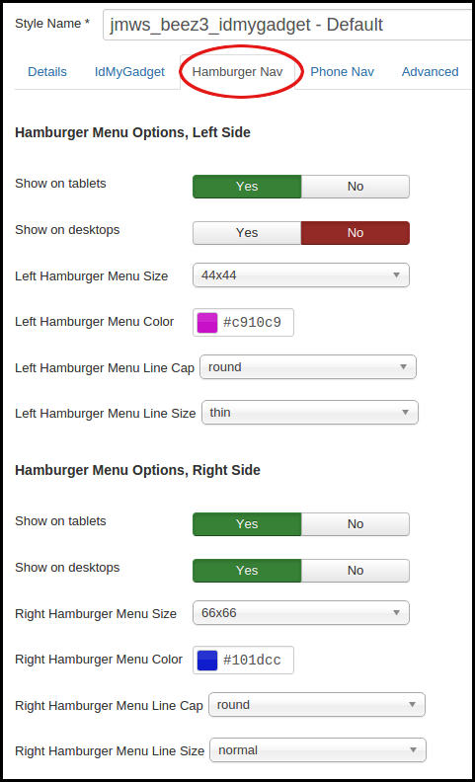

Slide 20
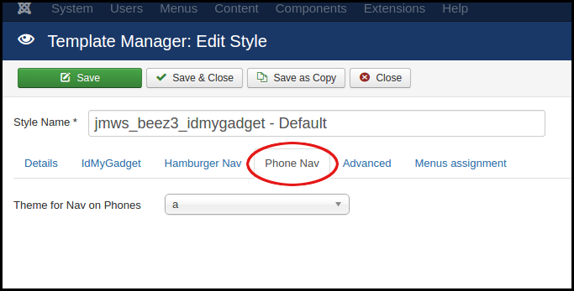
Beez3-IdMyGadget Admin 4

Slide 21
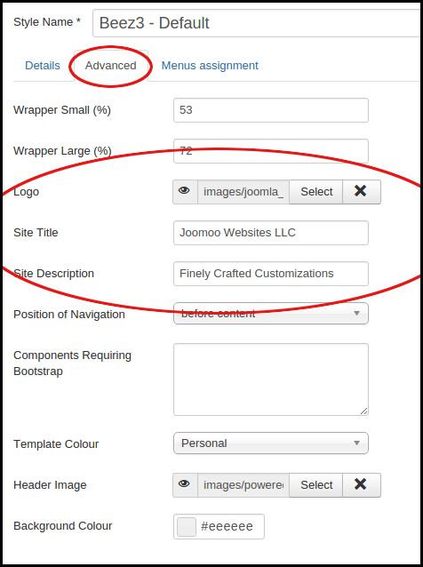
Beez3-IdMyGadget Adv Before

Slide 22
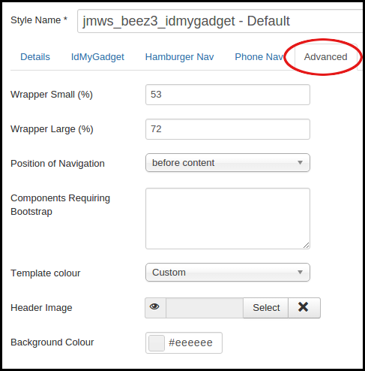
Beez3-IdMyGadget Adv After

Slide 23
jmws_protostar_idMyGadget
Github Repo:
  github.com/tomwhartung/jmws_protostar_idMyGadget
Still a Work in Progress (WiP)
  At this time I have no real definition of “complete” and no real incentive to define or do it
  You could change that!
I am not using it but will go through the administrator options

Slide 24
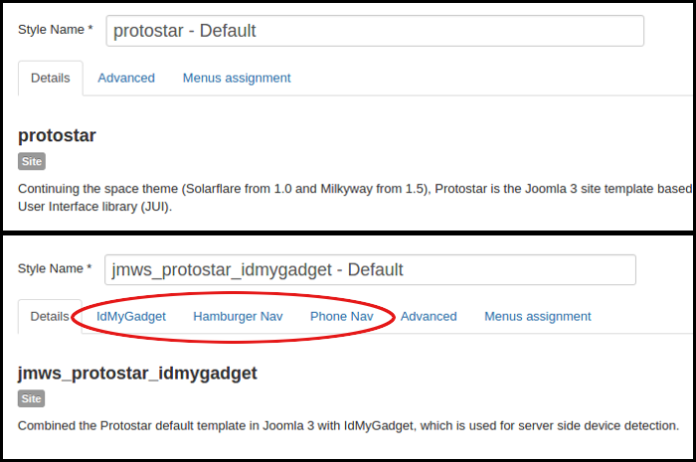
Protostar-IdMyGadget Admin 1

Slide 25
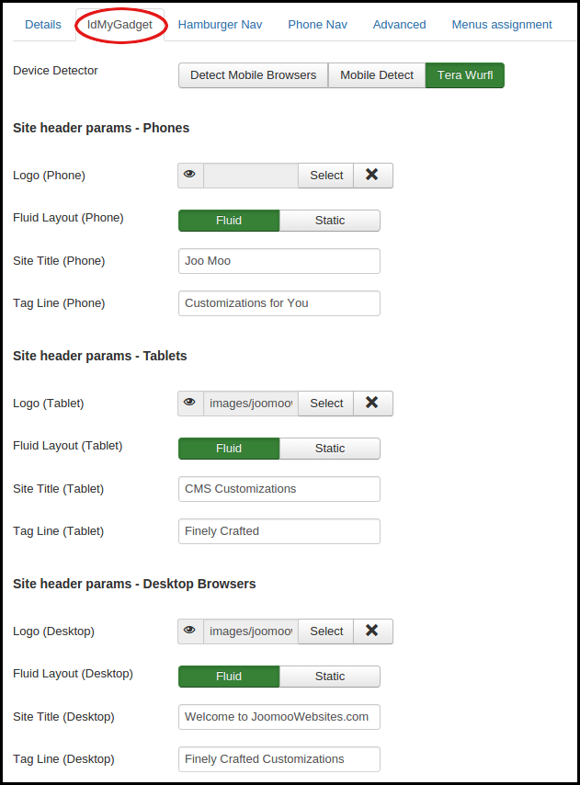

Slide 26
Advanced: Demo Module
Github repo:
  github.com/tomwhartung/jmws_mod_demo_idMyGadget
From Home page of JooMooWebSites.com:
  Login as meetup/meetup
  See the Change View module
This is for development and debugging, and for playing around with
This is not something you'd want to use on a live site

Slide 27
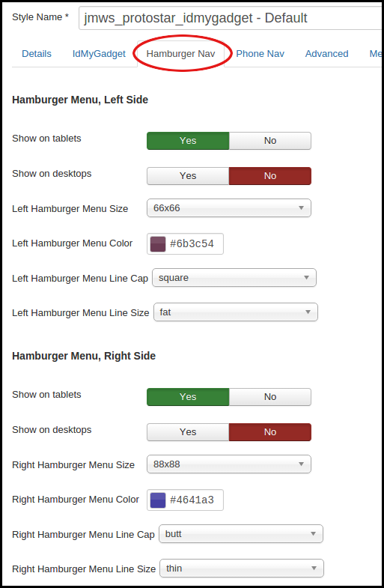

Slide 28
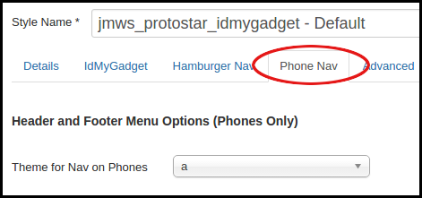
Protostar-IdMyGadget Admin 4

Slide 29
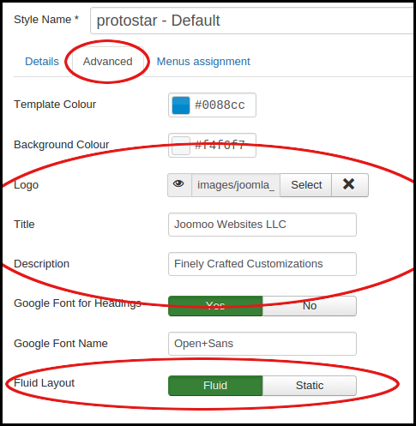
Protostar-IdMyGadget Adv Before

Slide 30
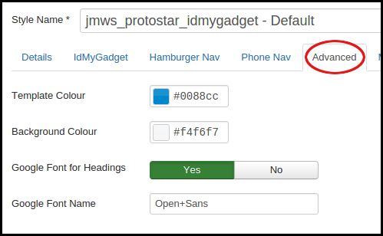
Protostar-IdMyGadget Adv After

Slide 31
jmws_protostar_tomh_idMyGadget
This is the template I am using for my joomoowebsites.com site
Github Repo:
  github.com/tomwhartung/jmws_protostar_tomh_idMyGadget
It has the same options as the protostar-IdMyGadget template, plus more

Slide 32
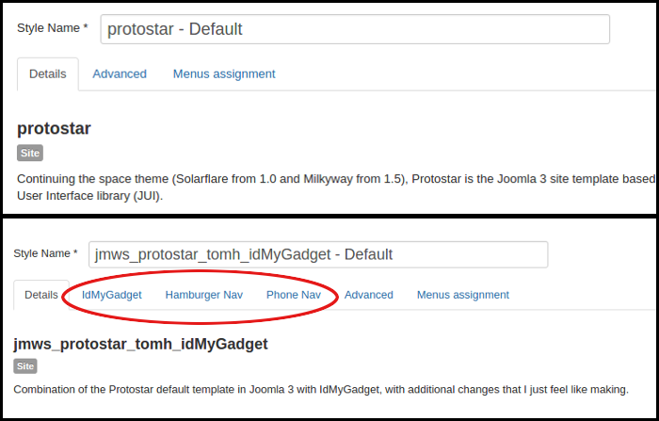
Protostar-Tomh-IdMyGadget 1

Slide 33
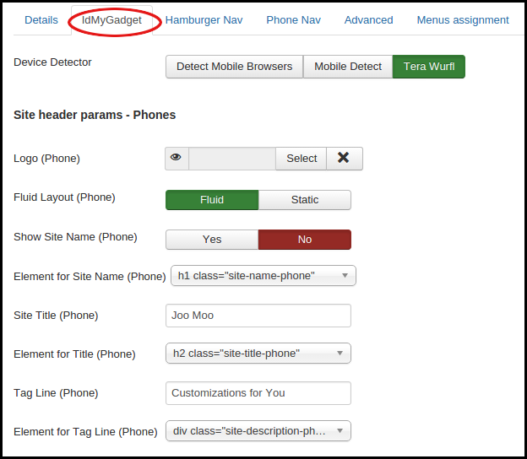

Slide 34
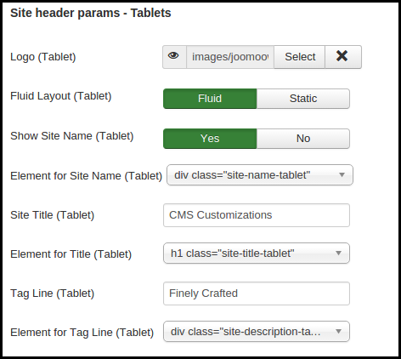
Protostar-Tomh-IdMyGadget 2b

Slide 35
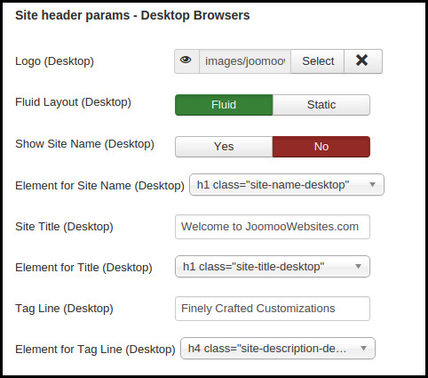
Protostar-Tomh-IdMyGadget 2c

Slide 36
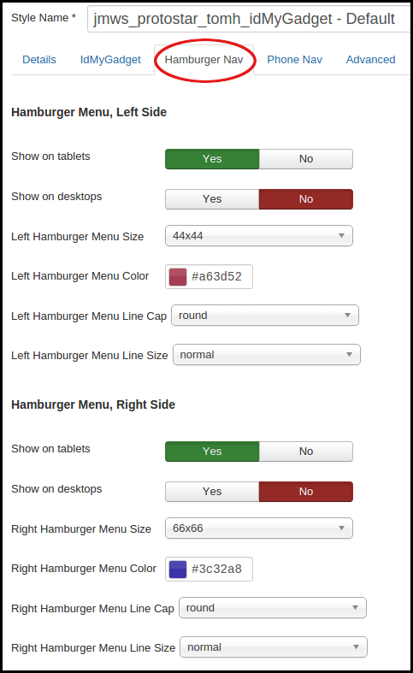

Slide 37
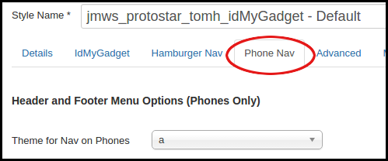
Protostar-Tomh-IdMyGadget 4

Slide 38
Protostar-Tomh-IdMyGadget Adv Before

Slide 39
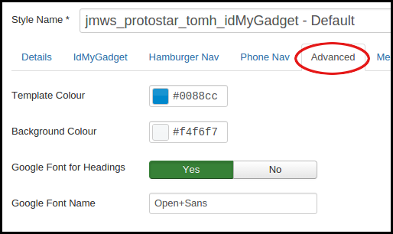
Protostar-Tomh-IdMyGadget Adv After

Slide 40
IdMyGadget Menu Module 1
Github repo:
  github.com/tomwhartung/jmws_mod_menu_idMyGadget
This module knows how to use the jQuery Mobile HTML5 data attributes to display the
  Header nav on phones
  Footer nav on phones
  Popup nav that appears when the visitor clicks on one of the hamburger menu icons

Slide 41
IdMyGadget Menu Module 2
I copied joomla's mod_menu module and really did not change very much of it
There is a strong dependency between this and the templates
  This will not work on a page where the template is not active
  The template's menu options will not work if the module is not installed and set up properly
  I am not sure whether this is kosher in joomla-land
Also: I split position-7 into three positions
  That is how I suppress main menu on phones and tablets

Slide 42
Phone Navigation 1
Implemented using jQuery Mobile jquerymobile.com
  You can add as many as you want, it will stack them (I have found one level looks best)
  You can theme them (I have found the built-in themes to be rather limited)
Appears on phones only
  It would be easy to make them appear tablets or desktops or both
  I think it looks good only on phones
  The styles used by jQuery Mobile can in some cases conflict with the styles used in the template

Slide 43
Phone Navigation 2
New positions in template:
  phone-header-nav
  phone-footer-nav
Menus created:
  Phone Header Nav
  Phone Footer Nav
Modules created:
  Phone Header Nav
  Phone Footer Nav

Slide 44
Device-Specific Content
Once we have device-specific menus, device-specific content is easy
Example:
  Downloads option on Desktop Menu
  Fremiums option on Mobile Menu
Content is still available, e.g. by typing into the location bar, but who does that anyway?

Slide 45
Advanced: Phone Burger Menu 1
Currently hard-wired to use jQuery Mobile pop-up
  If menu exists, always display on phones
  Parameters allow display on tablets and desktops
  I do not recommend using it on desktop views because of hard-wiring
  Could change desktop view to use different style of pop-up, but I do not have a need for that right now
Added to new positions in all three idMyGadget templates
  phone-burger-menu-left
  phone-burger-menu-right

Slide 46
Advanced: Phone Burger Menu 2
Added to new positions in all three idMyGadget templates
  phone-burger-menu-left
  phone-burger-menu-right
Menus created:
  Mobile Menu
    Top-level options are similar to those in the Desktop Menu
    Used instead of Desktop Menu on phones and tablets
  Mobile Demos
Modules created:
  Mobile Menu
  Mobile Demos

Slide 47
Advanced: Phone Burger Options
There are options to set the
  Size of the icon
  Bar thickness
  End cap
I am currently using image files...
Note that the images are scaled

Slide 48
Conclusions - Status
Beez3: I am not using it but it provides a good starting point for someone who might want to build on it
Protostar: I am not using it but it provides a good starting point for someone who might want to build on it
Protostar Tomh: Using it and happy with it!

Slide 49
Conclusions - Downsides
Bleeding edge: device-specific positions will not show up in joomla's positions preview
Things can get complicated, especially when used with a site that is already responsive
Have already been rejected for one job, for having a “strong opinion of device detection”

Slide 50
Conclusions - Upsides
I feel I am recovering from the Great JavaScript Library Explosion of 2014
This work is helping me figure out what I want to do when I grow up ☺
  Some JS is ok, but I wouldn't want to do it 24/7/365

Slide 51
Conclusions - Future
Planning to work on something similar for WordPress and Drupal (unless I find a job)
I think there is a huge amount of potential here:
  TVs
  Virtual Reality - I think it would be really nice, if not essential, to know if someone is visiting your site wearing the goggles
  Internet of Things - I find this to be fascinating and somewhat scary

Slide 52

Questions for Me?

Slide 53
Questions for You!
Interested in more?
  Phone burger gets a bit complicated...
  I could create a temporary admin account and let people play around a bit in the back end...
How do I use this work to market myself and make some $$$?
Do you think I should do something similar to the default themes in WordPress and Drupal?
  This is what I am planning to do, for this month anyway
  (Or maybe I should just try to find a real job?)

Slide 54
Why Use It?
What do You think?
I think it is cool technology and am open to ideas!

Slide 55
Appendix: CSS Line Counts
CMS | Template/Theme | Has This # of Lines | In This # of Files
Joomla | Beez3 | 5433 | 15
Joomla | protostar | 7479 | 1
WordPress | twentyfifteen | 6834 | 2
WordPress | twentyfourteen | 5174 | 2
Drupal | garland | 1786 | 5
Drupal | seven | 2058 | 9

