Slide 1
Spark For Scientists MISP Research Camp, Copenhagen 4 December 2017 Tom White @tom_e_white

Slide 2
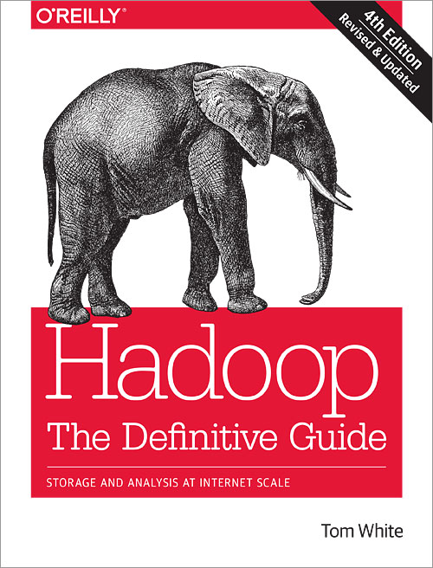
About Me
Data Science Team at Cloudera
Contributor to GATK, Hail
Apache Hadoop Committer, PMC Member, Apache Member
Author of “Hadoop: The Definitive Guide”

Slide 3
What is Hadoop?

Slide 4
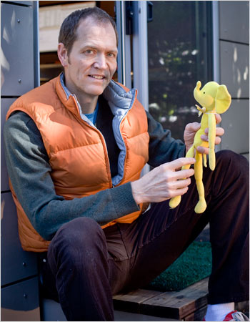

Hadoop
2004-2006: Doug Cutting and Mike Cafarella implement GFS/MapReduce in Apache Nutch
2006: Spun out as Apache Hadoop, Doug moves to Yahoo!
Named after Doug’s son’s yellow stuffed elephant

Slide 5
HDFS in a nutshell
Files are broken into large blocks (128MB)
Blocks are replicated across the cluster (3 way)
Fault-tolerant: gracefully responds to node/disk/network failures
Horizontally scalable: low marginal cost
High-bandwidth
HDFS storage distribution
1
2
3
4
5
Node A
Node B
Node C
Node D
Node E
2
4
5
1
2
5
1
3
4
2
3
5
1
3
4
Input File
Notes:
Large blocks
Blocks replicated around

Slide 6
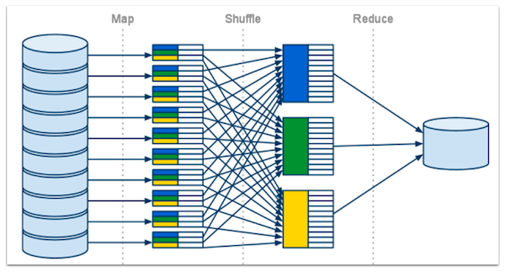
MapReduce
Notes:
Two functions required.

Slide 7
MapReduce in a nutshell
Structured as
Embarrassingly parallel “map stage”
Cluster-wide distributed sort (“shuffle”)
Aggregation “reduce stage”
Data-locality: process the data where it is stored
Fault-tolerance: failed tasks automatically detected and restarted

Slide 8
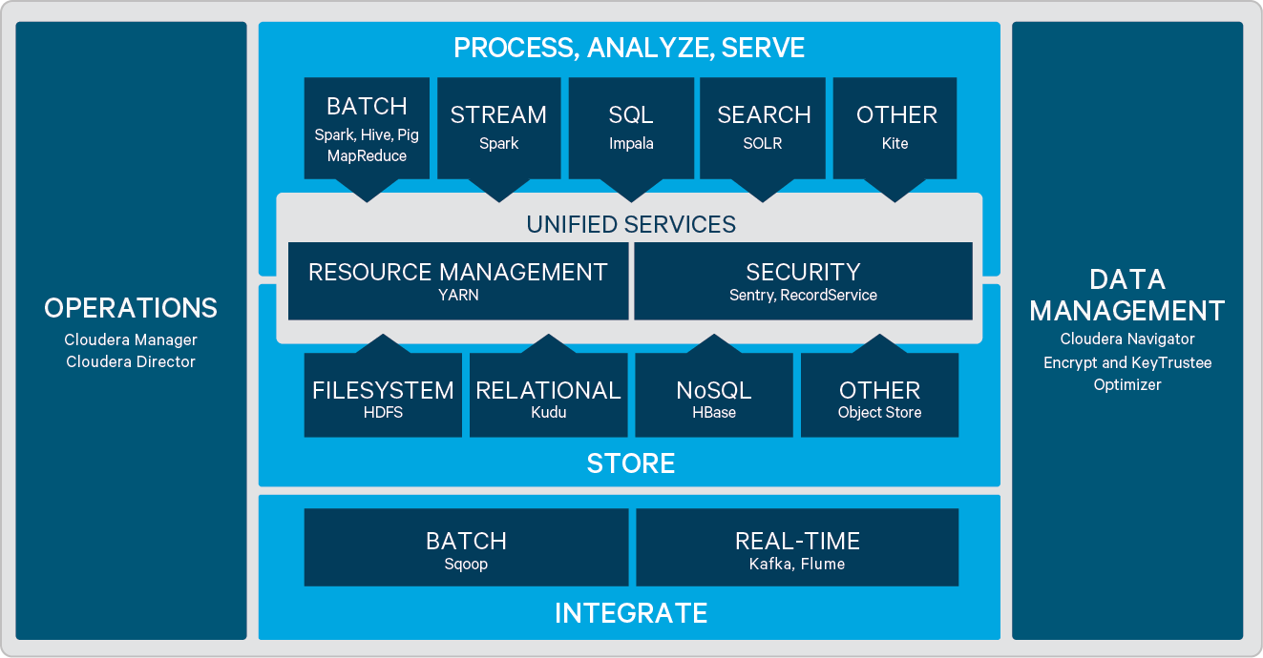
Cloudera’s Hadoop Platform (CDH)

Slide 9
What is Spark?

Slide 10
A better MapReduce

Slide 11
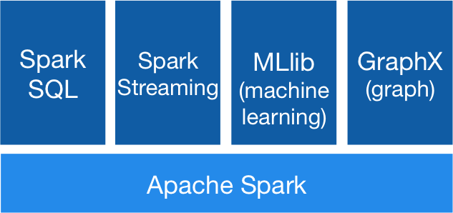
Apache Spark
Rich APIs in Scala, Java, Python, R
Multi-stage computations
In-memory computing
Fast
Great for iterative computations, e.g. machine learning
Streaming computations

Slide 12
Key Concepts
RDD (Resilient Distributed Dataset)
Data that is partitioned and distributed across the cluster
On disk or in memory
Resilient because Spark can automatically re-compute on node failure
Spark 2 – generally use Dataset/Dataframe
DAG (Directed Acyclic Graph)
Nodes = RDDs, Edges = transformations
Job
DAGs are run when an action is performed (e.g. save or collect)
A job is made up of stages, which are made up of tasks

Slide 13
Demo

Slide 14

On the Cluster

Slide 15
Word Count in Python
# Read book text into an RDD called 'lines'
lines = spark.read.text("books")\
.rdd.map(lambda r: r[0])
lines.first() # Look at the first line
# Find word counts (runs on cluster)
from operator import add
counts = lines.flatMap(lambda x: x.split(' ')) \
.map(lambda x: (x, 1)) \
.reduceByKey(add)
# Print out the counts (runs on driver)
output = counts.collect()
for (word, count) in output:
print("%s: %i" % (word, count))
Runs in a task
on an executor
Returns RDD data to driver.
Only do this if small!

Slide 16
R Example
# Start a Spark session
sc <- spark_connect(master = "yarn-client")
# Create a Spark dataset from a CSV file
tips <- spark_read_csv(sc, "tips", "tips.csv")
# Query to find if smokers tip more than non-smokers
tips %>%
filter(total_bill > 5) %>%
group_by(smoker) %>%
summarise(mean_tip = mean(tip))

Slide 17
Practicalities
Libraries
Python – use pip to install on driver, --py-files to ship to executors
R – use install.packages on driver
Distributed ML library: https://spark.rstudio.com/mlib/
Running Spark
Local install
QuickStart VM: https://www.cloudera.com/downloads/quickstart_vms.html
Shared cloud cluster for this camp (details later)

Slide 18
Examples of Spark in Science
GATK4 – scalable variant discovery
Java implementation of Spark pipelines for alignment, QC, variant calling
100 min to run whole human genome pipeline on 20 node cluster
Hail – scalable genomic data analysis (like PLINK)
Python interface for GWAS on 10K+ WGS
Notebook tutorial: https://hail.is/docs/stable/tutorials/hail-overview.html
CERN High Energy Physics
https://github.com/LucaCanali/Miscellaneous/blob/master/Spark_Notes/Spark_HEP_Examples/LHCb_OpenData_Spark.ipynb

Slide 19
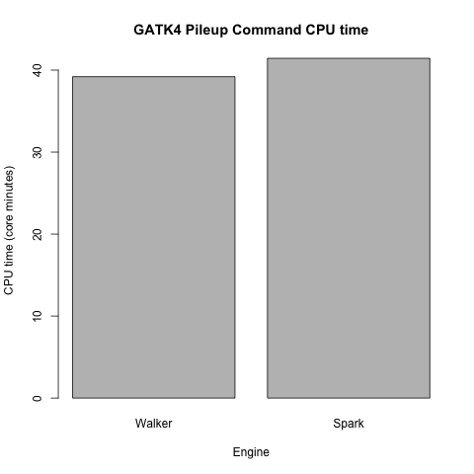
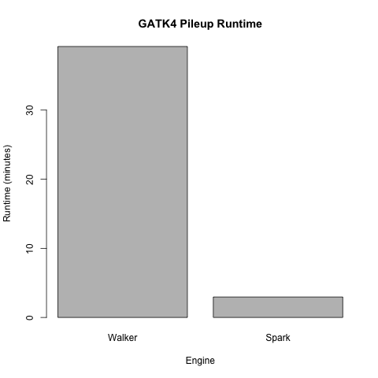
Performance: CPU vs wall clock time

Slide 20
Side effect: trying things you didn’t think were possible
With no prior experience of Spark, a team at the Broad were able to write a GATK4 Spark tool for analyzing structural variants that hadn’t been attempted on GATK3 due to its computational complexity, and get it running at what they estimated was one or two orders of magnitude faster than it would have been on GATK3.

Slide 21
Resources
Spark docs: https://spark.apache.org/
Spark API: https://spark.apache.org/docs/latest/api/python/index.html
sparklyr: https://spark.rstudio.com/
Starter examples: https://github.com/tomwhite/misp-demo
My email: tom@cloudera.com

Slide 22
Tom White @tom_e_white

