Slide 1

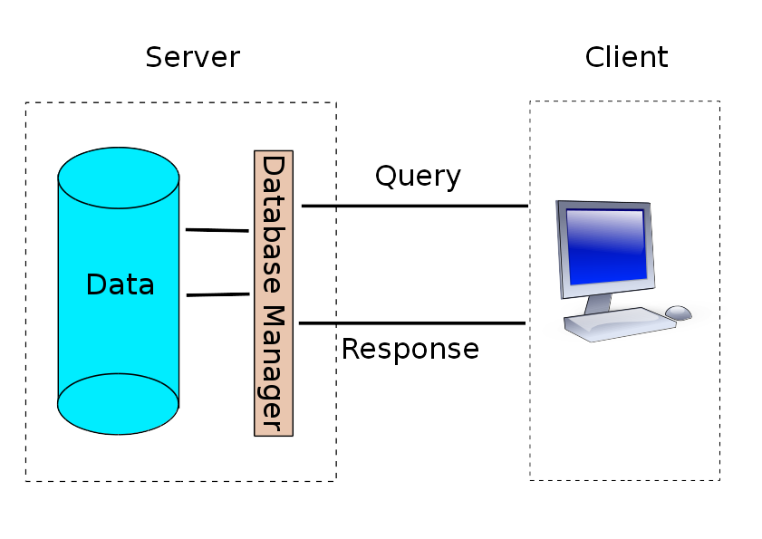
Storing Data
Contents

Slide 2
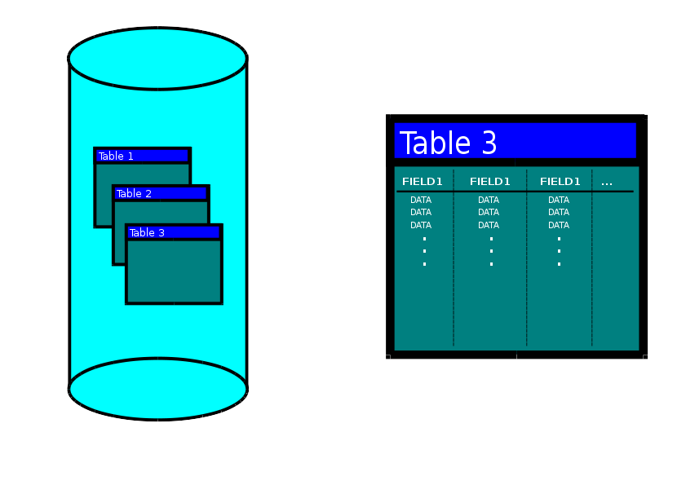
Database structure
Contents
Database
contains
Tables
contains
Fields (columns)
contains
Records (rows)
contains
Data

Slide 3
SQL
Contents
Structured Query Language
(SQL)
Language to communicate with database manager
Retrieve data, add data, delete data
SELECT field1 [,field2,...]
FROM table
[WHERE condition]
[GROUP BY field]
[GROUP BY field];
[] = optional

Slide 4
SQL
Contents

