Slide 1
Building Whimsical Instruments with Digital Waveguide Mesh
Advanced Acoustics
Summer 2016
Tom Xi

Slide 2
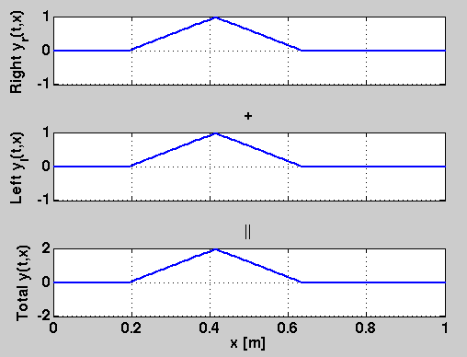
D’Alembert Solution
Animation Source: Julius Smith, Traveling Waves, CCRMA, 2010.

Slide 3
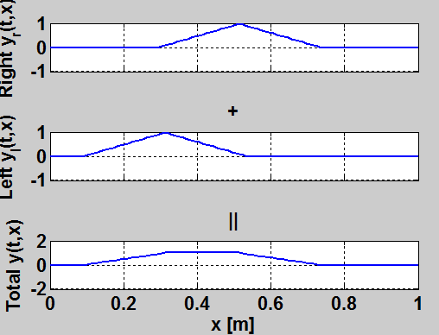
D’Alembert Solution
Animation Source: Julius Smith, Traveling Waves, CCRMA, 2010.

Slide 4
Bidirectional Delay Line
Direction of propagation
z⁻¹ | z⁻¹ | z⁻¹ | z⁻¹ | z⁻¹ | z⁻¹ | z⁻¹ | z⁻¹ | z⁻¹ | z⁻¹
z⁻¹ | z⁻¹ | z⁻¹ | z⁻¹ | z⁻¹ | z⁻¹ | z⁻¹ | z⁻¹ | z⁻¹ | z⁻¹
Direction of propagation

Slide 5
Scattering Junction
Scattering Junction
Wave Impedance R1
Wave Impedance R2

Slide 6
Scattering Junction
Delay line
Delay line
Scattering Junction
Delay line
Delay line
Delay line
Delay line
Delay line
Delay line

Slide 7
2D Waveguide Mesh
Delay line
Delay line
Delay line
Delay line
Delay line
Delay line
Scattering Junction
Scattering Junction
Scattering Junction
Delay line
Delay line
Delay line
Delay line
Delay line
Delay line
Delay line
Delay line
Delay line
Delay line
Delay line
Delay line
Delay line
Delay line
Scattering Junction
Scattering Junction
Scattering Junction
Delay line
Delay line
Delay line
Delay line
Delay line
Delay line
Delay line
Delay line
Delay line
Delay line
Delay line
Delay line
Delay line
Delay line

Slide 8
2D Waveguide Mesh
Delay line
Scattering Junction
Delay line
Delay line
Delay line

Slide 9
Special SJ: Boundary

Slide 10
DWM
Delay line
Delay line
Scattering Junction
Scattering Junction
Delay line
Delay line
Delay line
Delay line
Delay line
Delay line
Delay line
Delay line

Slide 11
String
Scattering Junction
Scattering Junction
Delay line
Delay line
Delay line
Delay line
Delay line
Delay line

Slide 12
2D Waveguide Mesh
Delay line
Delay line
Delay line
Delay line
Delay line
Delay line
Scattering Junction
Scattering Junction
Scattering Junction
Delay line
Delay line
Delay line
Delay line
Delay line
Delay line
Delay line
Delay line
Delay line
Delay line
Delay line
Delay line
Delay line
Delay line
Scattering Junction
Scattering Junction
Scattering Junction
Delay line
Delay line
Delay line
Delay line
Delay line
Delay line
Delay line
Delay line
Delay line
Delay line
Delay line
Delay line
Delay line
Delay line

Slide 13
DEMO

