Slide 1


Causal Explanations of Process Monitor Predictions
Tom Yaacov, Nathan Blake, and Hana Chockler
Notes:
Good afternoon, everyone. My name is Tom Yaacov, and I am a postdoctoral researcher at King's College London, and today I'll present joint work we did in our lab to explain the predictions of process monitors.

Slide 2
Predictive Process Monitors
Process mining: analyzing business process event logs. Each case produces a trace of events.
Predictive Process Monitoring: observes an ongoing event trace and predicts a future aspect of the process.
Prediction types: process outcome, next activity, remaining time.
Submit
Missing document
Request update
Late response
…
Predictive Model
High risk of delay Confidence: 0.87
A prediction is often not enough:
Trust: Can I rely on the model and this prediction?
Action: Can I intervene? How?
Improvement: Can the accuracy of the model be improved? Targeted retraining, feature design.
Explainability
Notes:
But before we get into the details, we should first start with some background. In process mining, we analyze business processes. These processes generate event logs. Each running instance of a business process is called a case, and it produces a trace, which is a sequence of events, as in the example of an application submission handling here. Predictive process monitoring trains a model on historical traces so that, at runtime, it can look at an ongoing trace and predict something about its future. It can be the next event, the remaining time to some event, or some final outcome of the process. But prediction on its own is rarely enough. In many cases, the user would like to understand whether he can rely on the model's prediction, whether he can intervene and how to change the outcome, or how to analyze and improve the model in case of errors. All three can be addressed using explainability. And in several domains, such as healthcare, explainability is not a nice-to-have feature; it's an ethical and often a legal requirement.

Slide 3

Current XAI Approaches for PPM
Explainable AI (XAI) techniques aim to explain these predictions, helping users assess their reliability and build informed trust in the models.
General XAI methods – LIME, SHAP.
These methods do not account for the temporal and causal structures inherent to processes.
e1,e2,e3,…,en
e1,e2,e3,…,em
…
Why process data is different?
Order matters - later events depend on earlier ones
Features are correlated - one-hot features are not independent
Traces vary in length - dimensionality can become extreme
Valid alternatives are constrained - not every perturbation is reachable
Notes:
The current standard in explainability tools today is post hoc, model-agnostic methods such as LIME and SHAP. Both LIME and SHAP explain predictions by examining different perturbations in the data and assigning an importance score to each input feature. The problem with these methods is that they explain the trace exactly as it was fed to the model, where the trace events are encoded into a feature vector and the trace is usually flattened into a table. In this setting, each feature is treated by the explanation method as independent. While this may suit other use cases, processes have characteristics that make this setting highly unsuitable. First, the order of the events in the trace matters, where later events depend on earlier ones. Second, the features are correlated due to the encoding and the behavior of the process. Also, the trace may vary in length, making dimensionality an issue for explainability methods. Finally, the interdependencies in the trace mean that not all perturbations are valid in the process, which highly affects the performance of current explainability methods. So we want explanations that respect the temporal and causal structure of the process.

Slide 4

Counterfactuals
same world
A
B
¬A
¬B
Counterfactuals: “Had the process been e1’,e2,e3’,…,en, the outcome would have changed”
Focuses on input/output changes
Limitations:
Non-minimality - a counterfactual may change more events than are actually needed to explain the outcome.
Causal inconsistency - a counterfactual may change downstream events without accounting for the events that caused them.
Missed causal behaviors: Overdetermination, Preemption.
Original trace:
e1,e2,e3,…,en
Prediction: REJECTED
Counterfactual
explanation:
e1’,e2,e3’,…,en
Prediction: ACCEPTED
over
determination
Rain or car are causes of me
being drenched?
Rain is a cause of me
being drenched.
Notes:
One approach to addressing that is counterfactual explanations. A counterfactual is a trace that is very similar to the original trace, except that the outcome changes. So the user receives this alternative trace as an explanation and is supposed to analyze, based on its difference from the original trace, what caused the prediction. While counterfactuals are intuitive and simple, they have several limitations. First, they might not be minimal and may include changes that are not needed to change the prediction. Second, the counterfactual may be inconsistent with the process and introduce unrealistic changes. Most importantly, simple counterfactuals do not capture some complex causal connections. To illustrate that, let's review the following example. So, here, let's assume I walked here this morning, and it rained and got me all wet. A simple counterfactual would capture that the rain is the cause of me getting wet: Had it not rained, I would not have gotten wet. To see where counterfactuals miss, let's make our example a bit more complicated. Let's assume that while I was walking, it started raining and a car drove through a puddle next to me and got me wet at the same time. A simple counterfactual would not capture that either the rain or the car alone is enough to get me wet. If it had not rained, I would still get wet from the car, and if the car had not passed, I would still get wet from the rain. This is an example of what we call overdetermination.

Slide 5
Counterfactuals
same world
A
B
¬A
¬B
Counterfactuals: “Had the process been e1’,e2,e3’,…,en, the outcome would have changed”
Focuses on input/output changes
Limitations:
Non-minimality - a counterfactual may change more events than are actually needed to explain the outcome.
Causal inconsistency - a counterfactual may change downstream events without accounting for the events that caused them.
Missed causal behaviors: Overdetermination, Preemption.
Original trace:
e1,e2,e3,…,en
Prediction: REJECTED
Counterfactual
explanation:
e1’,e2,e3’,…,en
Prediction: ACCEPTED
preemption
Car is a cause of me
being drenched,
but not the rain
8:00AM
10:00AM
Notes:
In another example, let's assume that I was walking for a long time, and the car got me first. Only after two hours did it start raining, but I was already drenched from the car passing by. Simple counterfactuals do not capture that the car caused me to get drenched, not the rain. Note that we are looking here for the cause of me going from dry to wet, so rain is not a cause.

Slide 6
Actual Causality
Actual causality provides a formal framework for reasoning about the causes of observed outcomes.
Actual causality extends counterfactual reasoning by having expressive causal models allowing complex causal structures:
A is an actual cause of B if there exists some contingency C (a change in the current world) in which B counterfactually depends on A.
A,C
B
A,¬C
B
¬A,¬C
¬B
original world
contingency
counterfactual dependence
J. Y. Halpern, Actual Causality. The MIT Press, 2016.
Notes:
In our work, we propose to address the explainability of process monitor predictions using actual causality. Actual causality is a formal framework for reasoning about the causes of observed outcomes. It can be viewed as an extension or generalization of counterfactual reasoning, providing a formal framework for reasoning about counterfactual dependence and addressing limitations of counterfactuals. Generally speaking, it defines A as an actual cause of B if there exists some contingency C, a change in the current world, such that B would counterfactually depend on A. The contingency that we allow here is what allows us to capture behaviors that counterfactuals do not.

Slide 7
Actual Causality
Overdetermination in actual causality:
The car is an actual cause of me
being drenched.
X
Contingency = no rain
Car is
a counterfactual cause
Notes:
So if we go back to the example of overdetermination we had before. In this example, the car is an actual cause of me being drenched. This is because, under the contingency that there is no rain, it becomes a counterfactual cause of me getting wet.

Slide 8
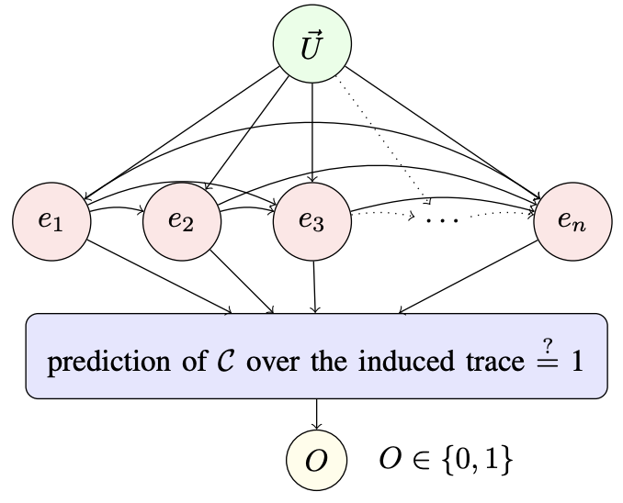
AC4PM Causal Explanations of PPM
Our causal model captures temporal dependencies by allowing each event to depend on preceding events.
It restricts analysis to reachable traces consistent with the process.
Its simple structure enables us to approximate causes without explicitly constructing the full model.
External factors and sources of randomness that influence the process
Analyzed trace
Monitor prediction
Notes:
Our causal model for explaining process monitor predictions defines each trace event, e, as a variable that may affect the final outcome, O, which is computed using the process monitor. The causal model captures temporal interdependencies within the trace by allowing each event to depend on preceding events. These interdependencies also restrict our causal analysis to reachable traces, that is, traces that are consistent with the process and may occur. This simple structure also allows us to generate explanations without explicitly constructing the full causal model, as we will see in the next slides.

Slide 9

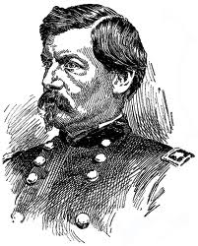


Computing Causes
Precise computation of actual causes is intractable.
Consequently, existing causal explanation generation approaches use heuristic search strategies, based on the degree of responsibility, which quantifies causal influence:
Each blue voter has a high responsibility for Lincoln’s win
Lincoln
McLellan
California:
51
49
…
…
Responsibility allows to rank causes based on the number of changes needed
Lincoln
McLellan
Each blue voter has a low responsibility for Lincoln’s win
New York:
90
10
…
…
H. Chockler and J. Y. Halpern, "Responsibility and blame: A structural-model approach," JAIR, 2004.
Notes:
So far, we have discussed the type of explanation we are seeking. Now, let's discuss how we can search for it. In general, computing actual causes, and consequently explanations, is intractable. Thus, several approaches to causal explanation generation rely on heuristic search strategies based on the notion of degree of responsibility. Essentially, responsibility quantifies causal influence. Let's look at the following example to understand how it works. Say we have elections in two states in America. In each state, we have 100 voters. In California, Lincoln got 51 votes against 49 votes for McLellan. In New York, Lincoln got 90 votes against 10 votes for McLellan. So, in both areas, each Lincoln voter is a cause of him winning. However, these are clearly different cases with different levels of causal influence, and we need to distinguish them. We won't get into the details of how responsibility is computed, but it largely corresponds to the number of variables that need to change in our model to change the outcome. So in the first case, each Lincoln voter will have high responsibility since they could, alone, change the outcome, and each Lincoln voter in the second case will have low responsibility since they need more voters to change the outcome.

Slide 10
AC4PM algorithm
Efficient, Responsibility-Guided Causal Explanation Search:
Sampled perturbed traces
Generate perturbed samples of the original trace using a process simulator, then obtain the monitor’s predictions for these samples.
Approximate event responsibilities
Approximate responsibility from prediction-changing samples by identifying the minimal required changed events.
Add events in order of approximated responsibility until the selected subset is sufficient to preserve the prediction.
Construct a sufficient explanation
Notes:
Using the notion of degree of responsibility, we defined an efficient, responsibility-guided explanation search algorithm. In the first step, we use a process simulator to generate perturbed samples of the original trace. Those are added to the training set, which serves as our pool of reachable traces, and query the process monitor on all of them to get their predictions. In the second step, we use the perturbed data and its prediction to approximate the responsibility of each event in the trace. In the final step, we build what we call a sufficient explanation, that is, a subset of events that alone is sufficient to reproduce the prediction. Using the approximated responsibility, we greedily add events in order of responsibility until we are guaranteed to reproduce the prediction. This subset of events is the returned explanation.

Slide 11

Experimental Evaluation
22
9
130k
1,800
binary outcome datasets
real-life event logs
traces in the largest dataset
events in the longest traces
Monitors: MLP and XGBoost
Process simulator: LSTM sequence model
100 perturbations per trace
Baselines: LIME and SHAP
Sampling: 10 correct test traces per dataset
Repetition: 10 random seeds per trace
Metrics: Stability, explanation size, runtime
I. Teinemaa et al., "Outcome-Oriented Predictive Process Monitoring: Review and Benchmark," ACM TKDD, 2019.
Notes:
For evaluation, we used a well-known benchmark in predictive process monitoring that includes 22 binary-outcome datasets from 9 real-life event logs. This logs come from different industries such as healthcare, finance, and manufacturing. Some datasets share a log but differ in the target label, so the same process is predicted but for different types of outcomes. Each dataset contained up to 130,000 traces, with each trace up to a length of 1,800 events. We explain two monitors: an MLP classifier and an XGBoost classifier, both using static one-hot encoding. The simulator is an LSTM trained per dataset; we generated 100 perturbations per trace for the causal analysis. We compared our approach with LIME and SHAP. For each dataset, we examined 10 test traces and ran each method 10 times with different seeds. We assessed all methods on three evaluation criteria: stability, measuring how similar the explanations are for the same trace under different seeds; succinctness, measuring the size of the explanation as a fraction of the trace; and runtime, measuring the time taken by the methods to generate an explanation.

Slide 12
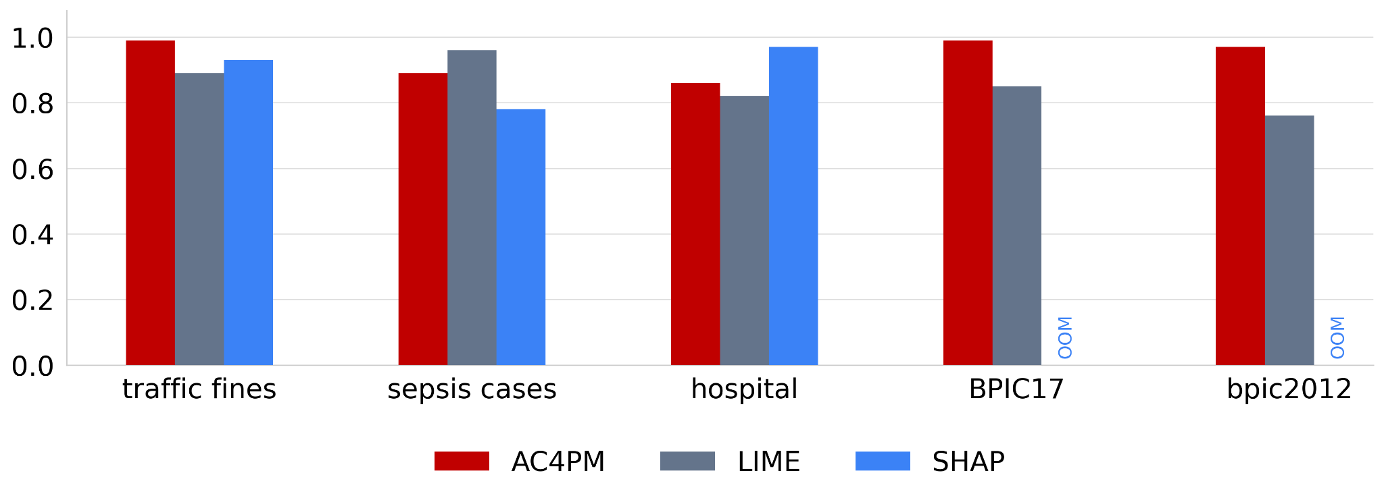
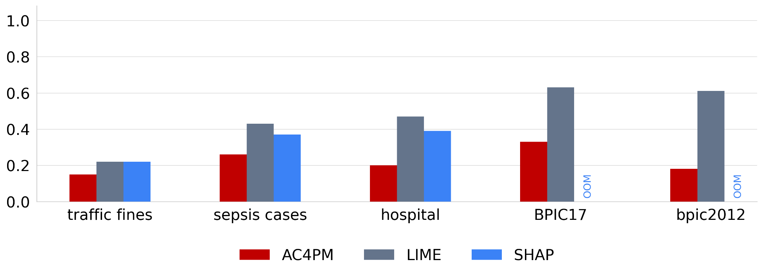
Results
Representative results (MLP monitor)
Explanation stability over 10 runs (VSI; higher is better)
Explanation size (fraction of trace; lower is better)
Key results: Across the benchmark, AC4PM generally produces more stable and concise explanations.
AC4PM’s stability improves in longer traces.
SHAP ran out of memory (OOM) on 13 of 22 datasets, even with memory reducing settings.
AC4PM’s runtime increases with trace complexity, but is still comparable with LIME and SHAP.
Notes:
So in terms of the results, our approach is the most stable method across the majority of datasets for both monitors. Moreover, our approach's stability improves as trace complexity increases, with longer traces. For explanation size, our approach's explanations are smaller on essentially all datasets, and dramatically so on the complex ones. Notably, SHAP ran out of memory on 13 of the 22 datasets, even with memory-reducing settings. This is a symptom of that dimensionality problem. In terms of runtime, it increases with trace length, which is expected as the complexity of the algorithm highly depends on trace length. However, it was still comparable to LIME and SHAP and we believe that, since this is a proof-of-concept implementation, there is plenty of room for runtime optimizations.

Slide 13
Thank you
tom.yaacov@kcl.ac.uk
Notes:
Thank you for listening. I'll be happy to take questions.

