Slide 1
Divide-and-Conquer
Recursive Algorithms
Notes:
Video Module 4-01

Slide 2

Overview
Objectives
Learn and understand the (recursive) Divide-and-Conquer strategy.
Analyze (recursive) Divide-and-Conquer algorithms.
Learn, understand, and use the recursion-tree method for solving recurrences.
Learn, understand, and use the substitution method for solving recurrences.
Learn, understand, and use the master method for solving recurrences.
Requirements
Read
Sections 2.3.1 and 2.3.2
Introduction to Chapter 4
Sections 4.3, 4.4, and 4.5

Slide 3
Divide-and-Conquer
What is the divide-and-conquer strategy?
Apply it to sort an array of elements
Merge-Sort
Read Section 2.3.1

Slide 4
What is Divide-and-Conquer Strategy?
The Divide-and-Conquer strategy consists of three steps:
Divide: divide the problem in (smaller) subproblems.
Conquer: conquer by keeping (recursively) dividing if the subproblems are not small enough to solve them in a straightforward (easy) manner.
Combine: combine the solutions of the subproblems into one solution of the original problem.
Examples of problems solved by Divide-and-Conquer:
Sorting a sequence (Solution is Merge Sort algorithm)
Matrix multiplication (Solution is Strassen’s algorithm)
Maximum-subarray problem (Solution algorithm exists, but with no name)

Slide 5
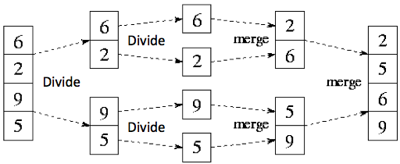
Using The Divide-and-Conquer Strategy
Problem: Sort a sequence A
Solution: Merge-Sort(A, p, r)
Inputs: Sequence A, index p of first element and index r of last element
Output: Sorted A.
Divide: divide the n-element sequence into two n/2-element subsequences.
Conquer: Sort the two subsequences recursively (Divide…)
Combine: merge the two sorted subsequences into one sorted .
A
p→
r→

Slide 6
Using The Divide-and-Conquer Strategy
Problem: Sort a sequence A
Solution: Merge-Sort(A, p, r)
Inputs: Sequence A, index p of first element and index r of last element
Output: Sorted A.
Divide: divide the n-element sequence into two n/2-element subsequences.
Conquer: Sort the two subsequences recursively (Divide…)
Combine: merge the two sorted subsequences into one sorted .
A
p→
r→

Slide 7
Using The Divide-and-Conquer Strategy (Slide 1/3)
Problem: Sort a sequence A
Solution: Merge-Sort(A, p, r)
Inputs: Sequence A, index p of first element and index r of last element
Output: Sorted A.
Merge-Sort(A, p, r)
if (p < r)
q = floor((p+q)/2)
Merge-Sort(A, p, q)
Merge-Sort(A, q+1, r)
Merge(A, p, q, r))
A
p→
q→
r→

Slide 8
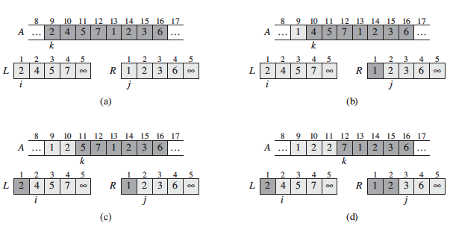
Using The Divide-and-Conquer Strategy (Slide 2/3)
Merge
Inputs: Sequence A, indexes p (first element), q (midpoint), and r (last element)
Output: Sorted A.

Slide 9
Using The Divide-and-Conquer Strategy (Slide 2/3)
Merge
Inputs: Sequence A, indexes p (first element), q (midpoint), and r (last element)
Output: Sorted A.

Slide 10
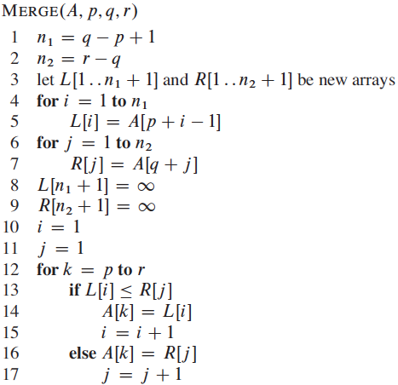
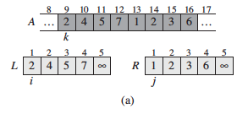
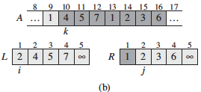
Using The Divide-and-Conquer Strategy (Slide 3/3)
Merge
Inputs: Sequence A, indexes p (first element), q (midpoint), and r (last element)
Output: Sorted A.

Slide 11
Using The Divide-and-Conquer Strategy (Slide 3/3)
Merge
Inputs: Sequence A, indexes p (first element), q (midpoint), and r (last element)
Output: Sorted A.

Slide 12
Time Complexity of Merge-Sort
Merge-Sort(A, p, r)
if (p < r)
q = floor((p+q)/2)
Merge-Sort(A, p, q)
Merge-Sort(A, q+1, r)
Merge(A, p, q, r))
Running time of Merge
Running time T(n) (time complexity) of Merge-Sort
Read Section 2.3.2
Notes:
Video Module 4-02

Slide 13
Running Time of Merge
Merge
Inputs: Sequence A, indexes p (first element), q (midpoint), and r (last element)
Output: Sorted A.
Input size
n elements from p to r
Which operations to count?
comparisons
How many comparisons?
n comparisons
What is the asymptotic growth?
Θ(n) (c.n for some constant c)

Slide 14
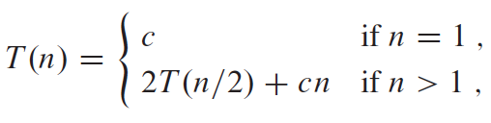
Running Time of Merge-Sort
Merge-Sort(A, p, r)
Inputs: Sequence A, index p of first element and index r of last element
Output: Sorted A.
Merge-Sort(A, p, r)
if (p < r)
q = floor((p+q)/2)
Merge-Sort(A, p, q)
Merge-Sort(A, q+1, r)
Merge(A, p, q, r)
Which operation to count?
Merge performs n comparisons (for an input of size n)
Merge-Sort calls itself!
What to do?
Answer
We will denote T(n) the running time of Merge-Sort(A, p, r) for an input of size n
We will try to determine T(n)
We must solve the recurrence relation (in short, a recurrence)
→T(n)
→T(n/2)
→T(n/2)
→ c.n

Slide 15
Recurrence-Tree Method
Merge-Sort(A, p, r)
if (p < r)
q = floor((p+q)/2)
Merge-Sort(A, p, q)
Merge-Sort(A, q+1, r)
Merge(A, p, q, r))
Methods to Solve Recurrence Relations
The Recurrence-tree Method
The Substitution Method
The Master Method
Read Introduction to Chapter 4
Read Section 2.3.2
Read Section 4.4
Notes:
Video Module 4-03

Slide 16
The Recursion-Tree Method
Construct a tree with:
the root being T(n) (the cost for the full problem)
each node representing the cost of a subproblem
each node will be expanded into the costs of its own subproblems (based on the recurrence)
the expansion will stop when we reach the node whose subproblem is of size 1 (i.e., T(1))
finding the total cost for each level of the tree
the total cost will be the sum of the costs of all levels.
Let us try the Recursion-Tree method with the recurrence of Merge-Sort:

Slide 17
The Recursion-Tree Method
Recursive Call
Tree
Row Sum
1st call cost T(n)
c.n
c.n
T(n/2)
T(n/2)
T(n/2) = 2T(n/2/2) + c.n/2
T(n/2) = 2T(n/4) + c.n/2

Slide 18
The Recursion-Tree Method
Recursive Call
Tree
Row Sum
1st call cost T(n)
c.n
c.n
c.n
2nd call T(n/2)
c.n/2
c.n/2
T(n/4)
T(n/4)
T(n/4)
T(n/4)
T(n/4) = 2T(n/4/2) + c.n/4
T(n/4) = 2T(n/8) + c.n/4

Slide 19
The Recursion-Tree Method
Recursive Call
Tree
Row Sum
1st call cost T(n)
c.n
c.n
2nd call T(n/2)
c.n/2
c.n/2
c.n
c.n/4
c.n/4
c.n/4
c.n/4
c.n
3rd call T(n/4)
T(n/8)
T(n/8)
T(n/8)
T(n/8)
T(n/8)
T(n/8)
T(n/8)
T(n/8)

Slide 20
The Recursion-Tree Method
Recursive Call
Tree
Row Sum
1st call cost T(n)
c.n
c.n
2nd call T(n/2)
c.n/2
c.n/2
c.n
c.n/4
c.n/4
c.n/4
c.n/4
c.n
3rd call T(n/4)
T(n/8)
T(n/8)
T(n/8)
T(n/8)
T(n/8)
T(n/8)
T(n/8)
T(n/8)
---------------------------------------
i^{th} call T(n/2^{i-1})
c.n/2^{i-1}
c.n/2^{i-1}
--------
c.n/2^{i-1}
c.n
T(n/2^{i})
T(n/2^{i})
T(n/2^{i})
T(n/2^{i})
-------
-----)
T(n/2^{i})
T(n/2^{i})

Slide 21
The Recursion-Tree Method
Recursive Call
Tree
Total Cost ?
Row Sum
1st call cost T(n)
c.n
c.n
How many “c.n”s?
2nd call T(n/2)
c.n/2
c.n/2
c.n
There are m levels
c.n/4
c.n/4
c.n/4
c.n/4
c.n
3rd call T(n/4)
Total Cost = m.c.n
T(n/8)
T(n/8)
T(n/8)
T(n/8)
T(n/8)
T(n/8)
T(n/8)
T(n/8)
What is m?
---------------------------------------
i^{th} call T(n/2^{i-1})
c.n/2^{i-1}
c.n/2^{i-1}
--------
c.n/2^{i-1}
c.n
We know n/2^{m}=1
Therefore n = 2^{m}
T(n/2^{i})
T(n/2^{i})
T(n/2^{i})
T(n/2^{i})
-------
-----)
T(n/2^{i})
T(n/2^{i})
Then m=log₂(n)
c.n/2^{m-1}
c.n/2^{m-1}
--------
c.n/2^{m-1}
c.n
Total Cost = c.nlog₂(n)
Θ(nlog₂(n))
m^{th} (Last)
call T(n/2^{m}=1)
Assuming n is a power of 2
c.n
T(1)
T(1)
T(1)
T(1)
-------
-----)
T(1)
T(1)

Slide 22
Substitution Method
Merge-Sort(A, p, r)
if (p < r)
q = floor((p+q)/2)
Merge-Sort(A, p, q)
Merge-Sort(A, q+1, r)
Merge(A, p, q, r))
Methods to Solve Recurrence Relations
The Recurrence-tree Method
The Substitution Method
The Master Method
Read Section 4.3
Notes:
Video Module 4-04

Slide 23
Substitution Method for Solving Recurrence Relations
Two steps: (textbook)
Guess the form of the solution
Use mathematical induction to find the constants and show that the solution works

Slide 24
Substitution Method for Solving Recurrences (Example)
Consider the recurrence relation we just solved:
Step 1: Make a guess
Use the solution we previously found T(n) = c.n.log₂(n)
Step 2: Use mathematical induction
Let substitute T(n/2) with its expression using: T(n) = c.n.log₂(n)
T(n/2) = c.n/2.log₂(n/2)
= ½.c.n.(log₂(n) – log₂(2))
= ½.c.n.(log₂(n) – l)
Now, let us evaluate 2T(n/2) + c.n
= 2(½.c.n.(log₂(n) –1) ) + c.n
= c.n. log₂(n) - c.n + c.n = c.n. log₂(n) = T(n)
So, it seems that the guess was good…...
But, we must check the boundary conditions:
Let us find T(1) using the expression T(n) = c.n.log₂(n)
T(1) = c.1.log₂(1) = 0
This is not good: based on the recurrence relation, we have T(1) = c.
What do?

Slide 25
Substitution Method: Boundary Conditions
Problem: T(1) = 0 does not match the recurrence relation
We are in fact interested only the asymptotic behavior (Θ(n.log₂(n)))
In this case, all we need is some n₀ for which the recurrence relation will hold.
Let us take n₀ = 2 as the base case.
Let us set T(n) = 2.c if n = 2 (this should be consistent with the recurrence relation)
Let us check if T(2) = 2c using the expression T(n) = 2T(n/2) + c.n
T(2) = 2T(2/2) + c.2 = 2T(1) + 2.c = 0 + 2.c = 2.c
This verifies
Then our guess Θ(n.log₂(n)) was good.

Slide 26
Substitution Method: Considerations and Subtleties
If looking only for an upper bound (O(Guess)) you need only to show that T(n) ≤ Guess
If looking only for an lower bound (Ω(Guess)) you need only to show that T(n) ≥ Guess
One can guess/start with weak bounds and progressively tie them up
Most of the time, boundary conditions can be ignored
The challenging problem of this method is to come up with a good guess: this requires experience or some patience to develop a good guess using the recursion-tree method.
Let us now study the third method: The Master Method

Slide 27
Master Method
Merge-Sort(A, p, r)
if (p < r)
q = floor((p+q)/2)
Merge-Sort(A, p, q)
Merge-Sort(A, q+1, r)
Merge(A, p, q, r))
Methods to Solve Recurrence Relations
The Recurrence-tree Method
The Substitution Method
The Master Method
Read Section 4.5
Notes:
Video Module 4-05

Slide 28
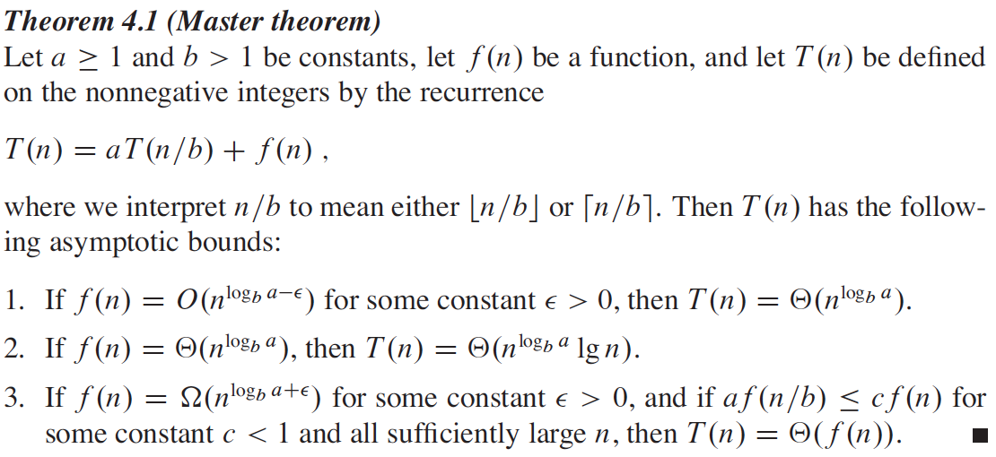
Master Method for Solving Recurrence Relations

Slide 29
Master Method for Solving Recurrence Relations

Slide 30



Example 1 : Using The Master Method
Consider T(n) = 9T(n/3) + n
We must identify/match a, b, and f(n).
Here
a = 9 (a ≥ 1)
b = 3 (b > 1)
f(n) = n
Let us compute
log_{b} a = log₃ 9 = log₃ 3² = 2
Then = n².
Since n = for ε= 1 > 0, Case 1 applies
then T(n) = Θ( ) = Θ(n²)

Slide 31


Example 2 : Using The Master Method
Consider T(n) = T(2n/3) + 1
We must identify/match a, b, and f(n).
Here
a = 1 (a ≥ 1)
b = 3/2 (b > 1)
f(n) = 1
Let us compute
log_{b} a = log_{3/2} 1 = 0
Then = n⁰ = 1.
Since 1 = , Case 2 applies
then T(n) = = Θ(lgn)

Slide 32

Example 3 : Using The Master Method
Consider T(n) = 3T(n/4) + n lg n
We must identify/match a, b, and f(n).
Here
a = 3 (a ≥ 1)
b = 4 (b > 1)
f(n) = n lg n
Let us compute
log_{b} a = log₄ 3 ≈ 0.79
Then ≈ n^{0.79}
Since n lg n = = Ω(n^{0.79+ε}) where ε≈ 0.2 > 0 , Case 3 applies,
but, we must check a.f(n/b) ≤ c.f(n) for some constant c < 1
We need 3.f(n/4) ≤ c.f(n), i.e., 3.n/4 lg n/4 ≤ c n lg n. For large values of n, we can have this with c = ¾ < 1
then T(n) = Θ(f(n)) = Θ(nlgn)

Slide 33
Wrap Up
Learn and understand the (recursive) Divide-and-Conquer strategy.
Analyze (recursive) Divide-and-Conquer algorithms.
Learn, understand, and use the recursion-tree method for solving recurrences.
Learn, understand, and use the substitution method for solving recurrences.
Learn, understand, and use the master method for solving recurrences.
Notes:
Video Module 4-06

