Slide 1

Designs
INVESTMENT NARRATIVE · V2 · AUGUST 2026
The world has never spent more making ammunition. Nobody has built the industry that unmakes it. We are assembling it.
TWB Designs — assembling the full-service platform for munitions end-of-life across allied nations.
$2.88T
$0
→
SPENT MAKING IT — WORLD MILITARY EXPENDITURE, 2025 (SIPRI)
PLATFORMS BUILT TO UNMAKE IT — UNTIL NOW
01 · TWB DESIGNS — CONFIDENTIAL
Notes:
Open cold. Three sentences, then let the room sit with the pair of numbers: $2.88T spent, $0 platforms built to unmake it. That contrast is the entire pitch in two figures — return to it on the closing slide.

Slide 2
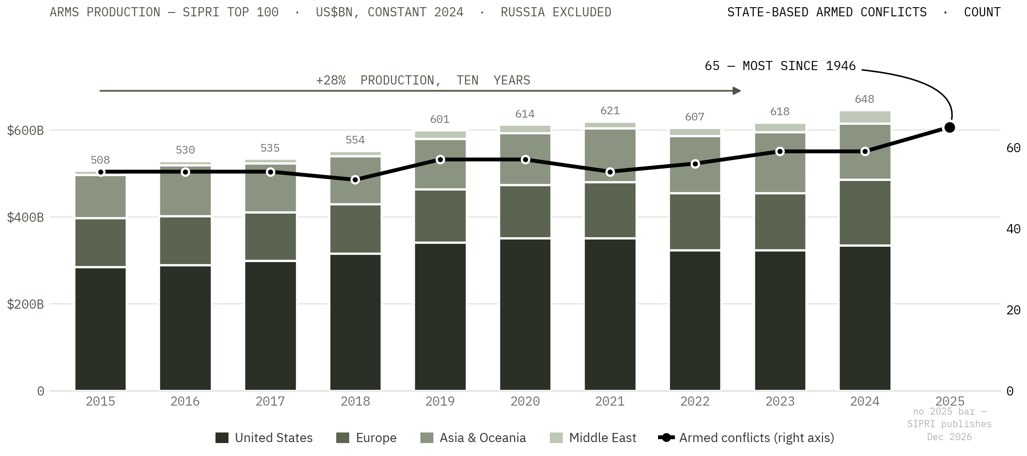
ACT I — THE REARMAMENT
The largest buildup in eighty years.
$2.88T world military expenditure, 2025 — an all-time record¹
Production is a crowded trade. Unmaking it is not — no incumbent, no index, almost no capacity.
SOURCES SIPRI Top 100 2002–24, regional aggregation ours, Russia excluded³ · UCDP/PRIO v26.1²
02 · TWB DESIGNS — CONFIDENTIAL
Notes:
The chart is the argument: production climbing for a decade across every region, conflicts climbing with it to a post-1946 record. Two panels, one timeline, one axis each — deliberately NOT a dual-axis overlay, so nobody can accuse us of scaling two series to look correlated. Note the honest gap: no 2025 production bar because SIPRI has not published it. If asked why arms-company revenue rather than 'ammunition production': there is no audited global ammunition-production series — the market-research numbers are unsourced and contradict each other. This is the closest verifiable proxy and it is checkable in two clicks.

Slide 3
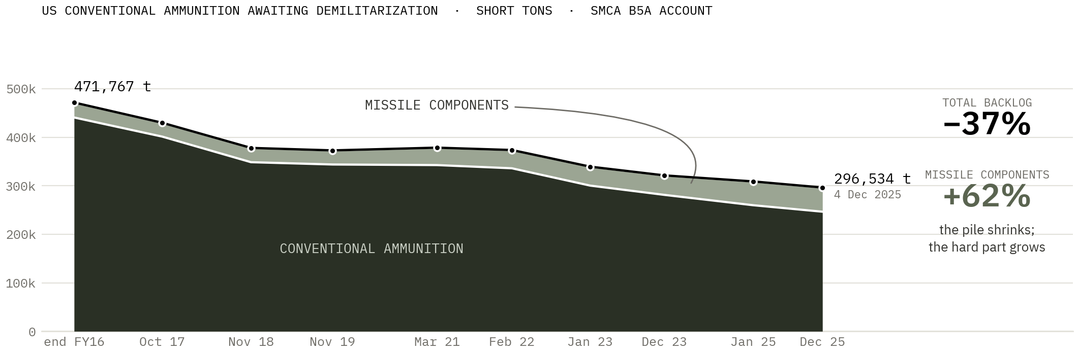
ACT II — THE LIABILITY
Ammunition is the only weapon you must destroy to retire.
296,534 t
9.4 yrs
$0.6–0.9B
AWAITING DEMILITARIZATION — US STOCKPILE, 4 DEC 2025⁵
TO CLEAR IT AT THE FUNDED RATE — BEFORE THE SURGE ADDS A ROUND⁵ ¹⁸
IMPLIED COST, AT PUBLISHED DEMIL RATES⁵ ⁶
The pile is worked down slowly — and the hard part grows inside it. Missile components went from 6.5% to 16.8% of the account, while funded destruction capacity fell from ~82,000 tons in FY2015 to 31,475 in FY2027.¹⁸
SOURCES Army Procurement of Ammunition justification books, FY2018–FY2027, line 4099EP1700⁵ · years-to-clear is our calculation¹⁷
03 · TWB DESIGNS — CONFIDENTIAL
Notes:
This chart is the deck's proprietary asset — ten consecutive snapshots pulled from the Army's own budget justification books, one line item, one account definition. Nobody has assembled it publicly. Two movements matter: the total falls 37%, and missile components climb from 6.5% to 16.8% — the account is shrinking and getting harder at the same time, and missile components are the expensive, difficult disposal category. The 9.4 years is ours: 296,534 tons divided by the FY2027 funded plan of 31,475 tons, and it assumes not one new round arrives, which the previous slide has just shown to be absurd. Older context if pressed: GAO put the account at 529,373 short tons in February 2015.

Slide 4
ACT II — THE STATUS QUO
Destruction never industrialised.
3
Sheriff's detectives killed⁷ — Los Angeles County, 18 July 2025, processing seized ordnance by hand. The status quo prices human hands over live munitions — until it doesn't.
BURN IT IN A PIT
TRUCK IT AWAY
DO IT BY HAND
Open burning / open detonation — no containment, no emissions control. ~$750/ton⁹, and being regulated out: the EPA's proposed rule (89 FR 19952) targets 67 US facilities still doing it.⁸
Live ammunition loaded onto highways to reach a fixed site. Every mile a diversion window. Every transfer a custody break. Every escort a cost the owner carries.
The default when nothing else is on site. No machine, no containment — just people and live ordnance in the same room.
Production has been industrialised. Destruction never was. That gap — the widest in eighty years — is the company.
04 · TWB DESIGNS — CONFIDENTIAL
Notes:
Lead with the number, not the sentence — let '3' sit before you explain it. Dashed strokes and dark neutral for the negative register. Never mock the incumbents; state the three methods flatly. This slide is why the mission matters beyond the money.

Slide 5
ACT III — THE FLIP
Geopolitics turned the waste stream into an ore body.
2,600%
ANTIMONY PRICE MOVE SINCE CHINA'S EXPORT RESTRICTIONS — PAST $50,000/TON. PENTAGON COMMITTED A REPORTED $1B TO SECURE SUPPLY¹⁰
Cu
COPPER
Pb
LEAD
Sb
ANTIMONY
Added to the US Critical Minerals List, 2025¹¹
Added to the US Critical Minerals List, 2025¹¹
China-restricted — repriced overnight¹⁰
An allied depot is an above-ground deposit of the metals the West just declared strategic. Paid once to destroy the liability. Paid again for what comes back.
05 · TWB DESIGNS — CONFIDENTIAL
Notes:
The slide that changes the category from waste management to strategic materials. Three of the output metals here are on the 2025 Critical Minerals List (90 FR 50494); steel is the fourth. Discipline: net cost of destruction — never 'cheaper' in the gross, and no dollar-recovery tables until third-party verification publishes.

Slide 6
ACT IV — THE UNASSEMBLED INDUSTRY
The capability exists — scattered. The company never has.
0
30–45 yrs
Consolidators at the founder scale. Strategics take the large end; nobody is assembling ours.
AGE OF THE SPECIALIST FIRMS — FOUNDED 1980S–90S, STILL FOUNDER- OR FAMILY-HELD
4–7×
Every specialist above sits at a different owner, a different depot, a different country — bought, partnered or built into one balance sheet.
EBITDA WHERE FOUNDER-HELD CAPABILITY TRADES TODAY — PRICED LIKE PLUMBING¹⁷
1
CAPABILITY PER FIRM, TYPICALLY — GOVERNMENTS ASSEMBLE THEIR OWN SUPPLY CHAIN
This is the venture: acquiring, partnering and developing it into one platform, while a succession cliff prices the pieces.
06 · TWB DESIGNS — CONFIDENTIAL
Notes:
The strangest fact in the market, and the heart of the thesis. Let '0' sit in silence before naming what it means. Fragmented supply, surging demand, repriced outputs, no incumbent platform: category assembly, the year before it happens. Disclosed sector deals cleared 1.5–3.1× revenue; we underwrite at real multiples.

Slide 7
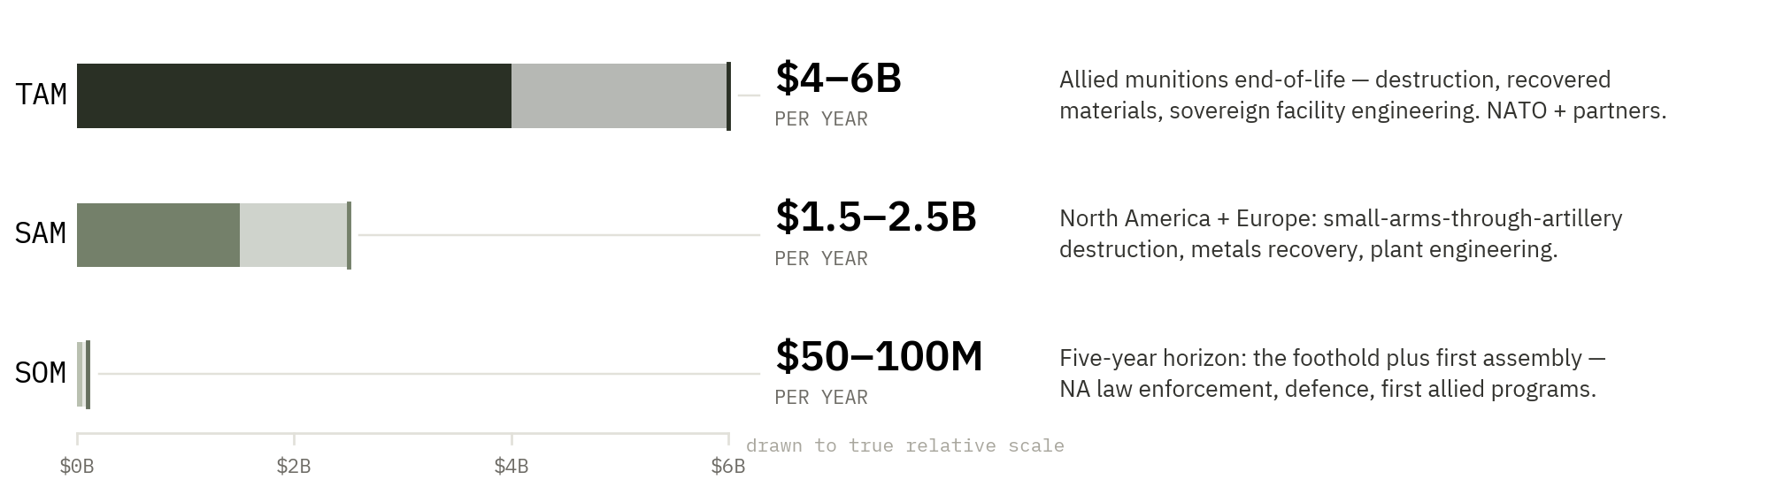
THE OPPORTUNITY — OUR CONSTRUCTION, EVERY ASSUMPTION ON THE PAGE
The end-of-life bill of a $2.88 trillion rearmament.
Three tiers, drawn to true relative scale. We are underwriting the sliver, in a market being built for us at record pace.¹⁷
HOW IT IS BUILT
WHY IT IS AVAILABLE
THE EPISODIC LAYER
Published demil rates⁶ applied to the allied stockpile that has to move, plus recovered materials and sovereign facility engineering. Every assumption is on this page.
No analyst covers this market. There is no index, no comparable set, no incumbent platform to be re-rated against. That is precisely why it is still purchasable at founder-scale multiples.¹⁷
Post-conflict recovery sits on top and is already priced: Ukraine's demining and explosive-ordnance requirement alone exceeds $30B.¹²
07 · TWB DESIGNS — CONFIDENTIAL
Notes:
The scale drawing does the work a table cannot: SOM is visibly a sliver of TAM, which is the honest shape of a venture case and pre-empts the 'your SOM is your TAM' objection before it is raised. Say plainly that this construction is ours — an uncovered market with no index is where category-defining returns live. Never let it be re-scored on tons per year.

Slide 8
ACT V — THE PLAN IS THE COMPANY
Assemble the platform: full service, one counterparty.
Not a machine business scaling a machine — a platform being assembled: the single counterparty an allied government calls for everything between “this must cease to exist” and “this is now material.” Three engines, run in parallel:
ACQUIRE
PARTNER
DEVELOP
4–7×
0
1
EBITDA¹⁷
imported today
standard to own
Buy the back of the lifecycle while it is cheap. Large-calibre & artillery demil · metals recovery · plant & equipment engineering · secure destruction for military and conflict customers.
Import what the industry never had. Robotics off the most dangerous work. Universities for sensing and materials science. Technologies from outside demilitarisation entirely.
Build what no one sells. Extend our destruction technology up the calibre ladder — plus the certification layer: auditable chain-of-custody records. Whoever owns the certificate owns the standard.
Capability categories only at this stage — the target work is done, named, and held for diligence.
08 · TWB DESIGNS — CONFIDENTIAL
Notes:
This is the venture slide — the story IS the roadmap. We are not selling a machine business; we are assembling the category. The acquisition homework exists as a ranked, contacted-ready shortlist; it stays out of circulating decks and comes out in diligence.

Slide 9
ACT V — THE PHASE LADDER
Foothold to full service in three phases.
1
2
3
NOW–18 MO
18 MO–3 YR
3–5 YR
Operate the foothold
Assemble the core
The sovereign full-service offer
Revenue from what runs today — custody destruction for law enforcement and defence, NA first, first allied programs. Cash, references and destruction data while the first acquisitions are negotiated.
First acquisitions — artillery demil and metals recovery — plus the first robotics and university partnerships. The platform starts selling capabilities no single firm ever could.
Design, build, operate and certify national munitions end-of-life capability inside allied borders — machines, plants, recovery, certification, post-conflict programs. One counterparty.
End state: when an allied nation decides ammunition must cease to exist, the call comes to us — and the property never leaves their custody on the way.
09 · TWB DESIGNS — CONFIDENTIAL
Notes:
Each phase funds and de-risks the next: Phase 1 cash and references price Phase 2 acquisitions; Phase 2 capability wins Phase 3 sovereign programs. The ladder is the use-of-proceeds logic — the ask slide sizes against it.

Slide 10
ACT VI — THE FOOTHOLD
We are not assembling from a whiteboard.
25
WHAT THE FOOTHOLD GIVES THE PLATFORM
The operating doctrine every acquired and developed capability will run on: same day, on site, the owner’s own people. Zero transfers. Recovered, not released. Nobody standing over live ordnance.
YEARS OPERATING — EMACS, IN SERVICE SINCE 2001, CO-DEVELOPED WITH THE RCMP¹⁶
Custody is the standard the whole catalogue inherits — and its data becomes the platform’s certification layer.
SCOPE
Small arms ammunition to .50 calibre · seized narcotics & property (LE)
FOOTPRINT
Everyone else moves the material. We move the machine — and soon, the whole capability set.
Canadian federal policing · US county LE · European defence disposal · allied militaries under NDA
REGISTER
Closed chamber — categorically not open burning under 40 CFR 260.10¹⁴
10 · TWB DESIGNS — CONFIDENTIAL
Notes:
One slide on the present, placed after the plan on purpose: proof we operate, not the story itself. 25 is the number that separates us from a slide deck — a quarter-century of custody destruction, references on three continents. Named references are ammunition work only; narcotics and seized property stated as capability, never as referenced past performance.

Slide 11
ACT V + VI — THE ASSEMBLED OFFER
1
→6
One counterparty. Six service lines.
Deployable destruction
OPERATING TODAY
Large-calibre & artillery demil
ACQUIRE
Mobile, on-site, same-day — inside the owner’s custody
The tonnage end of the market — up the calibre ladder
Materials recovery & reclamation
ACQUIRE
Plant & equipment engineering
ACQUIRE
Critical minerals returned to allied supply
Design-build of sovereign end-of-life facilities
Automated & unmanned processing
PARTNER
Certification & custody data
DEVELOP
Robotics and sensing over the dangerous work
The audit standard for the category
Governments already buy every line — separately, from single-capability vendors. The platform sells the lifecycle.
11 · TWB DESIGNS — CONFIDENTIAL
Notes:
The catalogue makes 'full service' concrete and shows the assembly logic at a glance — every line tagged by the engine that delivers it. Capability categories only; the named target work is held for diligence.

Slide 12
ACT VI — ALLIED BY DESIGN
Sovereignty is the product.
65
THE MARKET
NATO, the United States, Canada, Israel and partners — governments that buy sovereign capability, allied standing, and auditable custody.
ARMED CONFLICTS, 2025. NO GOVERNMENT WANTS ITS MUNITIONS — OR THE CRITICAL METALS INSIDE THEM — CROSSING BORDERS TO DIE²
THE STANDING
Canada is a DFARS 225.872 qualifying country — Canadian end products exempt from Buy American in US defence acquisition.¹³ Checkable, and underused. US entity planned; US-ready, allied-forward.
A domestic answer is the only politically survivable one. Sovereign custody, sovereign disposal, sovereign standing.
THE GIFT
Every allied ammunition plant opening today compounds future demand for the back of the lifecycle. Our market is being built for us, at record pace, by the largest industrial mobilisation since 1945.
12 · TWB DESIGNS — CONFIDENTIAL
Notes:
Allied-forward is a strategy, not a constraint: sovereign custody is what these governments are newly willing to pay for. Never claim US CAGE, small-business status, ATF FEL or DDTC registration — the DFARS qualifying-country line is the accurate, checkable version of US access.

Slide 13
THE MODEL
Paid to destroy. Paid for what returns.
$2,000–2,890
PER TON — THE PUBLISHED MARKET RATE FOR CONVENTIONAL DEMIL, TODAY (GAO FY15 / NAS)⁶
1 · THE FEE
2 · THE MATERIALS MARGIN
3 · THE NET COST
We don't need to beat this rate to win. Same-day, on-site, zero-transfer custody is a different product — not a discount on the incumbent's price.
Graded brass, copper and lead–antimony, sold into existing secondary markets at critical-minerals pricing — a revenue line the incumbents structurally can't capture.
Fee minus verified recovered value. The pricing argument no open pit and no fixed site can match — published once third-party verification lands.
Then it compounds up the plan: destruction fee → destruction + recovery contracts → sovereign build-operate-certify programs. Each phase adds a revenue layer without abandoning the last.
13 · TWB DESIGNS — CONFIDENTIAL
Notes:
Hold the discipline under questioning: never 'cheaper' in the gross — open burning runs ~$750/ton and wins any raw price race. The hero number is the market's own published rate, not ours — we're showing we don't need to win a price war to win the deal. No dollar-recovery tables until third-party verification of recovery rates publishes.

Slide 14
WHY NOW
Four clocks, all running. None of them re-opens.
4
01 · REARMAMENT
02 · REGULATION
Surge production is compounding allied stockpiles — today's shells are tomorrow's destruction queue.
The EPA is closing open burn / open detonation — 67 facilities targeted. The incumbent method is being outlawed in real time.⁸
03 · CRITICAL MINERALS
04 · SUCCESSION
Copper, lead and antimony repriced by policy — the output of destruction became strategic feedstock.¹¹
The founder generation that holds the capability is retiring — pricing the M&A at 4–7× EBITDA, for now.¹⁷
CLOCKS CONVERGING
Any one clock is a tailwind. All four at once is a category being born.
14 · TWB DESIGNS — CONFIDENTIAL
Notes:
The compounding is the point — each clock alone is an interesting trend; together they create a moment that will not repeat. Lead with '4' before naming them. This is the emotional peak before the ask.

Slide 15

Designs
Every war ends. Every stockpile ages. Every round, one day, must be unmade — inside its owner's custody, by the company that built the back of the lifecycle.
$2.88T
→
$0
SPENT MAKING IT, 2025
PLATFORMS TO UNMAKE IT
THE ASK — PLACEHOLDER, SIZED FROM THE PLAN
Raise, instrument and use of proceeds follow the phase ladder: acquisition capital at real multiples · partnership and development programs · working capital for first allied contracts. Reserved slides behind: milestones · team · references & past performance · financial model.
15 · TWB DESIGNS — CONFIDENTIAL
TWB DESIGNS INC. · HAMILTON, ONTARIO · A CLN COMPANY
Notes:
Close on the sentence AND the bookend numbers — return to slide one's contrast deliberately. V1/V2 leaves the ask open by design — the story earns the meeting; the number is set when the M&A math is locked. Then hand them the narrative document.

Slide 16
SOURCES & CITATIONS — 1 OF 2
Every number on the page, traceable.
Superscripts throughout the deck map to this list. Where a figure is our construction rather than a published one, it is labelled as such on the slide it appears.
1
SIPRI
6
US GAO / NAS
Trends in World Military Expenditure, 2025. SIPRI Fact Sheet, April 2026. World total US$2,887bn, constant 2024 prices; 11th consecutive annual rise.
US Government Accountability Office (FY2015) and National Academies of Sciences, Engineering and Medicine — published conventional demilitarization cost of approximately US$2,000–2,890 per ton.
2
UCDP / PRIO
7
LASD
UCDP–PRIO Armed Conflict Dataset v26.1 (Uppsala Conflict Data Program, 2026); Davies, Pettersson & Öberg, “Organized violence 1989–2025”, Journal of Peace Research, 2026. 65 state-based armed conflicts in 2025, the highest since records began in 1946. Regional series via Our World in Data.
Los Angeles County Sheriff’s Department — incident of 18 July 2025; three detectives killed while processing seized ordnance.
3
SIPRI
8
US EPA
SIPRI Arms Industry Database — Top 100 arms-producing and military services companies, 2002–24 workbook, retrieved December 2025. Constant 2024 US$. Regional totals aggregated by headquarters country — TWB calculation, not a SIPRI-published breakdown; reconciles to SIPRI totals within rounding.
Proposed rule, 89 FR 19952 — open burning / open detonation of waste explosives; 67 US facilities identified.
4
RHEINMETALL AG
9
INDUSTRY / AGENCY REPORTING
Publicly stated 155mm artillery ammunition capacity target of 1.5 million rounds per year by 2027.
Open burning / open detonation unit cost of approximately US$750 per ton.
5
US ARMY
10
MARKET & AGENCY REPORTING
Procurement of Ammunition, Army — President’s Budget justification books FY2018 through FY2027, budget line item 4099EP1700 (EP1700 in FY2018), “Conventional Munitions Demilitarization”. Each book states the tonnage held in the SMCA Resource, Recovery and Disposition Account (B5A) on a stated date; the ten snapshots charted run from end-FY2016 (471,767 tons) to 4 December 2025 (296,534 tons — 246,681 conventional, 49,853 missile components). Snapshot dates are irregular and are plotted at their actual dates. “Over 7,000 items” per Army AL&T, Fall 2024, and National Academies (2019).
Antimony: price move of approximately 2,600% since China’s export restrictions, past US$50,000/ton; US Department of Defense commitment to secure supply reported at approximately US$1bn.
16 · TWB DESIGNS — CONFIDENTIAL
Notes:
Leave these up during Q&A. The point is not that anyone reads them in the room — it is that the deck visibly survives being checked. If challenged on a number, go to the superscript, not to memory.

Slide 17
SOURCES & CITATIONS — 2 OF 2
Sources, continued.
11
US FEDERAL REGISTER
15
US DEPT. OF STATE
2025 US Critical Minerals List, 90 FR 50494 — copper, lead and antimony added.
Conventional weapons destruction assistance — in excess of US$4bn provided to partner nations since 1993.
12
WORLD BANK ET AL.
16
TWB DESIGNS
Ukraine Rapid Damage and Needs Assessment (RDNA4), February 2025 — demining and explosive-ordnance clearance requirement in excess of US$30bn.
Company record: eMACS in service since 2001, co-developed with the Royal Canadian Mounted Police. Deployment footprint and scope as stated.
13
US DFARS
17
TWB DESIGNS
DFARS 225.872 — Canada as a qualifying country; Canadian end products exempt from Buy American restrictions in US defence acquisition.
TWB analysis: TAM / SAM / SOM construction, sector M&A multiples (4–7× EBITDA; disclosed sector transactions 1.5–3.1× revenue), and the phase plan. Presented as our construction, not third-party research.
14
US CFR
18
US ARMY / PEO AMMUNITION
40 CFR 260.10 — definitions; closed-chamber destruction is categorically not open burning.
Demilitarization throughput: approximately 82,000 tons destroyed in FY2015 (PEO Ammunition, NDIA Global Demilitarization Symposium, December 2015). Funded plans from the same justification books: FY2023 28,568 tons; FY2024 41,566; FY2025 18,617; FY2026 29,313; FY2027 31,475 tons at $161.179M. Line-item funding fell from $235.1M (FY2021) to $161.2M (FY2027).
Discipline: no figure appears in this deck without a named source and a year. Derived figures are shown as ranges and labelled illustrative. Recovery-rate and net-cost economics are withheld until third-party verification publishes.
17 · TWB DESIGNS — CONFIDENTIAL
Notes:
Leave these up during Q&A. The point is not that anyone reads them in the room — it is that the deck visibly survives being checked. If challenged on a number, go to the superscript, not to memory.

