Slide 1

PAC-MAN by Olatomiwa Michael Shaibu

Slide 2
Brief History of Pac-Man
Designed by Toru Iwatani in 1980.
Designed to rival then sensations Space Invaders and Asteroids.
Originally Puck Man(English destruction of Japanese name Pakkuman).
Changed to Pac-Man to avoid defacement of arcade machines by changing the P to a F.
Made to appeal to girls and women.
Released by Namco.
Made to be antidote to overwhelming number of violent games at the time.
After rise to fame, many remakes were made including the sensation Ms. Pac-Man.

Slide 3
Goals/Objectives
I had planned to have a basic working game for the MVP/Oral Interview.
Basic Working meaning the game was playable i.e. the Pacman could collide with the ghosts, there was a score and the ghosts move about.

Slide 4
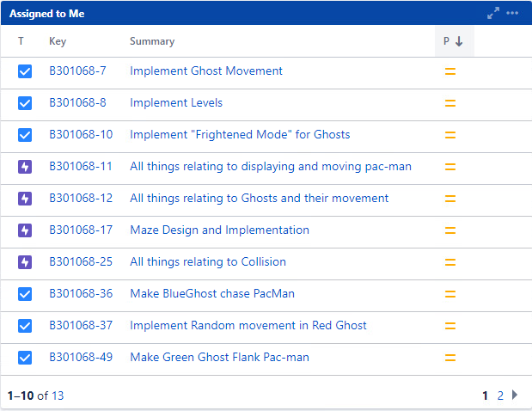
Plans for Development Of Pac-Man

Slide 5
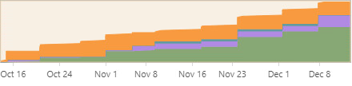

Progress

Slide 6
Links to Jira and GitLab
Jira : https://cseejira.essex.ac.uk/browse/B301068-55?filter=-4
In Jira I created epics for the Pac Man player, Ghosts, Collisions in the game and Maze design and implementation.
All user stories(gotten through feedback by having my housemates test the game) and tasks are linked to a corresponding epic.
Gitlab: https://cseegit.essex.ac.uk/ce301_21-22/CE301_shaibu_olatomiwa_m/-/tree/master/
I uploaded changes to my GitLab on a weekly basis and this is currently up to date with the code I have developed so far.

Slide 7
How I Went about Doing Tasks.
Spent 4-6 hours from Wednesday to Saturday every week researching ways to implement my ideas, finding the best method to use and then applying said method to my work.
Had a weekly meeting with my supervisor who helped me stay on course and helped me understand more of the research I had done.

Slide 8
Maze Design
I designed the maze by storing bitwise information of a box and using this to draw the maze, for instance, I used the number 2 to signify a top border and wherever the number 2 showed up I drew a top border.
Number | Significance
1 | Left Border
8 | Bottom Border
4 | Right Border
16 | Pellet
32 | Power Pellet
2 | Top Border

Slide 9
Maze Design
I also used the numbers 16 and 32 to signify if the current box had a pellet or power pellet in it. Anywhere the number 16 showed up I drew a yellow dot(pellet) and anywhere the number 32 showed up I drew a white dot(power pellet).

Slide 10
Pac-Man and Ghost Movement
I passed the maze class into the Pacman and Ghost classes so I could make use of one single maze.
I used the same bitwise information to restrict the movement of both the ghost and Pacman.
If there was a number 2, it meant there was a top border which meant that no one could go upwards where a number 2 was present and same goes for all the other borders.
For one of the ghosts(red), I simply mad him move about randomly by using a random number generator between 1 and 4(up, down, left, right).

Slide 11
Pac-Man and Ghost Movement
For another ghost(blue), I stored the current location(coordinates) of Pacman and made said ghost move towards Pacman in a chasing manner.
For the third ghost(green), I stored the current location(coordinates) of Pacman and tried to make said ghost flank Pacman by taking the longer distance to Pacman. This does not work perfectly and I am currently still trying to fix it.
When Pac-man collides with any of the ghosts, the characters are set to their initial positions and Pacman loses a life.
If Pacman loses all lives, the game is lost.

Slide 12
Pellets and Power Pellets
I made Pacman be able to swallow the pellets by removing said pellets from the screen when the pellets collided with Pacman.
When such collision happens, the pellets are swallowed and Pacman’s score is increased.
As of now, the power pellets have no functionality when swallowed but are still removed from the screen when swallowed.

Slide 13
Plans for the Future
I hope to finish the implementation of the ghost that flanks Pacman.
I hope to implement a fourth ghost that runs away from Pacman.
I hope to implement a way to pause the game.
I hope to give the power pellets functionality i.e. when Pacman eats the power pellets he can then eat the ghosts without dying.
If time permits I hope to implement other levels.

Slide 14
How Will I get Feedback??
I have two housemates who I would be regularly getting to play the game as I develop so that I can get feedback on what to improve.
I also plan to have a group of friends play the game and have them fill out an anonymous questionnaire to help me get feedback.

Slide 15
References
M. Ernkvist, History of Insolvancy and Bankruptcy, 2008.
D. M. Partridge, "22 May 1980: Pac-Man hits the arcades," moneyweek.com, 2015.
S. M. Lammers, Programmers at Work: Interviews, New York: Microsoft Press, 1986.
"Top 25 Smartest Moves in Gaming," Gamespy.com, 18 February 2009. [Online]. Available: https://web.archive.org/web/20090218003840/http://archive.gamespy.com/articles/july03/25smartest/index6.shtml.
C. Kohler, Power-Up: How Japanese Video Games Gave the World an Extra Life, 2005.
"The Essential 50 Part 10 -- Pac-Man from 1UP.com," 1Up.com, 3 October 2015. [Online]. Available: https://web.archive.org/web/20151003105413/http://www.1up.com/features/essential-50-pac-man.
P. Jamey, The Pac-Man Dossier, Gamasutra, 2009.
R. Purchese, "Iwatani:Pac-Man was made for women," Eurogamer, 20 May 2010.
[Online]. Available: http://web.eecs.utk.edu/~bvanderz/teaching/guiSp13/notes/display-mgt/.
M. Mateas, "Expressive AI: Games and Artificial Intelligence," Georgia Tech, 2003.
D. Hodges, "Pac-Man's Ghost Behaviour Analyzed," 30 December 2008. [Online]. Available: http://donhodges.com/pacman_pinky_explanation.htm.
"Game Internals- Understanding Pac-Man Ghost Behavior," 2 December 2010. [Online]. Available: https://gameinternals.com/understanding-pac-man-ghost-behavior.

