Slide 1
GPU Acceleration of Community Detection using Label Propagation (CDLP) Algorithm
Nachuan Wang, Xiwei Wang, Zhongbo Zhu, Zheyuan Zhang
Notes:
Talk about how we can utilize artificial general intelligence to assist out study and academic research

Slide 2
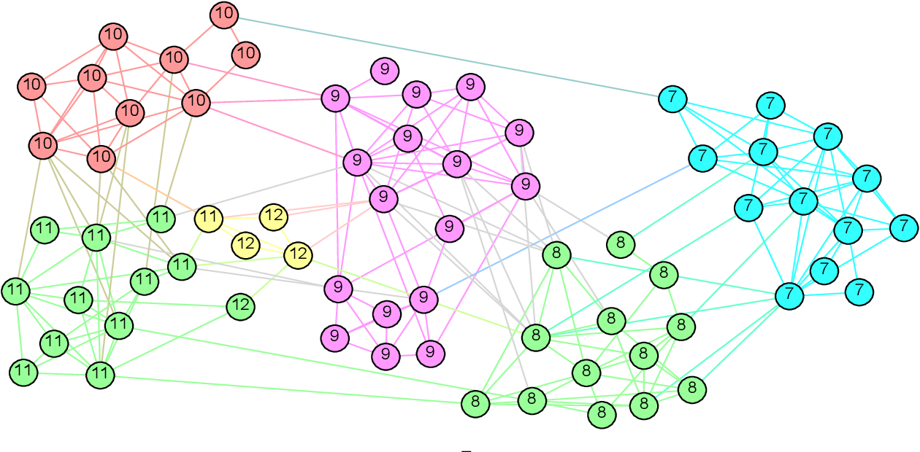
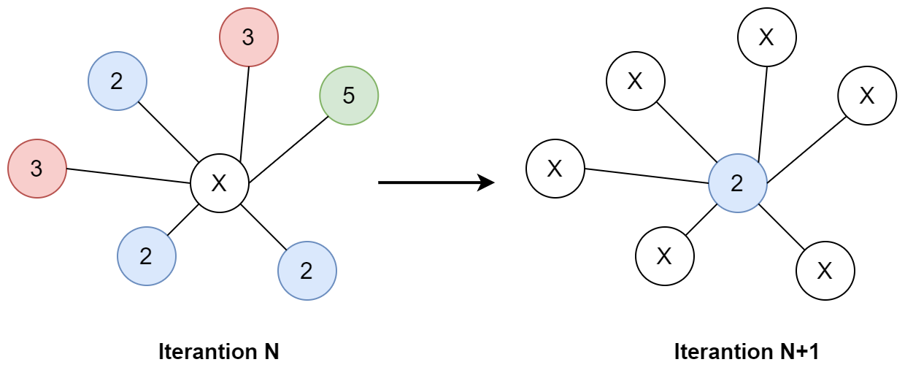
CDLP Algorithm
Each node in a graph is initially assigned a random label
Let label propagate across node until convergence
To find tightly connected communities in graph

Slide 3
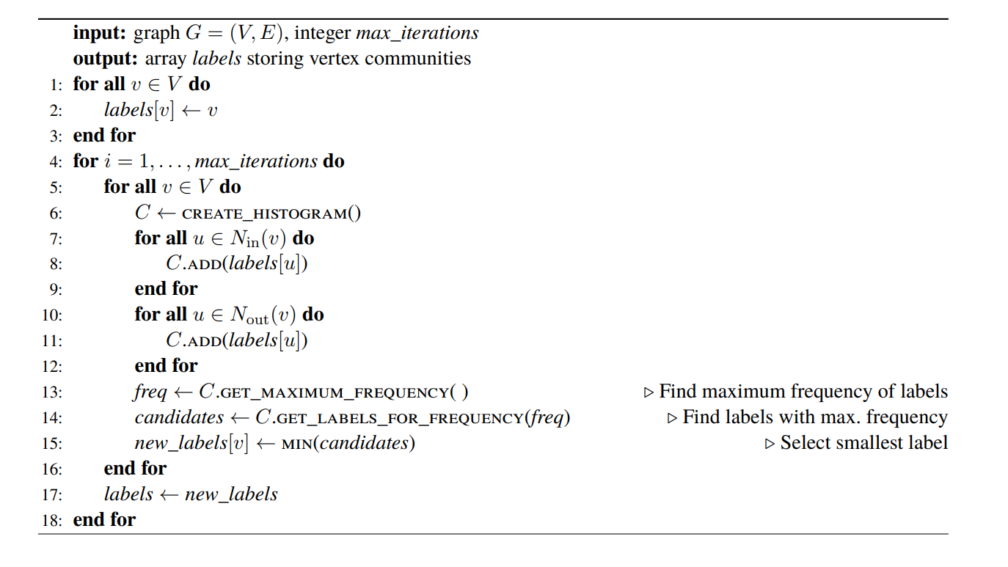
CDLP Pseudo Code
Each node does a histogram over its neighbors

Slide 4
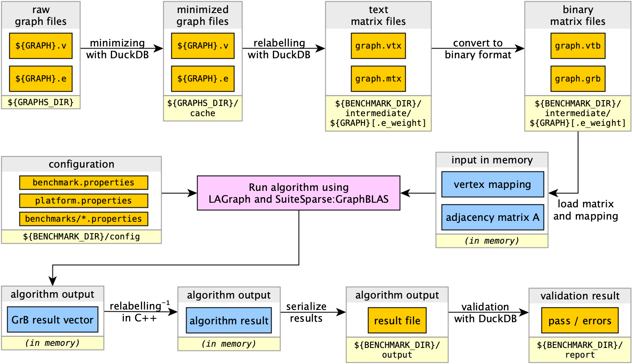
Workflow
Deep integration with LDBC Competition's test framework.
Built Docker image for local PCs and rai server.
Benefits: standard format of input, output and data structure.

Slide 5
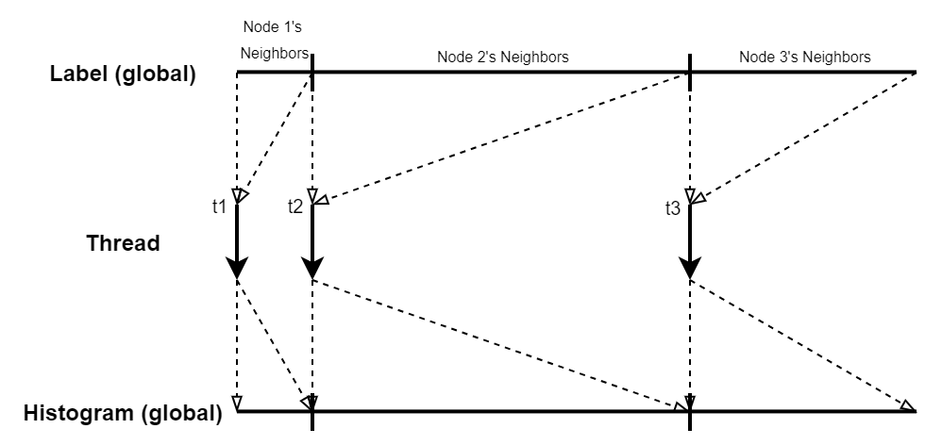
Baseline
Each thread work on one node
Count labels’ frequencies using a histogram, looking for maximum number meanwhile
Histogram size determined by number of neighbors
Parallel over source nodes, and sequentially build histogram in one thread

Slide 6
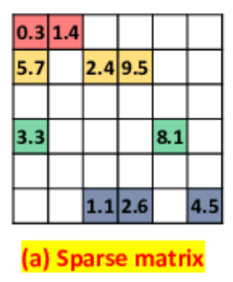
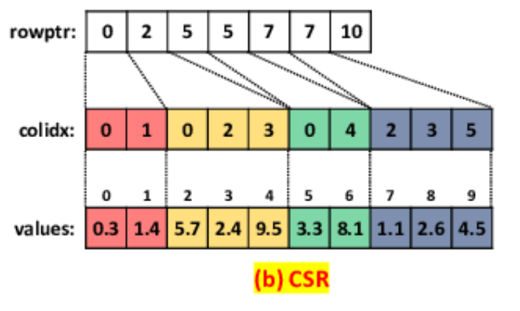
Our Innovation In Baseline
Doing histogram in CDLP is non-trivial, need to use hashing in CUDA!
The label's value range can be very sparse, like 3, 10, 10000, 20000
Innovation: lock free linear hash table can be used to accumulate label frequencies.
Lock free: each source node has its own dedicated memory region specified by row pointer
Linear hash table: use linear probing to resolve hash conflicts, allocate 2x hash table slots for less collision

Slide 7
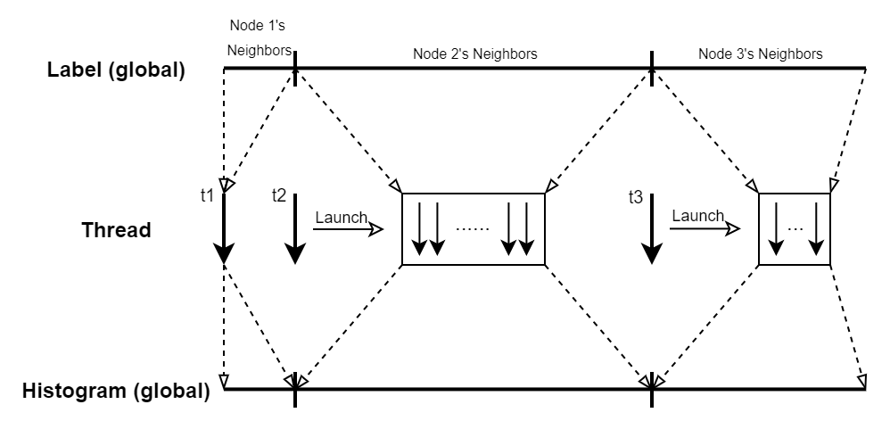
Dynamic Parallelism
Dynamically launching new kernel based on the number of neighbors
Many atomic operations
Operations nearly serialized at convergence

Slide 8
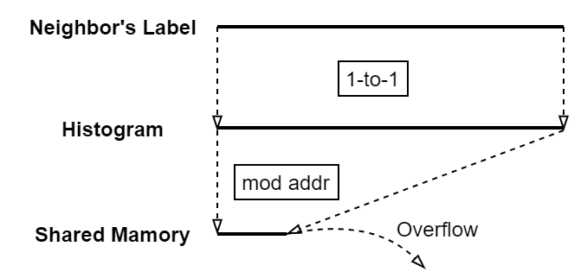
Dynamic Parallelism with Hashing
Observation: labels quickly converge to a small set after several iterations
Threads update small fraction of memory addresses with high frequency
Would be good if we can put them to shared memory
However, histogram is indexed using label (which is just an integer)
Statistically, labels are uniformly distributed across the histogram
But we want to group them to a small piece of shared memory
So……hashing!
Map large memory space to small memory space
Use linear probing to resolve index conflictions
Maintain a utilization value of shared memory
Only small fraction of counters overflow to global memory
Notes:
Histogram size should equal to # neighbors, since worst case each neighbor has its own label

Slide 9
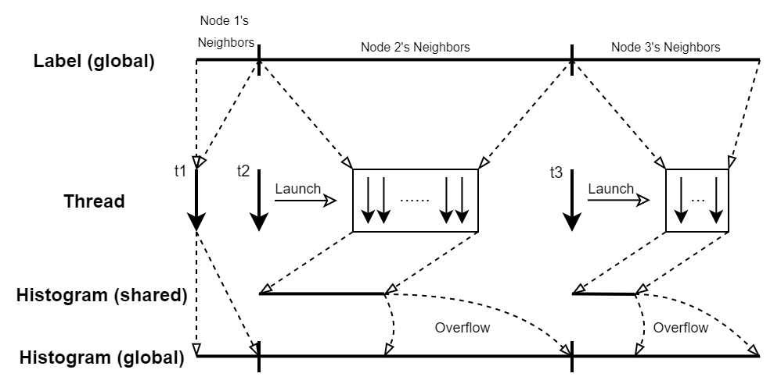
Dynamic Parallelism with Hashing
Shared memory size proportional to dynamic kernel size
Now most memory write goes to shared memory

Slide 10
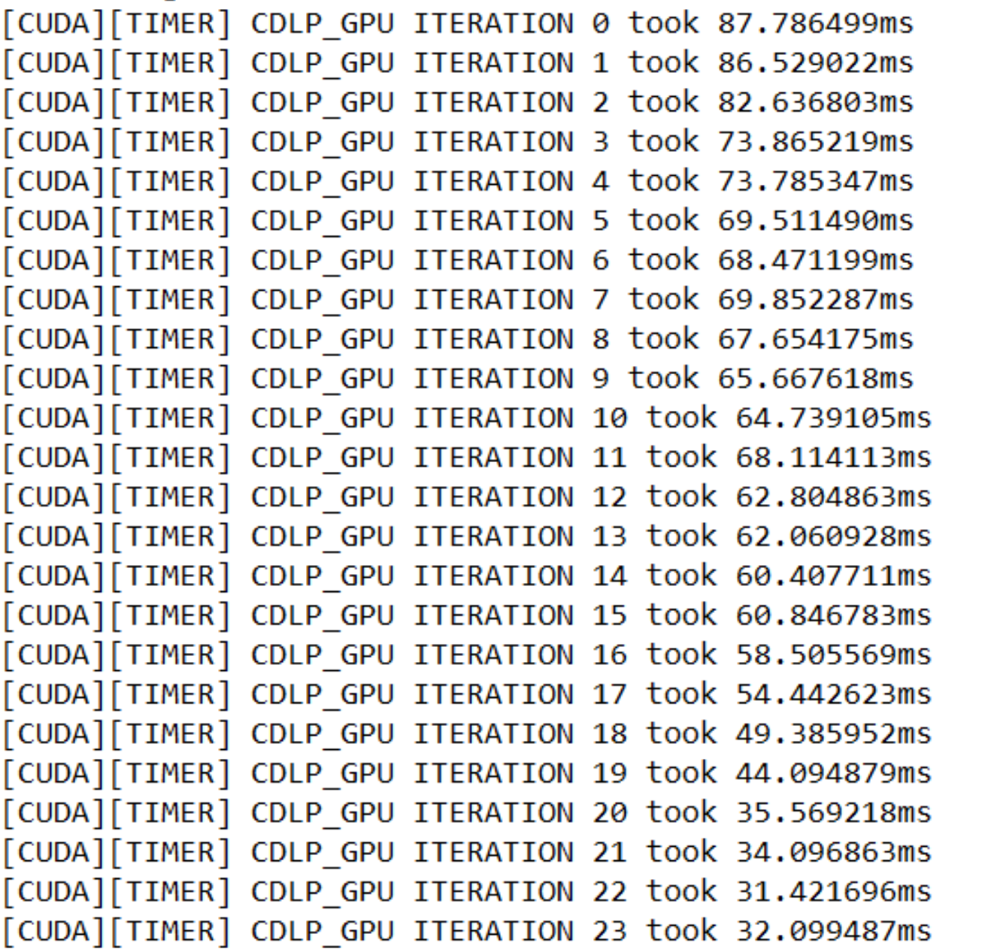
Evaluation
Dataset datagen-7_5-fb:
Num vertices: 633432
Num edges: 34185747
Directed: false
Default Iteration: 10
Performance:
Before GPU: 20s~21s
Baseline without Hashing: 7s
With Hashing: 600ms
Hashing itself bring nearly 12x performance increase

Slide 11
Challenges & Future Work
Challenges:
Having multiple threads doing histogram introduce atomic operations, even with shared memory, the performance drop is significant
Shared memory can be used up very quickly, then we overflow to global memory
Profiling tools are hard to use together with the LDBC benchmark framework (written in java, execute benchmark by opening subprocesses)
Parameters for dynamic kernels with hashing are hard to tune
Future Work:
Think about better lock-free design
Need more fine-grained profiling
Need to understand how to avoid shared memory overflow

Slide 12
Thank you! Questions?

