Slide 1

Data Structures & Algorithms using C++ (PRG102) Railway Management System

Slide 2
Index
Data structure used
Passenger stack
Insertion in passenger stack
Printing stack of passenger
Train stack
Enter data in train stack
Deletion of train stack using pop function
C++ code screenshot

Slide 3

Data structure used
Data structure - Stack
In menu option of stack
1) Passenger
2) Train
3) Exit

Slide 4
Passenger Stack
1) Insert
2) Delete
3) Print
4) Quit

Slide 5
Insertion in Passenger Stack
1) Passenger ID
2) Passenger Name
3) Passenger Age
4) Passenger Seat Number
5) Passenger Reservation Status

Slide 6
Printing stack of passenger
1) ID
2) NAME
3) AGE
4) SEAT NUMBER
5) RESEVATION OF STATUS

Slide 7
Train Stack
1) Insert
2) Delete
3) Print

Slide 8
Enter data in train stack
1) Train number
2) Train name
4) Arrival time
5) Departure time
5) Availability Seats

Slide 9
Deletion of Train stack Using pop function
Printing train stack
1) Train Number
2) Train name
3) Arrival Time
4) Departure time
5) Availability of seats

Slide 10
C++ code Screenshot

Slide 11
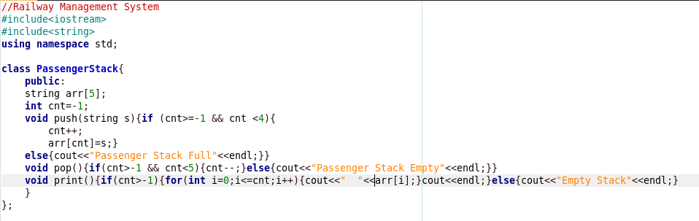

Slide 12
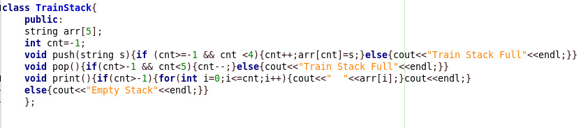

Slide 13
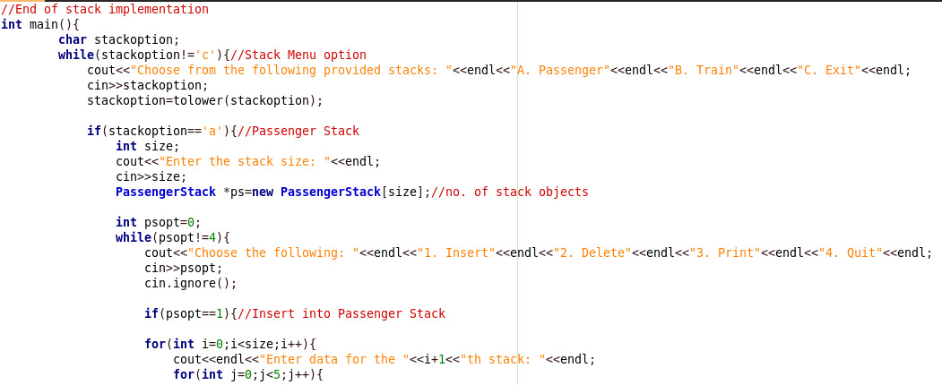

Slide 14
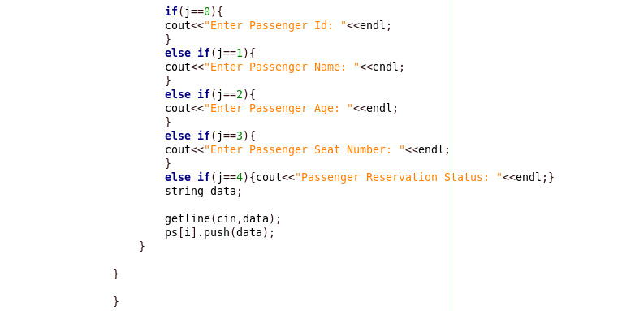

Slide 15
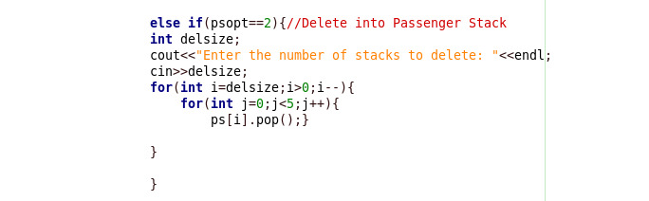

Slide 16
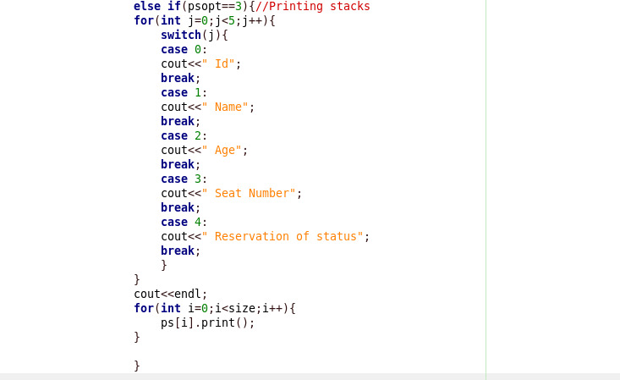

Slide 17
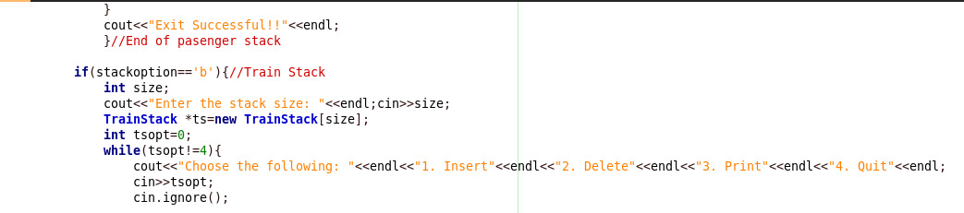

Slide 18
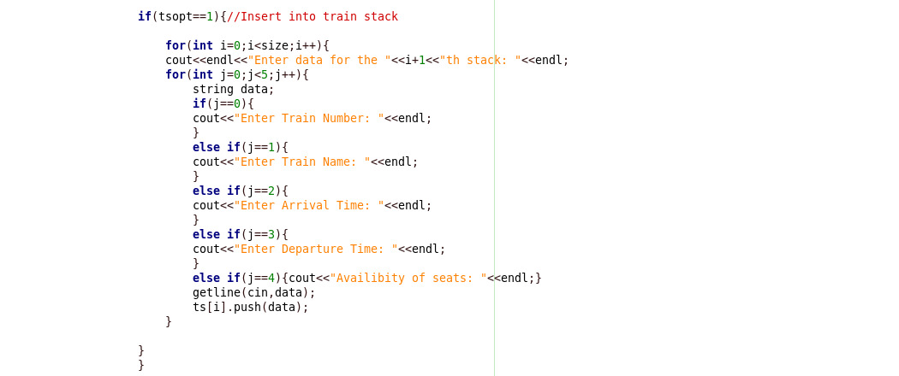

Slide 19
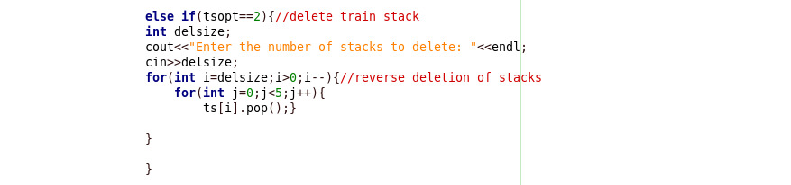

Slide 20
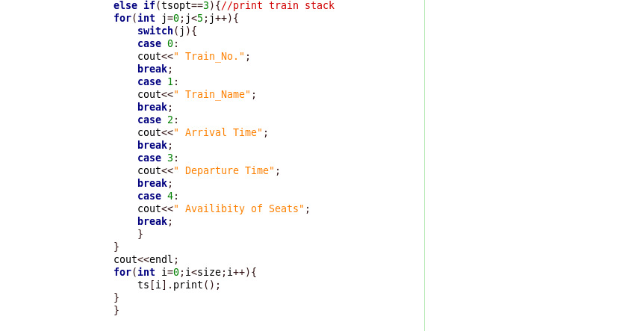

Slide 21
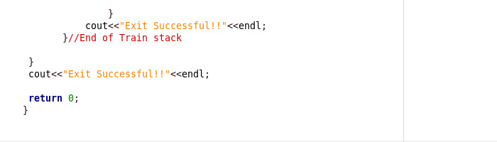

Slide 22
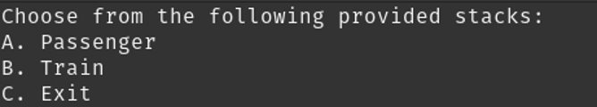
Code Output

Slide 23
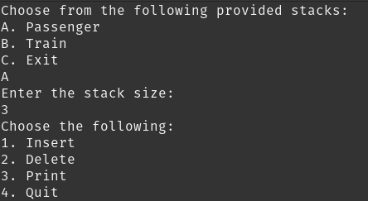

Slide 24
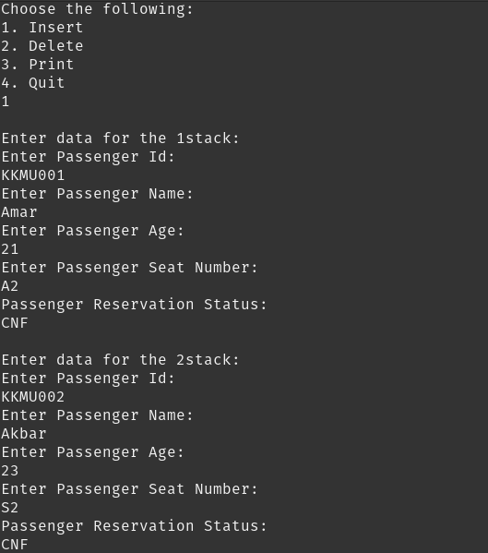

Slide 25
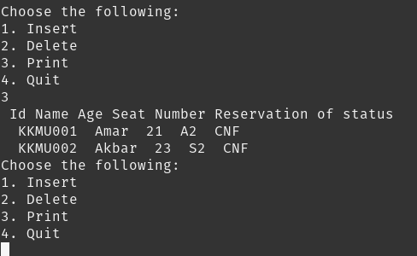

Slide 26
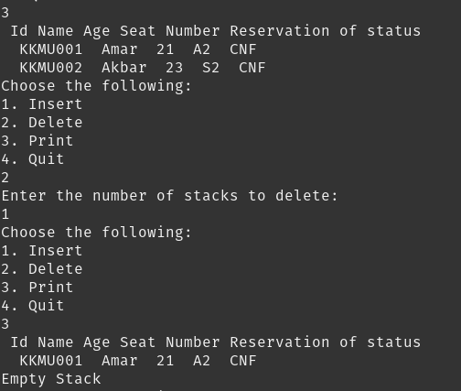

Slide 27
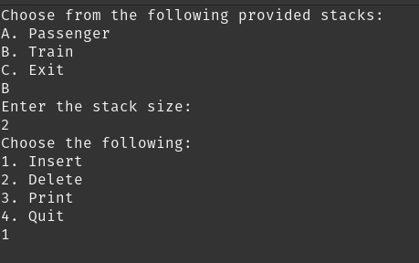

Slide 28
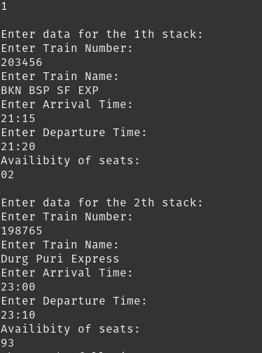

Slide 29
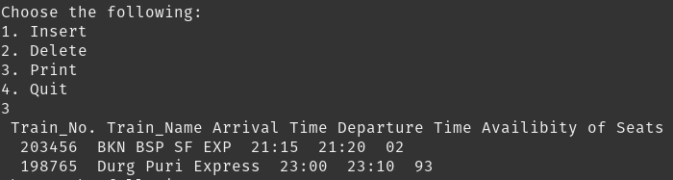

Slide 30
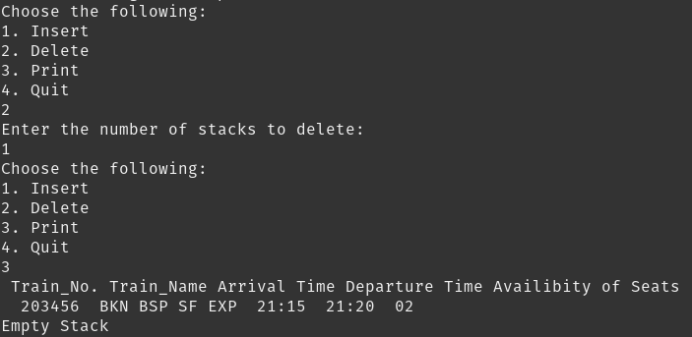

Slide 31


