Slide 1

Group 5
Civil Engineering Department
黃琮煒
R10521606
周遠同
R10521608
江郁瑄
R10521605
馮意凡
R10521609

Slide 2
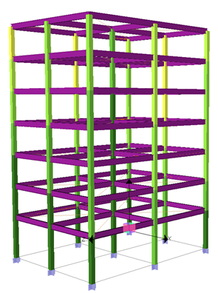
Motivation & Background
Structural Design
Structural design is a continous iterative process, which takes engineers lots of time and effort. The design is hard to be optimized due to the time-consuming structural analysis. However, our ongoing research can speed up the analysis process using AI.
Hence, without the high cost in structural analysis, we find the potential using AI to optimize the structure design in terms of economical material usage and sufficient seismic resistance.
Design structure elements’ sections
Result Evaluation
Structural Analysis
Improve the design based on analysis results
Compute response under earthquakes

Slide 3
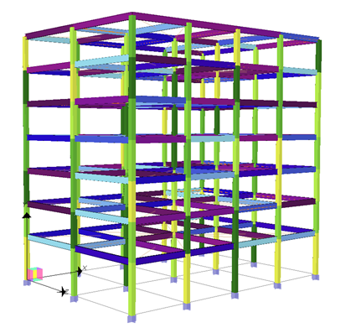
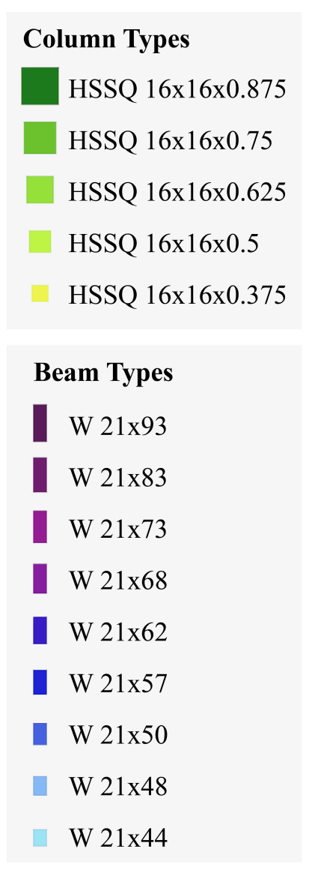
Target Problem
We form the structural design problem as a series of searching decisions, where
each beam/column should have 1 section type assigned
the most important elements (ex: 1F columns) will be decided first
we can get a design score after all elements are assigned with a section type
the design score can be used to improve the design in the next round

Slide 4
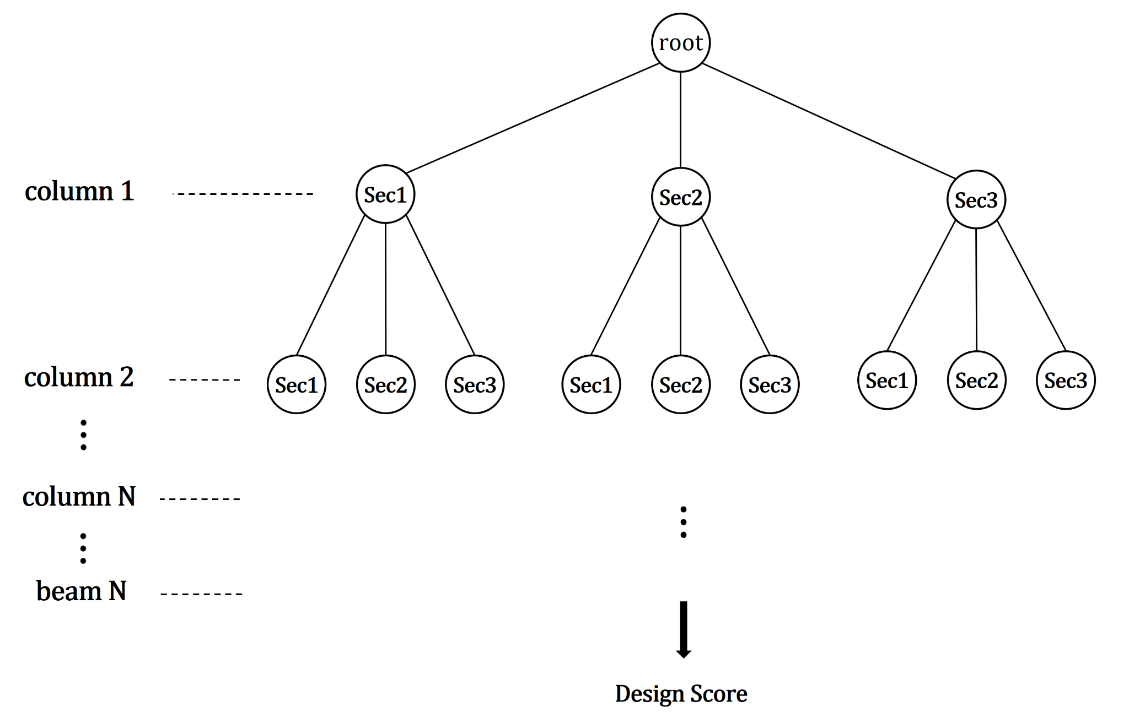
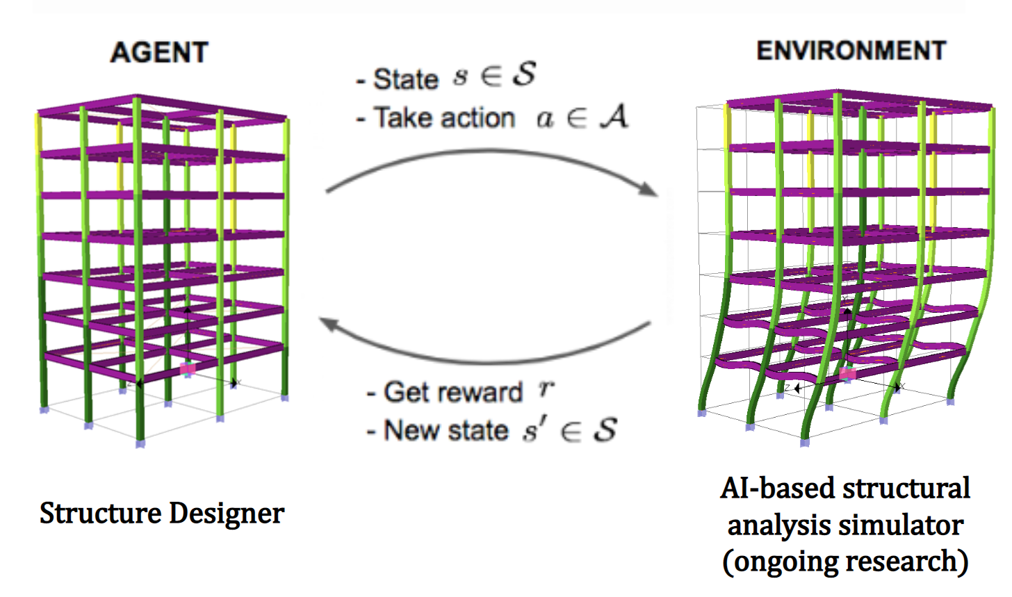
Proposed Solution
We propose using the following methods to make a series of structure section design:
Monte Carlo Tree Search
Genetic Algorithm
Reinforcement Learning
Using RL to optimize structure design
Using MCTS to get good design candidate

