Slide 1
Agent & Environment
CAE碩一 周遠同
指導教授：陳俊杉

Slide 2

Environment (StructureSimulator)
from Searching import Environment
env_args = {"simulator_path": XXX, "ground_motion_number": 5,
"method": "MCTS"}
env = Environment . StructureSimulator(**env_args)

Slide 3
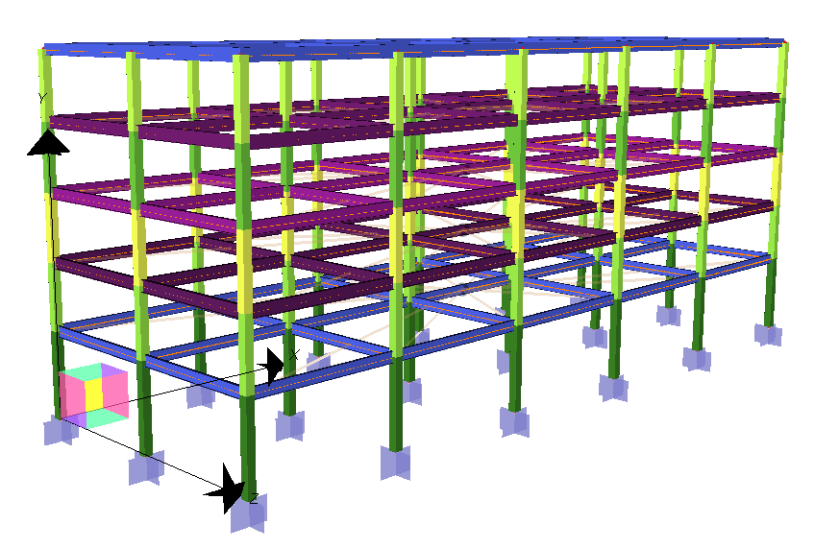
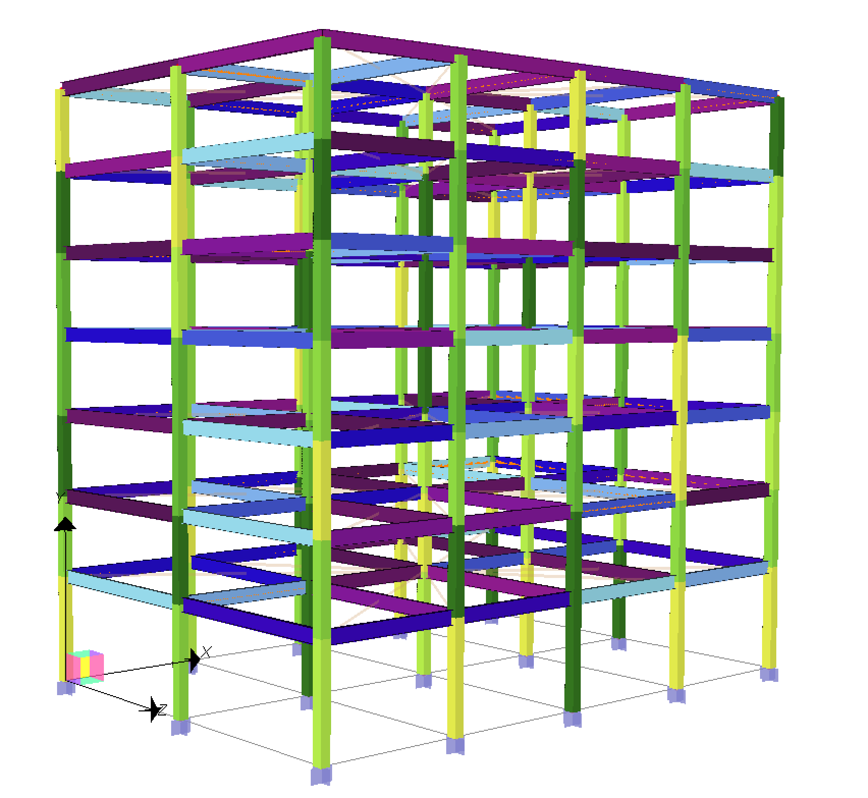
Agent (StructureDesigner)
from Agent import StructureDesigner
agent_args = {"mode": "story”, “environment”: env}
agent = Agent . StructureDesigner(**agent_args)
mode = “story”
mode = “element”

Slide 4
Agent
state : [1F_col, 2F_col, …, 1F_X_bm, 1F_Y_bm, 2F_X_bm, 2F_Y_bm…]
state_index: [ 0, 1, …, 6, 7, 8, 9, …]
agent.initialize_state()
agent.get_state() → ['16x16x0.375‘, '16x16x0.375‘, …, ‘W21x44’, ‘W21x44’]
agent.steps() → how many sections need to design
agent.get_state_index() → index which col/bm you are designing
agent.available_actions(state_index) → ['W21x93', 'W21x83', … , 'W21x44']
agent.take_action(action) → state_index will + 1
agent.is_final_state() → return if final state, if yes, don’t take action more
agent.get_design() → return the section list for all element (if ‘element’ mode, then it will be same as agent . get_state(), but are different in ‘story’ mode)

Slide 5
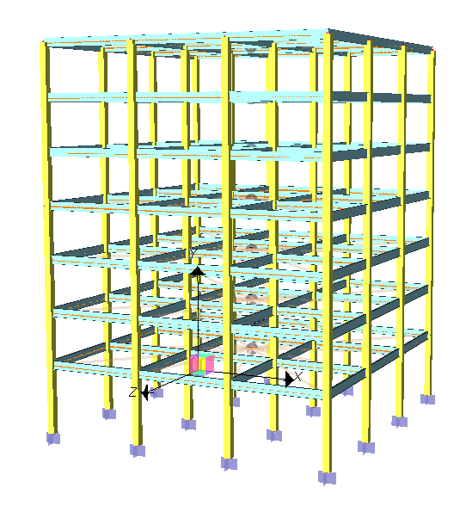
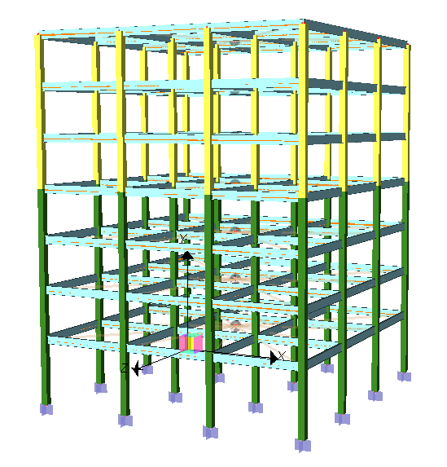
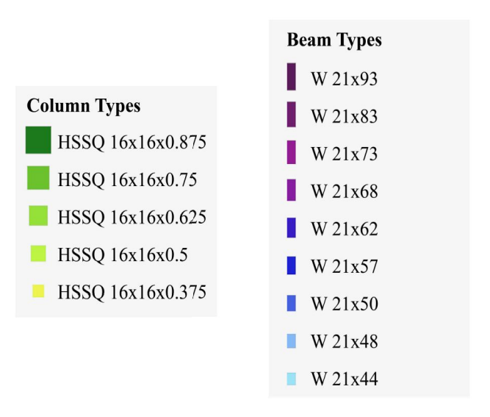
Score of the design
score = env . score(agent, agent.get_design())
Currently because the simulator model is still training, I modified the score to be only evaluated by material usage, and using more material will get higher score. You can use this simple mechanism to test your RL model first. Sorry ☹
improve

Slide 6
Output final design & response
if agent.is_final_state():
agent.output_design() → In Files/Output/Method/Time/design.ipt
or
final_design = agent.get_design()
agent.output_design(final_design)
agent.visualize_response() → In Files/Output/Method/Time/Response/
or
agent.visualize_response(final_design)

Slide 7
Thanks for listening!

