Slide 1
Large Language Models and Argumentation
A corpus linguistics study of the use of linking adverbials in argumentative essays generated by Large Language Models
Giovanna Tonazzo
Notes:
ID=d924773e-9a16-4d6d-9803-8cb819e99682 Recipe=text_billboard Type=TextOnly Variant=0 FamilyID=AccentBoxWalbaum_Zero

Slide 2
Introduction
Large language models (LLMs) have made significant advancements in generating human-like text, exhibiting impressive fluency and coherence.
Companies are increasingly integrating LLMs into their business processes and many face a critical decision when selecting an appropriate LLM, particularly whether to opt for open-source or proprietary (closed) models. This choice can significantly impact factors such as cost, customization, and data privacy.
However, LLMs are fundamentally statistical models designed to predict and generate text based on patterns they learn from data, which raises questions about their abilities in tasks that involve logical thinking.
For these reasons, argumentative writing can be challenging for LLMs, as it aims to persuade an audience by presenting reasons and evidence to support a particular claim or position.

Slide 3
Introduction
The aim of this research is to compare human-written argumentative essays with essays generated by LLMs and to analyze differences in argumentative writing across various LLMs.
The research focuses on the use of linking adverbials, which play a crucial role in establishing logical connections and cohesion within argumentative essays.
The research follows a corpus linguistics approach to ensure empirical, objective, and quantitative results. A qualitative approach is used to address specific questions.
Code and data available at github.com/tonazzog/LLM_Argumentation/

Slide 4
Agenda
Background
Relevance and limitations
Research questions
Methodology
Results
Discussion
Conclusion

Slide 5
Background
Cohesion and Coherence

Slide 6
Cohesion and Coherence
In the study of discourse in general, and of argumentative discourse in particular, the concepts of coherence and cohesion are fundamental to understanding how texts are structured and how meaning is conveyed [Halliday and Hasan, 1976]
Coherence
refers to the overall sense of unity and logical flow within a text
abstract quality that emerges when all parts of a text work together to create a meaningful whole
guides the reader through the argument or narrative in a way that is clear and easy to follow
achieved through the logical arrangement of ideas and the clear development of themes
uses implicit connections that allow readers to understand the relationships between different parts of the text

Slide 7
Cohesion and Coherence
Cohesion
refers to the linguistic devices and grammatical structures that link sentences and parts of the text together
it is about the surface connections between words, phrases, and clauses that create a sense of unity
is concerned with the formal links between elements in the text, ensuring that it is linguistically connected
occurs where the interpretation of some element in the discourse is dependent on that of another
is achieved through the use of cohesive devices

Slide 8
Cohesive Devices
[Halliday and Hasan, 1976] identify several types of cohesive devices, including:
Reference: using pronouns or other referring expressions to link parts of a text (“John went to the store. He bought some milk”)
Substitution: replacing a word or phrase with another word to avoid repetition (“I need a pen. Do you have one?”)
Ellipsis: omitting part of a sentence because it is understood from the context. “I’ll take the first bus, and you [take] the second.”
Conjunction: using linking words (such as “and”, “but”, “therefore”) to connect sentences or parts of sentences.
Lexical Cohesion: the repetition of words, synonyms, or related words to create connections between parts of the text. “The cat sat on the mat. The feline seemed content.”

Slide 9
Conjunctions
Conjunctions are crucial for creating cohesion in a text because they explicitly signal the relationships between different parts of a text, guiding the reader through the logical structure of the argument. [Halliday and Hasan, 1976] categorize conjunctions into several types based on the kind of relationship they establish between ideas:
Additive conjunctions add information or ideas. Examples: and, furthermore, moreover, in addition, besides (“She enjoys reading and writing.”)
Adversative conjunctions introduce a contrast or opposition between ideas. Examples: but, however, on the other hand, nevertheless, yet. (“The weather was terrible, but we decided to go hiking anyway.”)
Causal conjunctions express a cause-and-effect relationship. Examples: because, therefore, so, thus, consequently, hence. (“He studied hard for the exam, so he passed with high marks.”)
Temporal conjunctions indicate the timing or sequence of events. Examples: then, next, after that, before, meanwhile, finally. (“First, we went to the museum. Then, we had lunch.”)

Slide 10
Linking Adverbials
Biber uses the term "linking adverbials" to describe words or phrases that function similarly to Halliday's conjunctions [Biber et al., 1999, pp 765, 875]:
“those adverbials that serve to connect two stretches of discourse”
they “make explicit the relationship between two units of discourse” and are therefore “important devices for creating textual cohesion”
their main function is “to state the speaker/writer's perception of the relationship between two units of discourse” and “to make semantic connections between spans of discourse of varying length”
Biber’s classification of linking adverbials is based on the corpus analysis of how these adverbials function in actual usage.

Slide 11
Comparison between conjunctions and linking adverbials
Analogies:
both classifications deal with how ideas are connected in discourse, with significant analogies in their functional categories (e.g. additive, adversative, …).
Differences:
Biber uses the term "linking adverbials" to emphasize their role as standalone elements (usually at the beginning of a sentence or clause), while Halliday talks about "conjunctions" more broadly, including within-clause connections.
Biber addresses the issue of the meaning of linking adverbials: they should be viewed as meaning markers that contribute to discourse cohesion by indicating how the reader should interpret information that follows in light of what has preceded it.

Slide 12
Classification of Linking Adverbials
Category | Function | Examples
Enumeration and Addition | enumeration of pieces of information in an order chosen by the speaker/writer addition of items of discourse to one another | enumeration: first(ly), second(ly), next, first of all addition: in addition, similarly, also, furthermore, likewise, moreover
Summation | show that the unit of discourse is intended to conclude or sum up the information in the preceding discourse | in sum, to conclude, all in all, in conclusion, overall, to summarize
Apposition | show that the second unit of text is to be treated either as equivalent to or included in the preceding unit; the second unit can be a restatement of the first, reformulating the information it expressing some way or stating it in more explicit terms an example, and it is presented as information that is in some sense included in, rather than exactly equivalent to, the previous text | which is to say, in other words, that is, e.g., for example, for instance, namely, specifically

Slide 13
Classification of Linking Adverbials
Category | Function | Examples
Result/ inference | show that the second unit of discourse states the result or consequence - either logical or practical - of the preceding discourse | result: therefore, consequently, thus, so Inference: then
Contrast/ concession | contrast: can mark incompatibility between information in different discourse units concession: can mark concessive relationship, showing that the subsequent discourse expresses some reservation about the idea in the preceding clause | contrast: on the other hand, in contrast, alternatively concession: though, anyway, anyhow, besides, nevertheless, after all
Transition | mark the insertion of an item that does not follow directly from the previous discourse; the new information is not incompatible with what it is linked to, but rather it is only loosely connected, or unconnected. | by the way, incidentally

Slide 14
The interactive role of linking adverbials
Linking adverbials are an important part of Hyland’s [Hyland, 2018] theory of metadiscourse. Metadiscourse is the language that signals the writer's or speaker's attitude towards the content, their relationship with the audience, and the organization of the discourse. It acts as a guide to the reader or listener, helping them navigate the text and understand the intended meaning. Hyland distinguishes between
Interactive metadiscourse: concerns the ways in which writers organize their discourse to make it coherent and easy for readers to follow. It includes elements like transitions, frame markers, endophoric markers, evidentials, and code glosses.
Interactional metadiscourse: involves engaging with the reader, including the writer's stance, engagement with the audience, and how the text reflects the relationship between writer and reader (includes hedges, boosters, attitude markers, etc.)
Linking adverbials fall within the category of interactive metadiscourse. In this framework, linking adverbials are key tools that writers use to manage the flow of ideas and to interact with the readers, ensuring that they can follow the logical progression of the text.
Notes:
Interactive: Help to guide reader through the text
Transitions: express semantic relation between main clauses (in addition / but / thus / and)
Frame markers: refer to discourse acts, sequences, or text stages (finally / to conclude / my purpose is)
Endophoric markers: refer to information in other parts of the text (noted above / see Fig / in section 1)
Evidentials: refer to source of information from other texts (according to X / (Y, 1990) / Z states)
Code glosses: help readers grasp meanings of ideational material (namely /e.g./such as / in other words)
Interactional: Involve the reader in the argument
Hedges: withhold writer’s full commitment to proposition (might / perhaps / possible /about)
Boosters: emphasize force or writer’s certainty in proposition (in fact / definitely / it is clear that)
Attitude markers: express writer’s attitude to proposition (unfortunately / I agree / surprisingly)
Engagement markers: explicitly refer to or build relationship with reader (consider / note that / you can see that)
Self mentions: explicit reference to author(s) (I / we / my / our)

Slide 15
Relevance and Limitations

Slide 16
Limitations
The aim of this research is to compare the use of linking adverbials in human-written argumentative essays with essays generated by LLMs. These cohesive ties help to create a connected and unified text, which is a fundamental aspect of coherence
…but cohesion does not always imply coherence: a text can be cohesive without being coherent if the ideas don't make logical sense together, or if the reader cannot easily follow the intended meaning. For instance, a text might use cohesive devices but still be confusing or illogical due to poorly structured arguments or irrelevant content.
Some studies (i.e. [Appel & Szeib, 2018]) have shown that L2 learners tend to overuse linking adverbials to “to impose surface logicality on a piece of writing where no deep logicality exists”.
Cohesion does not always imply coherence…

Slide 17
Limitations
Other studies have shown that there is a correlation between the use of cohesive ties and coherence.
[Weiss et al., 2019] observe the correlation between measures of lexical, syntactic and discourse complexities to the essay gradings in high-school examinations.
[Somasundaran et al. 2018] use discourse markers to evaluate the story-telling aspect of student writing and show that discourse markers can be used to measure the coherence quality of a text.
In this research we will consider linking adverbials as an indicator of coherence in argumentation.
… but there is a correlation

Slide 18
Relevance
[Tudino & Qin, 2023] write that “the inquiry into AI and ChatGPT’s role in academia predominantly centers on ethical and authenticity concerns”.
Significant portion of the literature is dedicated to the ethical issues emerging from the model’s utilization and the threats associated with large language models and their impact on academic works’ authenticity and credibility (i.e. [Sardinha, 2024] compares human written and LLM generated text focusing on authorship problems).
Considerable attention is devoted to content (i.e. [Hinton & Wagemans, 2023] study the quality of argumentative texts produced by GPT-3 ), whereas “form” (intended as the AI-generated-texts linguistic resemblance to human writing) remains largely unexplored.
This suggests the need for further in-depth investigation into the linguistic characteristics and patterns of AI-generated academic prose to determine whether ChatGPT effectively emulates human writing also in terms of language choices.
We know little about the linguistic and dialogical differences of argumentation between AI and human written texts

Slide 19
Related work
Two papers investigate into the linguistic characteristics and patterns of AI-generated texts.
[Tudino & Qin, 2023] analyze the differences in terms of parts of speech, subordinating conjunctions, 3-gram and 4-gram phraseologies between ChatGPT-generated academic texts in comparison to human-authored texts in the field of social sciences.
They conclude that ChatGPT can produce academic-style texts, but falls short in terms of linguistic complexity, coherence, and the appropriateness of formal academic language.
The authors note that research focuses on social sciences, and the result may not be generalizable to other academic fields.
Coherence discourse markers are not analyzed, and text are generated only ChatGPT-3.5 (so the research is already outdated).

Slide 20
Related work
[Herbold et al. 2023] compare AI-generated argumentative essays with essays written by students. They analyze nominalization and sentence complexity, modal and epistemic constructions, lexical diversity and the use of linking discourse markers.
They combine human scoring and quantitative analysis and conclude that ChatGPT-generated essays were generally rated higher in quality than human-written. ChatGPT-4 outperformed ChatGPT-3.5 in most areas.
They employ the Penn Discourse Treebank list of linking discourse markers, which does not include all of Biber’s adverbials (only single word markers are included) and discourse markers are not categorized according to their semantic function.
They find that “While there is no difference in the use of discourse markers between humans and ChatGPT-3, ChatGPT-4 uses significantly fewer discourse markers” and conclude that “We believe that this might be due to the rigid structure of the generated essays: instead of using discourse markers, the AI models provide a clear logical structure by separating the different arguments into paragraphs, thereby reducing the need for discourse markers.”
They compare ChatGPT-3.5 with ChatGPT-4, other LLMs are not considered.

Slide 21
Research questions

Slide 22
Q1 - How do patterns of linking adverbial usage differ between student-written and LLM-generated argumentative essays? Q2 - What variations exist in linking adverbial use among different LLMs? Q3 - What do these differences imply about the argumentative writing of LLMs?

Slide 23
Methodology
Corpus creation

Slide 24
Options for reference corpus
Corpus of Argument-Annotated Persuasive Essays
MICUPS Corpus
PERSUADE Corpus
[Stab & Gurevyc, 2017]
contains argumentative essays annotated for various argumentative structures
the lengths of the essays vary significantly, some consist of only two paragraphs
Michigan Corpus of Upper-Level Student Papers
essays often cover highly specialized topics across various fields (economics, philosophy…) and include extensive notes and references
essays can be very long, with some extending to nearly 20,000 words
Persuasive Essays for Rating, Selecting, and Understanding Argumentative and Discourse Elements [Crossley et al., 2022]
argumentative essays written by students in grades 6 through 12; essays are scored
the average number of words of the essays which obtained the higher scores (5 and 6) is around 600

Slide 25
Selection of reference corpus
As a preliminary step, some LLMs were prompted to write an argumentative essay.
It was observed these essays tend to have an average length of approximately 400-500 words.
They typically follow a standardized structure, consisting of an introduction, three argumentative body paragraphs, and a conclusion.
The PERSUADE corpus was selected as the most appropriate reference corpus for comparison with the LLM-generated essays, due to its comparable essay length and focus on argumentative discourse on generic topics.

Slide 26
The PERSUADE corpus
The PERSUADE corpus is an open-source corpus of over 25,000 essays written by students in grades 6 through 12. It comprises two types of essays: source-based and independent essays.
The source-based writing requires the student to refer to a text; essays were written from seven writing prompts and related sources. For two of the prompts, the source text could not be retrieved and only five source-based prompts were used.
The independent set reflects writing where background knowledge of the topic was not a requirement, and no sources were required to produce the texts. The independent essays were derived from eight writing prompts.
The corpus includes holistic scores of writing quality for each essay. The scores use a scale between 1 (minimum) and 6 (maximum).

Slide 27
The PERSUADE corpus
Example of source-based essays
Driverless cars are coming: “In the article “Driverless Cars are Coming,” the author presents both positive and negative aspects of driverless cars. Using details from the article, create an argument for or against the development of these cars. Be sure to include: your position on driverless cars; appropriate details from the article that support your position; an introduction, a body, and a conclusion to your argumentative essay.”
Example of independent essays
Phones and driving: “Today the majority of humans own and operate cell phones on a daily basis. In essay form, explain if drivers should or should not be able to use cell phones in any capacity while operating a vehicle.”

Slide 28
The PERSUADE corpus
Source-based essays topics
Independent essay topics
A Cowboy Who Rode the Waves
Car-free Cities
Does the electoral college work?
Driverless cars are coming
The Face on Mars
Cell phones at school, Community service,
Distance learning, Summer projects,
Grades for extracurricular activities
Mandatory extracurricular activities
Phones and driving, Seeking multiple opinions
Corpus creation
78 essays (6 for each topic) were randomly chosen from the PERSUADE corpus among the essays that were rated as good examples of student writing (with holistic scores greater than 5)

Slide 29
The corpus of LLM written essays
Six large LLMs were tasked with generating argumentative essays on each of the 13 topics from the PERSUADE corpus.
Three closed LLMs (ChatGPT, Claude and Gemini) and three open LLMs (Llama, Mistral, Gemma) were included.
Objective of this research was to test LLMs “out of the box”, with minimal prompting strategy (zero shot prompting). The following prompt was used:
“Your task is to write an argumentative essay on the following topic. Your aim is to persuade the reader. You utilize critical thinking and logical reasoning in your argument to ensure discourse coherence and cohesion. You make extensive use of complex, compound sentences. You do NOT use lists or bullet points. Topic: {one of the 13 essay topics} “

Slide 30
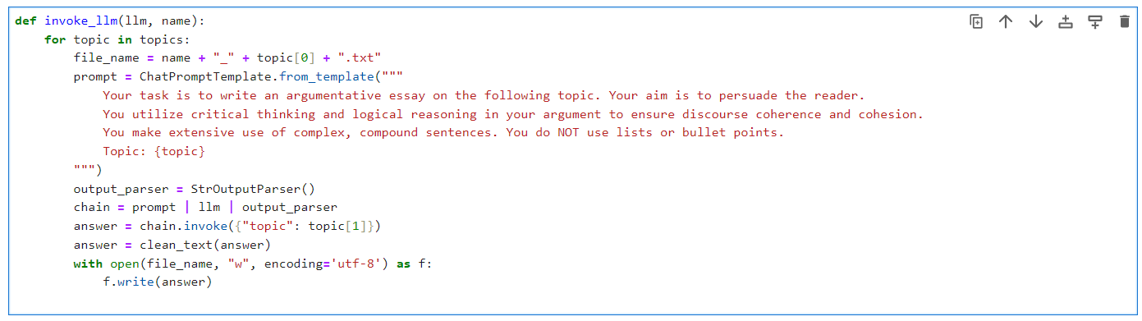
The corpus of LLM written essays
The temperature parameter of LLMs was set to 0.7 (temperatures between 0.5 and 1 should balance coherence with creativity and diversity).
For Claude and Llama interaction was via chat interface (Claude APIs require VAT number for registration, Llama3 APIs were not available in Italy).
For the other models, interaction was via API calls using LangChain (Python framework that abstracts from LLMs differences and allows uniform interaction).
Python function that asks a LLM to generate an argumentative essay for each topic and saves the answer to a text file

Slide 31
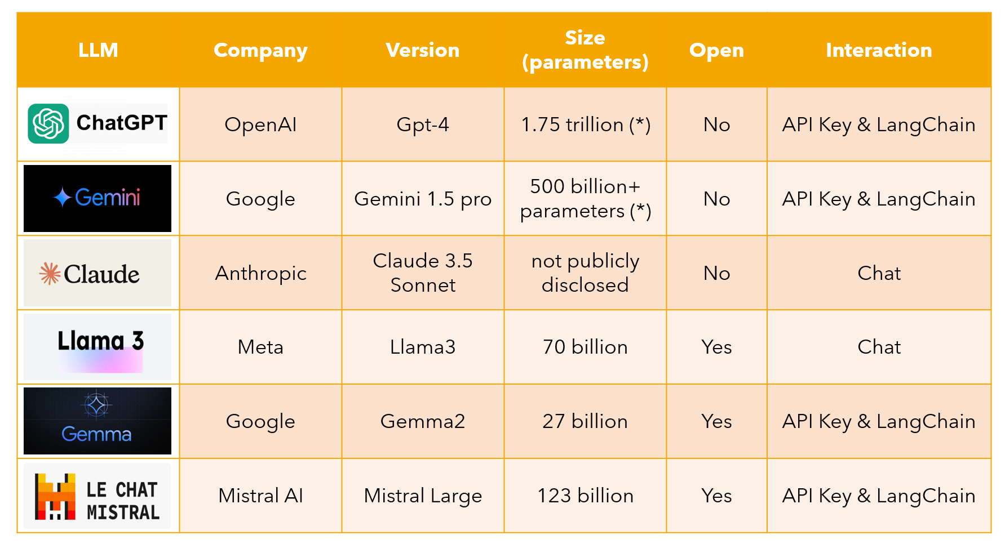
(*) Estimations, actual parameters are not publicly disclosed by the organization

Slide 32
Methodology
Analysis procedure

Slide 33
Procedure for data analysis
Step 1
Step 2
Step 3
A list of linking adverbials was compiled based on Biber's classification. For each adverbial, the corresponding regular expression was specified for search purposes. For instance, "to summarize" was represented as "to summari[sz]e" to account for both American and British spelling variations.
A custom Python procedure was developed to identify occurrences of these adverbials within the text. This procedure utilized regular expressions and recorded several key pieces of information for each match: the specific adverbial found, its starting position in the text, as well as the surrounding left and right context.
A manual check of the results was conducted using the AntConc software.
This step allowed for verification that the automated process hadn't missed any relevant instances.

Slide 34
Procedure for data analysis
Step 4
Step 5
Step 6
The results of the search were then saved in an Excel file.
A manual analysis of these results was performed to exclude any "false positives" that may have been captured by the automated process.
The Stanford Stanza natural language processing library with the “en” pipeline was used to parse the text. This allowed for the computation of the number of tokens and sentences for each file. According to the documentation, its accuracy rates are 99.77% for tokenization and 92.20% for sentence segmentation
Data analysis and visualization were conducted using SQL server, R programming language and ggplot2 library, and AntConc software.
Notes:
https://stackoverflow.com/questions/75989822/what-is-stanford-corenlps-recipe-for-tokenization Manning: Linguistic Data Consortium (LDC)'s English tokenization + new treebank tokenization -> UD tokenization

Slide 35
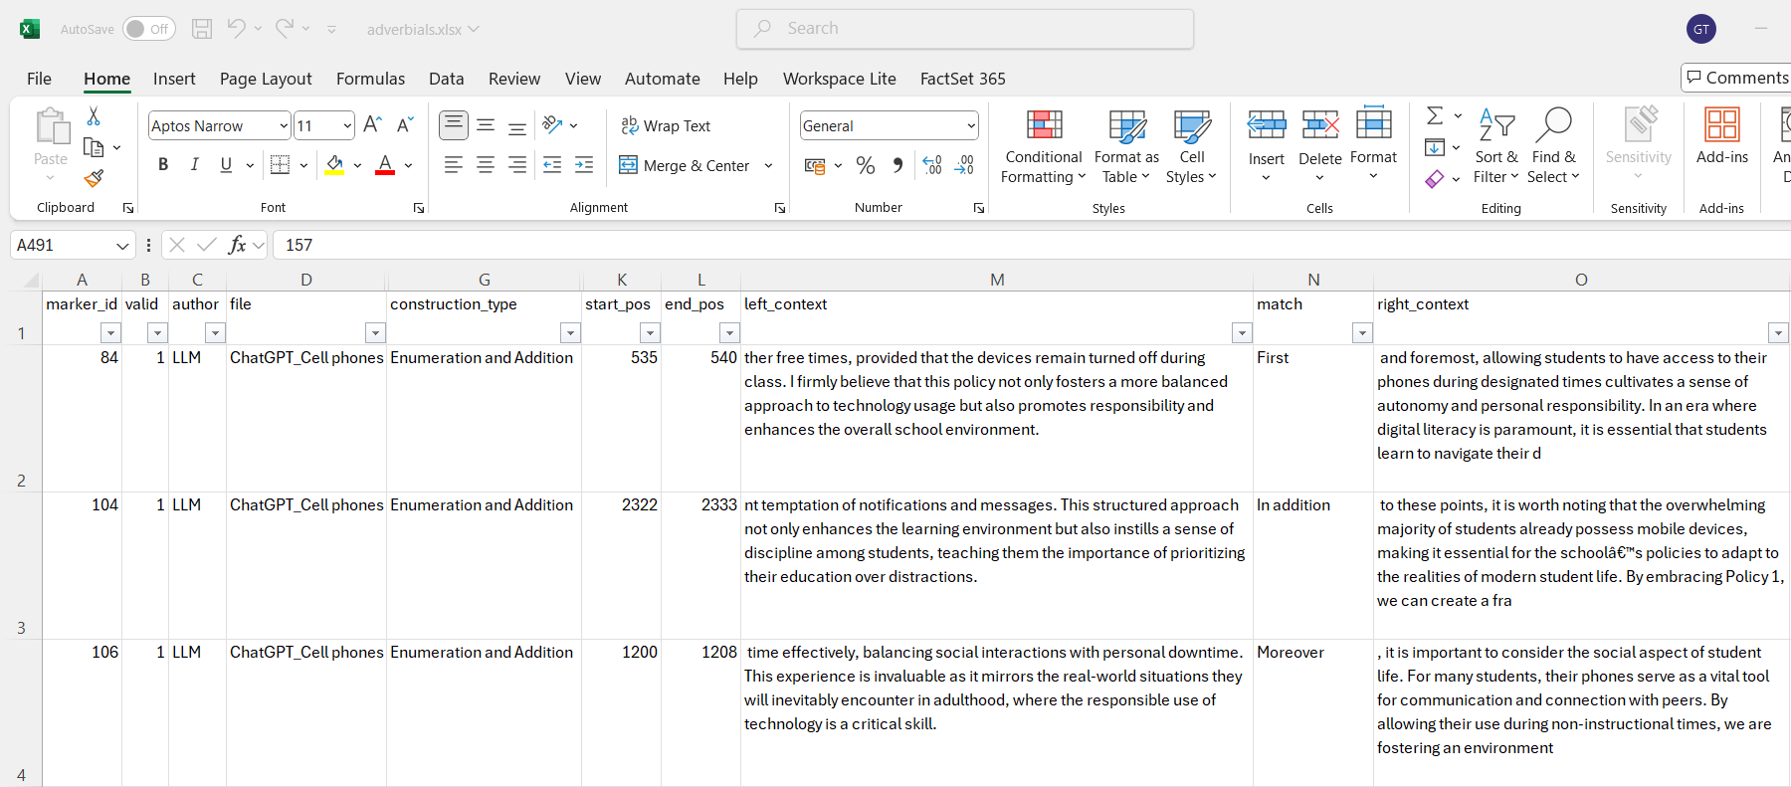
The Excel file generated by the procedure

Slide 36
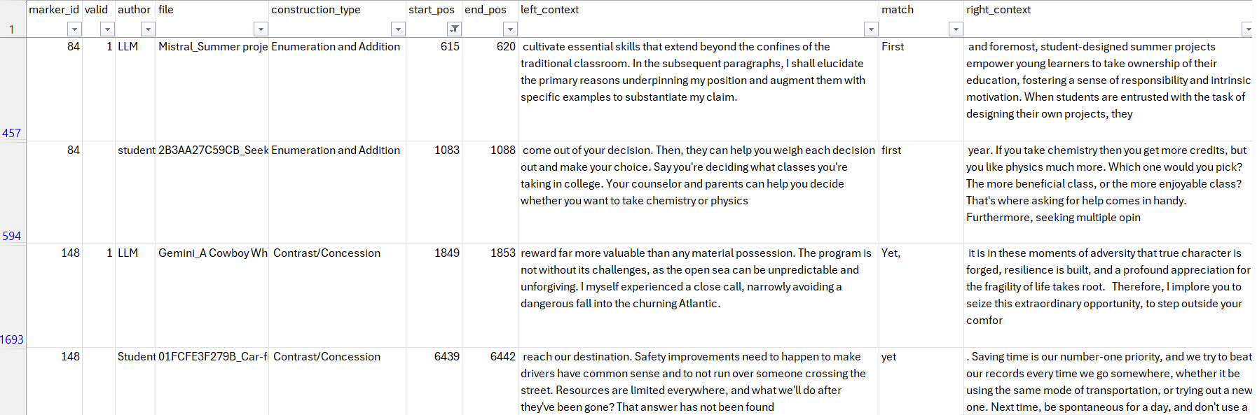


Examples of manual analysis
“First” as linking adverbial vs adjective, “Yet” as linking adverbial vs time adverbial
Other examples: Rather: exclude “rather quiet", "rather tired”, Similarly: exclude e.g. “men and women behave similarly”

Slide 37
Results

Slide 38
Corpus size and number of adverbials
 | Students | LLM | Total
Number of files | 78 | 78 | 156
Corpus size (number of tokens) | 50849 | 36689 | 87538
Linking adverbials (retrieved by the procedure) | 1152 | 729 | 1881
Valid linking adverbials (after false positive removal) | 725 | 600 | 1325
False positive percentage | 37% | 18% | 30%
The corpus of student-written essays contains more words and more linking adverbials.
The number and the proportion of false positives were higher in the student corpus.

Slide 39
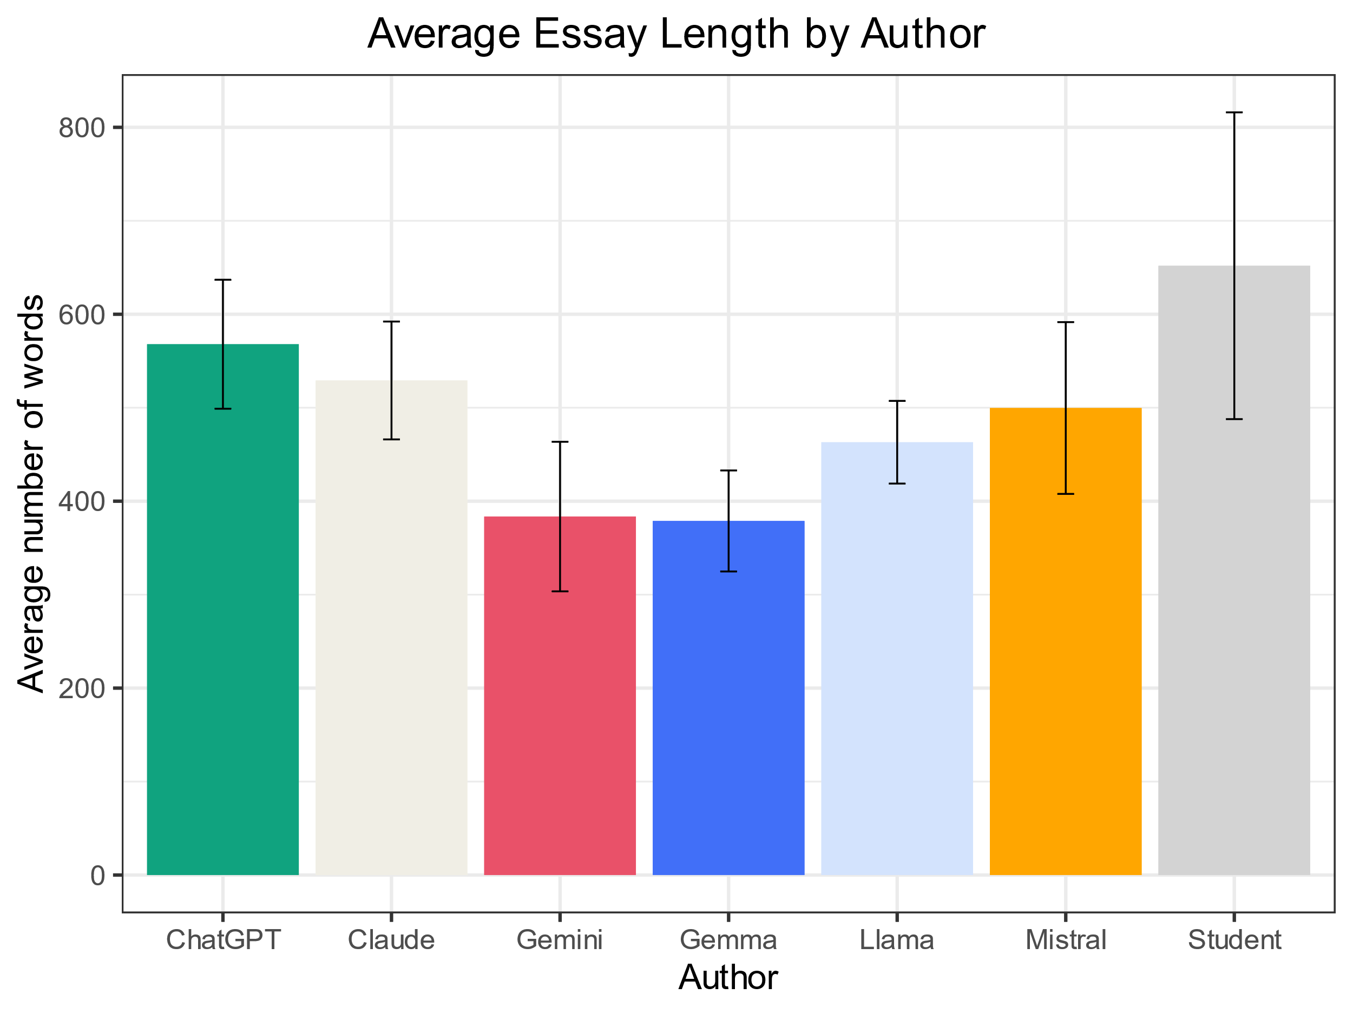
Essay length
Essays by students are on average longer.
The error bar (one standard deviation) shows greater variability in essays by students.
ChatGPT writes longer essays than other LLMs, followed by Claude.
Gemini (close LLM) and Gemma (open) write shorter essays (both models are by Google).
Mistral shows more variability than other LLMs.
Notes:
stat_summary( fun.data = "mean_sdl", geom = "errorbar", fun.args = list(mult = 1), position = position_dodge(width = 0.90), width = 0.1) +

Slide 40
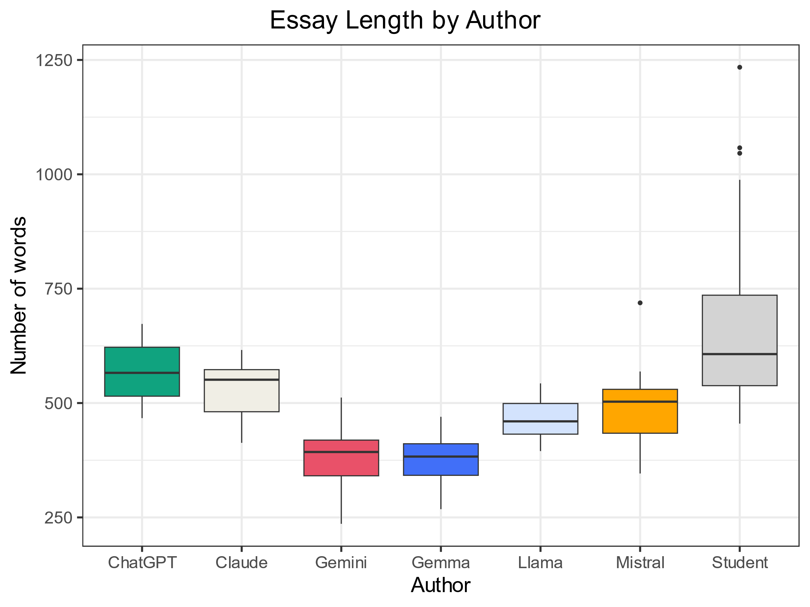
Essay length
The median essay length by students is very close to that of ChatGPT and Claude.
There is more variability in student essays (some outliers: few, very long texts).
LLMs are more consistent (especially ChatGPT (closed model) and Llama (open).
Claude, Gemini, Mistral show more variability below the median.
One outlier in Mistral (possibly due to instability in API calls); the value is not too extreme (z-score < 2.5), so the outlier was not removed.
Notes:
To compute a z-score from an individual score: subtract the mean from the score and divide the result by the standard deviation
Word length for Mistral is normally distributed: Shapiro-Wilk -> W = 0.94351, p-value = 0.504

Slide 41
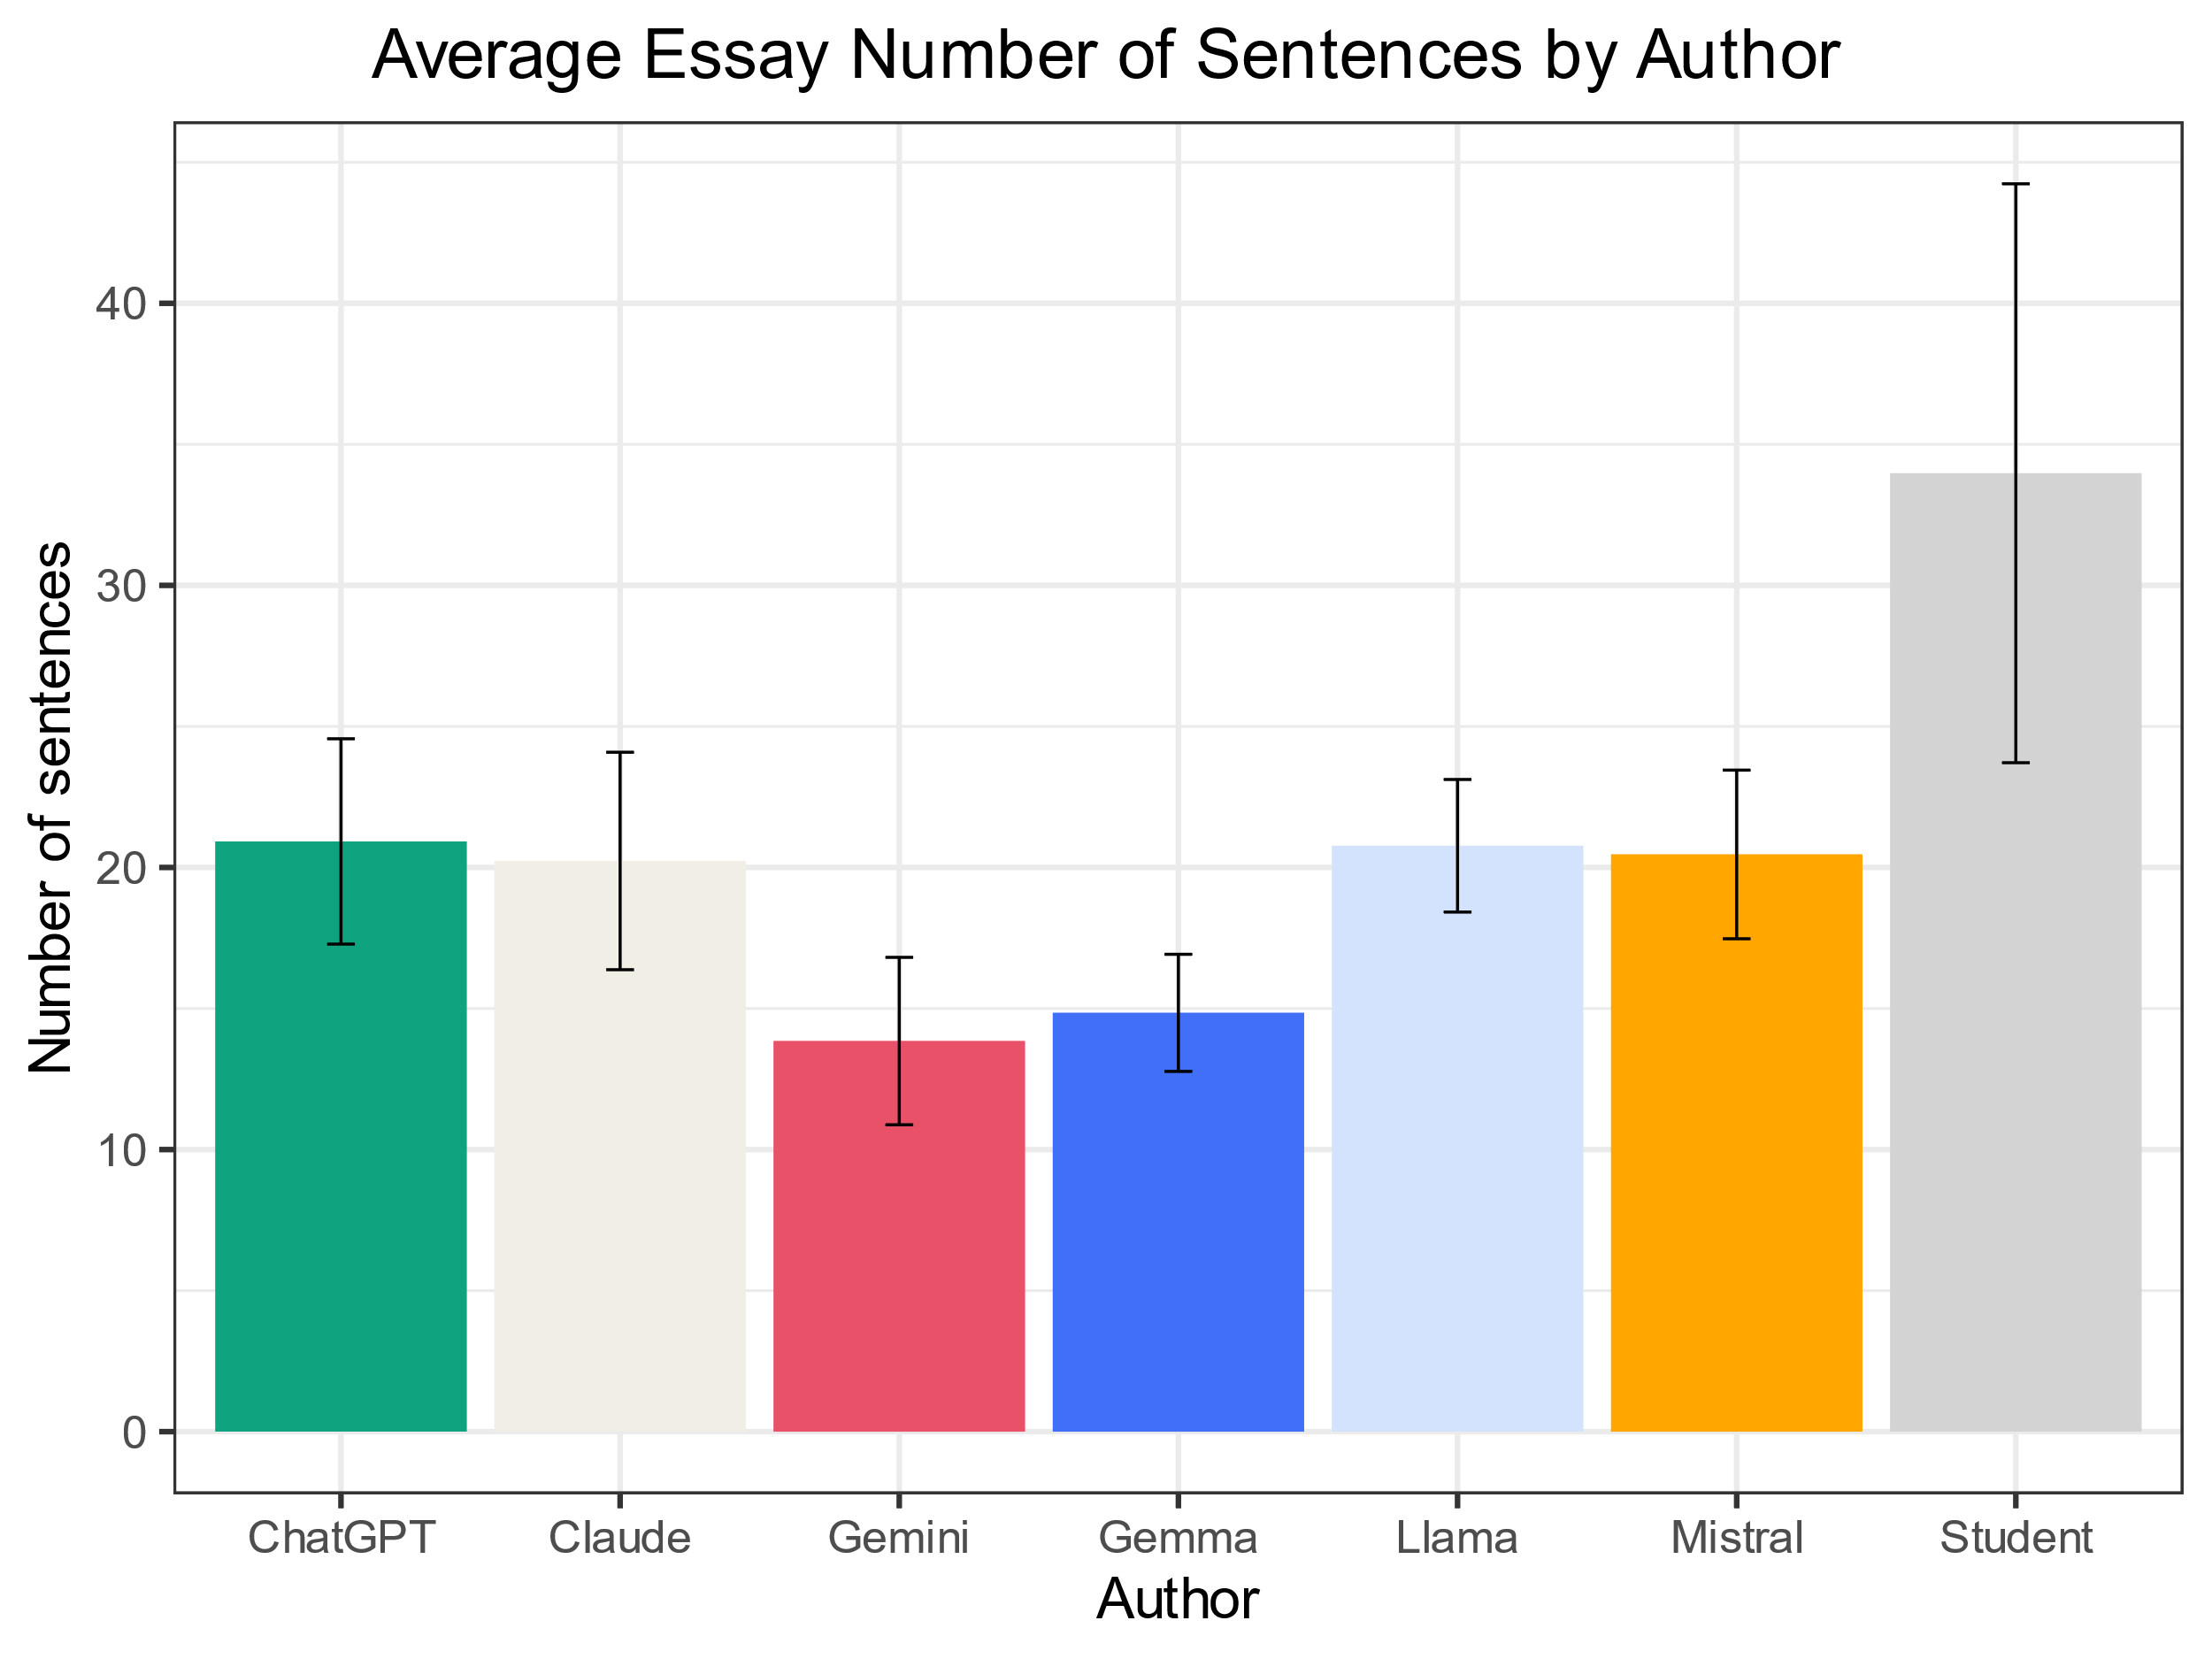
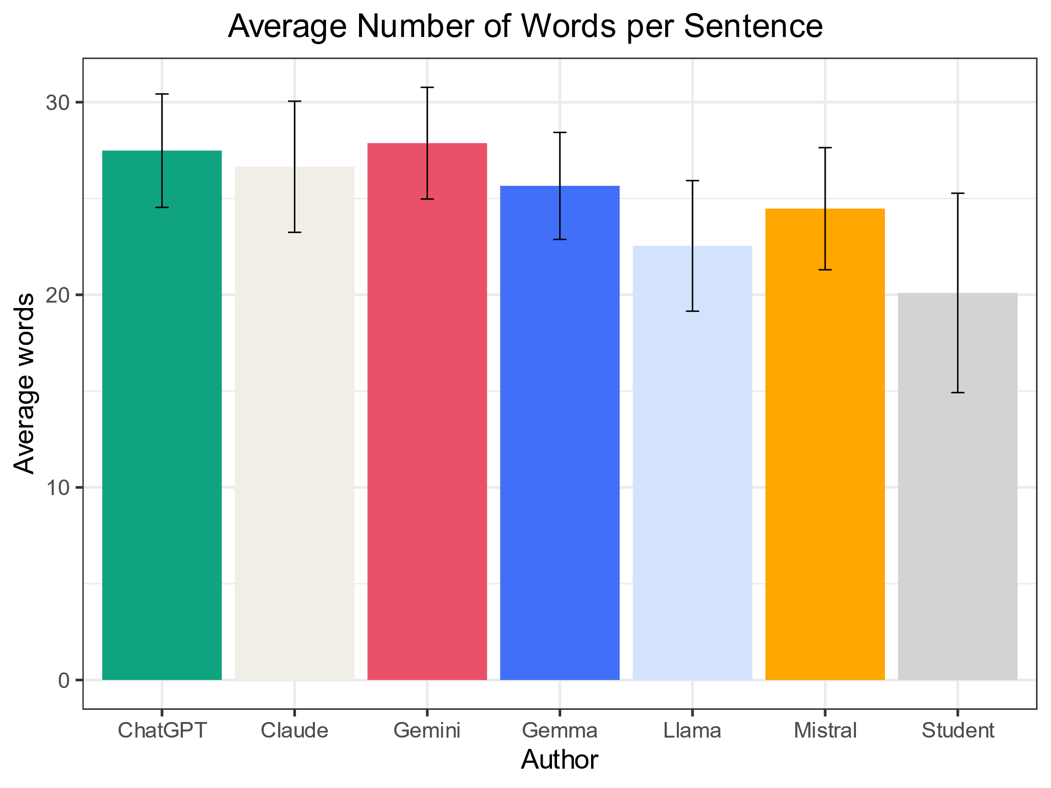
Number of sentences and words per sentence
Student essays contain more sentences on average, but they show more variability.
The average number of word per sentence is higher for all language models than for students.

Slide 42
Differences in the choice of adverbials
Category | Used by both Students and LLMs | Used only by Students | Used only by LLMs | Not used
Apposition | for example, for instance, altogether | that is, in other words | specifically, namely | that is to say
Contrast/ Concession | yet, instead, however, rather, on the other hand, still, in contrast, though, of course | anyway | by contrast, conversely, nevertheless | anyhow, at any rate, in any case, nonetheless
Enumeration and Addition | furthermore, moreover, in the first place, too, secondly, to begin with, first, as well, thirdly, in addition, lastly, also, as well as, firstly, finally, additionally, second | besides, then, next | fourthly, similarly | for another thing, for one thing, fourth, in the fourth place, in the second place, in the third place, likewise, third, to start with, what's more

Slide 43
Differences in the choice of adverbials
Category | Used by both Students and LLMs | Used only by Students | Used only by LLMs | Not used
Result/ Inference | as a result, so, therefore, then, thus, consequently | accordingly | thereby | hence, in consequence, in that case
Summation | in conclusion | overall, to conclude, all in all |  | by the same token, in sum, in summary, to sum up, to summarize
Transition |  | now, by the way | meanwhile, in comparison | incidentally

Slide 44
Occurrences of adverbials for each category
 | Apposition | Contrast/ Concession | Enumeration and Addition | Result/ Inference | Summation | Transition | Total
ChatGPT | 14 | 22 | 74 | 18 | 13 | 1 | 142
Claude | 7 | 29 | 47 | 2 | 12 | 1 | 98
Gemini | 2 | 23 | 28 | 5 | 6 | 1 | 65
Gemma | 4 | 11 | 28 | 2 | 7 |  | 52
Llama | 12 | 21 | 68 | 5 | 13 |  | 119
Mistral | 21 | 17 | 64 | 9 | 13 |  | 124
Student | 42 | 159 | 291 | 185 | 41 | 7 | 725
Total | 102 | 282 | 600 | 226 | 105 | 10 | 1325

Slide 45
Frequencies of adverbials for each category
 | Apposition | Contrast/ Concession | Enumeration and Addition | Result/ Inference | Summation | Transition | Total
ChatGPT | 1.90 | 2.98 | 10.02 | 2.44 | 1.76 | 0.14 | 19.23
Claude | 1.02 | 4.22 | 6.83 | 0.29 | 1.74 | 0.15 | 14.25
Gemini | 0.40 | 4.61 | 5.62 | 1.00 | 1.20 | 0.20 | 13.04
Gemma | 0.81 | 2.23 | 5.69 | 0.41 | 1.42 | 0.00 | 10.56
Llama | 1.99 | 3.49 | 11.30 | 0.83 | 2.16 | 0.00 | 19.77
Mistral | 3.23 | 2.62 | 9.85 | 1.39 | 2.00 | 0.00 | 19.09
Student | 0.83 | 3.13 | 5.72 | 3.64 | 0.81 | 0.14 | 14.26
Frequencies are per 1000 words

Slide 46
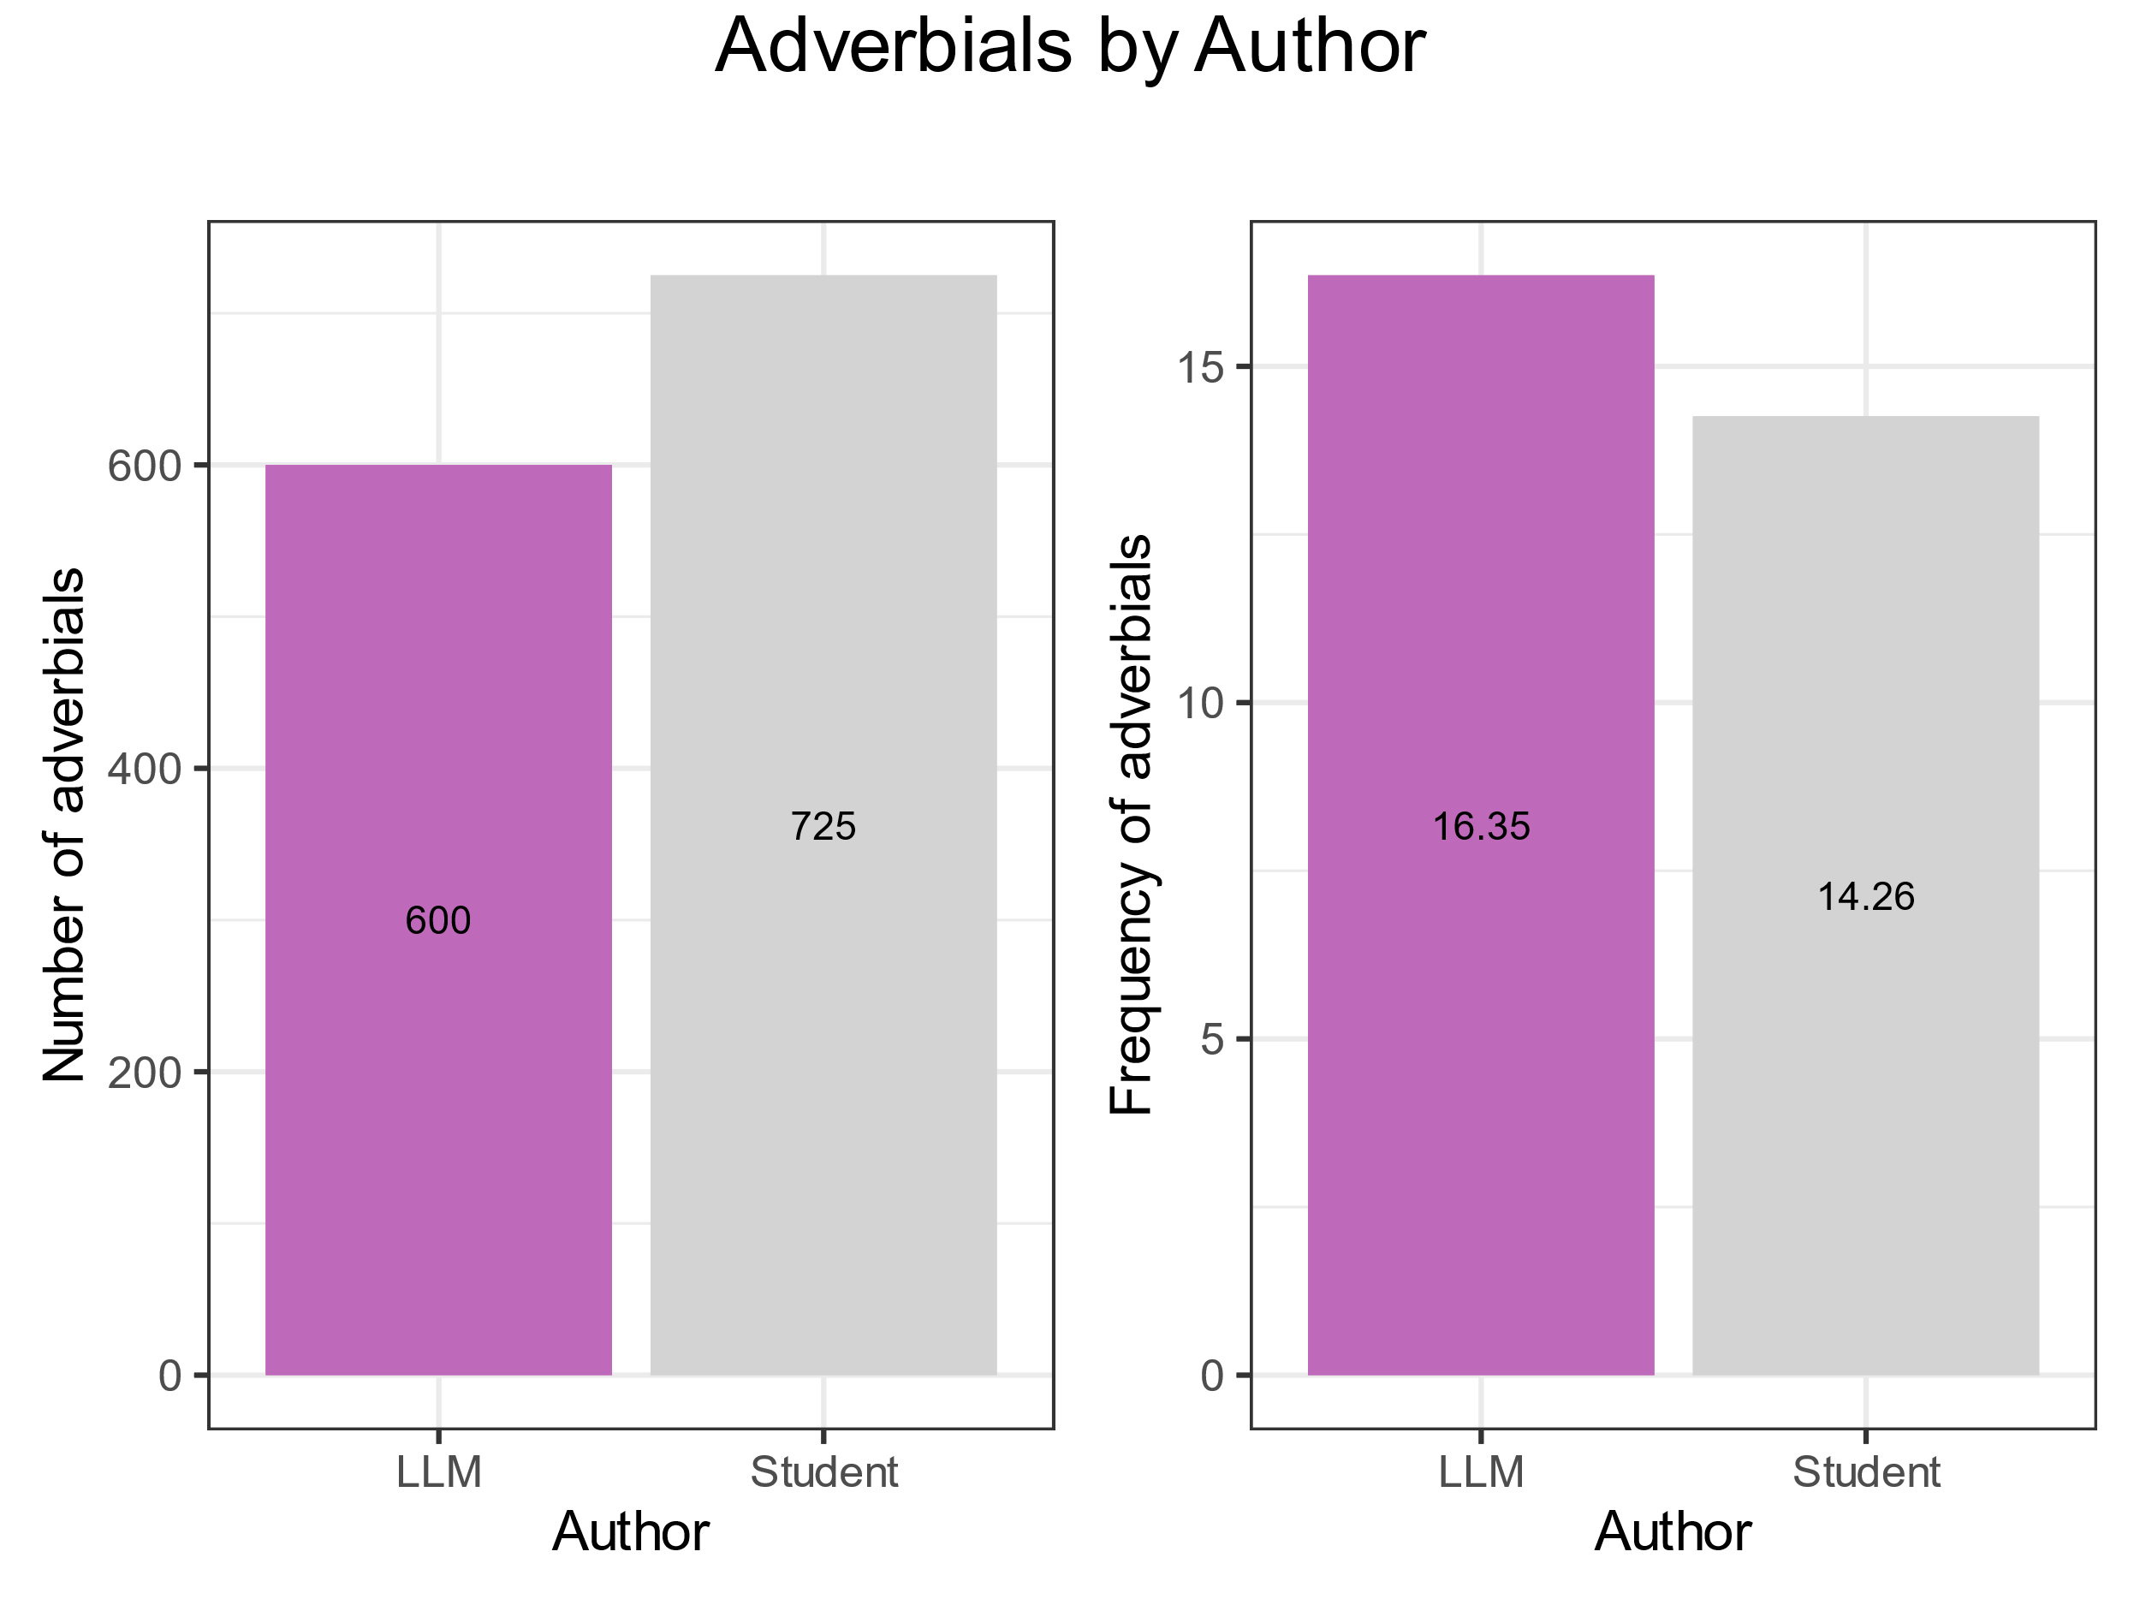

Occurrences and frequencies of linking adverbials
The number of adverbials in essays by students is higher, but linking adverbials are used more frequently by LLMs.
Here the frequency is computed as
$$\frac{Number of Adverbials}{Number of Tokens}∗1000$$
considering the essays by LLMs as a single corpus.

Slide 47
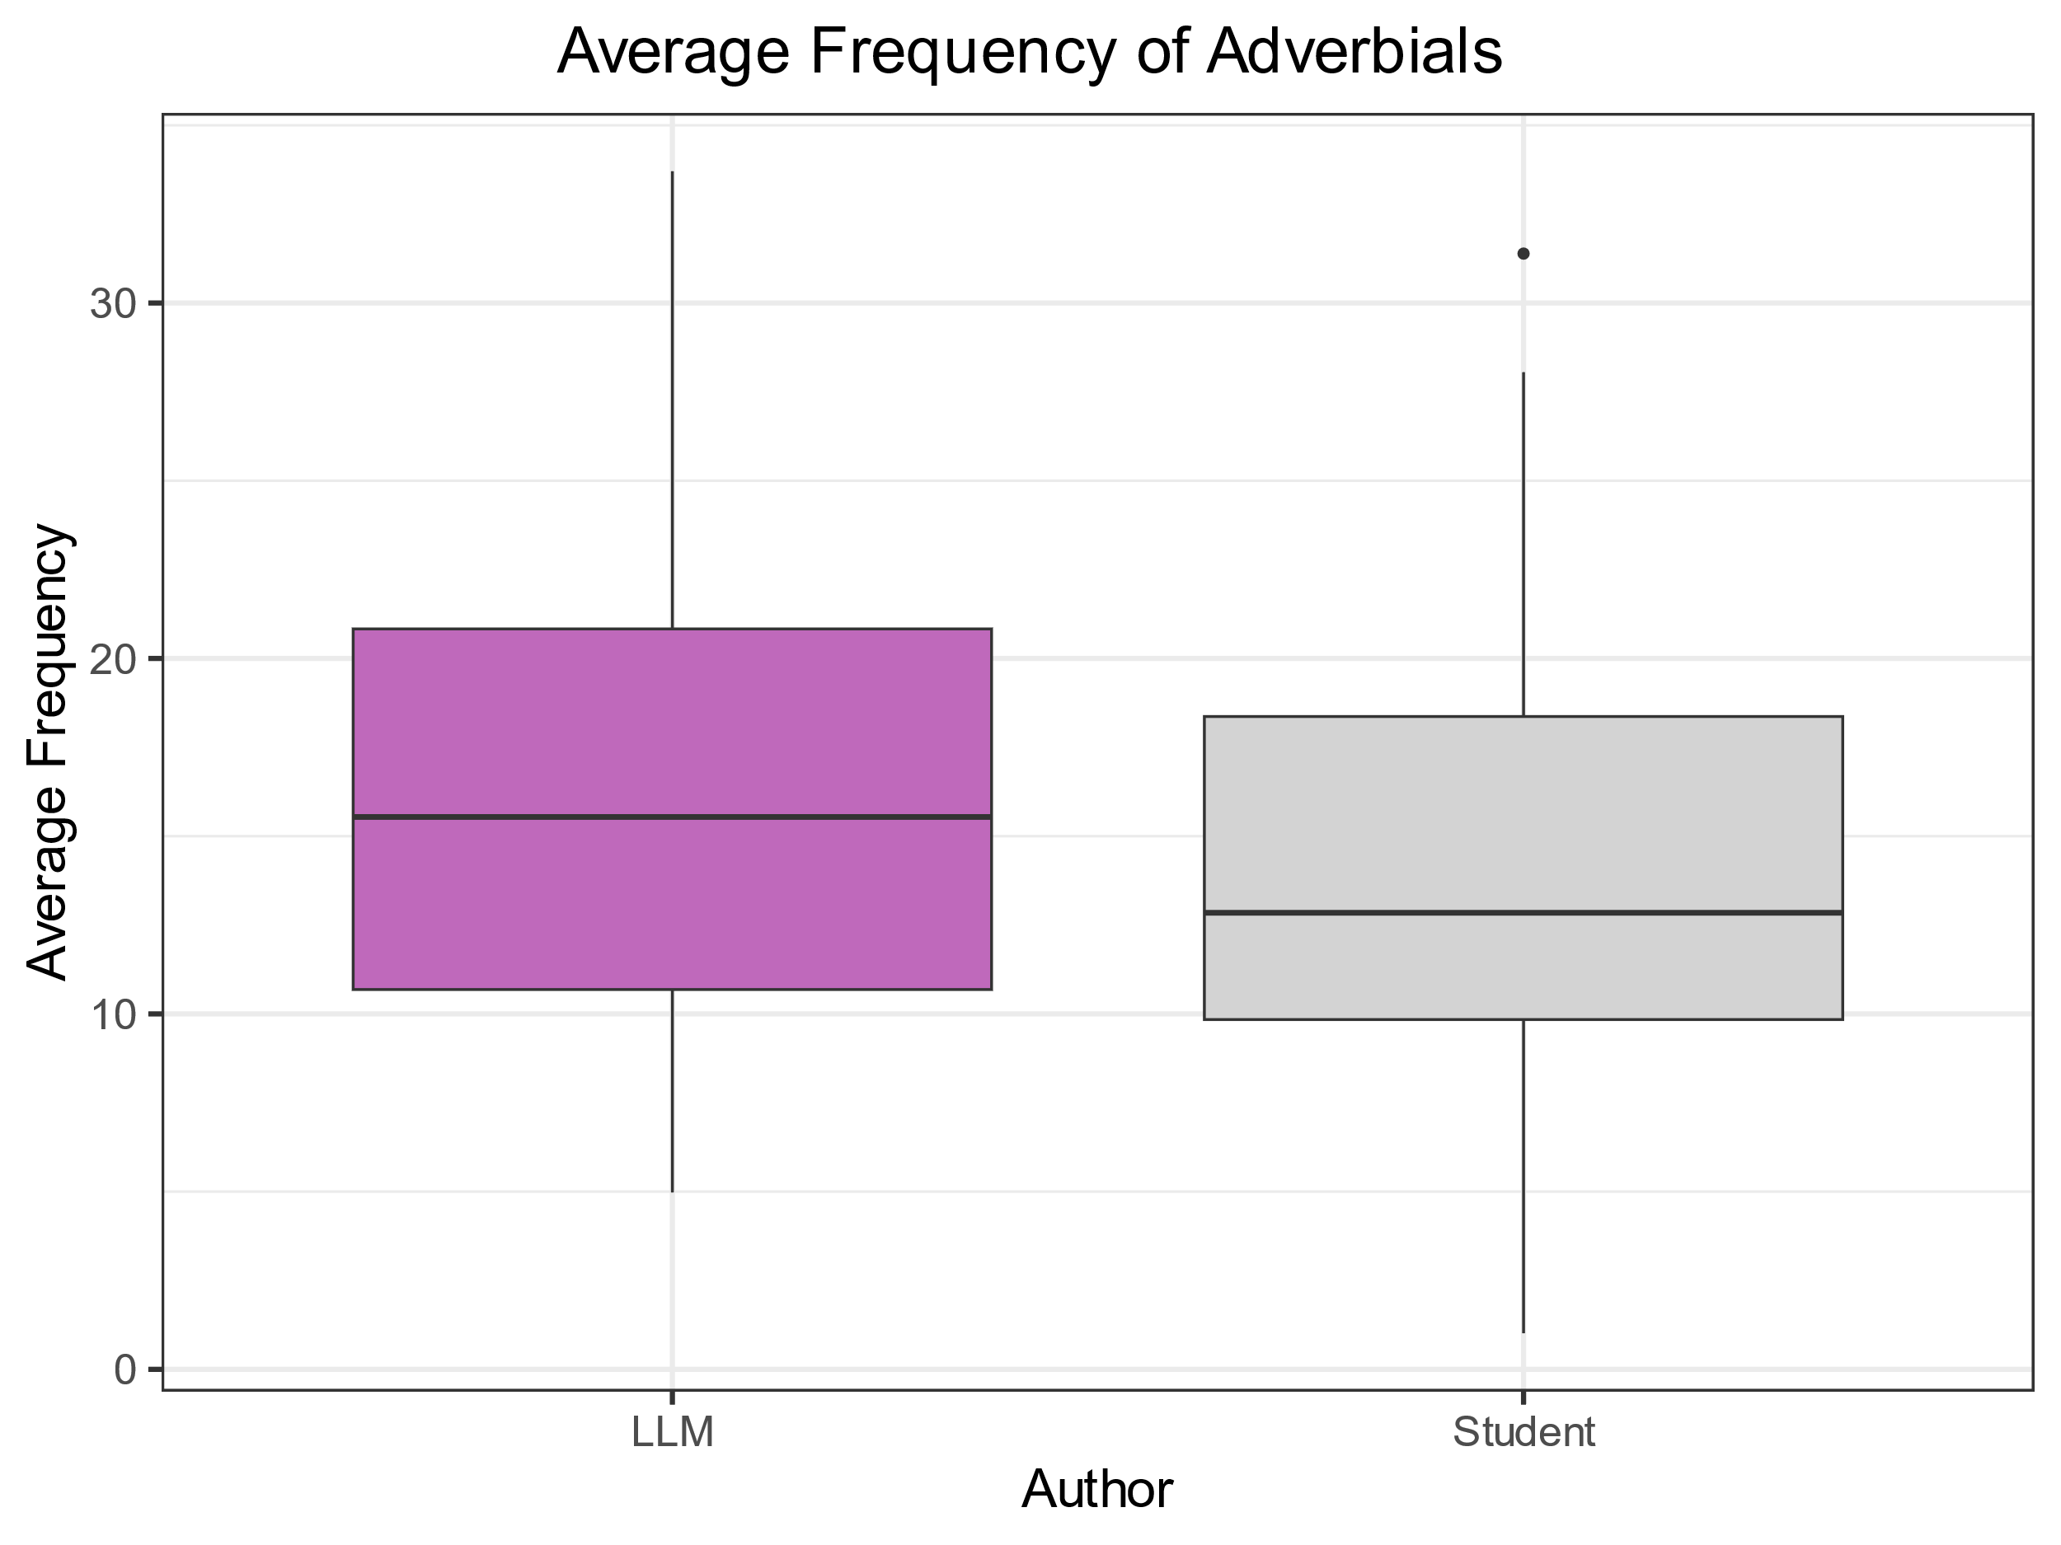
Occurrences and frequencies of linking adverbials
To see if the difference in frequencies is statistically significant, the independent two-tailed t-test was computed.
In this case, each file was considered as an observation and the frequency of adverbials computed for each file as the observed variable.*
The t-test showed that the difference is not statistically significant: t(153.97) = 1.920, p-value = 0.057.
* There are 156 observations, so the t-test with Welch’s adjustment can be applied even if the data is not normally distributed [Brezina 2018, p. 189]

Slide 48
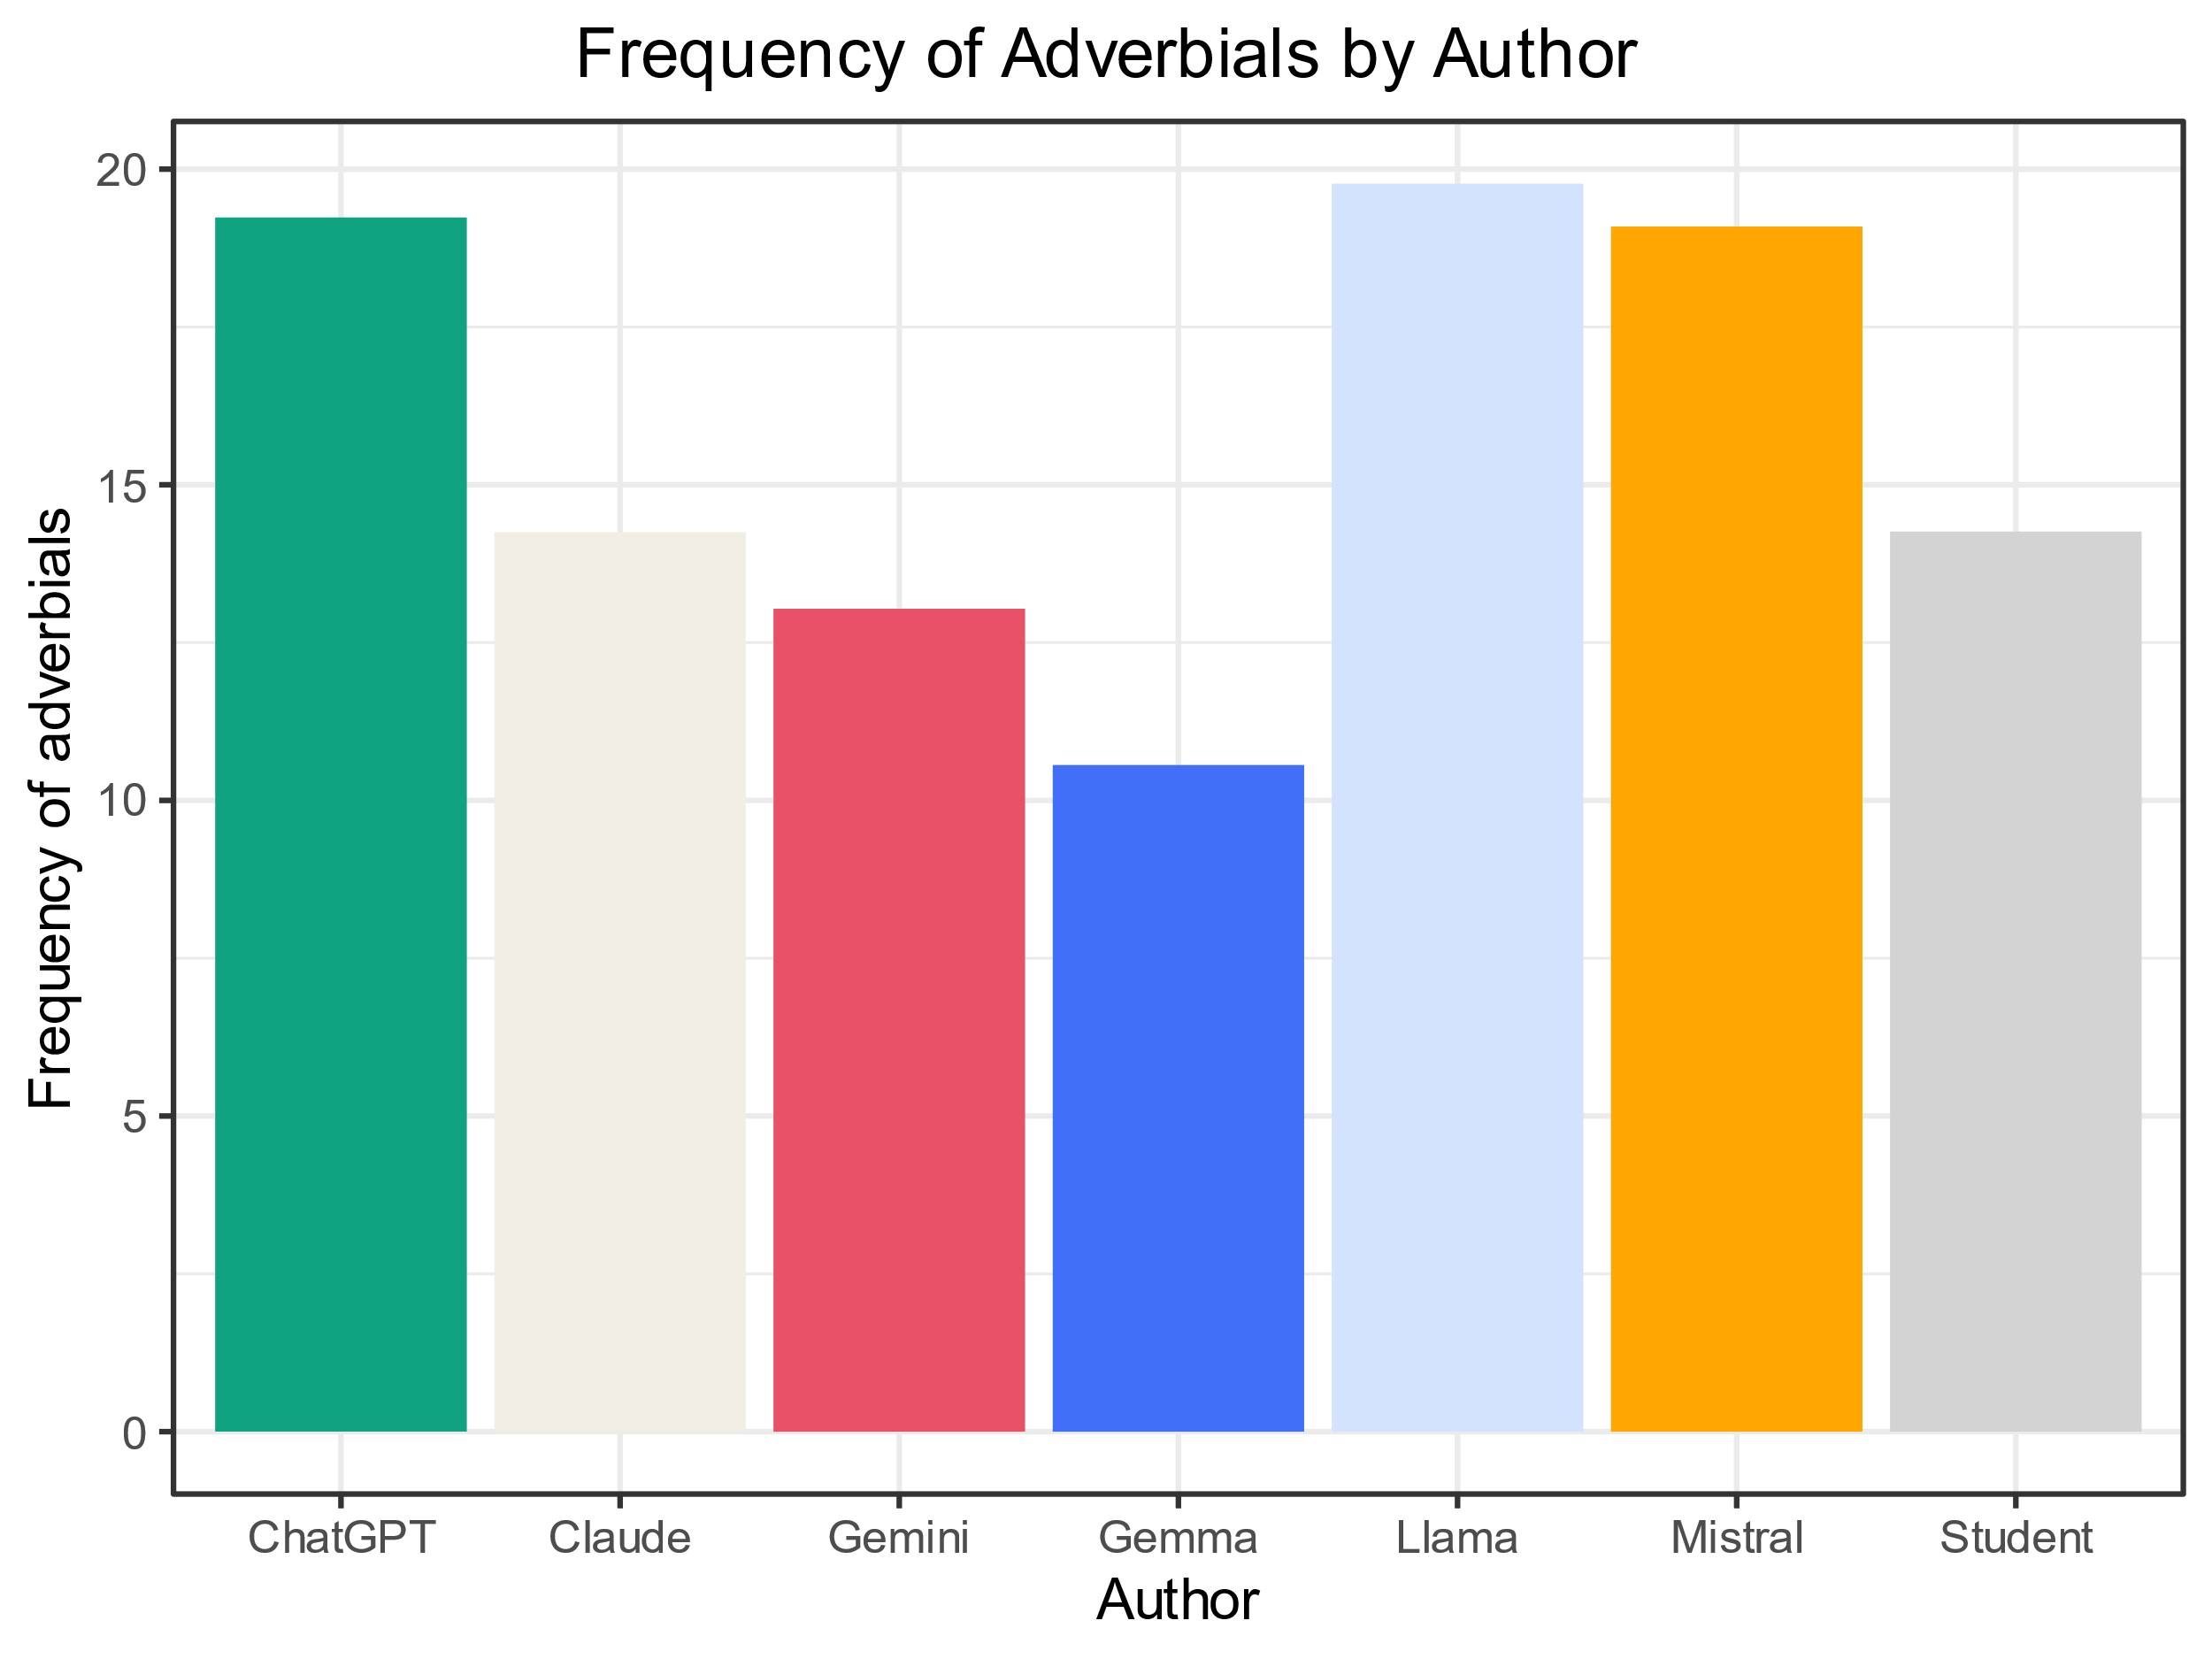
Detail of frequency of adverbials
ChatGPT, Llama and Mistral use adverbials more frequently.
Claude is very close to students.
Gemini and Gemma show lower frequencies.

Slide 49
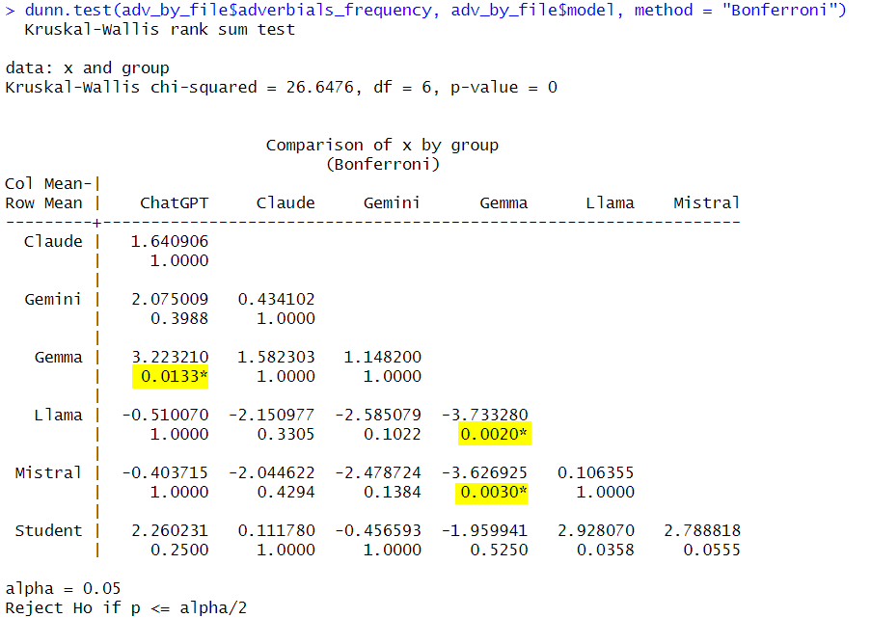
Statistical significance of differences in frequencies
The Dunn test was performed to see if there are statistically significant differences in the frequencies of adverbials between groups.
The Kruskal-Wallis test shows that there is a statistically significant difference for at least one group (p-value=0), so the Dunn test can be applied.
The Dunn test with Bonferroni correction shows that there are not statistically significant differences between Students and LLMs.
The differences are significant between Gemma and three other models: ChatGPT, Llama and Mistral.
Notes:
Dunn’s test is used to identify differences between specific groups after a non-parametric Kruskal-Wallis test. Bonferroni correction adjusts the significance level by dividing the original alpha by the number of comparisons to reduce the risk of Type I (false positive) errors in multiple comparisons.

Slide 50
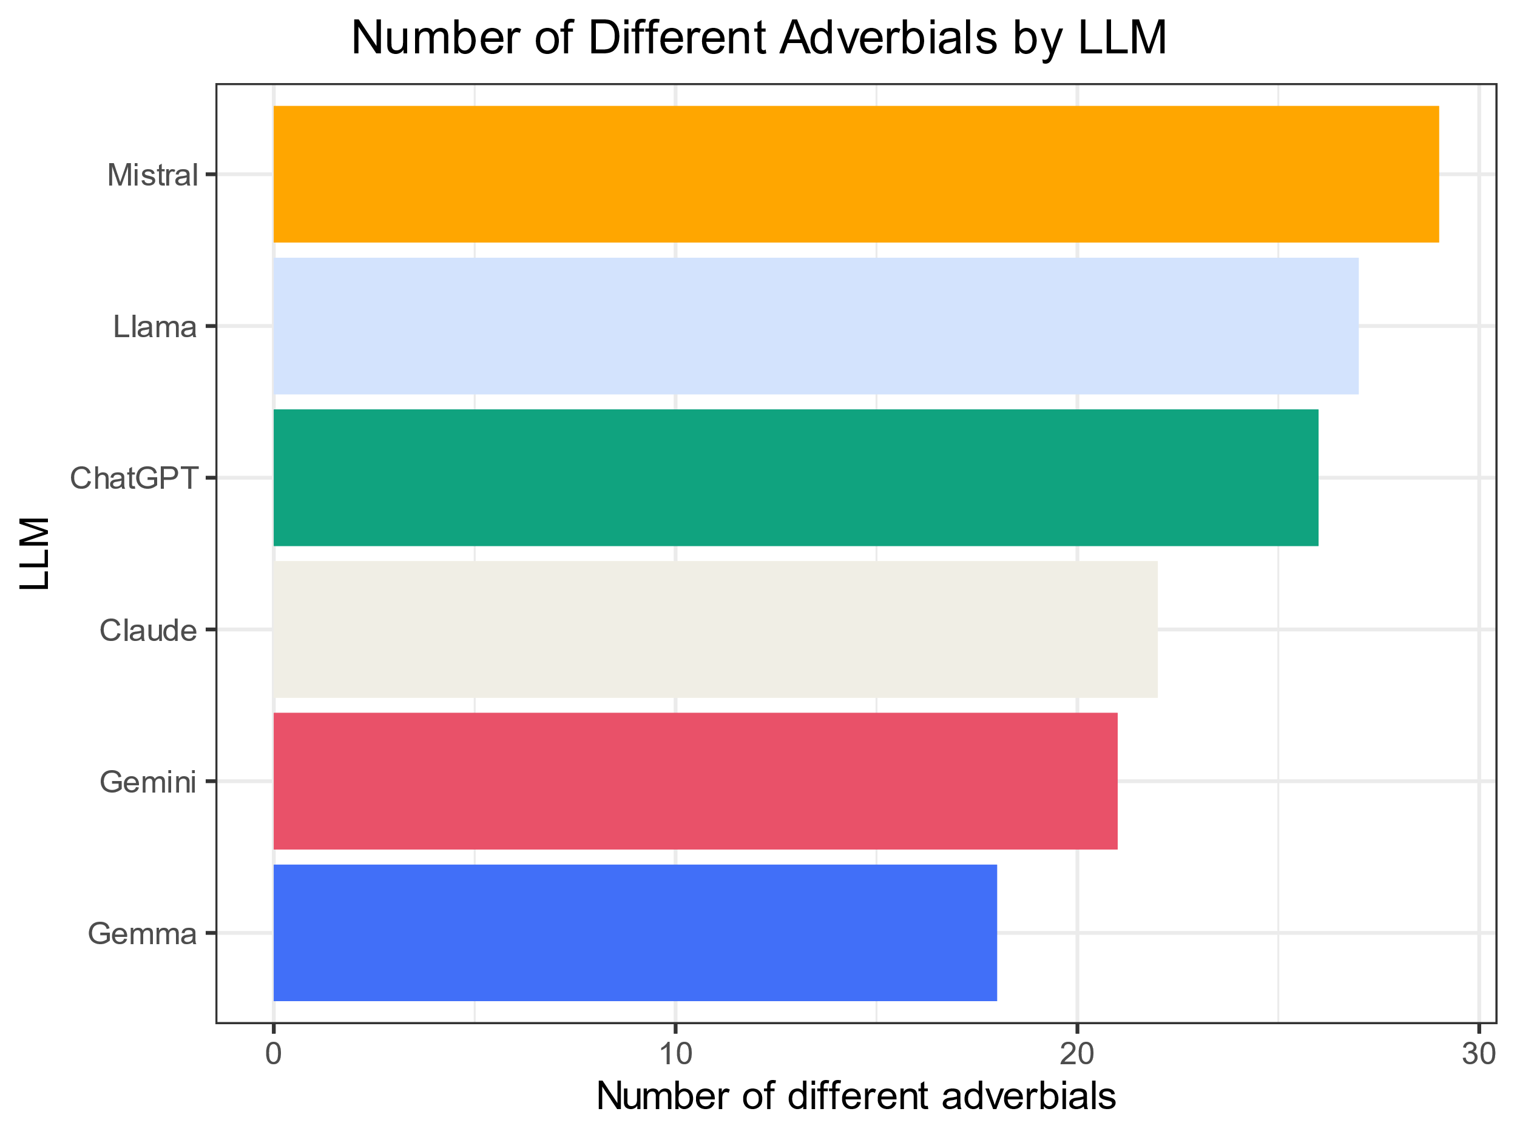
Variety of linking adverbials by LLM
Mistral and Llama use a wider variety of different linking adverbials compared to others.

Slide 51
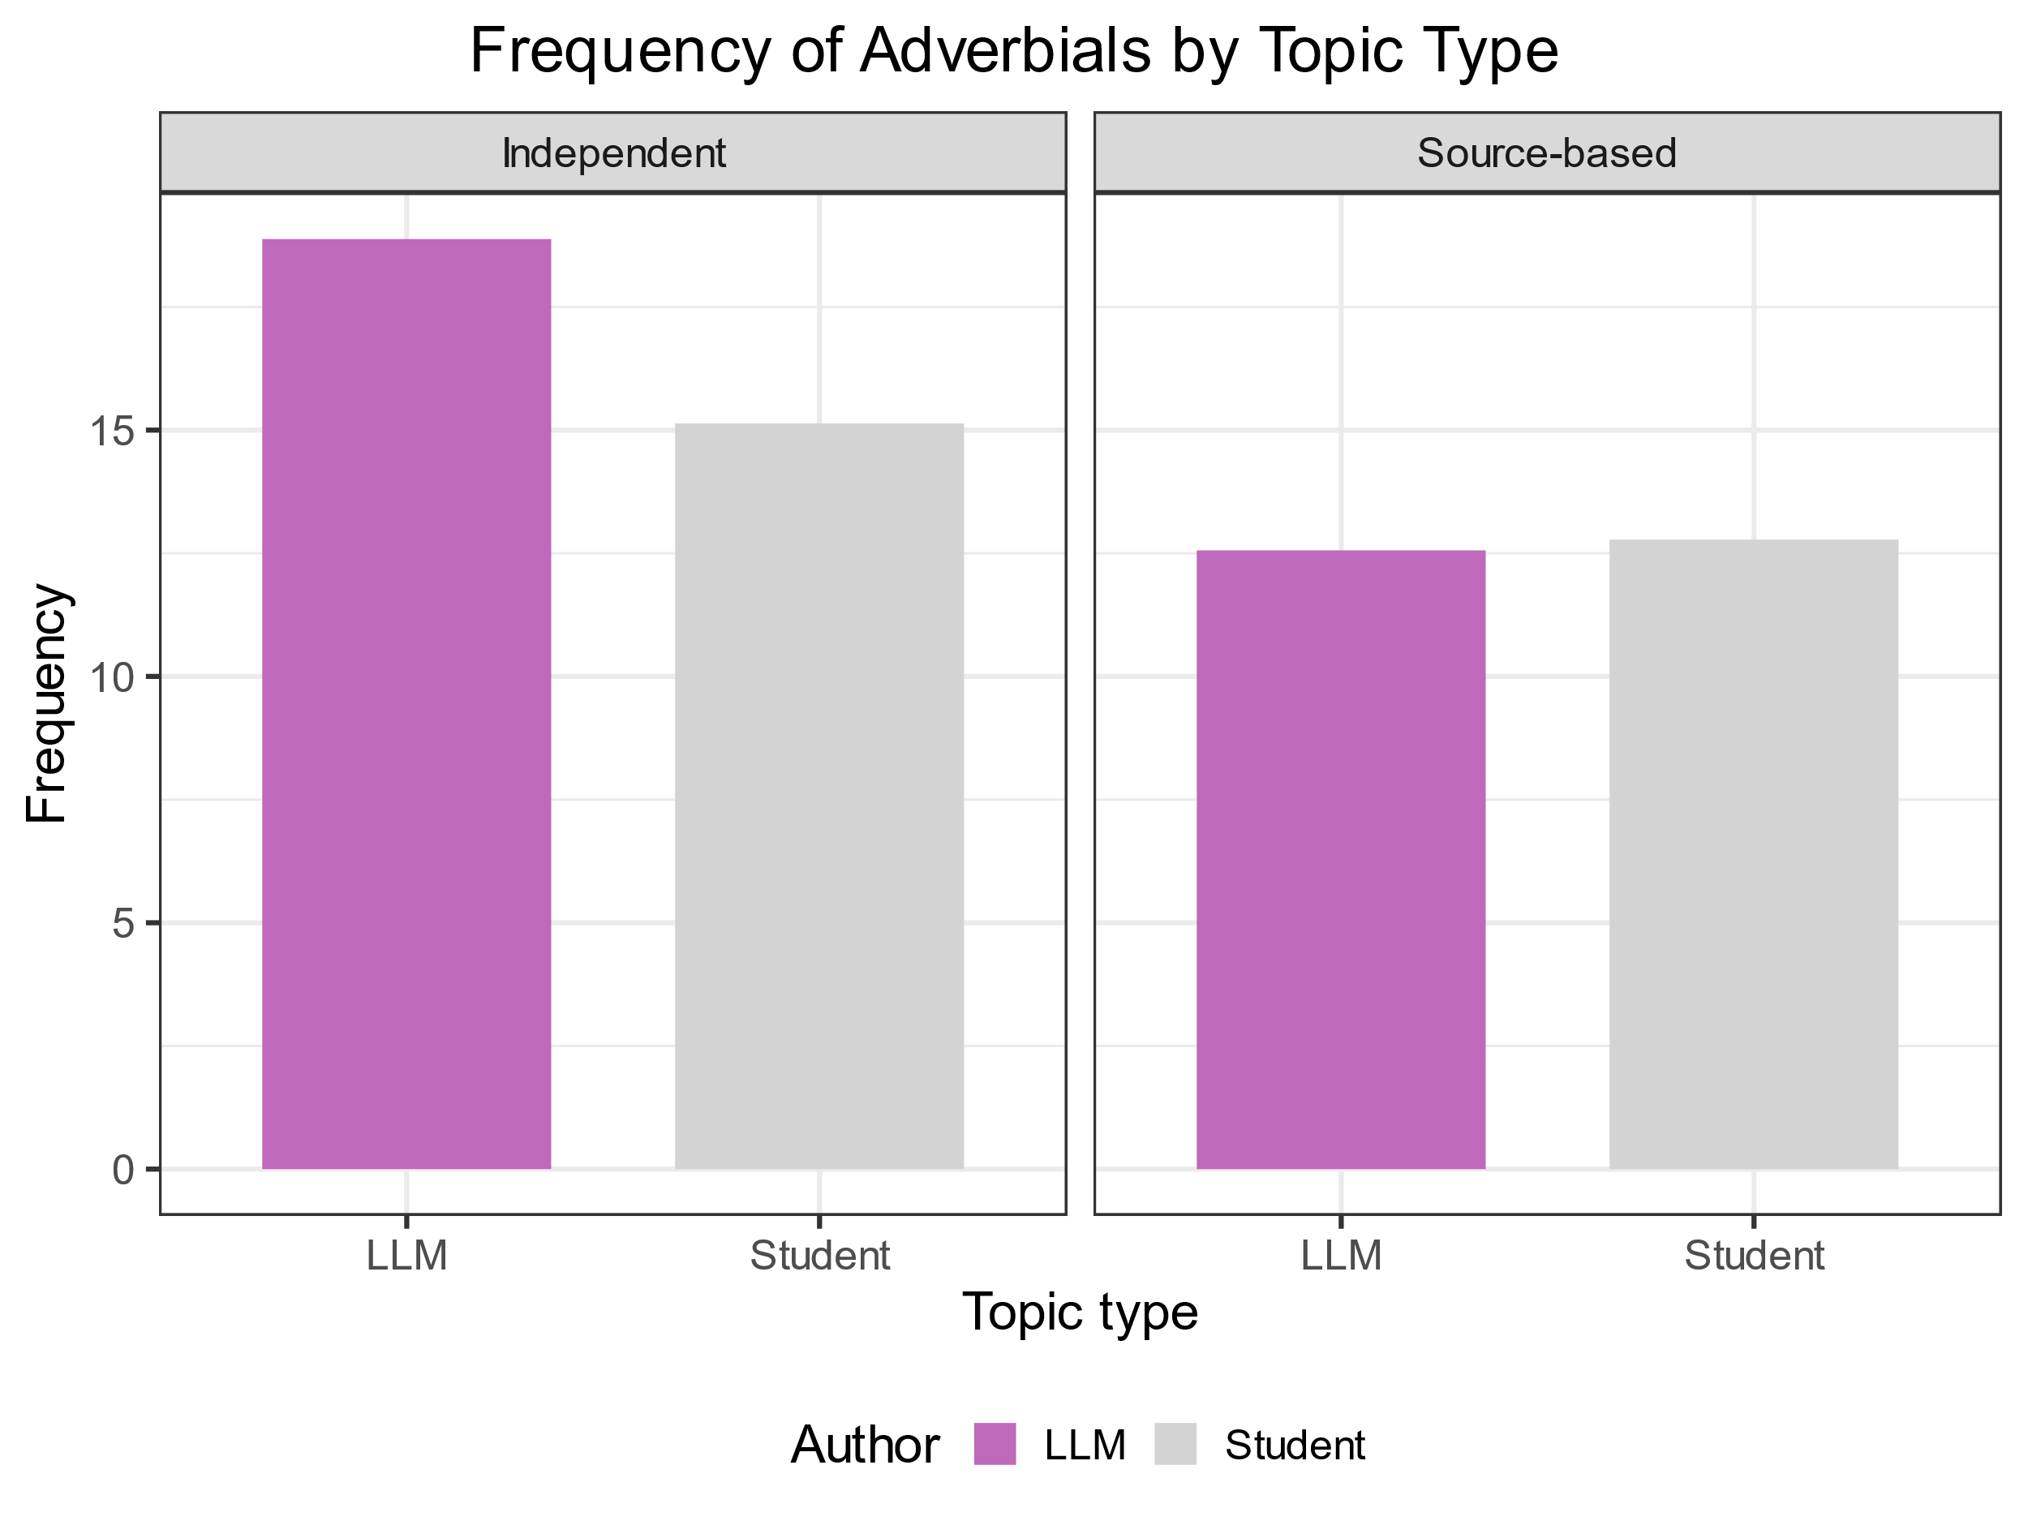
Frequency of adverbials by topic type
Both students and LLMs use adverbials more frequently in independent essays.
The frequencies in source-based essays are very similar.

Slide 52
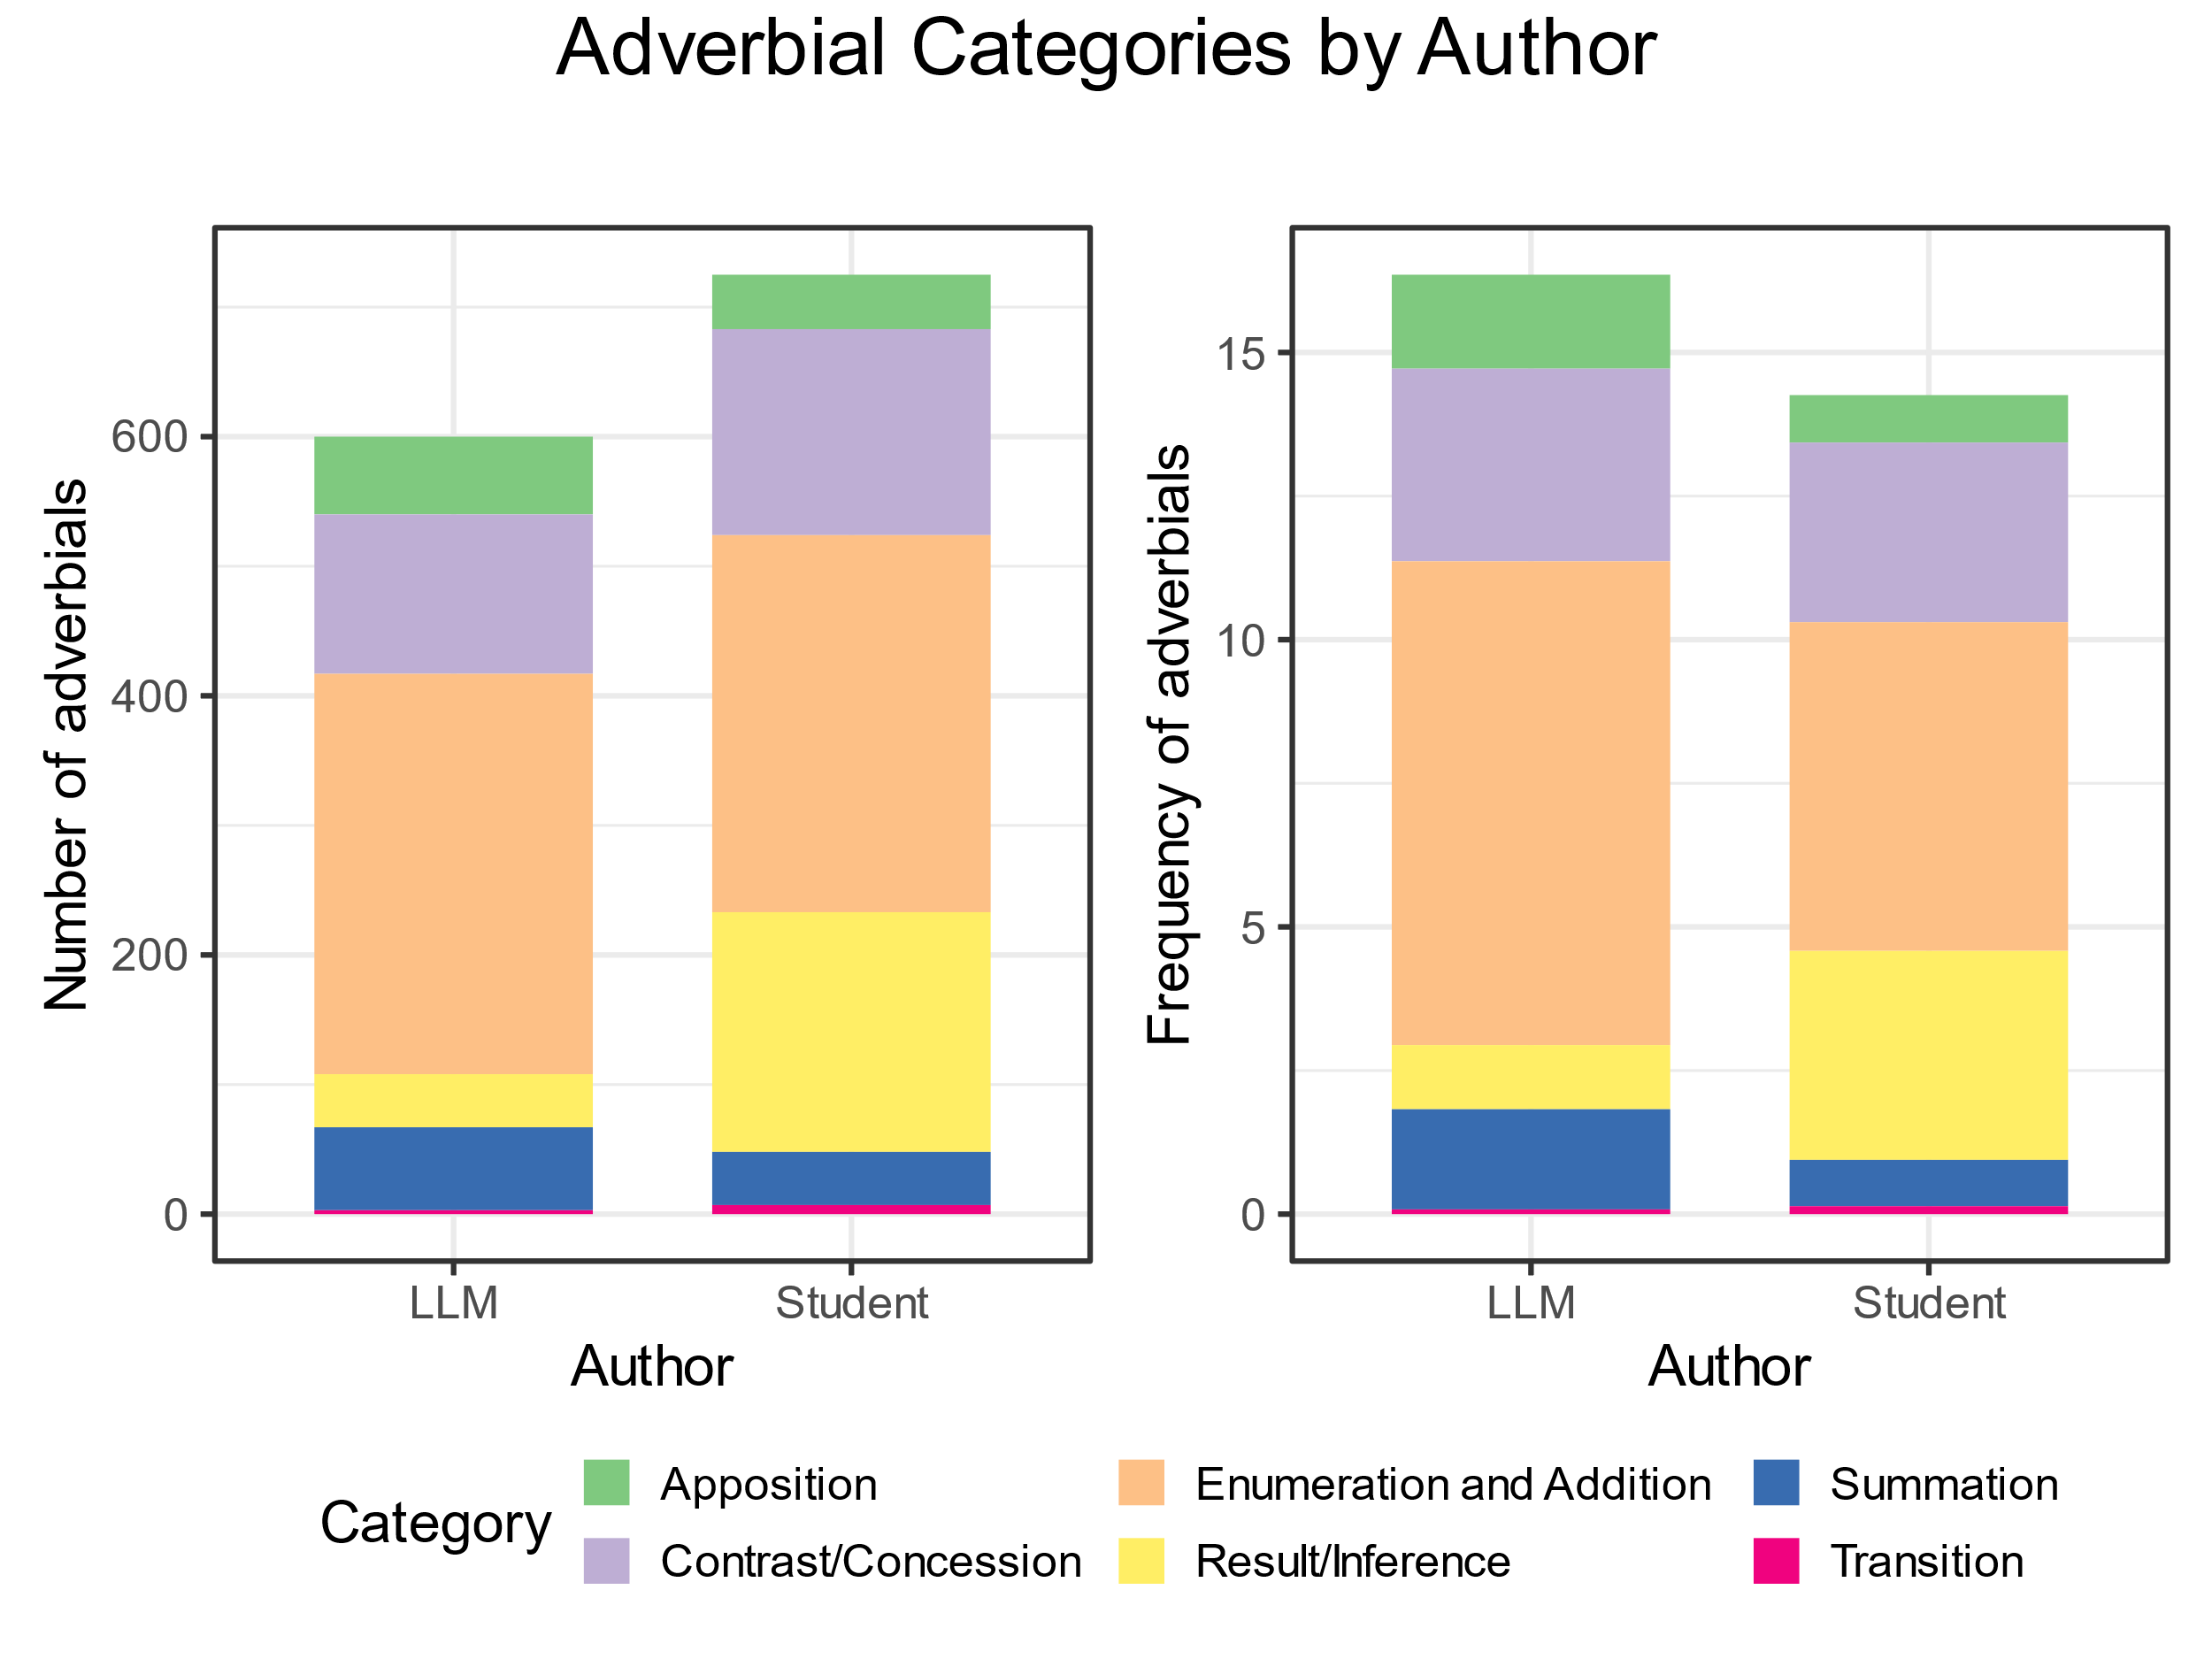
Occurrences and frequencies of Biber’s categories
LLMs and Students show different proportions in the use of the functional categories from Biber’s classification.

Slide 53
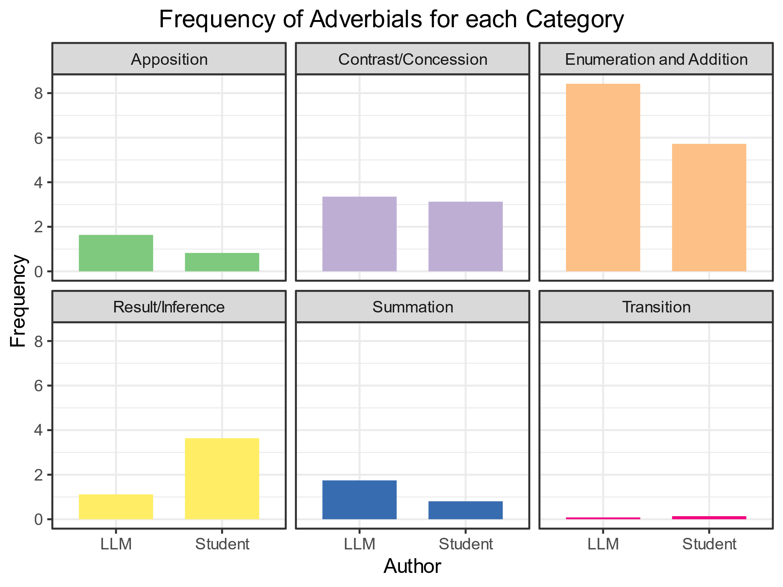
Frequency of Biber’s categories
Apposition, Enumeration and Addition, and Summation adverbials are used more frequently by LLMs.
Result/Inference adverbials on the contrary are use more frequently by Students.
The frequencies of Contrast/ Concession adverbials are very close.
Transition adverbials are very infrequent both in LLMs and Student essays.

Slide 54
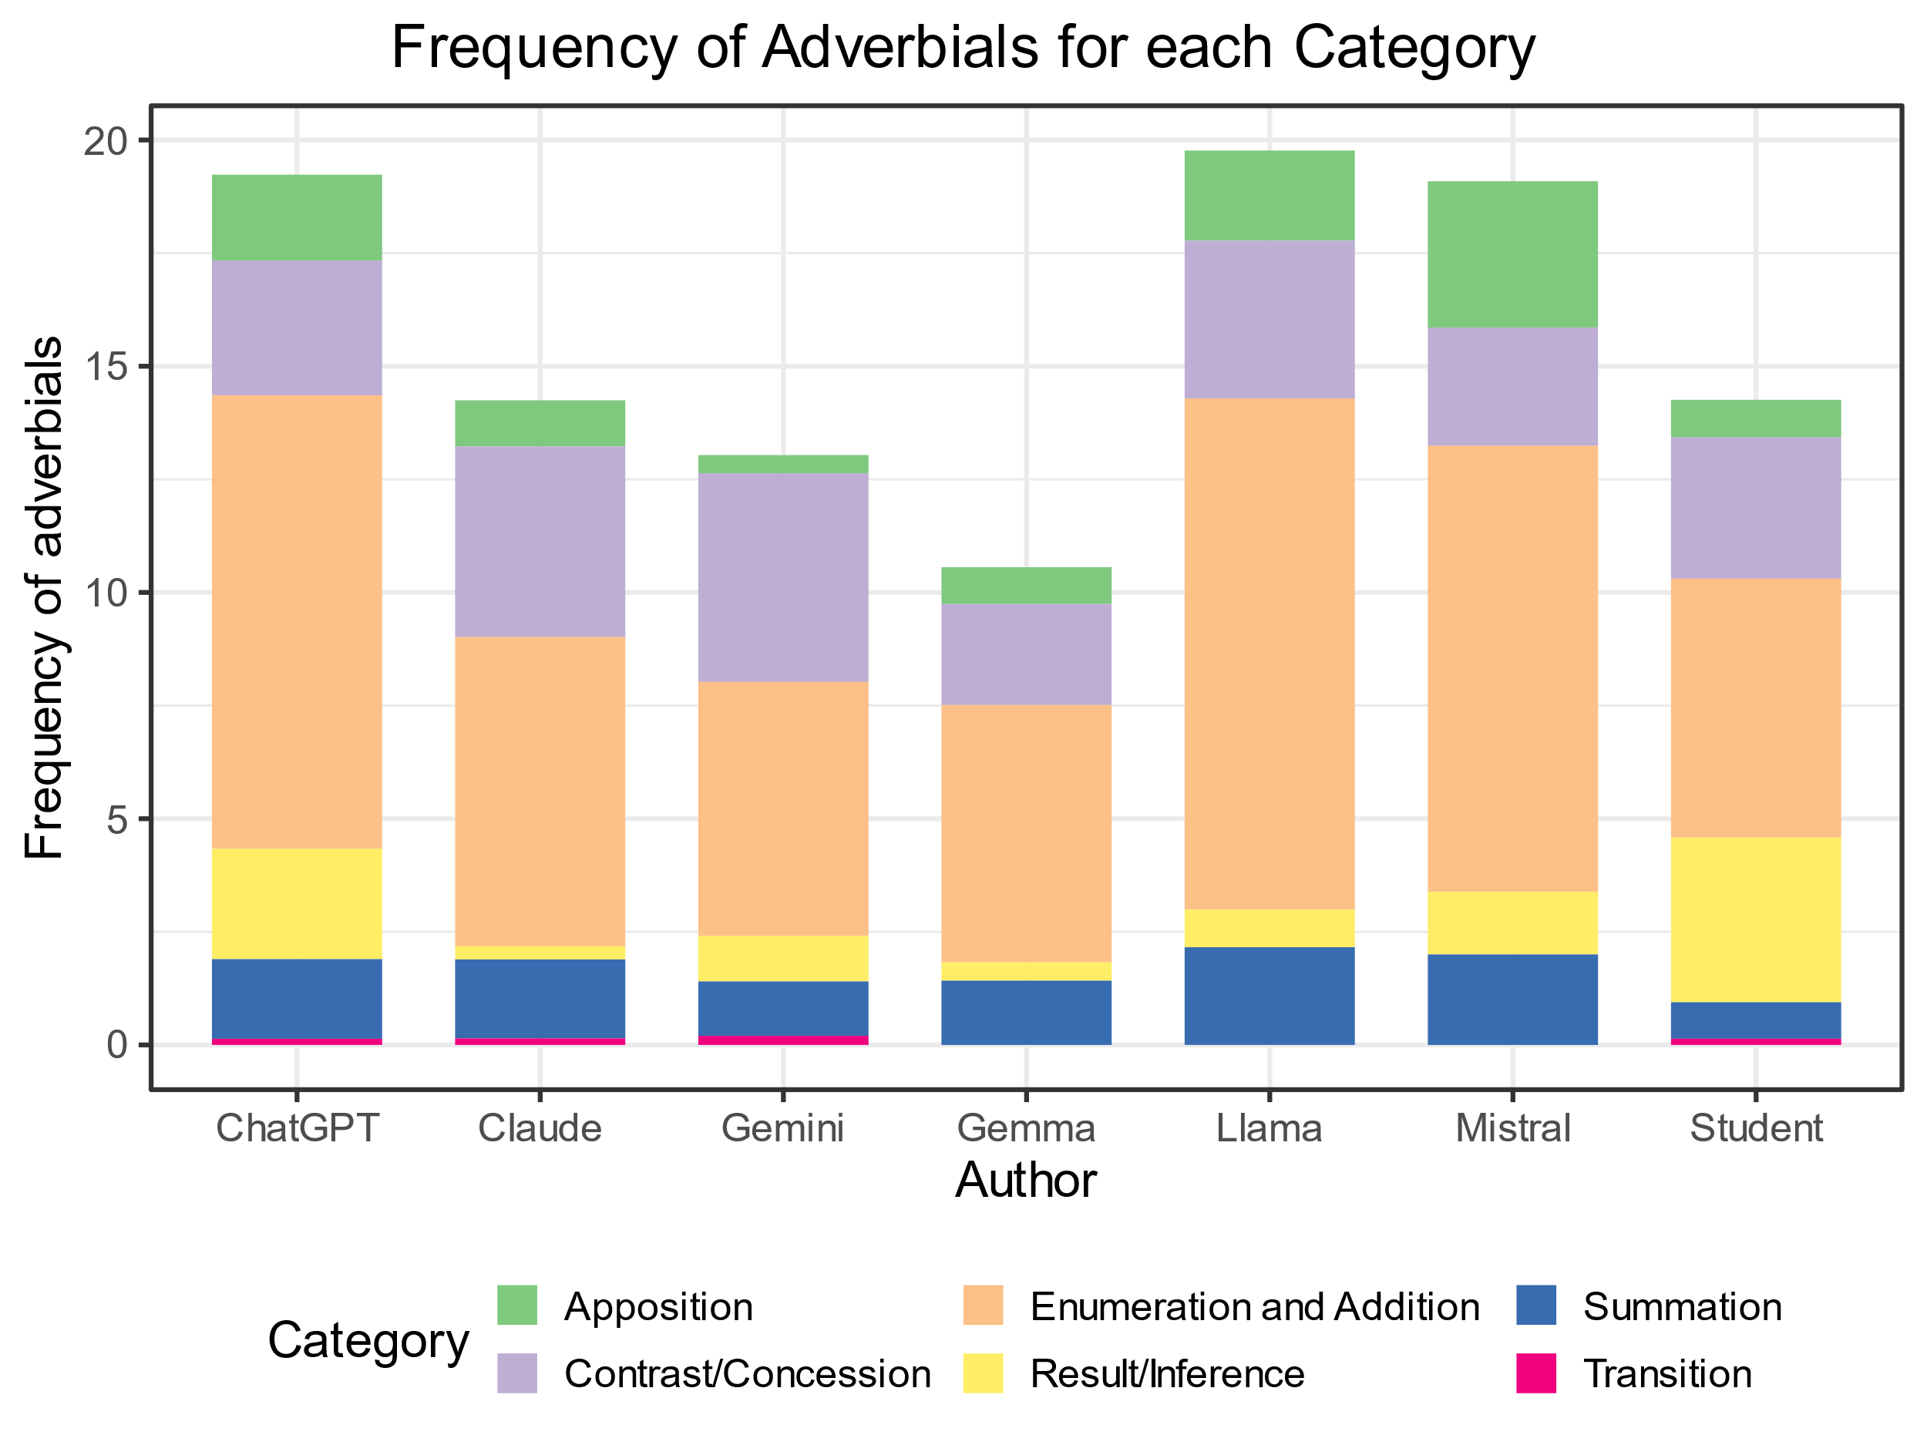
Detail of Biber’s categories
There are also differences across LLMs.
The differences seem to be relevant for the Apposition, Enumeration and Addition, Summation and Result/Inference categories, so the Kruskal-Wallis test was performed on these categories to see if the differences are statistically relevant.

Slide 55
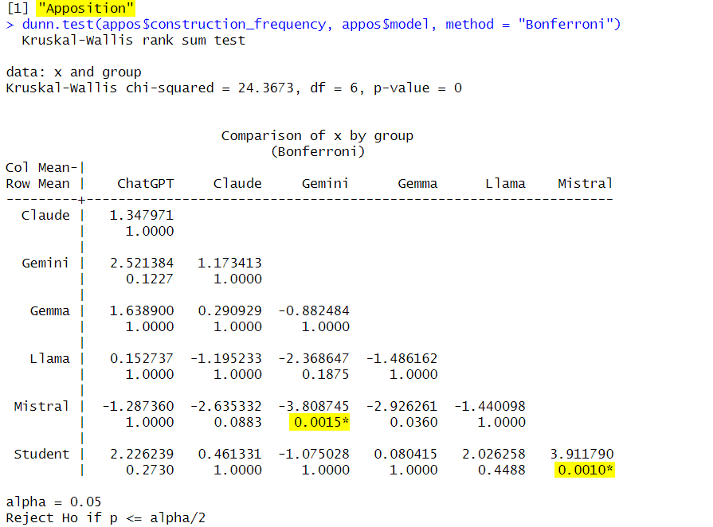
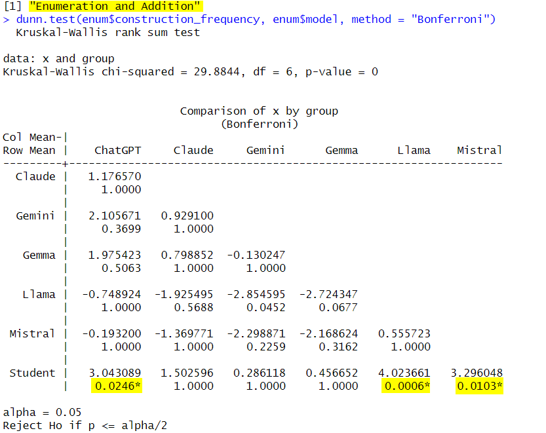
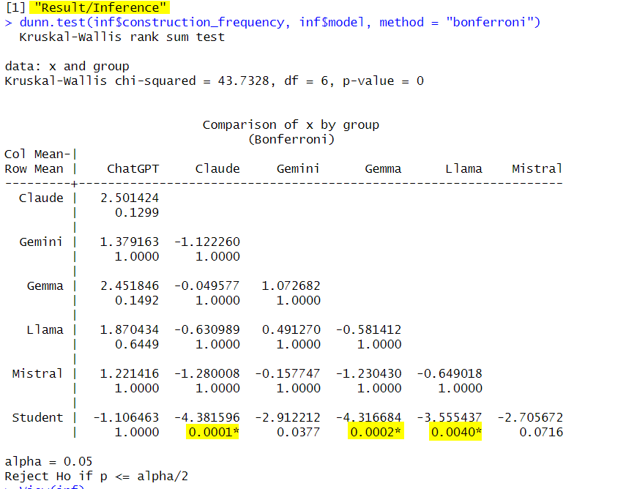
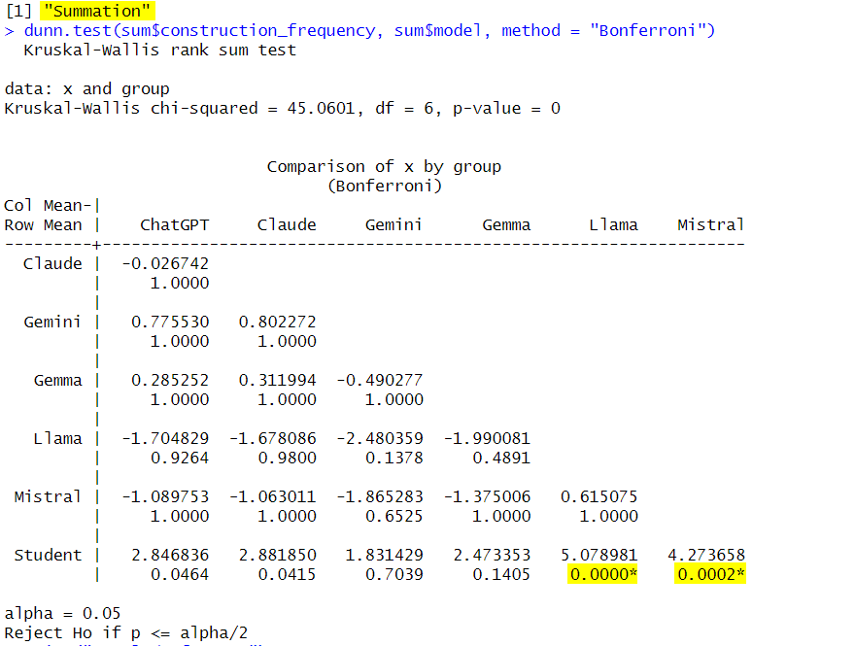
Kruskal-Wallis and Dunn test on the categories
The Kruskal-Wallis test shows that there are a statistically significant differences for at least one group (p-value=0) in all categories, so the Dunn test can be performed.
The Dunn test with Bonferroni correction shows that for the Enumeration and Addition, and Result/Inference categories the differences are statistically relevant between Students and three LLMs.

Slide 56
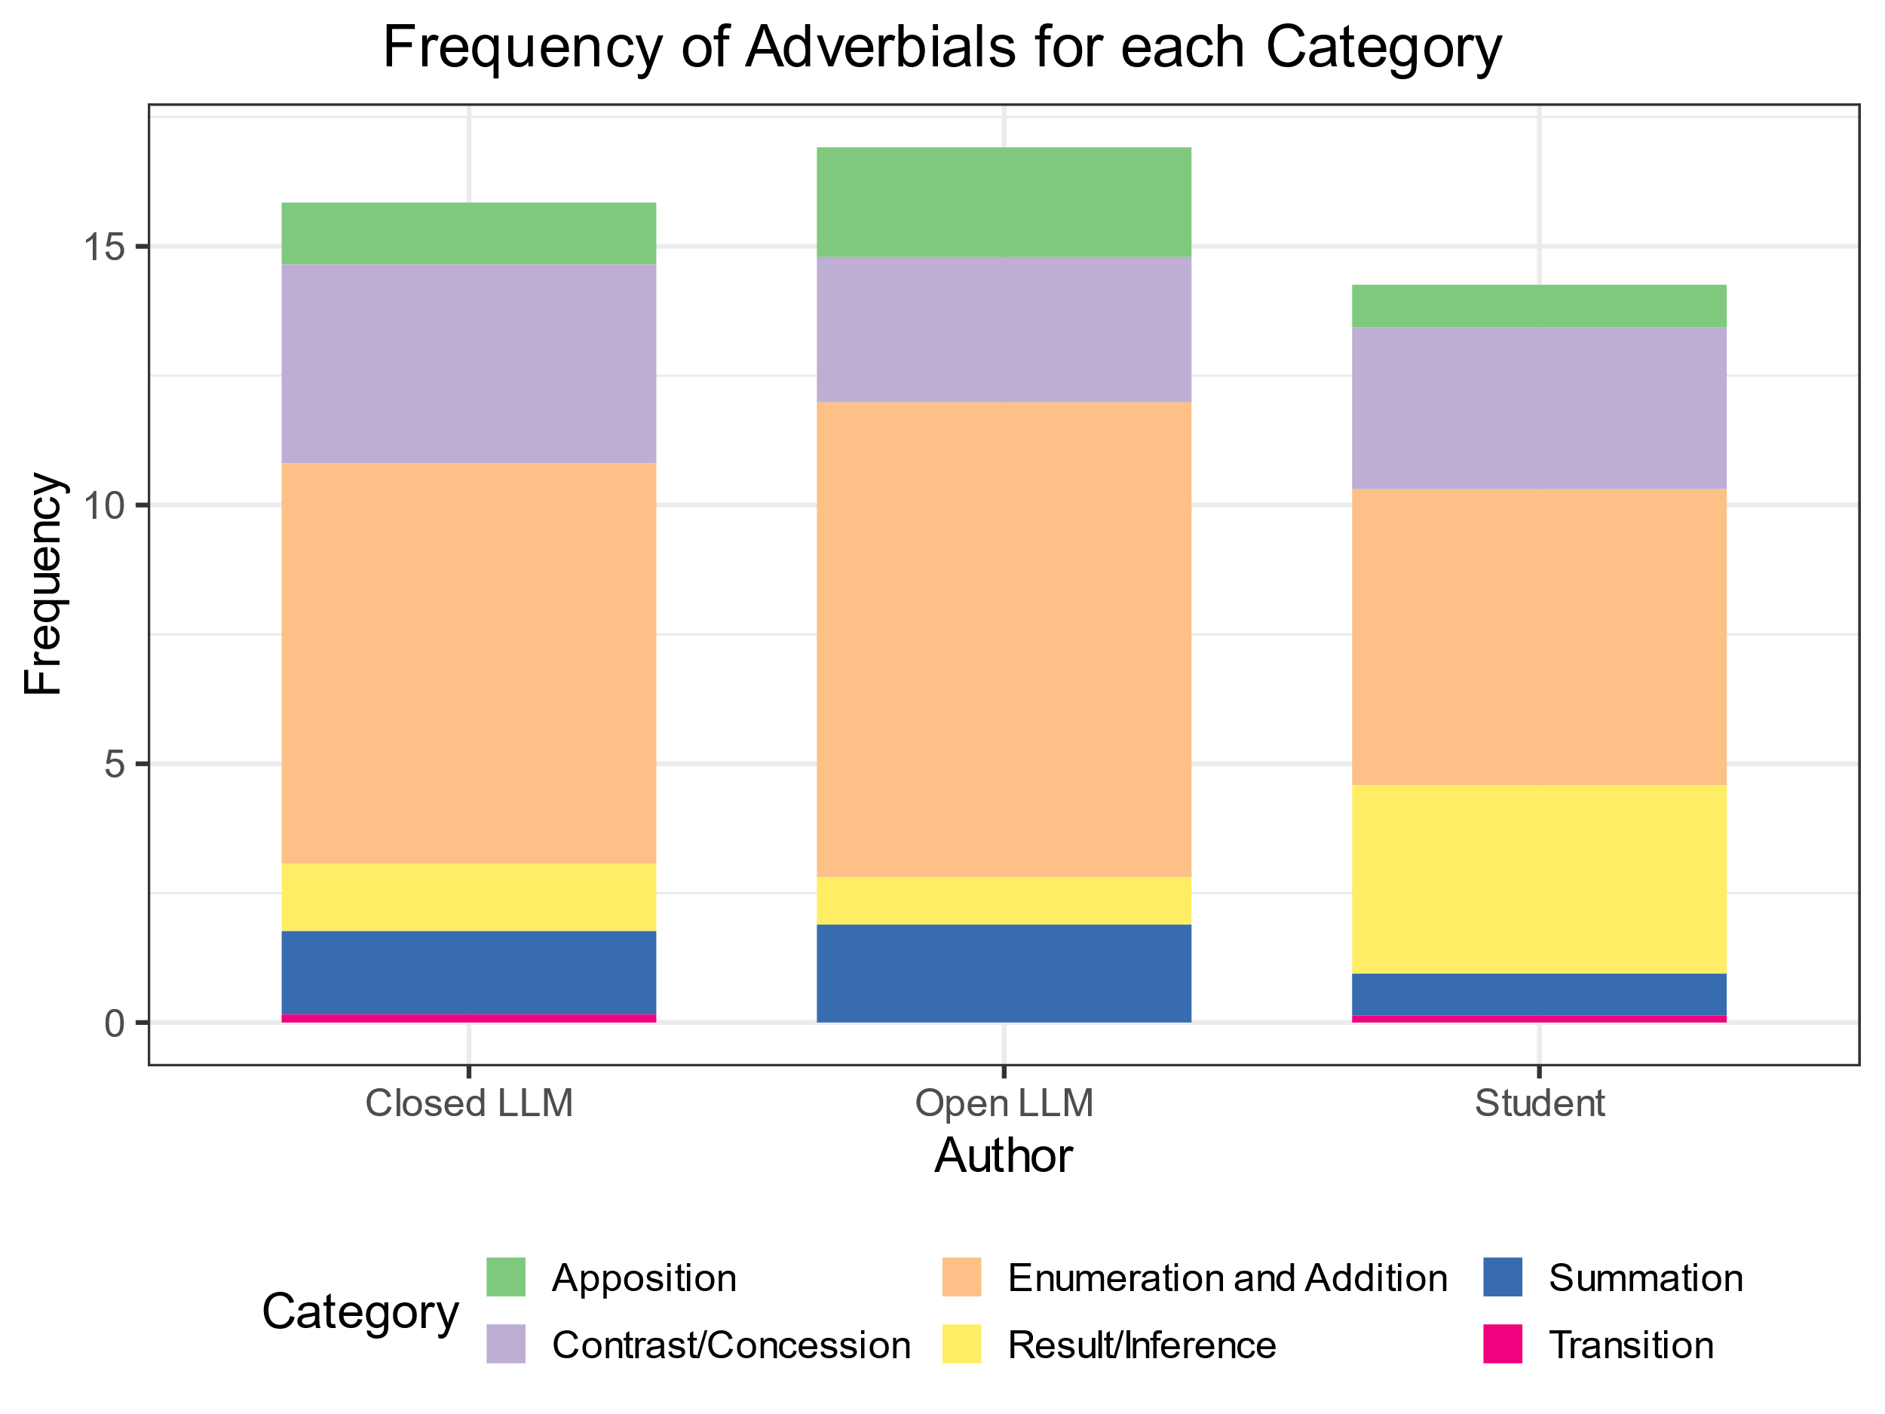
Comparison between Open LLMs, Closed LLMs and Students
Open LLMs use linking adverbials more frequently than Closed LLMs and Students.
The Kruskal-Wallis test showed that difference in frequencies between Open LLM, Closed LLMs and Students is not statistically relevant (chi-squared = 12.25, df = 6, p-value = 0.06).
Open LLMs use even fewer Result/inference adverbials than Closed LLMs.

Slide 57
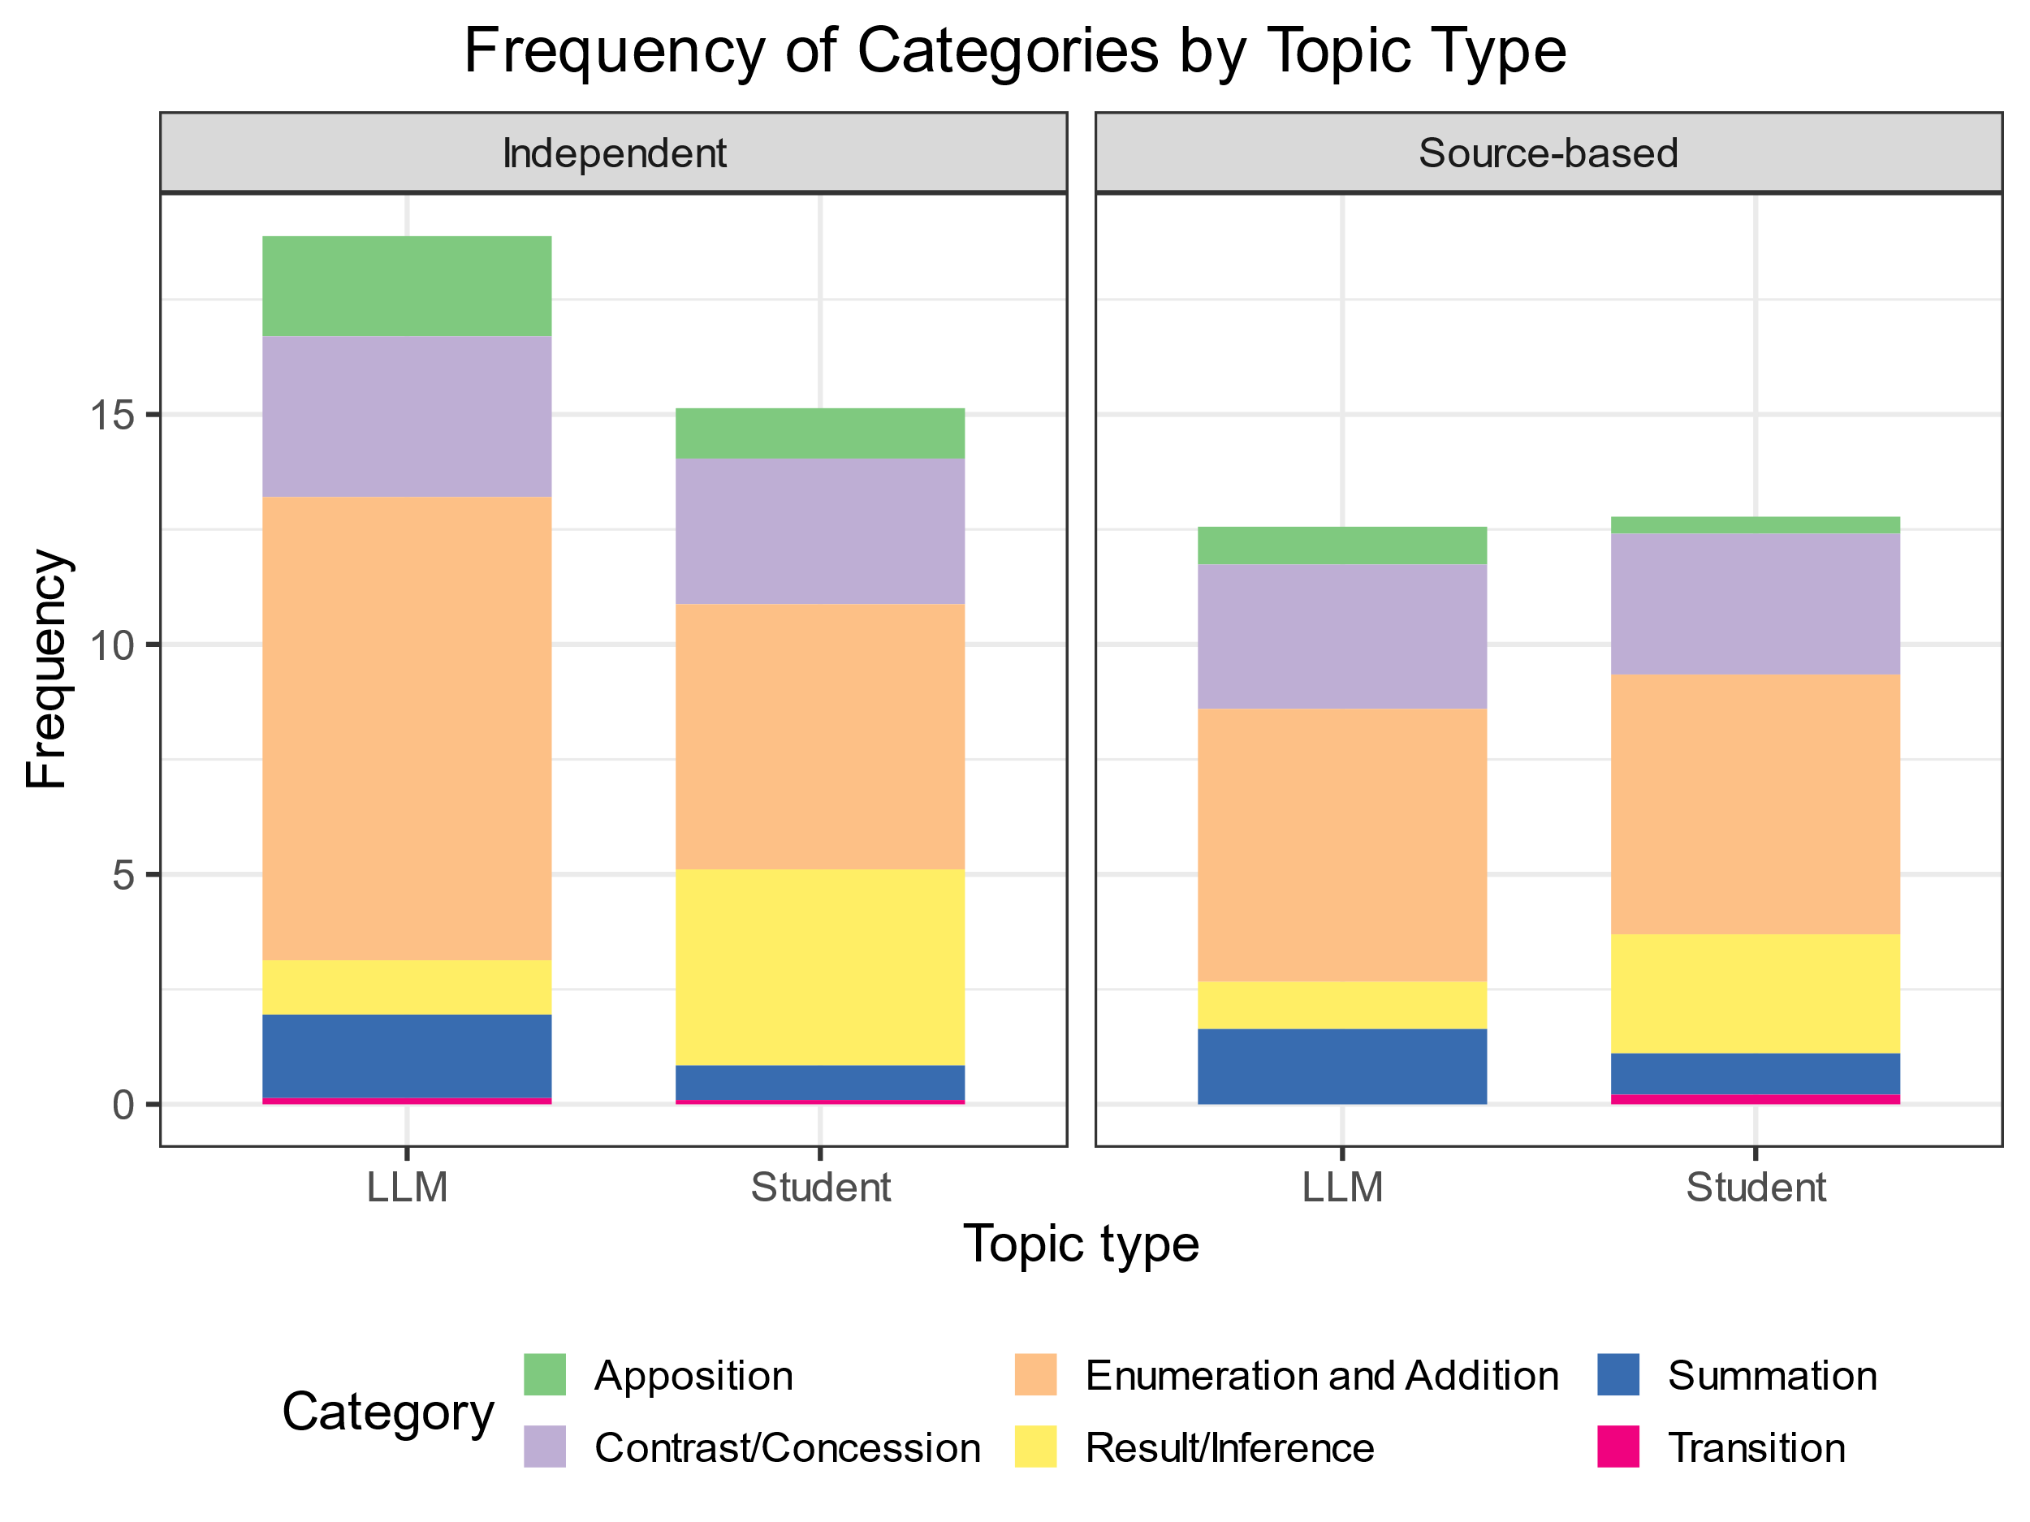
Frequency of categories by topic type
In independent essays LLMs use Enumeration and Addition adverbials very frequently, while Result/Inference adverbials are rare.
In source-based essays, both groups use fewer adverbials across all categories compared to independent essays. The reduction in Result/Inference adverbials is notable in LLMs

Slide 58
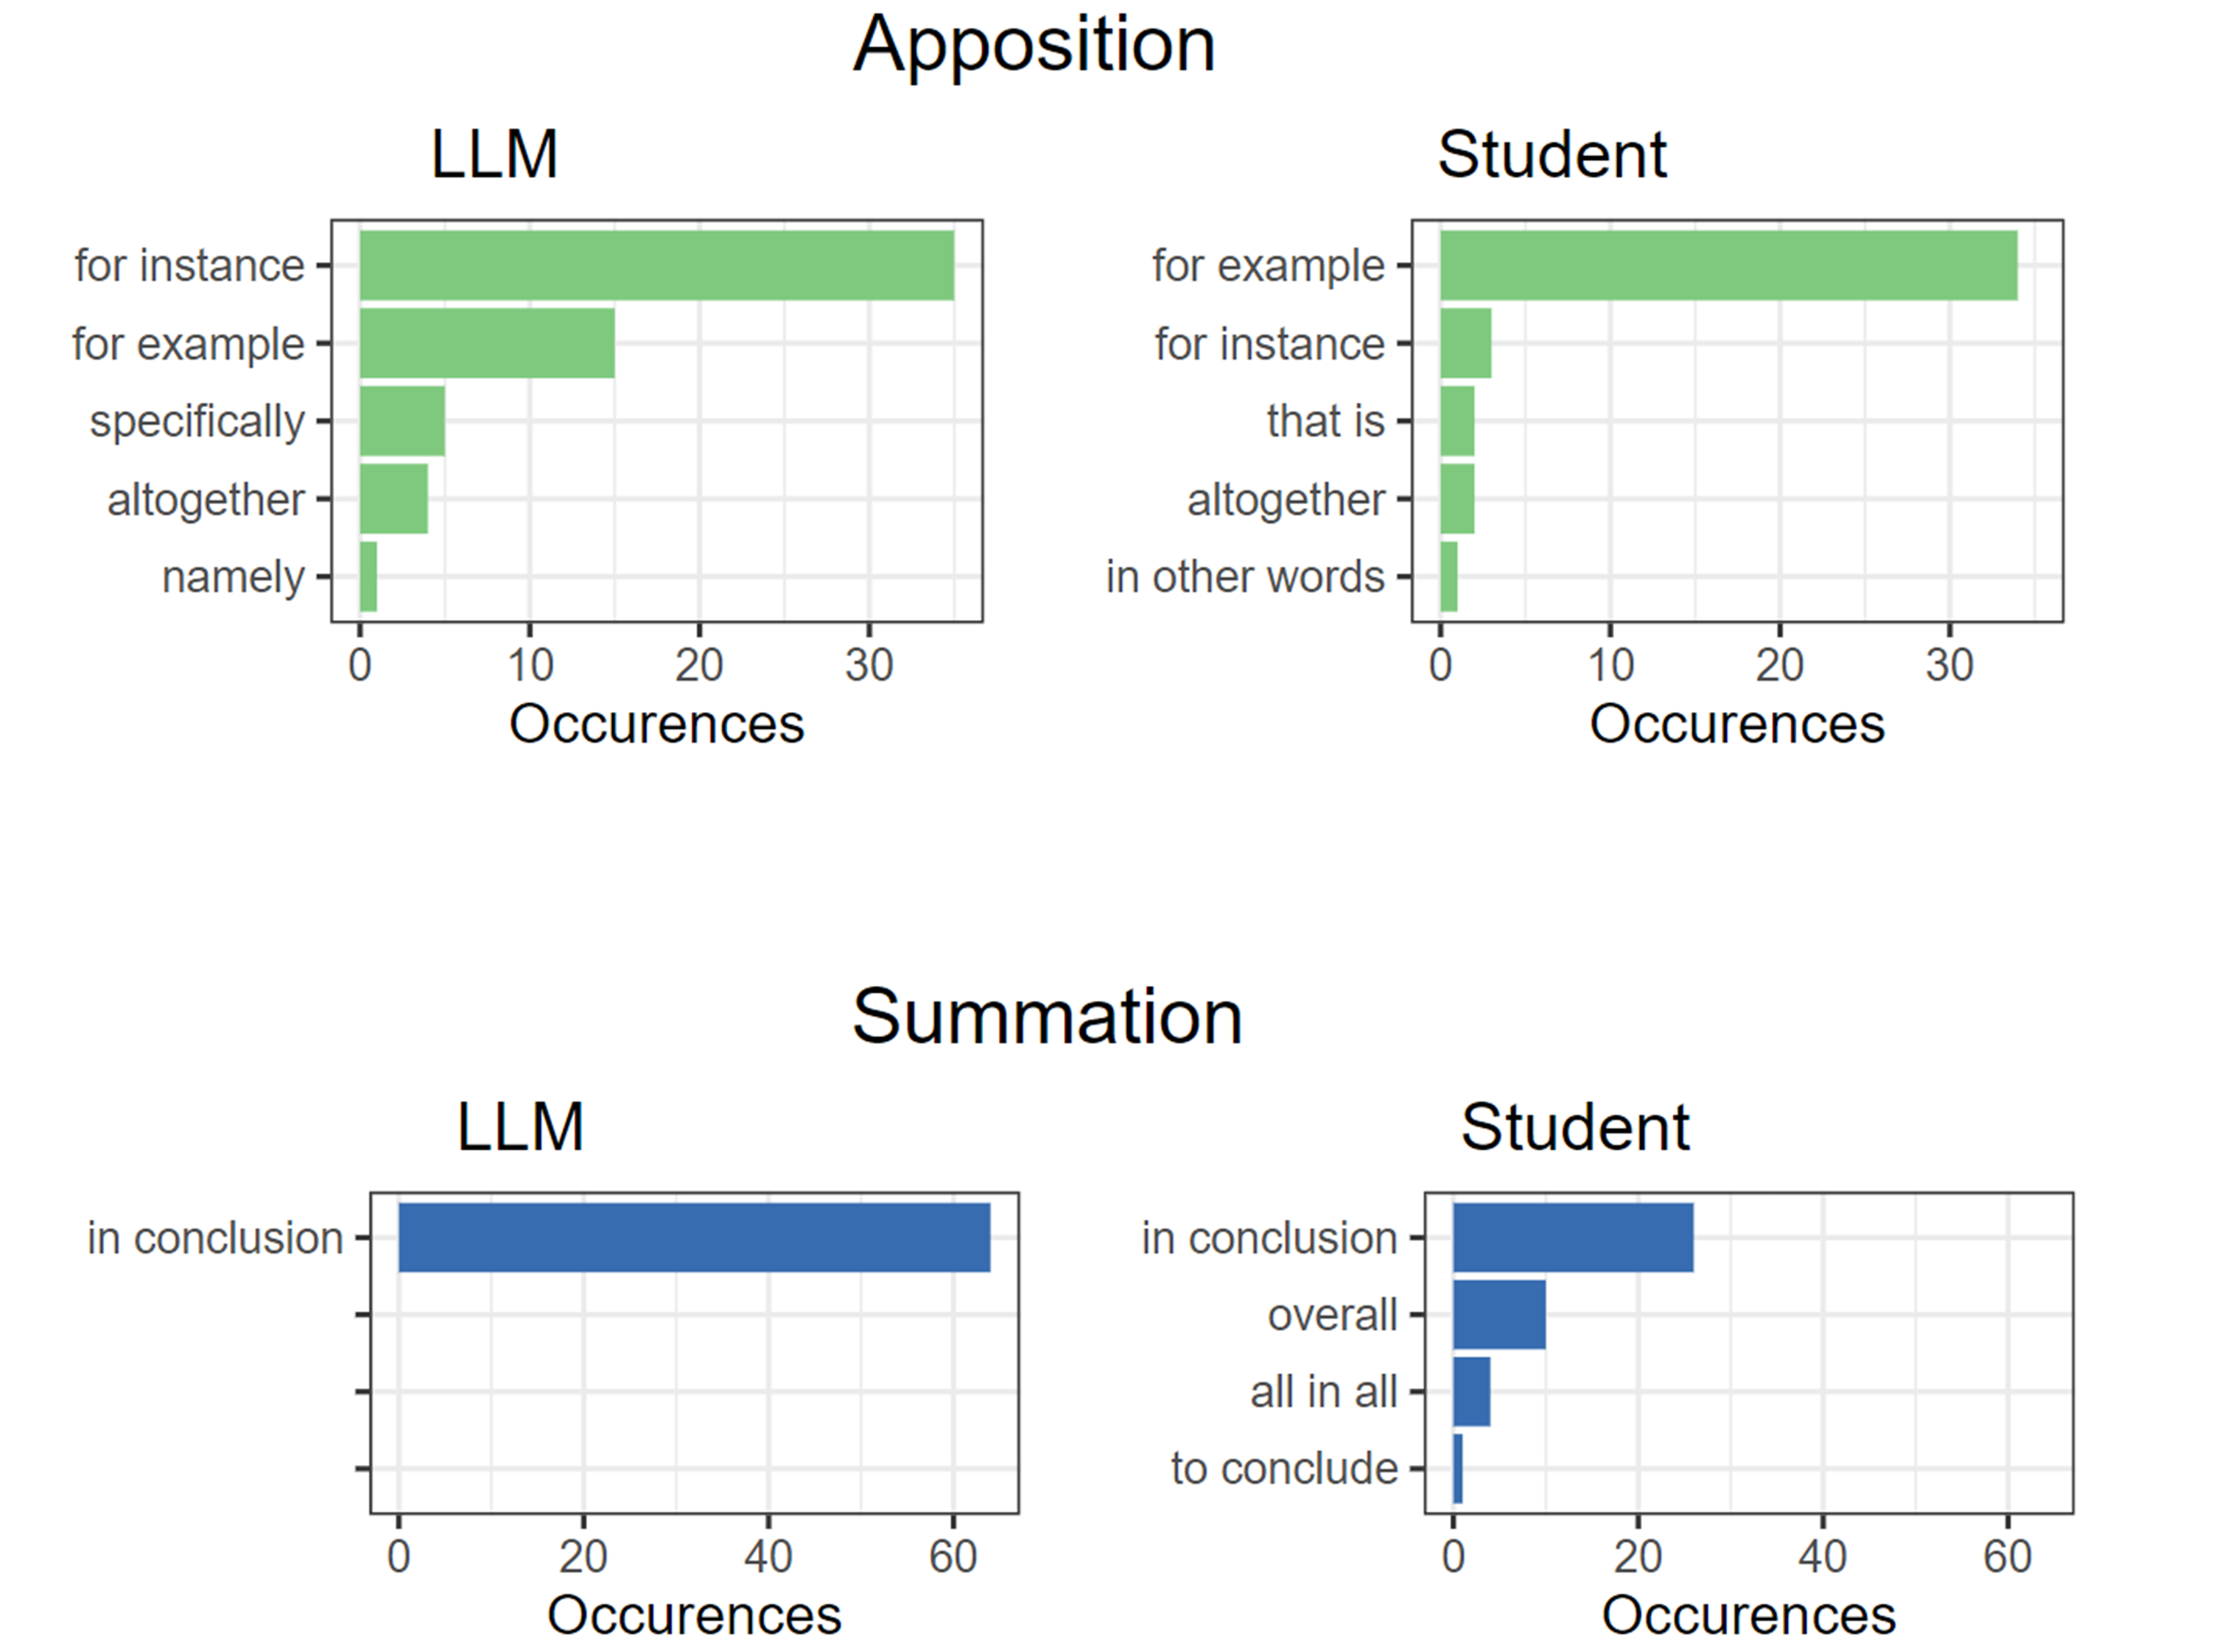
Most used Apposition and Summation adverbials
For Apposition adverbials, “for instance” and “for example” are the most used by both LLMs and Students, but “for instance” occurs only sporadically in student essays.
“Specifically” and “namely” are used only by LLMs while “that is” and “in other words” only by students.
For Summation adverbials, LLMs use only “in conclusion”, while students choose among four options.

Slide 59
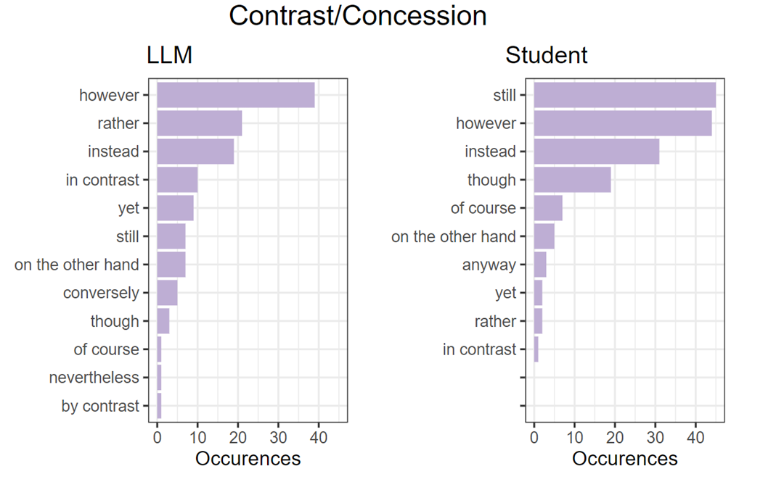
Most used Contrast/Concession adverbials
“still” is the preferred Contrast/Concession adverbial for students, while “however” is the most used by LLMs.
In this case, LLMs show more variability, they use “conversely”, “nevertheless” which do not appear in the Student corpus.
Students rely more heavily on words like "of course" and "anyway“.

Slide 60
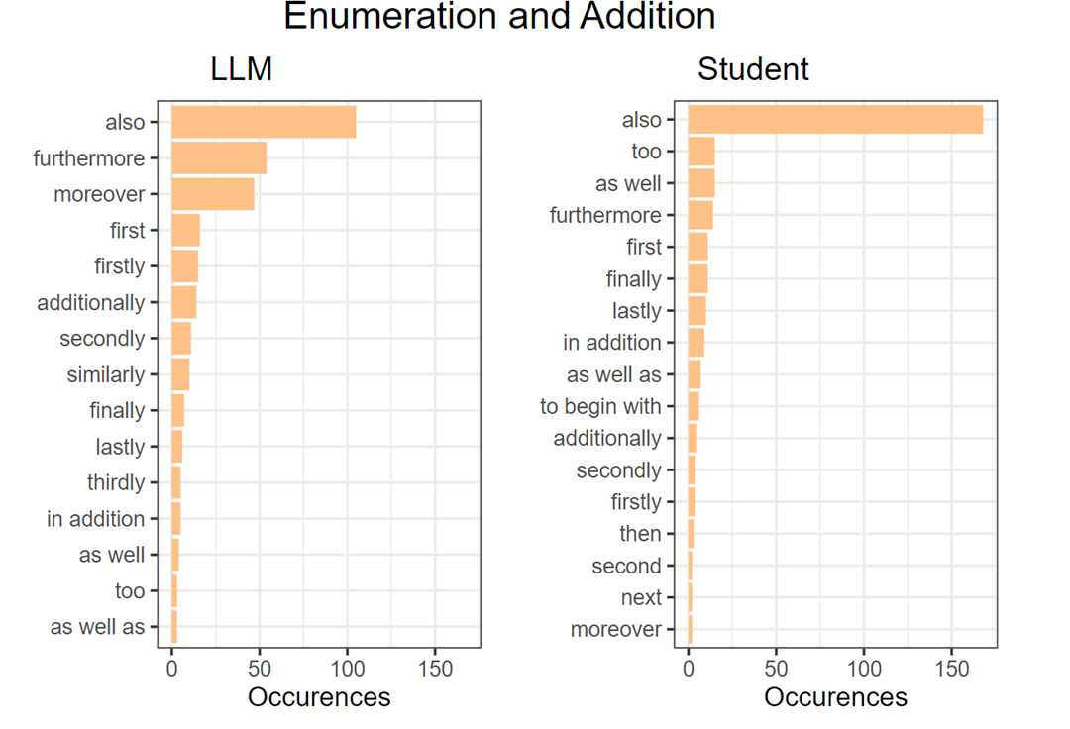
Most used Enumeration and Addition adverbials
Both the LLMs and students use the word “also” far more frequently than any other adverbial, especially students.
Students frequently use “too”, “as well”, which are rare in essays by LLMs.
LLMs use “furthermore”, “moreover”, “additionally” and “similarly” more frequently than students.

Slide 61
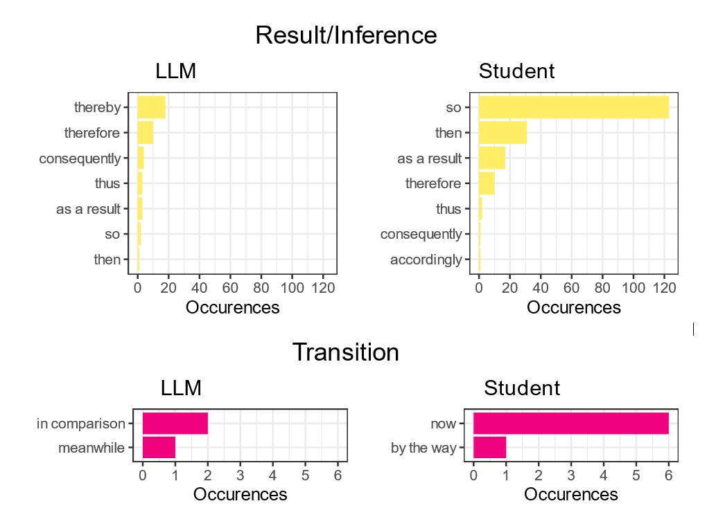
Most used Result/Inference and Transition adverbials
For Result/Inference adverbials, “so” is the most used by students, followed by “then”, while LLMs prefer “thereby”, which is not used by students, “therefore” and “consequently”.
For Transition adverbials, LLMs and students make completely different choices: “in comparison” and “meanwhile” are used by LLMs and “now” and “by the way” by students.

Slide 62
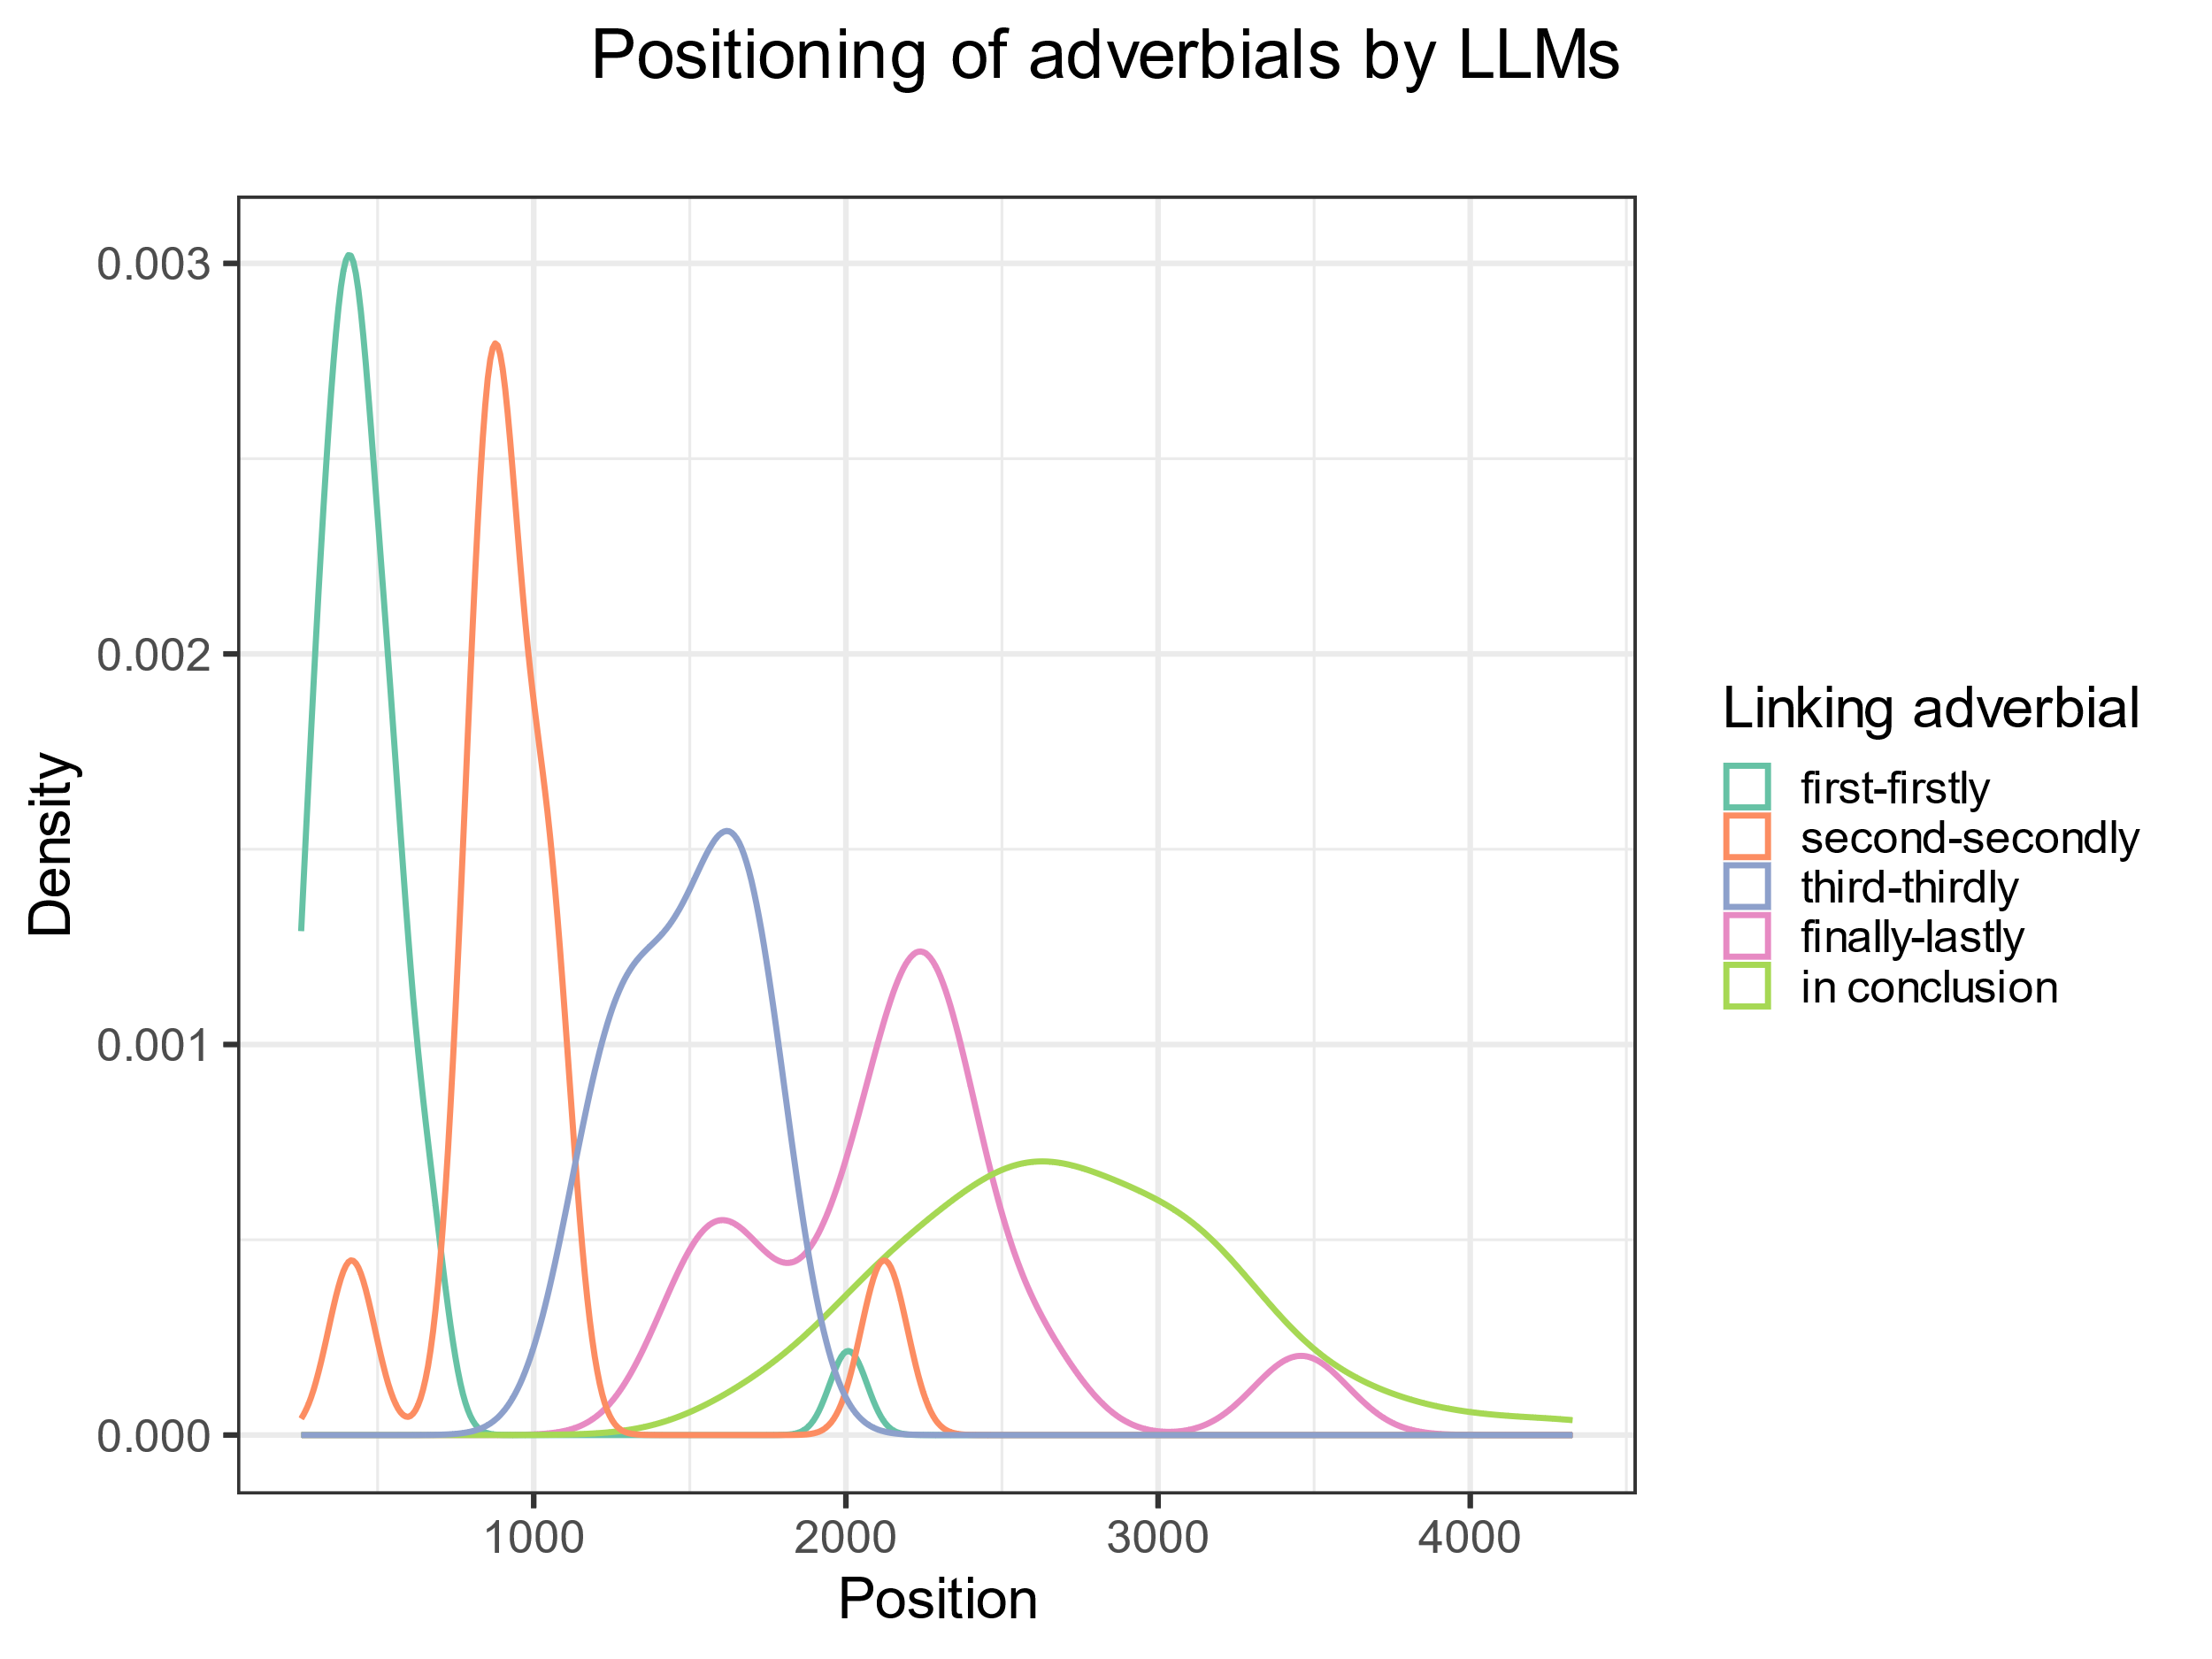
Use of Enumeration and Addition adverbials in LLMs
The density plot of the positioning of the occurrences of linking adverbials shows that they are used appropriately by LLMs (occurrences of “first-firstly” appear at the beginning, followed by “second-secondly”…)

Slide 63
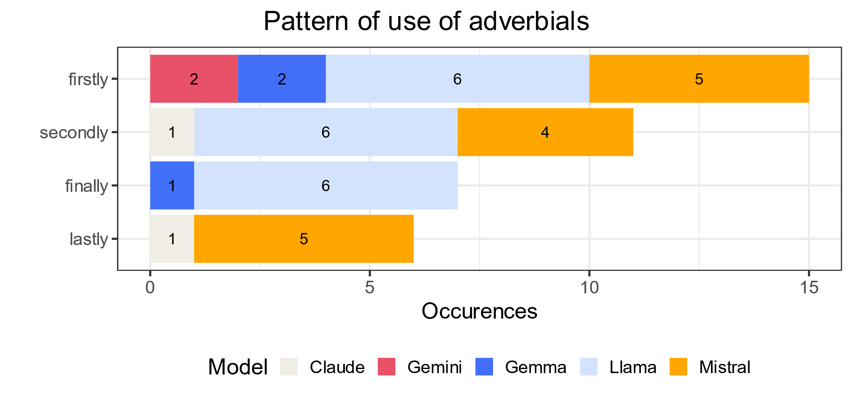
Pattern of use of Enumeration and Addition adverbials in LLMs
Llama and Mistral frequently use “firstly” followed by “secondly”.
While Llama uses “finally” six times to conclude the enumeration and never uses “lastly”, Mistral uses only “lastly” five times.

Slide 64
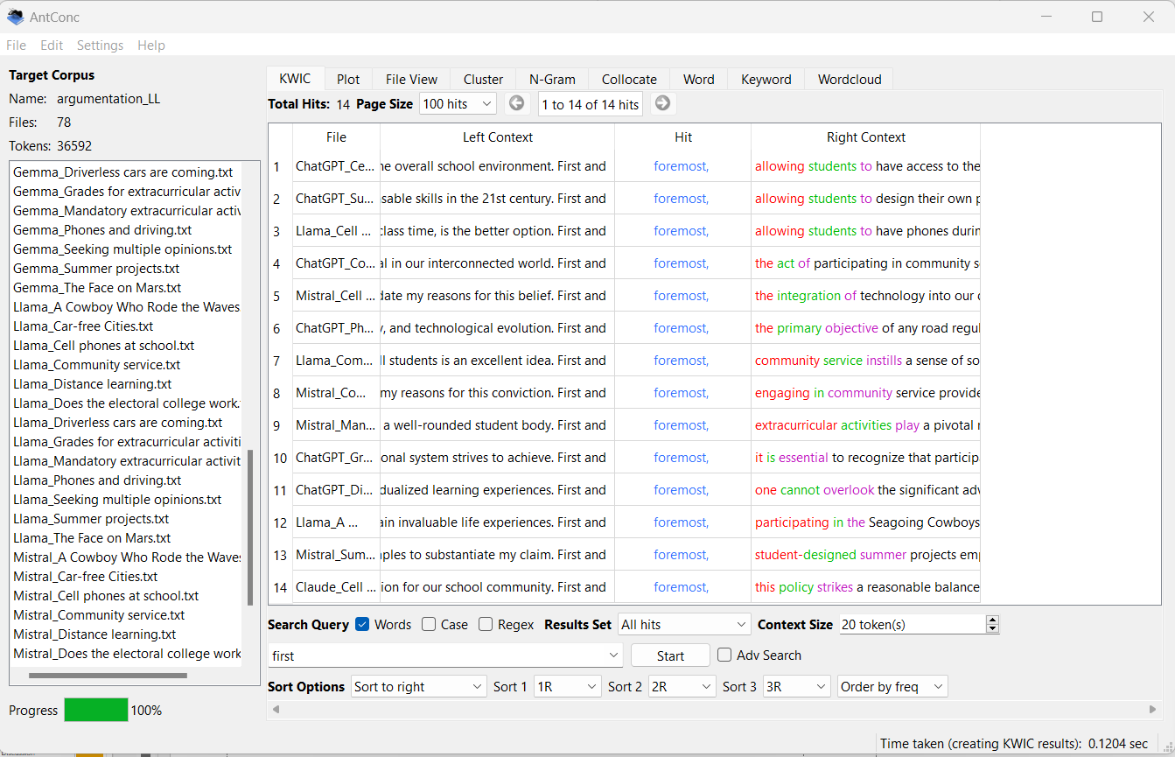
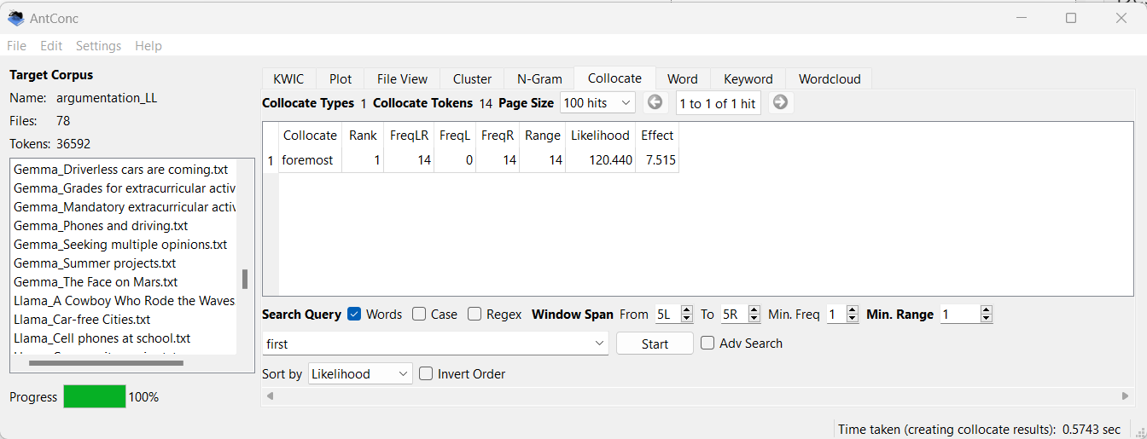
Use of “First and foremost” in LLMs
The only collocate for “first” in LLMs corpus is “foremost”.
“First and foremost” is used frequently by LLMs but it doesn’t appear in the Student corpus.

Slide 65
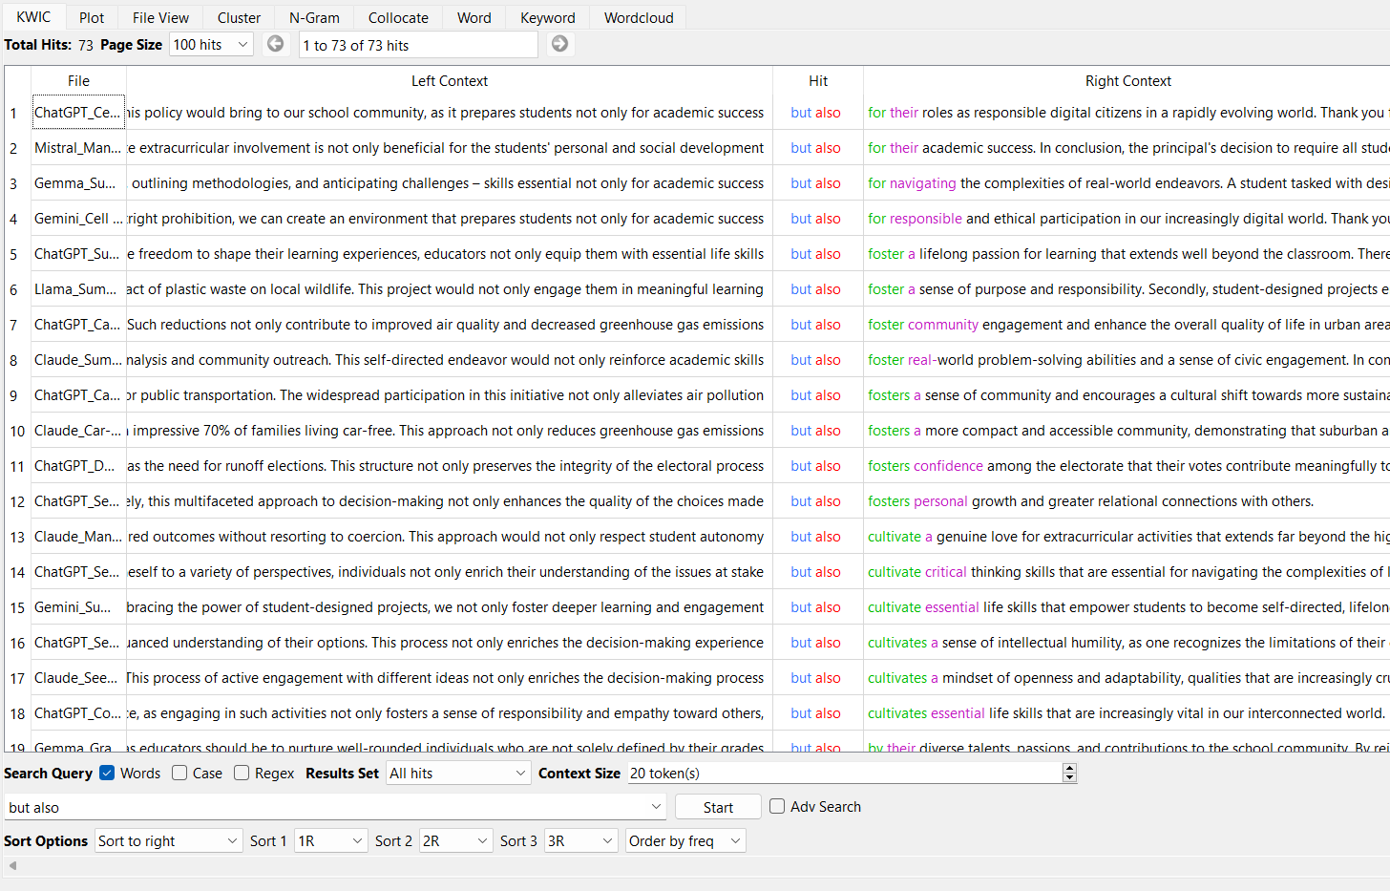
Use of “not only…but also” in LLMs
The pattern “not only…but also” is used frequently by LLMs and sparingly by Students (6 occurrences).

Slide 66
Discussion

Slide 67
Writing style and usage of adverbials (Q1)
Writing style: essays by students are longer and contain more sentences, but essays by LLMs contain longer sentences, which indicates more sophisticated and complex language use in LLMs.
Usage of adverbials: LLMs use linking adverbials more frequently than students, but the difference has been shown not to be statistically relevant. The slight difference also shows that LLMs do not overuse linking adverbials to sound more authoritative. The difference is even smaller in source-based essays: this can be explained considering that independent essays demand more explicit connections between ideas, while source-based essays rely more on content derived from external sources for coherence.
Usage across categories: Enumeration and Addition is the most frequent category in both LLMs and students, showing that both groups tend to structure arguments by adding points in a list-like manner. LLMs show a preference for Apposition, Enumeration and Addition, and Summation adverbials, while students more frequently employ Result/Inference adverbials.

Slide 68
Formality and formulaic language (Q1)
Language formality: while there is a large overlap in the choice of adverbials, LLMs tend to user more formal adverbials (e.g., "for instance" instead of "for example“, specifically”, “namely”, "conversely", "nevertheless”…), while students use more colloquial language (“that is”, “in other words”, "still", "anyway", "of course", "too“…). In particular, for Result/Inference adverbials students use frequently "so" and "then", which Biber [Biber et al., 1998, p. 887] reports as the most frequent in conversation.
Formulaic language use: LLMs show a preference for fixed constructions (“Not only...but also”, “First and foremost”), which are infrequent or absent in student corpus.
Repetitive patterns: Open-source LLMs (Llama, Mistral) show a repetitive use of certain patterns (“firstly”, “secondly”, “finally/lastly”), which results in more standardized, less diverse writing style. The use of formulaic expression and repetitive patterns reveals the statistical nature of LLMs training process.

Slide 69
Comparison between open and closed LLMs (Q2)
Gemma (the smallest open LLM) produces shorter essays and shows lower frequency of adverbial use, but it is comparable with Gemini (closed).
Closed LLMs (especially ChatGPT) are more consistent in essay length, while open LLMs (especially Mistral) show more variability. Claude (closed) shows some variability, similar to open models
Open models like Llama and Mistral perform comparably to closed models (e.g., ChatGPT) in terms of linking adverbial use and essay structure.
Open LLM (Llama and Mistral) rely more heavily on formulaic expressions (e.g., "firstly", "secondly", "finally"/"lastly").
ChatGPT is closer to students in the use of Result/Inference adverbials.
We can conclude that the larger open LLMs (Llama and Mistral) perform very closely to ChatGPT in argumentative writing and outperform other closed LLMs (especially Gemini).

Slide 70
Difference in Result/Inference adverbials (Q3)
The use of fewer Result/Inference adverbials by LLMs is worth analyzing.
[Herbold et al. 2023] found fewer discourse markers in AI-generated texts. According to them, the reason students use more discourse markers than LLMs “could be due to a greater reliance on explicit markers to guide readers through their arguments, whereas LLMs might generate text with more inherent logical flow, reducing the need for such markers”.
Here we propose another explanation based on Hyland’s theory of metadiscourse [Hyland, 2018].
Hyland makes a distinction between transition and structuring signals (which include Enumeration and Addition adverbials) and resultative and framing signals (which include Result/Inference adverbials).

Slide 71
Difference in Result/Inference adverbials (Q3)
Transition and structuring signals, “while essential for readability and flow, do not add any propositional information to a discourse but serve to make explicit relations that already exist in a text by virtue of the meanings of the propositions that they link”. They do not contribute to shaping the content of the text but serve to guide the reader through the argument.
In contrast, resultative and framing signals “are tied directly to the core content and argument of the text, often indicating critical connections and conclusions”. They show that the writer is actively guiding the reader toward a particular interpretation or conclusion, they are used to emphasize the importance of certain claims or to signal key turning points in the argument. They play a direct role in constructing and framing the argument within a specific perspective.
The lower frequency in LLM-generated essays indicates that LLMs are less inclined to express a sense of personal perspectives and persuasive interactions that are essential in argumentative writing.

Slide 72
Difference in Result/Inference adverbials (Q3)
The use of fewer adverbials suggests that LLMs focus more on logical flow than persuasion. Their emphasis is on how to argue, not on what is being argued.
This makes LLMs similar to ancient Greek Sophists in their use of rhetoric, where structure is prioritized over truth or conviction. Like the Sophists, LLMs can argue both sides without having personal beliefs or preferences.
As a result, LLM-generated arguments may feel mechanical or detached, lacking the personal touch that human writers use to persuade and express judgment.
This suggests investigating Hyland’s interactional metadiscourse linguistic features to better understand the differences between LLMs and students in engaging with their readers, guiding interpretation, and managing interactions.

Slide 73
Conclusion

Slide 74
Key points
Linguistic Sophistication: LLMs demonstrate a capacity for producing sophisticated, formally structured argumentative essays, often using more complex sentence structures and formal language than students.
Adverbial Usage Patterns: While LLMs use linking adverbials slightly more frequently than students, there are notable differences in usage across categories. LLMs show a preference for Enumeration/Addition and Apposition adverbials, while students more frequently employ Result/Inference adverbials.
Formulaic vs. Natural Language: LLMs, particularly open-source models, show a tendency towards formulaic language patterns, which contrasts with the more varied writing style of students.
Personal Perspective: The lower frequency of Result/Inference adverbials in LLM-generated texts suggests potential limitations in injecting personal perspective into arguments, a key aspect of persuasive writing.
Further Research: Investigating Hyland’s interactional metadiscourse to better understand the differences on how LLMs and humans engage with the readers.

Slide 75
References
[Appel & Szeib, 2018] Appel, R., Szeib, A., Linking adverbials in L2 English academic writing: L1-related differences, System (2018), doi: 10.1016/j.system.2018.08.008
[Biber et al, 1999] Biber, D., et al. (1999). Longman grammar of spoken and written English. Edinburgh: Pearson Education Ltd.
[Brezina, 2018] Vaclav Brezina, Statistics in Corpus Linguistics, Cambridge University Press, 2018
[Crossley et al, 2022] Scott A. Crossley, Perpetual Baffour, Yu Tian, Aigner Picou, Meg Benner, Ulrich Boser, The persuasive essays for rating, selecting, and understanding argumentative and discourse elements (PERSUADE) corpus 1.0, Assessing Writing, Volume 54, 2022
[Halliday & Hasan, 1976] Halliday, M. A. K., & Hasan, R. (1976). Cohesion in English. English Language Series, London: Longman
[Herbold et al., 2023] Herbold, S., Hautli-Janisz, A., Heuer, U. et al. A large-scale comparison of human-written versus ChatGPT-generated essays. Sci Rep 13, 18617 (2023)

Slide 76
[Hinton & Wagemans, 2023] Hinton, Martin and Wagemans, Jean, How persuasive is AI-generated argumentation? An analysis of the quality of an argumentative text produced by the GPT-3 AI text generator, Argument & Computation 14 (2023) 59–74
[Hyland, 2018] Hyland, K., (2018) Metadiscourse - Exploring Interaction in Writing, Bloomsbury Academic
[McNamara et al, 2010] McNamara, D. S., Crossley, S. A. & McCarthy, P. M. Linguistic features of writing quality. Writ. Commun. 27, 57–86 (2010)
[Sardinha, 2024] Tony Berber Sardinha, AI-generated vs human-authored texts: A multidimensional comparison, Applied Corpus Linguistics, Volume 4, Issue 1, 2024
[Somasundaran et al, 2018] Somasundaran, S. et al. Towards evaluating narrative quality in student writing. Trans. Assoc. Comput. Linguist. 6, 91–106 (2018)
[Stab & Gurevich, 2017] Christian Stab and Iryna Gurevych. 2017. Parsing Argumentation Structures in Persuasive Essays. Computational Linguistics, 43(3):619–659
[Tudino & Qin, 2023] Tudino, Giordano and Qin, Yan, A Corpus-Driven Comparative Analysis of Ai in Academic Discourse: Investigating Chatgpt-Generated Academic Texts in Social Sciences. Available at http://dx.doi.org/10.2139/ssrn.4891634
[Weiss et al, 2019] Weiss, Z., Riemenschneider, A., Schröter, P. & Meurers, D. Computationally modeling the impact of task-appropriate language complexity and accuracy on human grading of German essays. In Proceedings of the Fourteenth Workshop on Innovative Use of NLP for Building Educational Applications, 30–45

Slide 77


Thank you
Giovanna Tonazzo - 5216819
giovanna.tonazzo01@icatt.it

