Slide 1
Kubernetes Basics
Antonin Stoklasek | 29th October 2018

Slide 2

Antonin Stoklasek
Technical Team Lead
Java, Docker, React …
Banking Software Company
Osomahe
Twitter @tonda100
GitHub tonda100

Slide 3
Agenda
What is kubernetes?
Basic elements
Logging and monitoring
Advanced topics

Slide 4
What is kubernetes
Orchestration for containers
Manages lifecycle of containers
Open Source (Go)
Developed by Google
Docker, rkt, etc.

Slide 5
Installation
Localhost – Docker, Minikube
On premise – own hardware
Cloud (AWS, GCE) – using kops, kadmin
Cloud Managed – EKS, GKE, AKS
Hybrid

Slide 6
kubectl
Command line interface
Manages Kubernetes cluster
Support – Windows, Linux, MacOS
https://kubernetes.io/docs/tasks/tools/install-kubectl/

Slide 7
Task 1
Install kubernetes cluster
Install kubectl
Verification command – “kubectl get nodes“

Slide 8
Pod
Group of one or more containers
Tightly coupled
Communication via localhost
Smallest deployable unit

Slide 9
Deployment
Definition of deployment
Multiple pods
Stateless deployment

Slide 10
Service
Logical set of pods
Using label selector
Type
ClusterIP – default, reachable within the cluster
NodePort – expose service via port [30000-32767]
LoadBalancer – using cloud provider’s load balancer e.g. ELB

Slide 11
HEalthcheck
Part of pod definition
Running command in container
URL http checks
Liveness Probe – container is running
Rediness Probe – container is ready to serve trafic

Slide 12
Resources
CPU and memory restrictions
Requests – necessary for container
Limits – maximum for container

Slide 13
Secrets
Used for distribution – credentials, keys, passwords etc.
Usage
Environment variable
File in pod

Slide 14


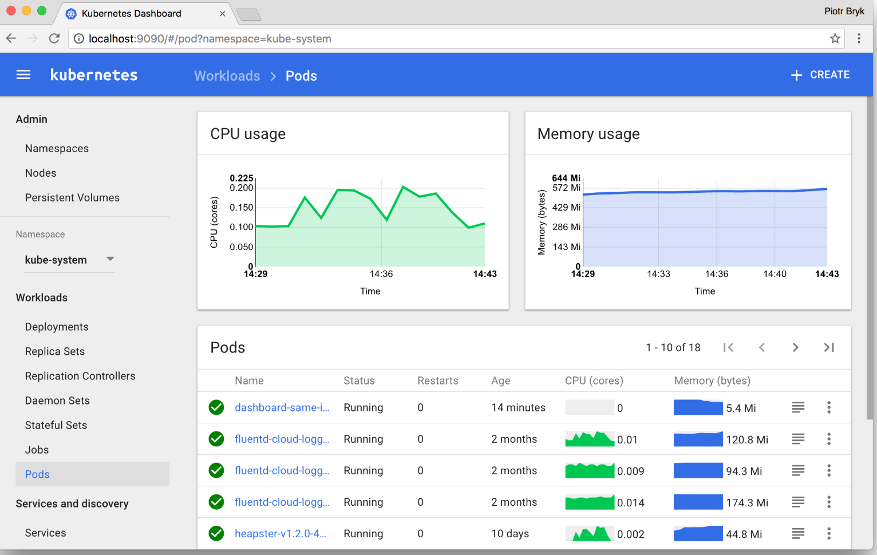
Web UI
web-based Kubernetes user interface
Similar set of operations as kubectl

Slide 15
ConfigMap
Configuration parameters - NOT secret
Contains
Key-value pairs
configuration files
Using for container customization

Slide 16
Logging
Centralized necessary
System output
Logging agents
ELK stack
LogDNA
Splunk
Fluentd

Slide 17
ALERTING & Monitoring
Must have
Prometheus + Kibana
Datadog
Instana
NewRelic
…

Slide 18
Advanced
Secrets Management - Security Vaults (Harshicorp, Aqua, Twistlock)…
Persistence Volumes – EBS, AzureDisk, Ceph, GlusterFS, OpenEBS …
Helm – package manager for kubernetes
Service Mesh - Istio
HorizontalPodAutoscaler, StatefulSet, DeamonSet, Ingress

Slide 19
Summary
Never deploy pod directly – use Deployment or StatefulSet
Use Services for inner cluster communication
Production requirements
Resource restrictions
Health checks
Logging
Alerts and Monitoring

Slide 20
Thank YOU

