Slide 1

Docker for beginners
Build, Ship, and Run Anywhere
Antonin Stoklasek | 18th May 2017

Slide 2

Antonin Stoklasek
Technical Team Leader
Programmer 10+ years
BSC Praha
Java, Docker, React, …
Twitter @tonda100
GitHub tonda100

Slide 3
Agenda
What is Docker
How to run container
How to build docker image
How to ship docker image

Slide 4
What is Docker
Container platform
Lightweight virtualization
Single responsibility
Layer architecture
No memory restrictions
No CPU restrictions

Slide 5
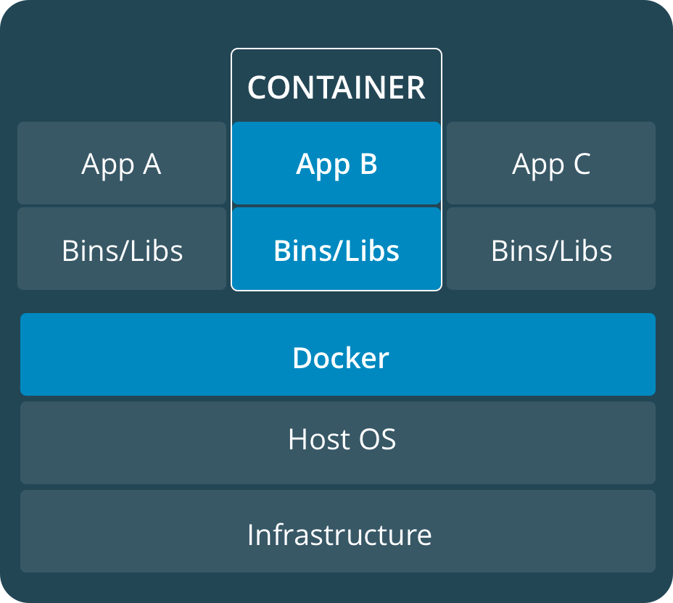
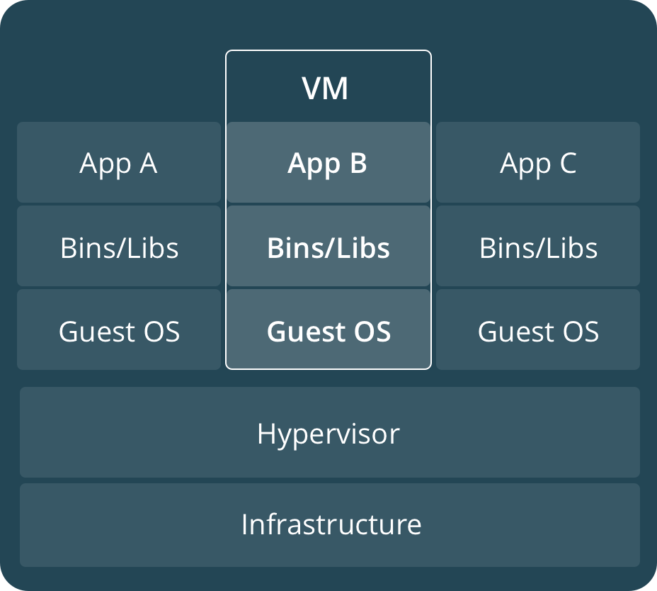
Container vs VM

Slide 6
Docker
Repository – storage for images http://hub.docker.com
Image – read-only template for container
Container – instance of image write layer

Slide 7
Demo Docker Hub docker run ...

Slide 8
Layer architecture

Slide 9
Dockerfile
Build file for Image
FROM
Single command => new layer

Slide 10
Container lifecycle
Pull docker image
Start container from image
Stop container
Remove container

Slide 11
Docker features
Environment variables
Volumes
Docker network

Slide 12
Demo FE image BE image

Slide 13
Thank you

