Slide 1


PRESENTATION
Event Sourcing
Antonin Stoklasek
4th October 2018

Slide 2


Antonin Stoklasek
Technical Team Lead
Programmer 10+ years
Banking Software Company
Java, Docker, React, …
Twitter @tonda100
GitHub tonda100

Slide 3
Events matters
State is irrelevant

Slide 4
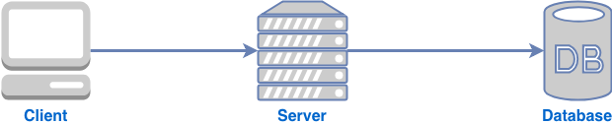
Traditional approach

Slide 5
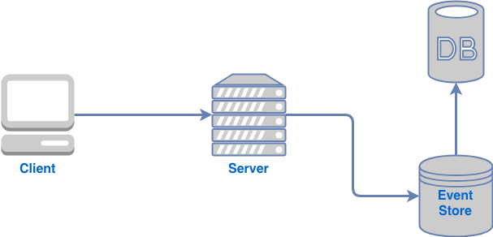
Event Sourcing approach

Slide 6
Why?
Events -> State
Not loosing information
Time travelling
Audit log out of the box
Append only model easier to scale
Loose coupling
Great integration pattern
Real wolrd abstraction
Performance

Slide 7
Issues
Eventual consistency
Event upgrading
Not traditional
Append only – data bigger and bigger

Slide 8
Thank you

