Slide 1
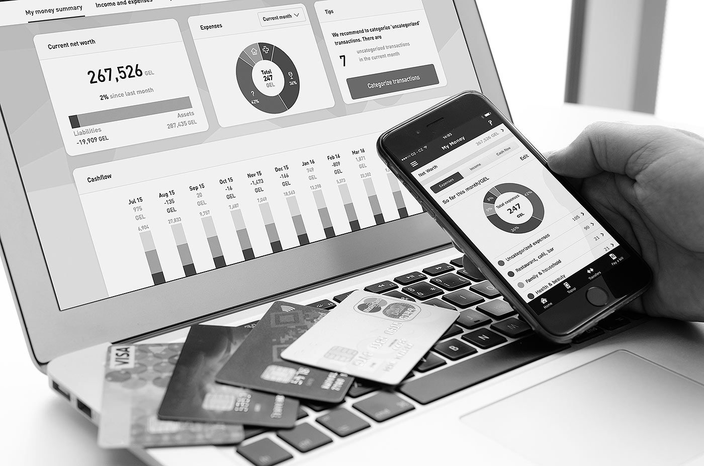

PRESENTATION
AI INTRODUCTION
Antonin Stoklasek
16th April 2019

Slide 2
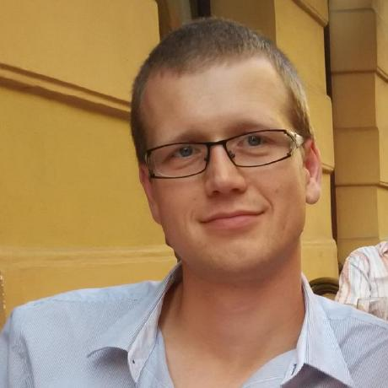
Antonin Stoklasek
Technical Team Leader
Programmer 10+ years
Banking Software Company, pobočka Olomouc
Java, Docker, React, …
Twitter @tonda100
GitHub tonda100

Slide 3
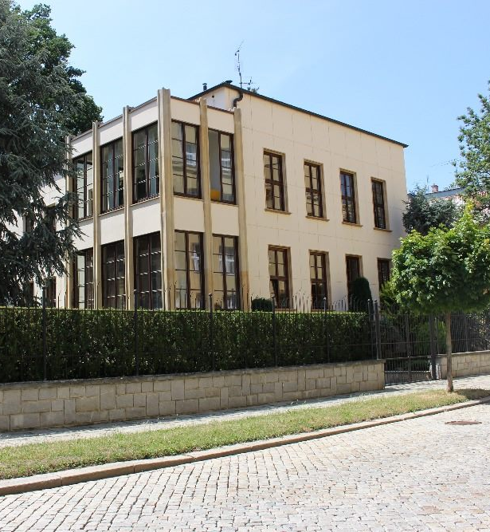
Banking Software Company
Since 1990
IT for financial institutions
7 millions clients
17 countries
8 branches (PRG, OLO, PRS, …)
https://www.bankingsoftware.company

Slide 4
Agenda
AI
Machine learning
Deep learning
Neural networks
Usage in banking
AI and Java?

Slide 5
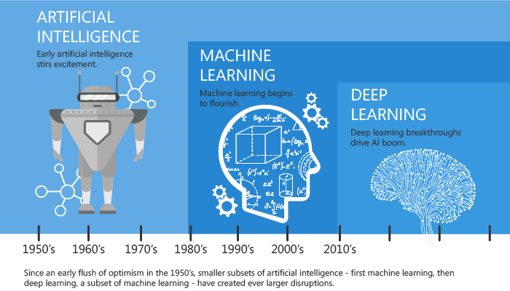
AI, ML & DL

Slide 6
Artificial Intelligence
Human Intelligence => Machines
Solving logic problems
planning
understanding language
objects and sound recognition
playing chess

Slide 7
Machine Learning
Subset of AI
Ability to learn
Use provided data
Make accurate predictions
Method of training algorithm

Slide 8
Machine Learning
Weight (grams) | Texture | Type of Fruit
155 | Rough | Orange
180 | Rough | Orange
135 | Smooth | Apple
110 | Smooth | Apple
120 | Smooth | ???

Slide 9
Deep Learning
Subset of ML
Inspired by human brain
Data – various categories
Comparing to known items
Neural Networks – brain like decision making
Discovers features
Big amount of training data

Slide 10
Neural Network
Set of algorithms - Human brain like
Recognize pattern
Finding similarities
Real data (image, sound, text …) => numerical representation
Universal Approximator – f(x) = y
f(x) = 3x + 12 or f(x) = 9x - 0.1

Slide 11
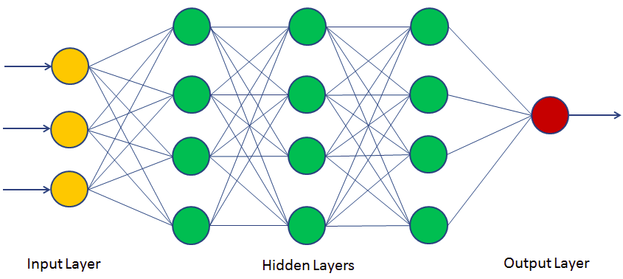
Neural Network

Slide 12
DL usual tasks
spam filter – spam / not spam
recognize facial expressions – angry / joyful
recognize gesture in video
identify objects in images – stop sign, car, …
detect voices – identify speaker, transcribe voice to text

Slide 13
Clustering
Unsupervised learning
Learning without labels
Tasks:
comparing documents
finding similar items
anomalies detection
unusual behavior – fraud detection

Slide 14
Classification
Supervised learning
Transfer human knowledge into dataset
Manual labeling of data
Tasks:
spam filter – spam / not spam
recognize facial expressions – angry / joyful
recognize gesture in video
rdentify objects in images – stop sign, car, …
detect voices – identify speaker, transcribe voice to text

Slide 15
Implementation - SL
Get dataset
Split dataset 80/20 or 90/10
Train (dataset 80)
Validate (datase 20)
Execute
Train again – collect data for further training

Slide 16
AI & banking
PFM
Fraud protection
Security login – Fingerprint, Face ID …
Customer service automation
Chat bot

Slide 17
AI and Java
Python
TensorFlow
Theano
Keras
C++
TensorFlow
Caffe
MLPack
Java
DL4J

Slide 18
Summary
It is stupid, but super-fast
More data an algorithm can train on, the more accurate it will be
DataSets - http://www.vision.caltech.edu/Image_Datasets/
DL4J - https://deeplearning4j.org/
https://github.com/deeplearning4j/dl4j-examples

Slide 19
THANK YOU
@tonda100
https://github.com/tonda100/trainings/tree/master/ai-intro

