Slide 1
Drone Mission Analysis
Gaurav Nitin Gandhi
Rachana Tondare
Siddhesh Salgaonkar
Taashi Priya Khurana

Slide 2
Background
Drones have finally arrived! The age of robotics is here!
These flying robots can do jobs that are dull, dirty and dangerous.
In many applications, drones do outperform human e.g. infrastructure inspection.
But being new technology, there are no standards in place.
Results of the inspections can vary depending on the skill and experience of the drone operator.
And there comes DMA to the rescue!
CS 6620 - Drone Mission Analysis

Slide 3
What is DMA exactly ?
Commercial drone operators can contact the company and download pre-program inspection missions, then visit the inspection site and fly the mission i.e. capture photos
Operators upload photos to the mobile application to double check whether the mission was successful or not.
This is done by validating the metadata extracted from the images taken during inspection against input data.
Metadata in this case is the EXIF/XMP data (Geolocation information) along with the thumbnail.
CS 6620 - Drone Mission Analysis

Slide 4
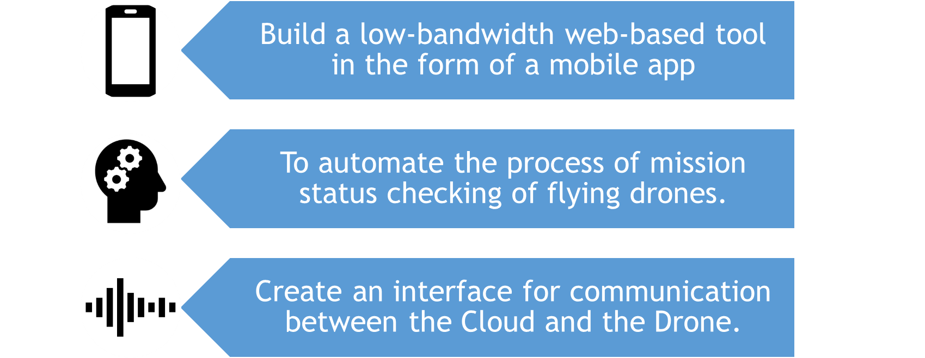
Vision and Goals
CS 6620 - Drone Mission Analysis

Slide 5
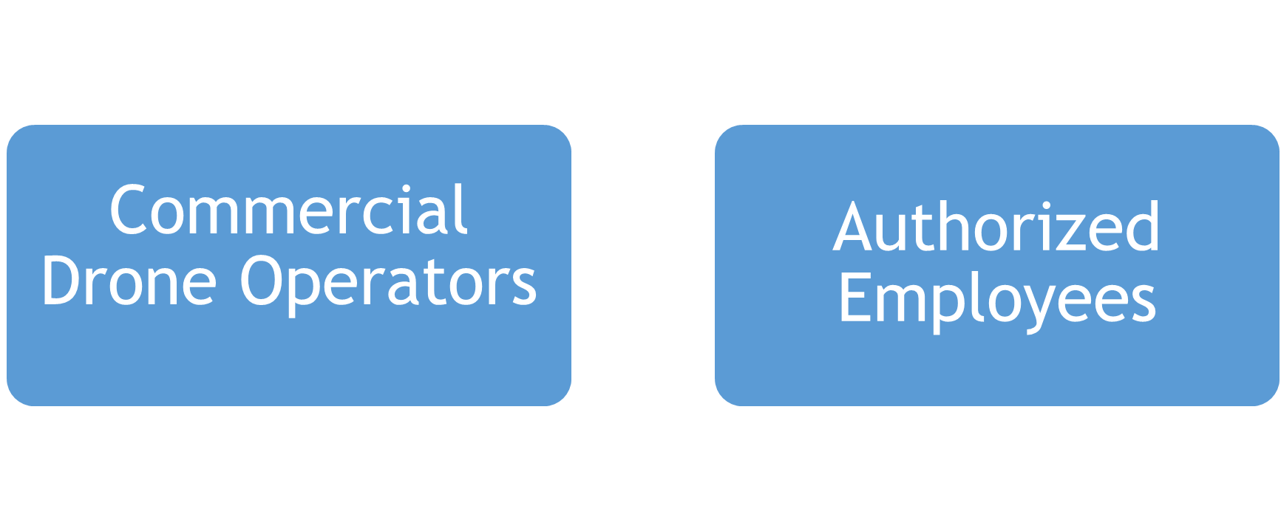
Users/Personas
CS 6620 - Drone Mission Analysis

Slide 6
Continued…
Their role includes -
Download the mission plan from the mobile application and transfer it to the drone.
Monitor/Control the drone while it completes the mission.
Transfer the images captured to the mobile from the SD card.
Upload the images to the mobile app for further processing.
Upon processing, download a new set of instructions for the drone.
CS 6620 - Drone Mission Analysis

Slide 7
Scope & Features
A simple, low bandwidth yet compelling web-based interface.
Authentication mechanism to access the system.
Extract metadata like XMP, EXIF and thumbnails from the drone-taken images for analysis.
Upload the meta data to a custom cloud service (back end logic) for validation against the mission plan.
Provide a result as either ‘Mission Complete’ or an instruction to re-fly all or part of the mission.
CS 6620 - Drone Mission Analysis

Slide 8
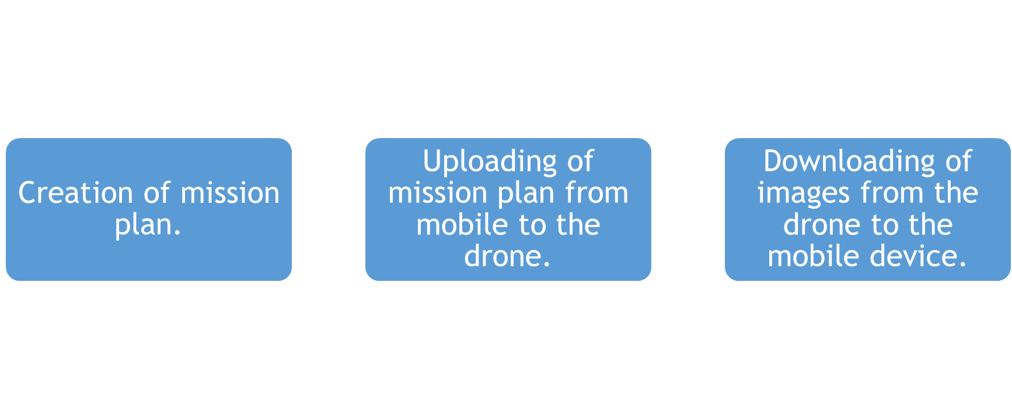
What will be not covered?
CS 6620 - Drone Mission Analysis

Slide 9
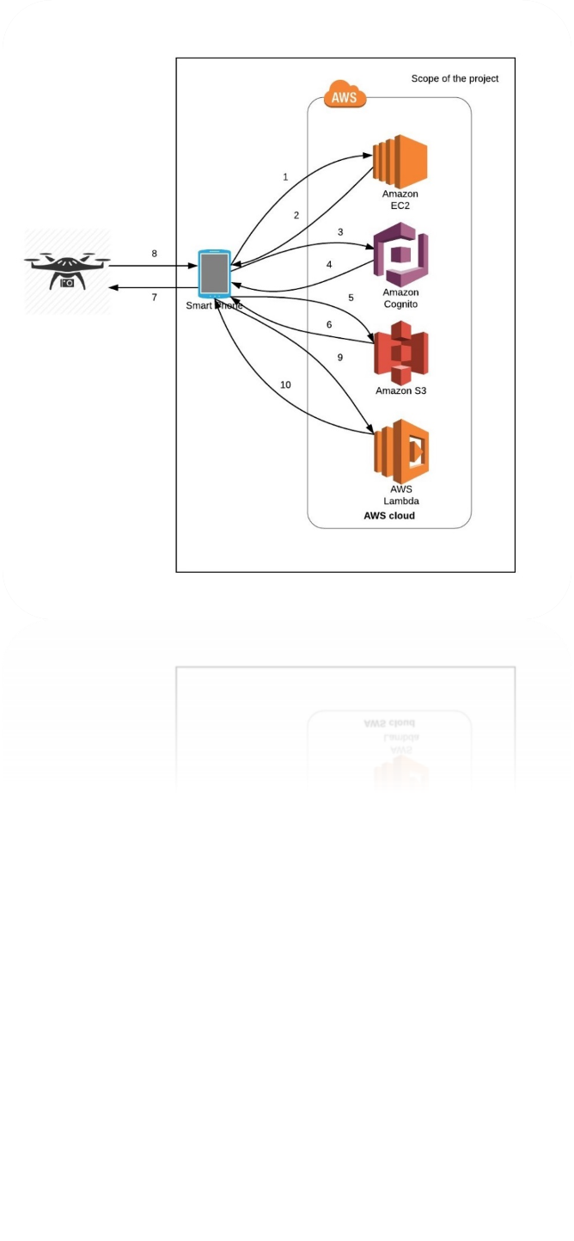
Solution Concept
CS 6620 - Drone Mission Analysis

Slide 10
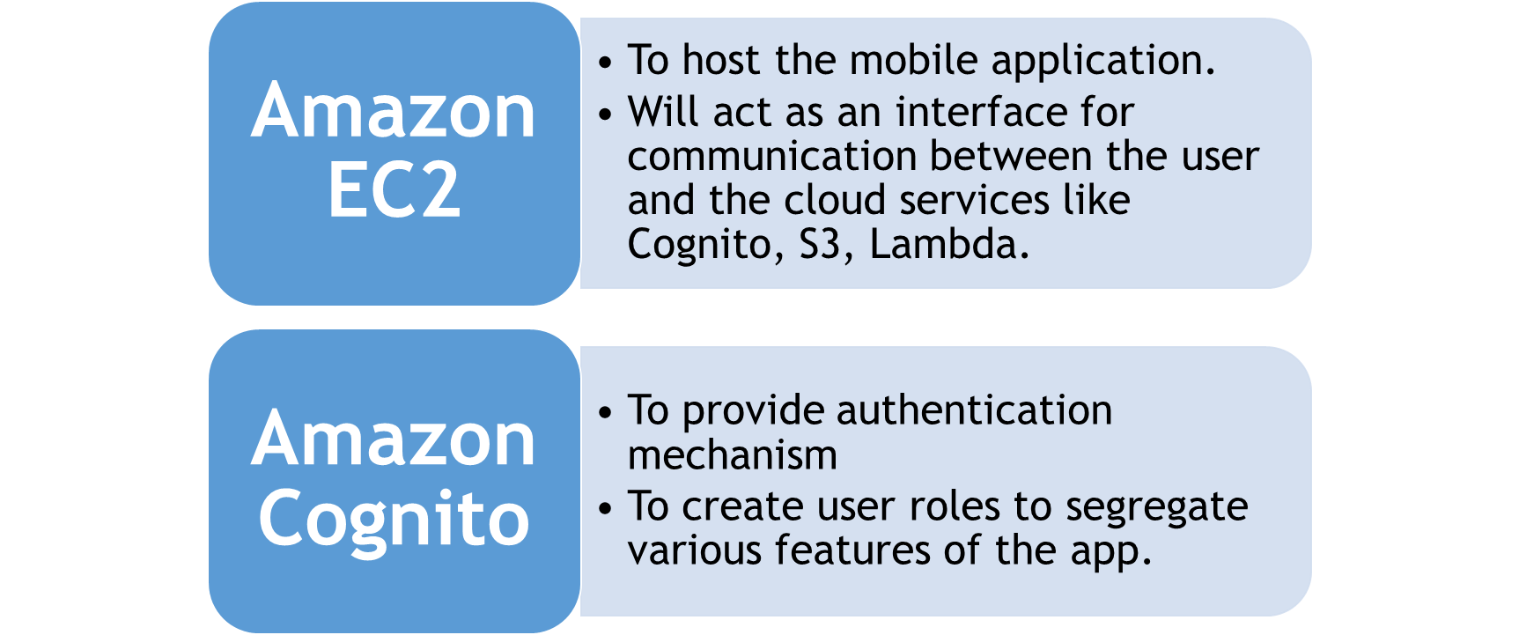
Continued…
CS 6620 - Drone Mission Analysis

Slide 11
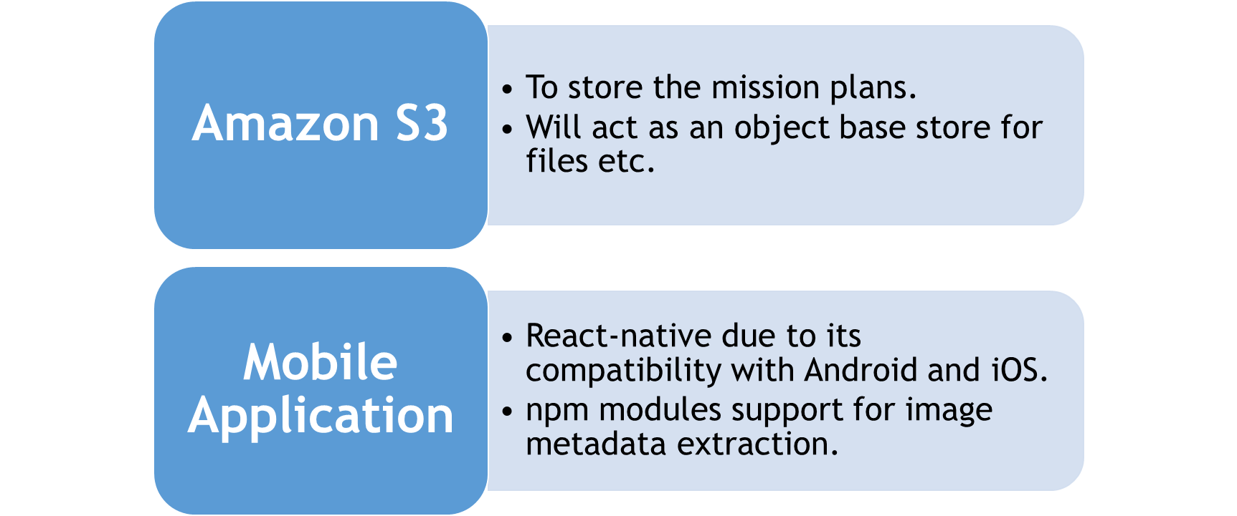
Continued…
CS 6620 - Drone Mission Analysis

Slide 12
Challenges
Extracting relevant EXIF and XMP meta data from the images in an efficient way.
Determining an effective algorithm/logic for comparison of the extracted data from image and data from the input plan.
Decide suitable error margins/threshold values as exact match can lead to false negatives.
CS 6620 - Drone Mission Analysis

Slide 13
Acceptance criteria
The mobile device gets a mission plan from the cloud.
After the mission is flown the application reads the image data from the SD card.
The mobile device extracts and then uploads the image metadata to the cloud for analysis.
The mobile application will display the status of the mission after the analysis is complete.
CS 6620 - Drone Mission Analysis

Slide 14
Nice to have
Pictorial visualization of mission status.
Report generation of the data comparison.
Registering a new user and creating login credentials for the user on mobile app.
Functionality of uploading a new mission plan to the cloud application using a web interface.
CS 6620 - Drone Mission Analysis

Slide 15

Release Planning - Iterations
1
2
3
4
5
CS 6620 - Drone Mission Analysis

Slide 16
Iteration 1
Tasks
Gathering the requirements.
Deciding the technologies to be used.
Project proposal documentation.
Role assignment.
Learning curves for React-native, Image processing and metadata understanding and AWS technology.
CS 6620 - Drone Mission Analysis

Slide 17
Iteration 2
Tasks
Researching efficient ways of extracting image metadata.
Setting up the AWS backend services.
Brainstorming comparison algorithm.
Learning curves for React-native, Image processing and metadata
understanding and AWS technology.
Deliverables
UI mock-ups for the mobile application.
Application architecture.
CS 6620 - Drone Mission Analysis

Slide 18
Iteration 3
Tasks
Pseudo code for the comparison algorithm
Deliverables
UI wireframes for mobile application in react-native
Extracting data from the image using npm module
Login functionality
CS 6620 - Drone Mission Analysis

Slide 19
Iteration 4
Tasks
Implementing the comparison algorithm.
Deliverables
Plan download functionality.
Multiple Image upload functionality.
CS 6620 - Drone Mission Analysis

Slide 20
Iteration 5
Tasks
Dry run of the comparison algorithm.
Rigorous system testing.
Application handover.
Deliverables
Mission status generation functionality.
CS 6620 - Drone Mission Analysis

Slide 21
Thank You!

