Slide 1
Drone Mission Analysis
Gaurav Nitin Gandhi
Rachana Tondare
Siddhesh Salgaonkar
Taashi Priya Khurana

Slide 2

Release Planning - Iterations
1
2
3
4
5
CS 6620 - Drone Mission Analysis

Slide 3
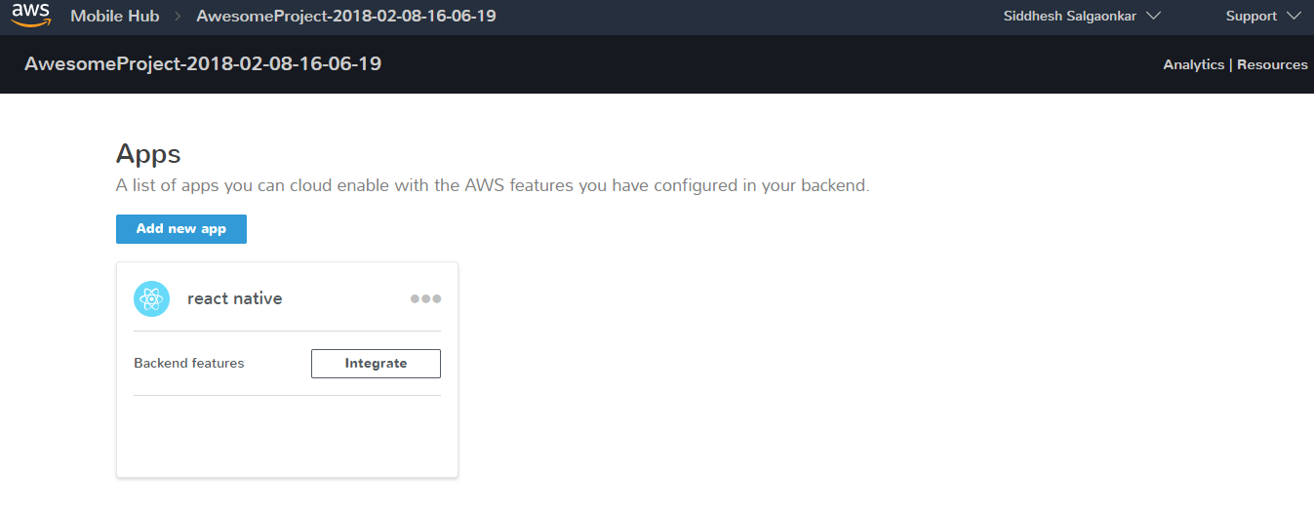
Setting up AWS Mobile Hub
CS 6620 - Drone Mission Analysis

Slide 4
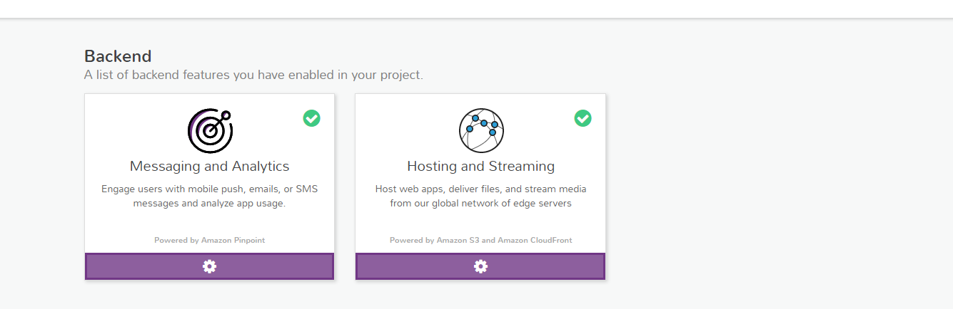
Continued…
CS 6620 - Drone Mission Analysis

Slide 5
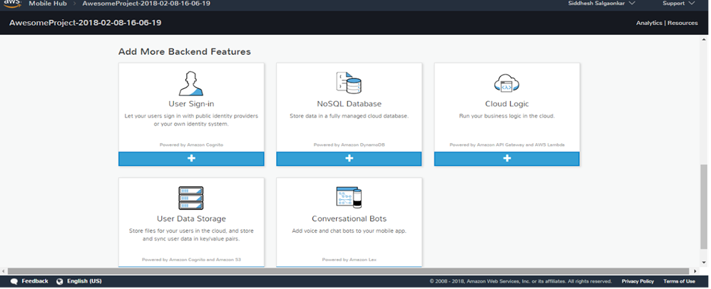
Continued...
CS 6620 - Drone Mission Analysis

Slide 6
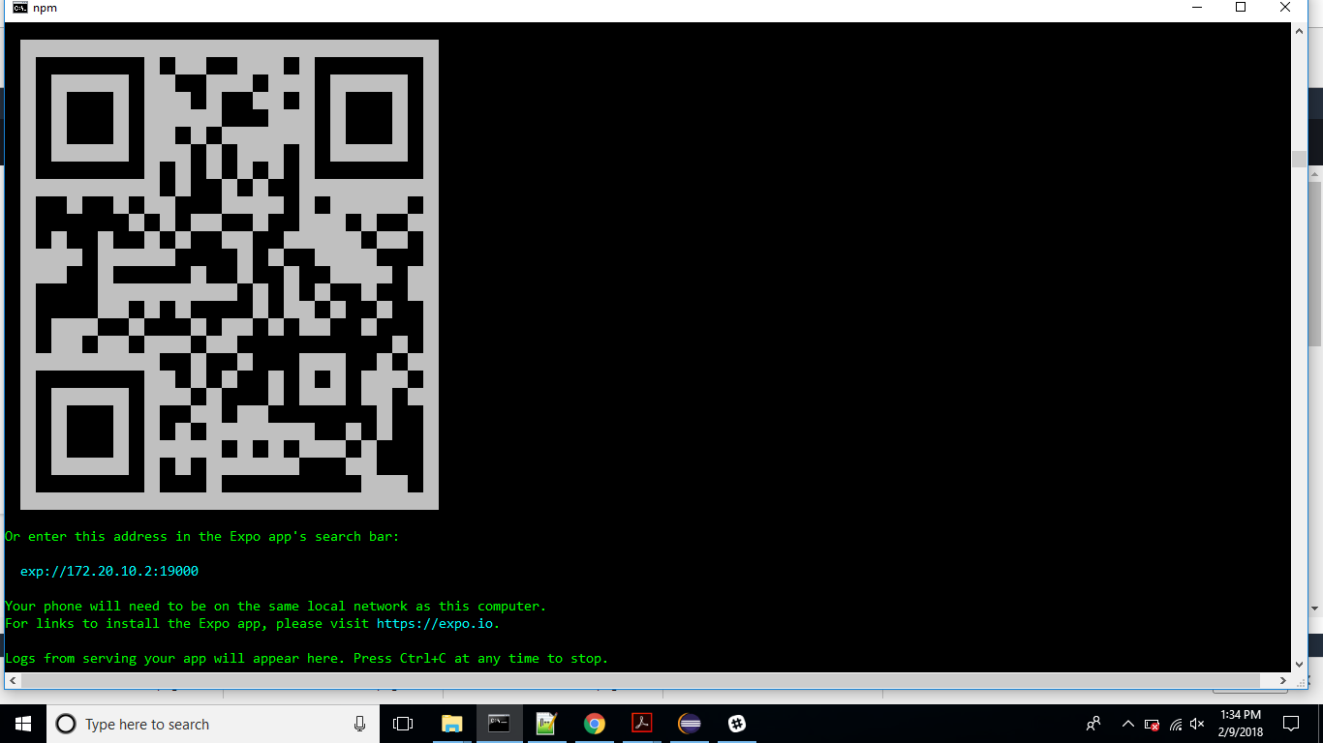
React Native Local Setup
CS 6620 - Drone Mission Analysis

Slide 7

Local Setup Running
CS 6620 - Drone Mission Analysis

Slide 8
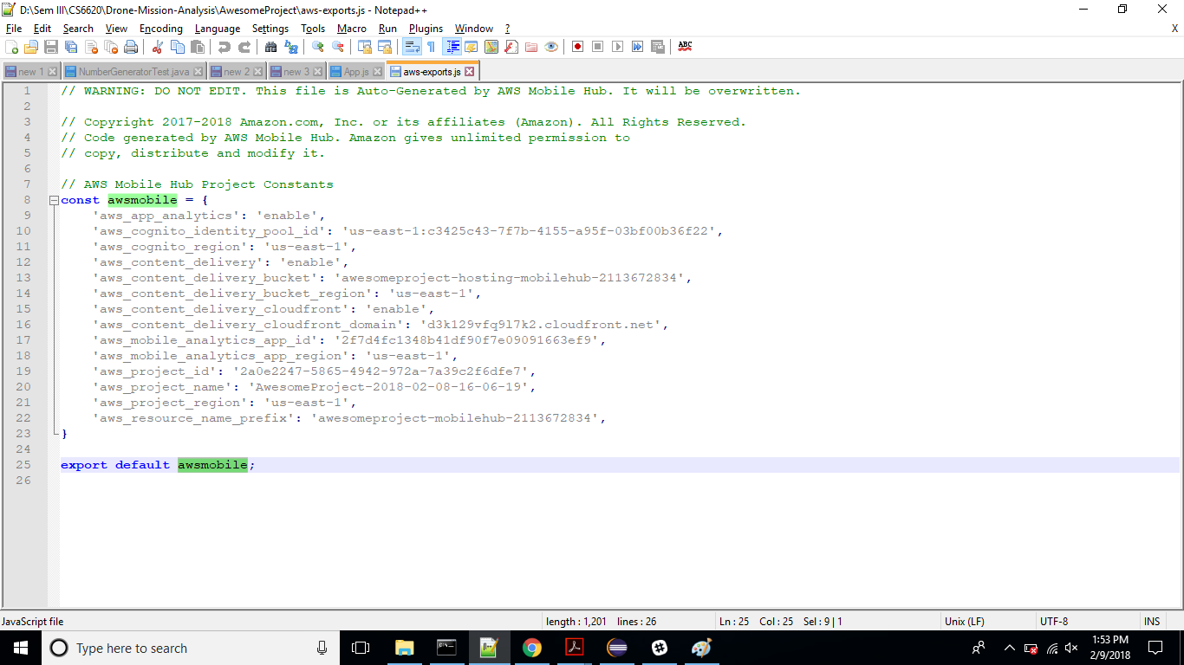
AWS Mobile Config File
CS 6620 - Drone Mission Analysis

Slide 9
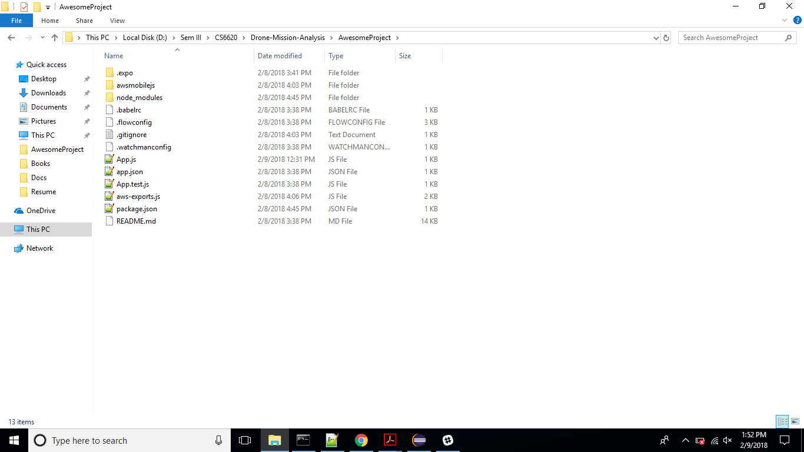
Project Structure
CS 6620 - Drone Mission Analysis

Slide 10
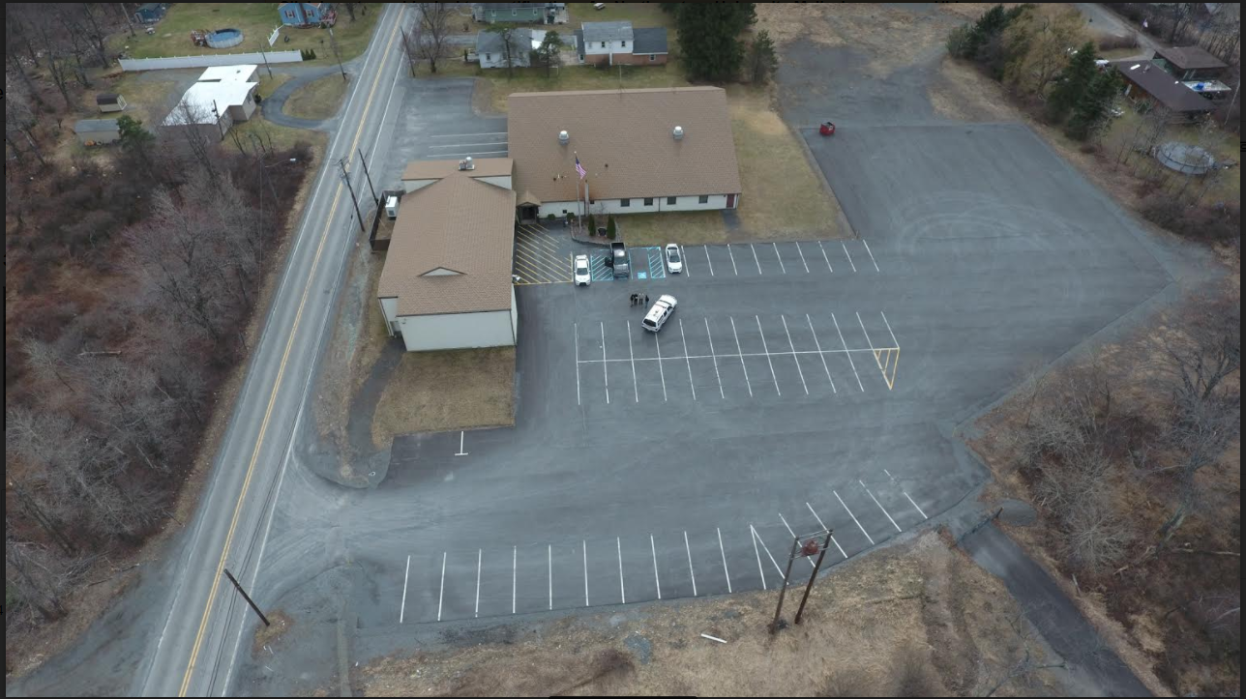
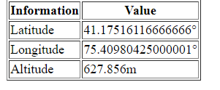
POC for extracting image metadata
EXIF-JS library - https://github.com/exif-js/exif-js
CS 6620 - Drone Mission Analysis

Slide 11
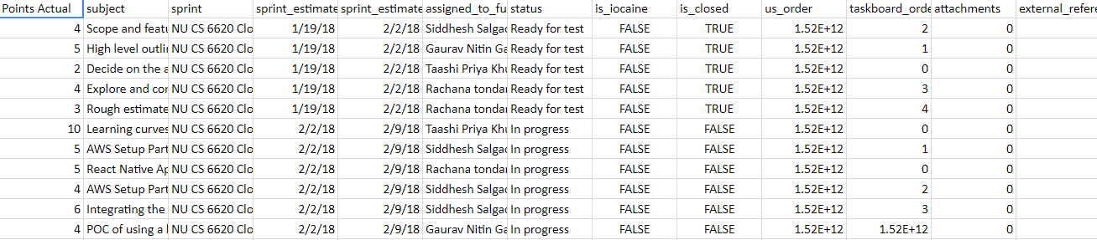
Task board
CS 6620 - Drone Mission Analysis

Slide 12
Iteration 1
Tasks
Setting up AWS services.
React Native application setup on AWS.
POC for extracting image metadata.
Learning React Native.
Researching and prototyping react-native libraries for extracting image metadata from image on mobile app.
CS 6620 - Drone Mission Analysis

Slide 13
Iteration 2
Tasks
Researching efficient ways of extracting image metadata.
Setting up the AWS backend services.
Brainstorming comparison algorithm.
Learning curves for React-native, Image processing and metadata
understanding and AWS technology.
Deliverables
UI mock-ups for the mobile application.
Application architecture.
CS 6620 - Drone Mission Analysis

Slide 14
Iteration 3
Tasks
Pseudo code for the comparison algorithm
Deliverables
UI wireframes for mobile application in react-native
Extracting data from the image using npm module
Login functionality
CS 6620 - Drone Mission Analysis

Slide 15
Iteration 4
Tasks
Implementing the comparison algorithm.
Deliverables
Plan download functionality.
Multiple Image upload functionality.
CS 6620 - Drone Mission Analysis

Slide 16
Iteration 5
Tasks
Dry run of the comparison algorithm.
Rigorous system testing.
Application handover.
Deliverables
Mission status generation functionality.
CS 6620 - Drone Mission Analysis

Slide 17
Thank You!

