Slide 1
Drone Mission Analysis
Gaurav Nitin Gandhi
Rachana Tondare
Siddhesh Salgaonkar
Taashi Priya Khurana

Slide 2

Release Planning - Iterations
1
2
3
4
5
CS 6620 - Drone Mission Analysis

Slide 3
Iteration 2
Tasks
Researching efficient ways of extracting image metadata.
Setting up the AWS backend services.
Brainstorming comparison algorithm.
Learning curves for React-native, Image processing and metadata
understanding and AWS technology.
Deliverables
UI mock-ups for the mobile application.
Application architecture.
CS 6620 - Drone Mission Analysis

Slide 4
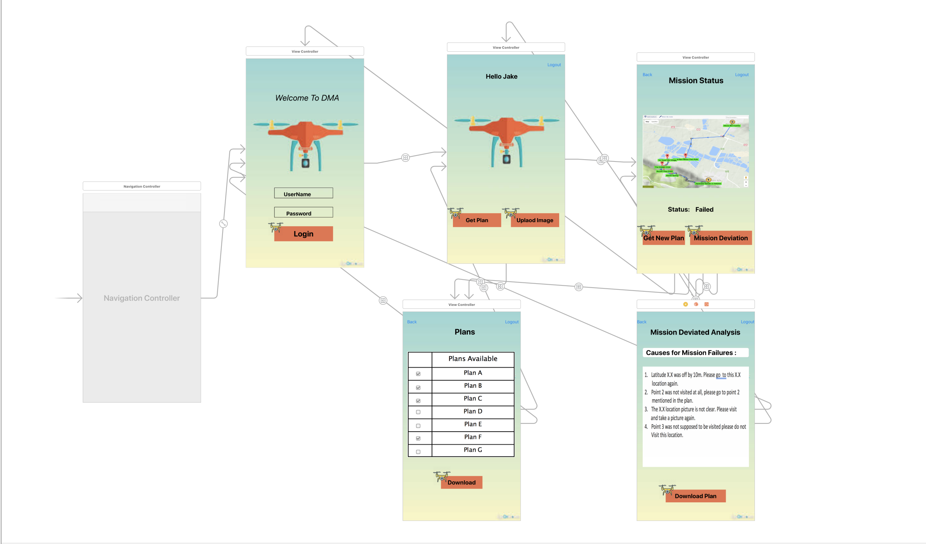
UI Mockups
CS 6620 - Drone Mission Analysis

Slide 5
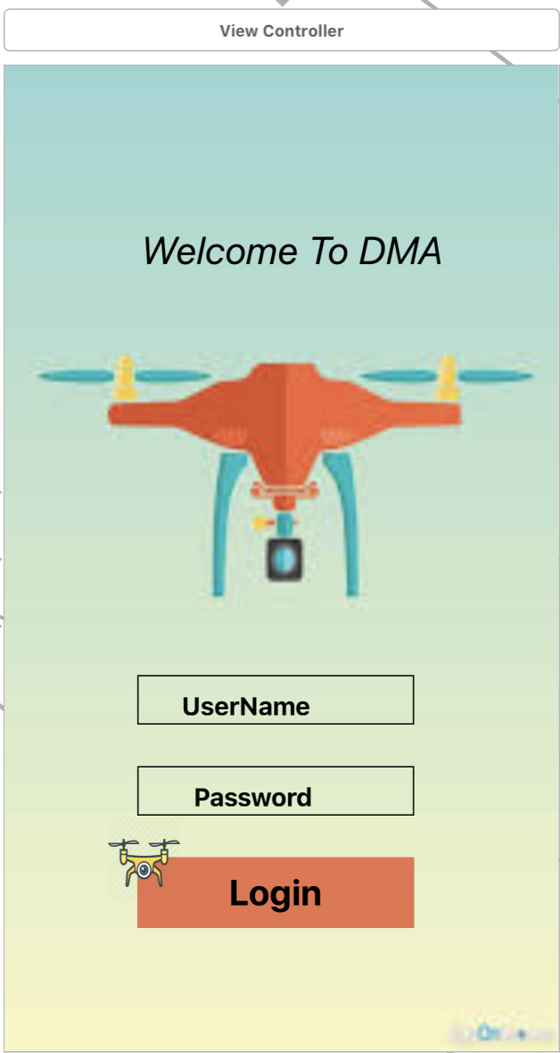
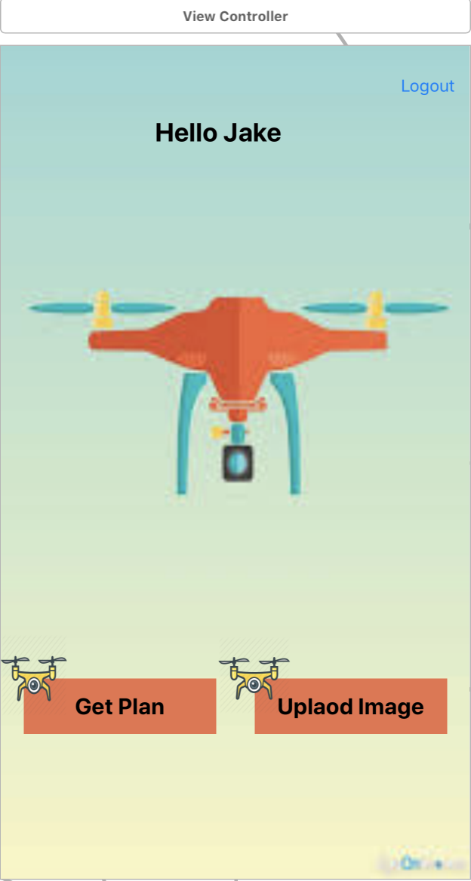
Continued…
CS 6620 - Drone Mission Analysis

Slide 6
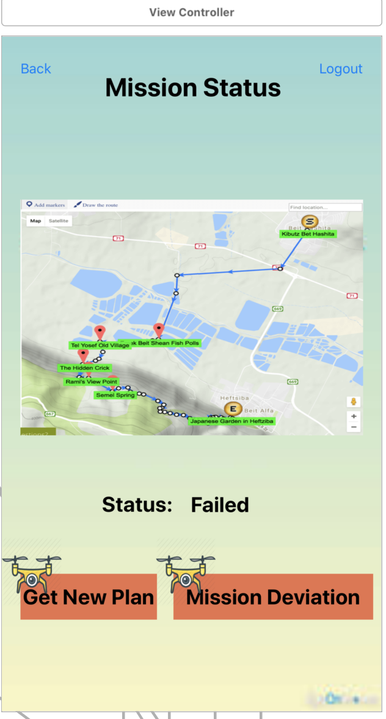
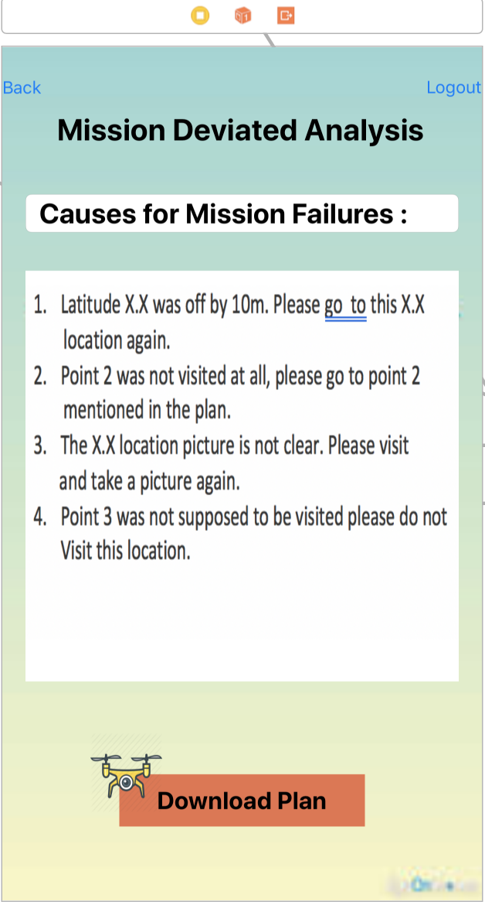
Continued…
CS 6620 - Drone Mission Analysis

Slide 7
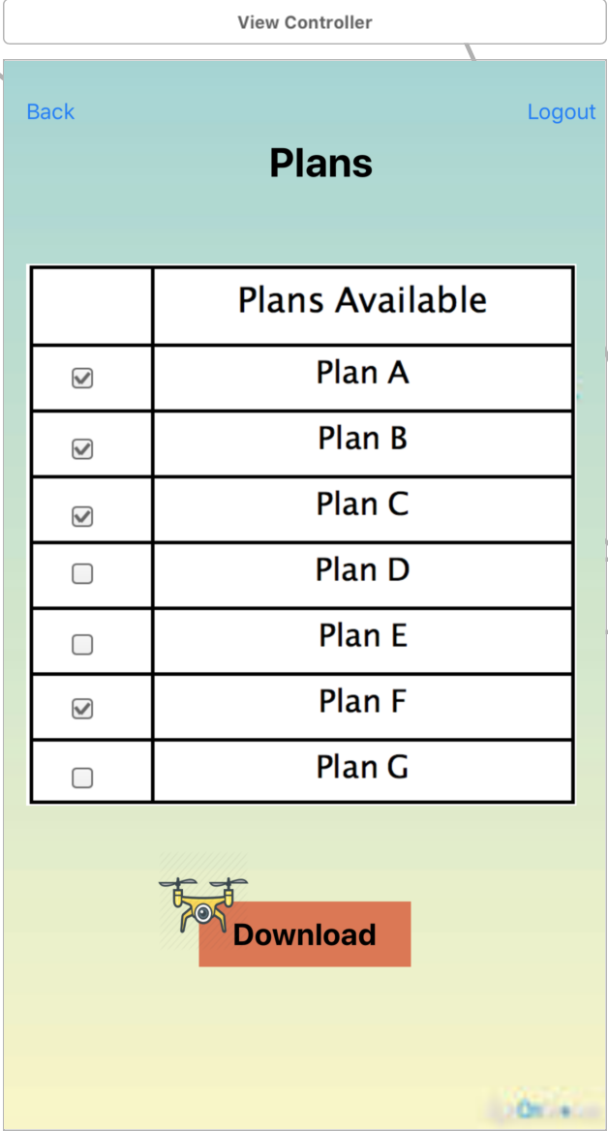
Continued…
CS 6620 - Drone Mission Analysis

Slide 8
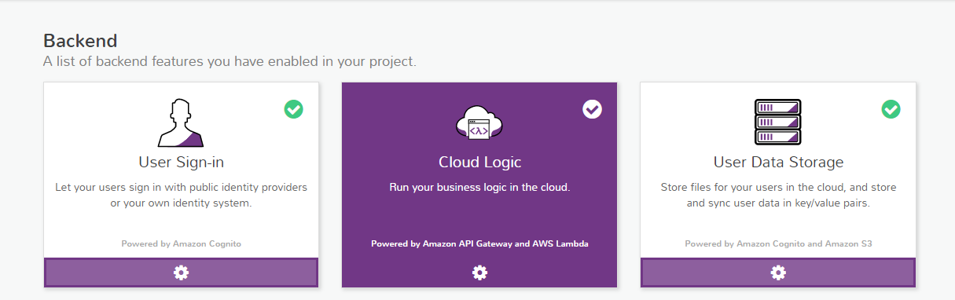
Application Architecture
CS 6620 - Drone Mission Analysis

Slide 9
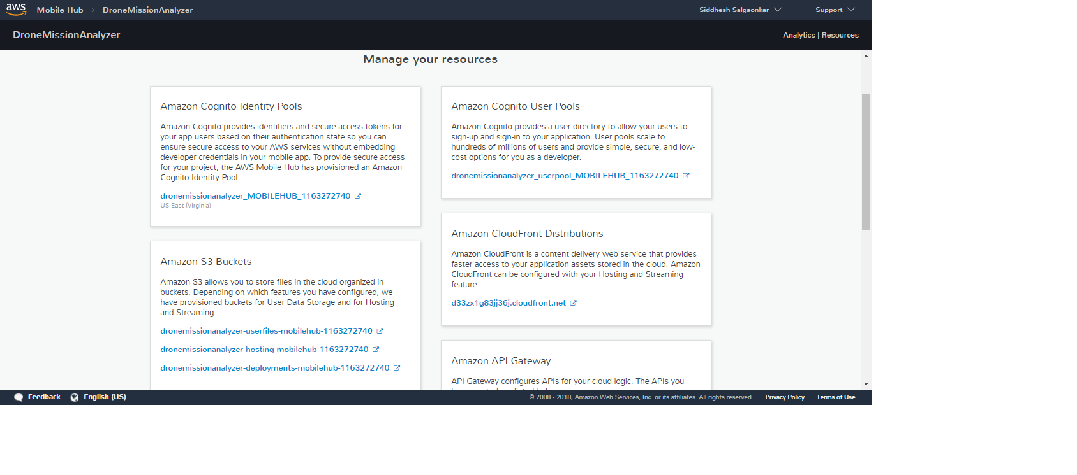
Services Configured
CS 6620 - Drone Mission Analysis

Slide 10
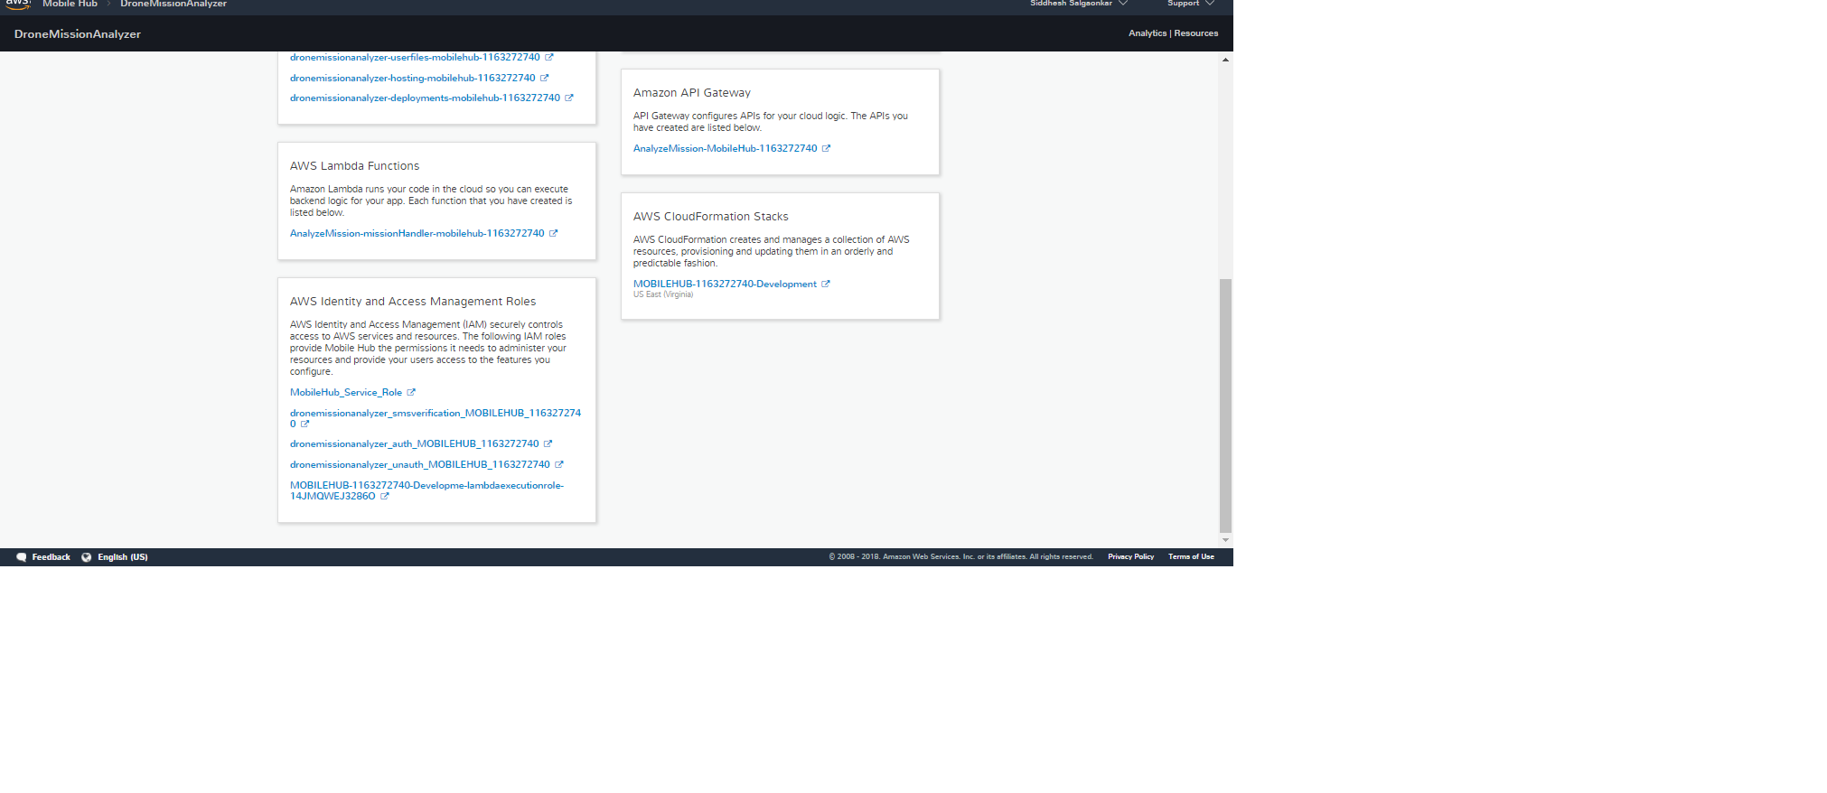
Services Configured
CS 6620 - Drone Mission Analysis

Slide 11
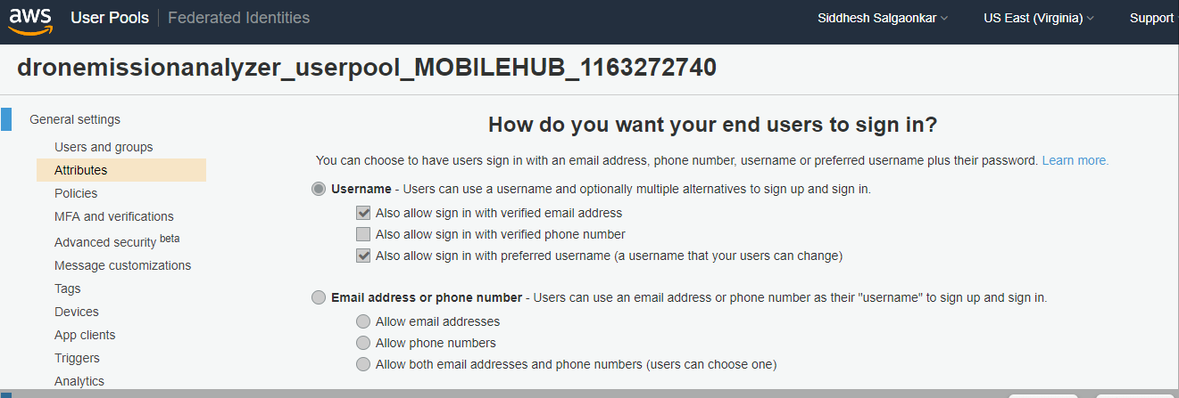
AWS Cognito
CS 6620 - Drone Mission Analysis

Slide 12
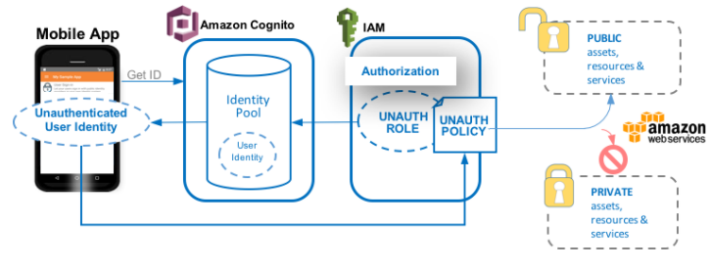
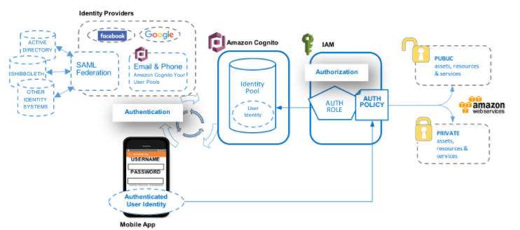
Continued…`
Unauthenticated User
Authenticated User
CS 6620 - Drone Mission Analysis

Slide 13
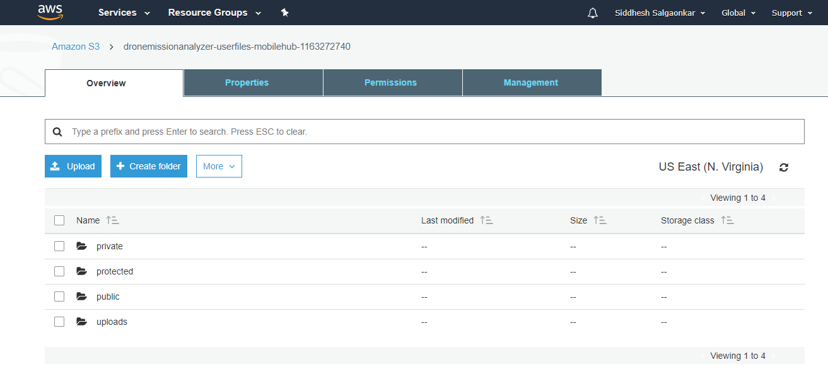
AWS S3
CS 6620 - Drone Mission Analysis

Slide 14
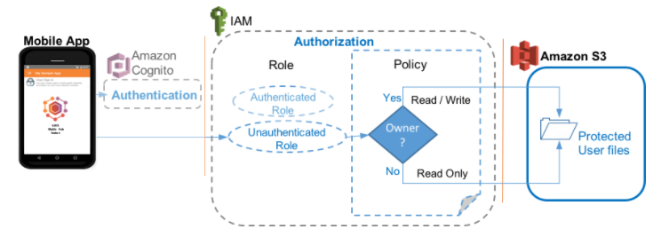
Continued…
CS 6620 - Drone Mission Analysis

Slide 15
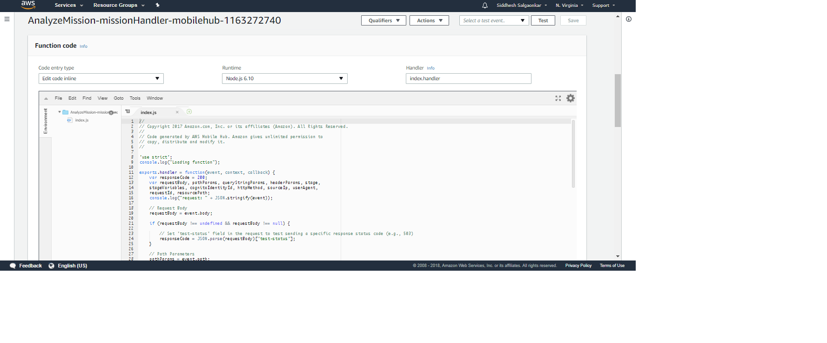
AWS Lambda
CS 6620 - Drone Mission Analysis

Slide 16
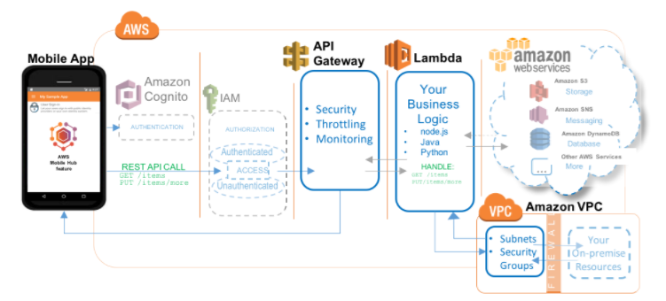
Continued…
CS 6620 - Drone Mission Analysis

Slide 17
New Features
Required:
Display mission deviation
Nice to have:
Generate new mission plan
CS 6620 - Drone Mission Analysis

Slide 18

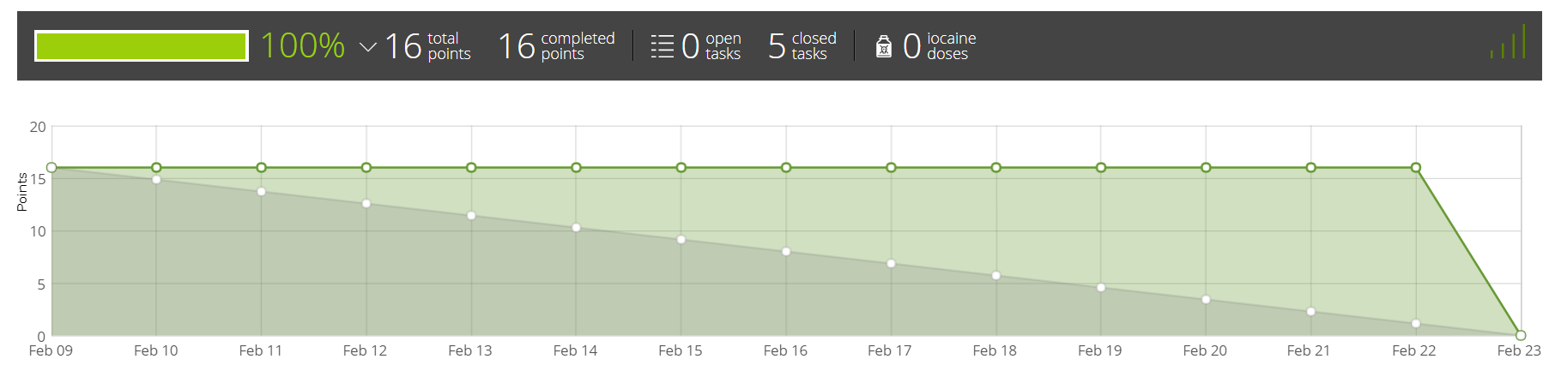
Burndown Chart
CS 6620 - Drone Mission Analysis

Slide 19
Iteration 1
Tasks
Setting up AWS services.
React Native application setup on AWS.
POC for extracting image metadata.
Learning React Native.
Researching and prototyping react-native libraries for extracting image metadata from image on mobile app.
CS 6620 - Drone Mission Analysis

Slide 20
Iteration 2
Tasks
Researching efficient ways of extracting image metadata.
Setting up the AWS backend services.
Brainstorming comparison algorithm.
Learning curves for React-native, Image processing and metadata
understanding and AWS technology.
Deliverables
UI mock-ups for the mobile application.
Application architecture.
CS 6620 - Drone Mission Analysis

Slide 21
Iteration 3
Tasks
Pseudo code for the comparison algorithm
Create UI for the app
Integrate Login into the app
Deliverables
UI wireframes for mobile application in react-native
Extracting data from the image using NPM module
Login functionality
CS 6620 - Drone Mission Analysis

Slide 22
Iteration 4
Tasks
Implementing the comparison algorithm.
Deliverables
Plan download functionality.
Multiple Image upload functionality.
CS 6620 - Drone Mission Analysis

Slide 23
Iteration 5
Tasks
Dry run of the comparison algorithm.
Rigorous system testing.
Application handover.
Deliverables
Mission status generation functionality.
CS 6620 - Drone Mission Analysis

Slide 24
Thank You!

