Slide 1
Drone Mission Analysis
Gaurav Nitin Gandhi
Rachana S. Tondare
Siddhesh Salgaonkar
Taashi Priya Khurana

Slide 2
Release Planning - Iterations
1
2
3
4
5
6
CS 6620 - Drone Mission Analysis

Slide 3
Overview
Commercial drone operators can contact the company and download pre-program inspection missions, then visit the inspection site and fly the mission i.e. capture photos
Operators upload photos to the mobile application to double check whether the mission was successful or not.
This is done by validating the metadata extracted from the images taken during inspection against input data.
Metadata in this case is the EXIF/XMP data (Geolocation information) along with the thumbnail.
CS 6620 - Drone Mission Analysis

Slide 4
Iteration 5
Tasks
Integration testing of the comparison algorithm.
Optimization and twerking in the existing comparison algorithm to include camera angle and direction towards to POI
Download new mission plan from AWS with user access control
Test data creation from obtained images.
Deliverables
Plan download functionality with user access control.
Optimized results for mission status validation
Multiple Image upload functionality.
CS 6620 - Drone Mission Analysis

Slide 5
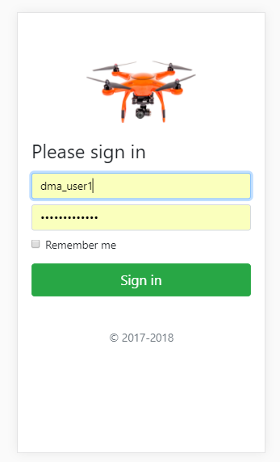
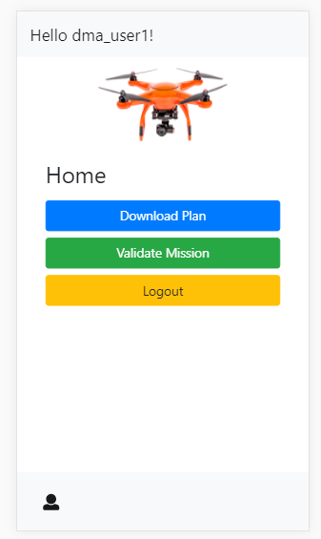
Application Flow
CS 6620 - Drone Mission Analysis

Slide 6
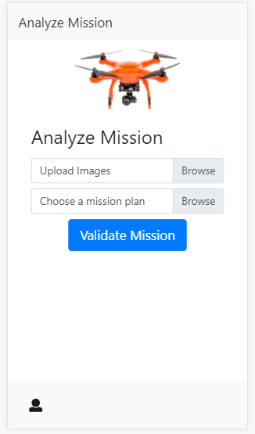
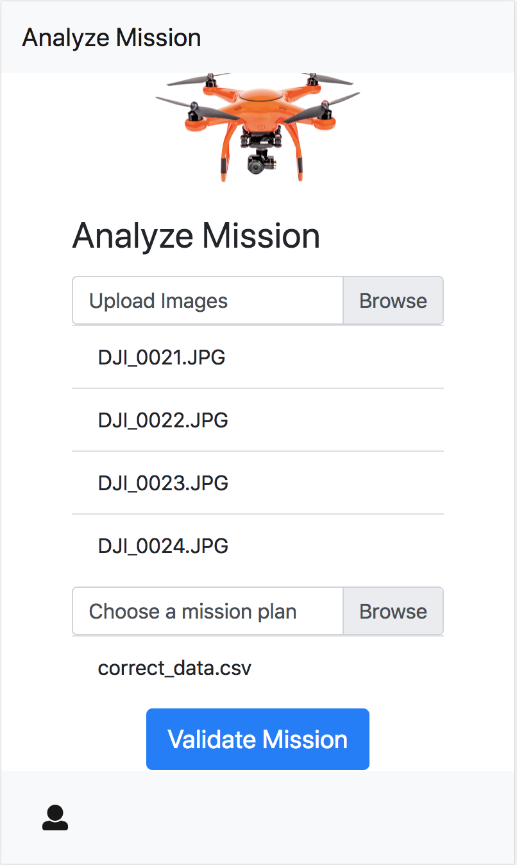
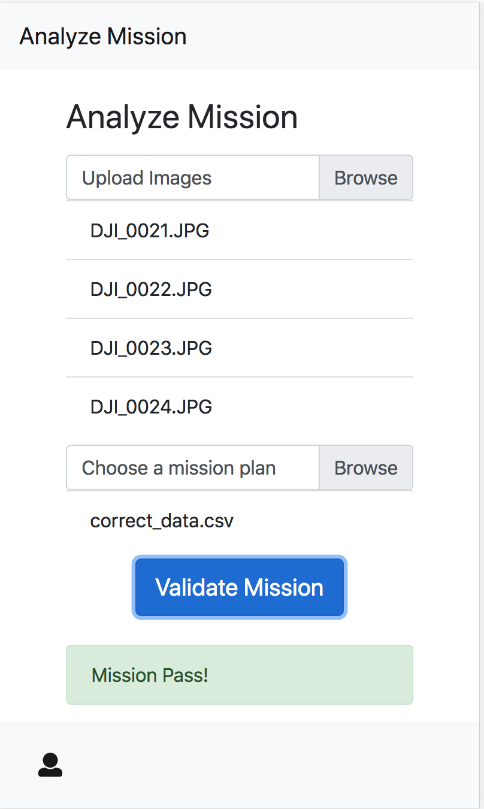
Validate Mission (Mission Passed)
CS 6620 - Drone Mission Analysis

Slide 7
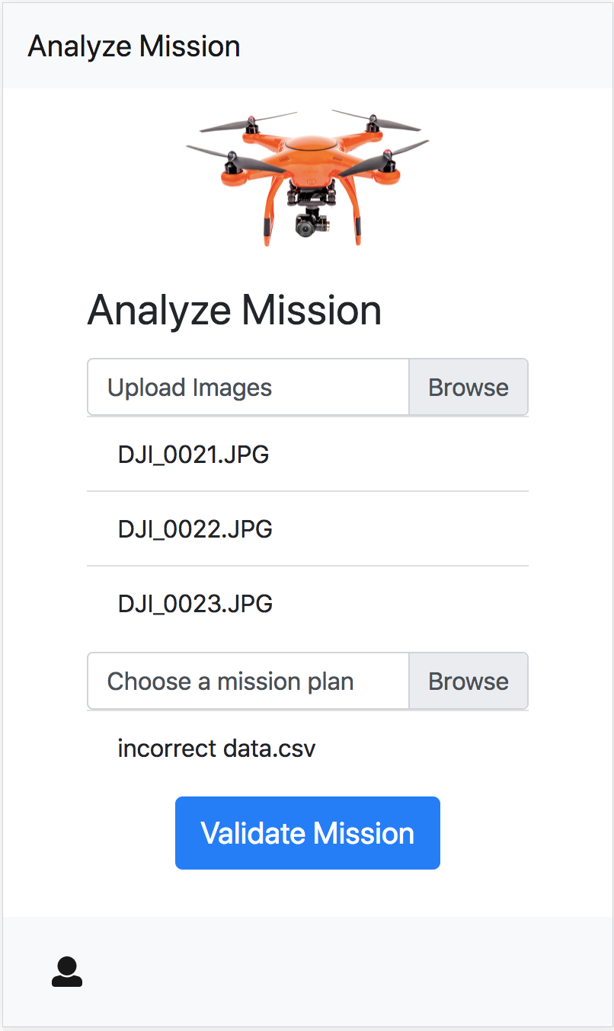
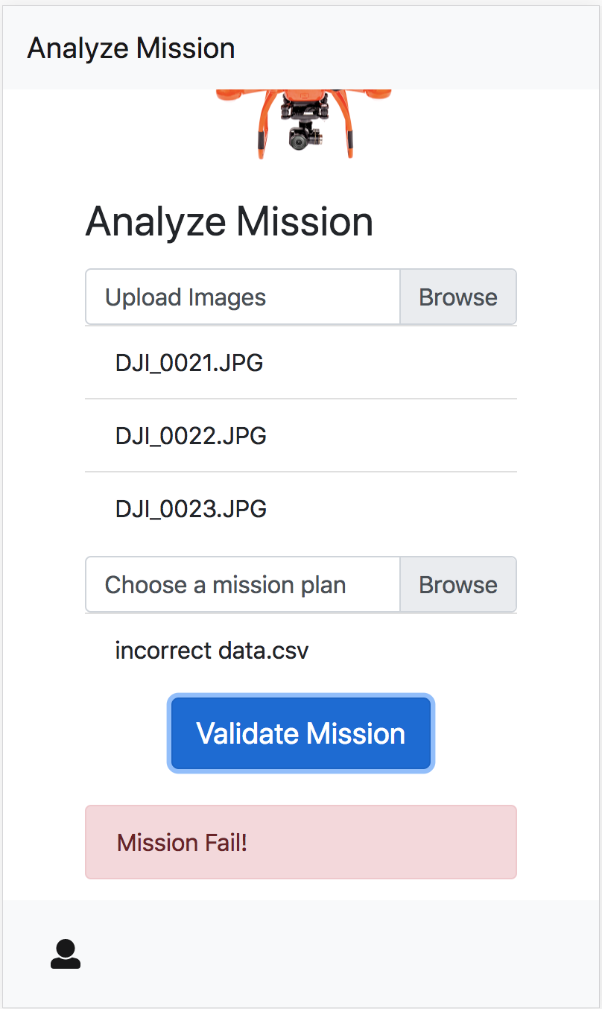
Validate Mission (Mission Failed)
CS 6620 - Drone Mission Analysis

Slide 8
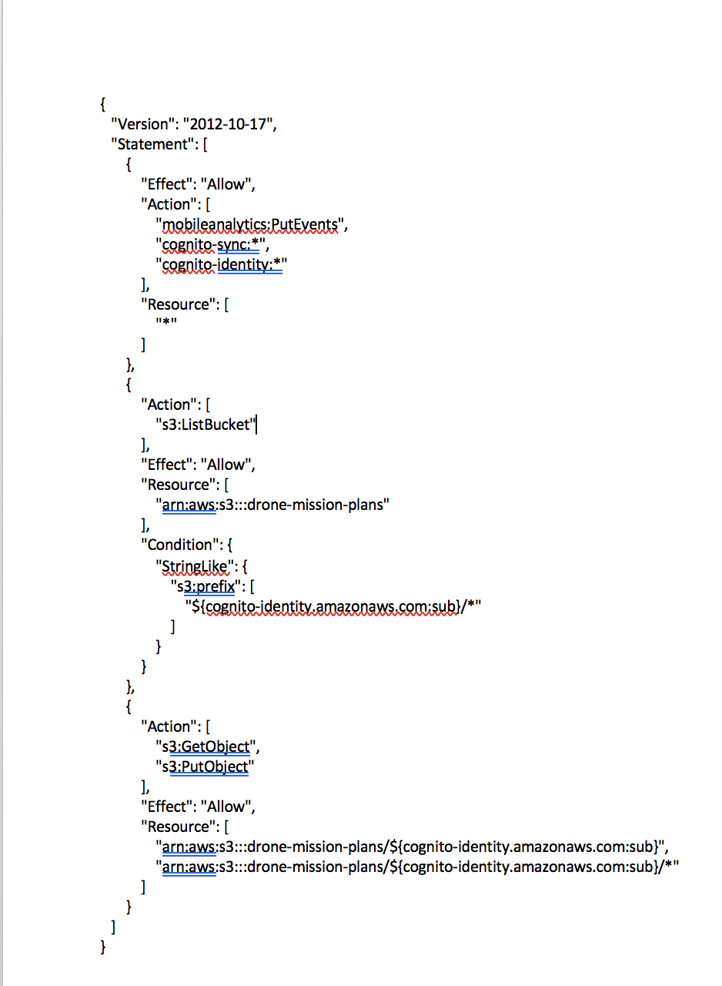
IAM POLICY
CS 6620 - Drone Mission Analysis

Slide 9
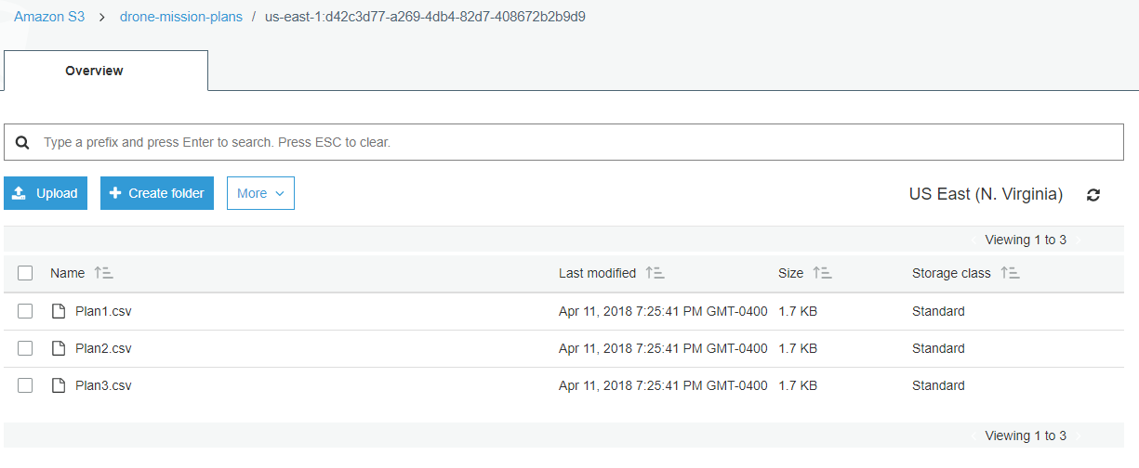
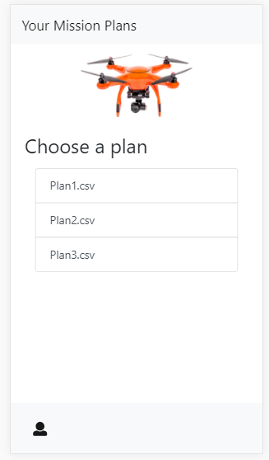
User Access Control (AWS)
CS 6620 - Drone Mission Analysis

Slide 10
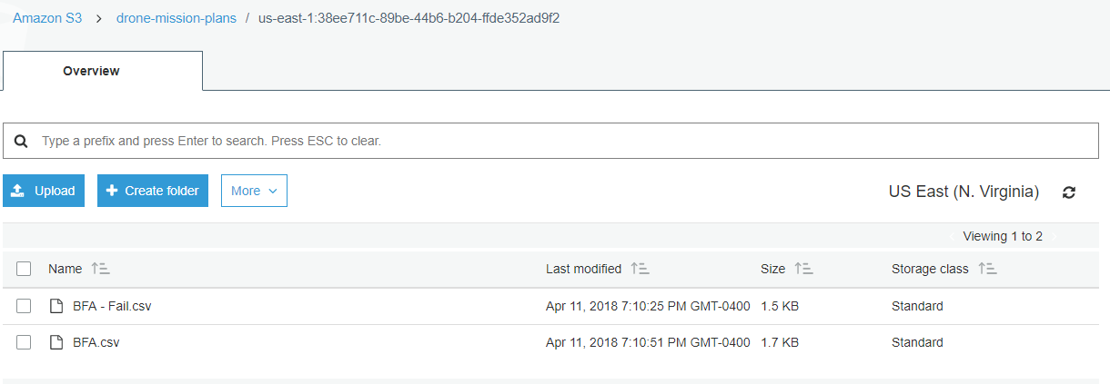
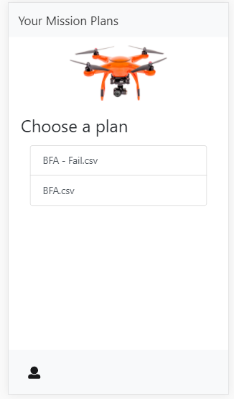
User Access Control (AWS)(Cont.)
CS 6620 - Drone Mission Analysis

Slide 11
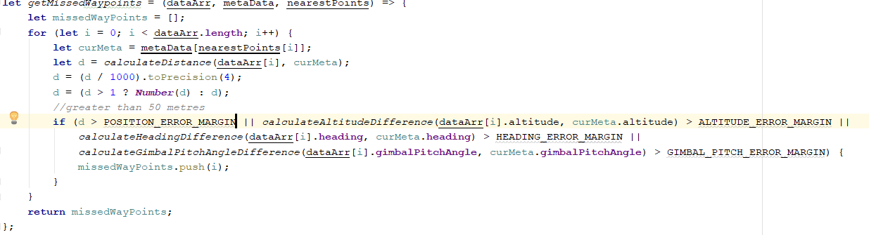
Comparison Algorithm
CS 6620 - Drone Mission Analysis

Slide 12
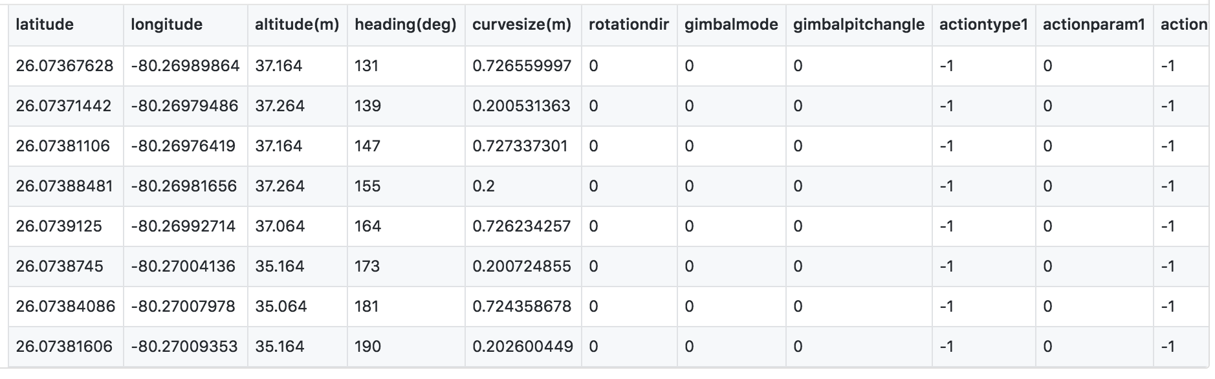
Test Data
Additional links
https://github.com/BU-NU-CLOUD-SP18/Drone-Mission-Analysis/blob/master/test/mock/Fail.csv
https://github.com/BU-NU-CLOUD-SP18/Drone-Mission-Analysis/blob/master/test/mock/Success-10-metre.csv
CS 6620 - Drone Mission Analysis

Slide 13
Challenges
Visualization of the flown mission path and the ideal mission path on google maps.
Integration test data creation
CS 6620 - Drone Mission Analysis

Slide 14
Plans for next Sprint
Implementing visualization of the mission data.
Installation documentation and project packaging for hand over.
Error handling and fine tuning styling on front end.
Fine tuning code with completed documentation
Presentation preparation.
CS 6620 - Drone Mission Analysis

Slide 15
Iteration 1
Tasks
Setting up AWS services.
React Native application setup on AWS.
POC for extracting image metadata.
Learning React Native.
Researching and prototyping react-native libraries for extracting image metadata from image on mobile app.
CS 6620 - Drone Mission Analysis

Slide 16
Iteration 2
Tasks
Researching efficient ways of extracting image metadata.
Setting up the AWS backend services.
Brainstorming comparison algorithm.
Learning curves for React-native, Image processing and metadata
understanding and AWS technology.
Deliverables
UI mock-ups for the mobile application.
Application architecture.
CS 6620 - Drone Mission Analysis

Slide 17
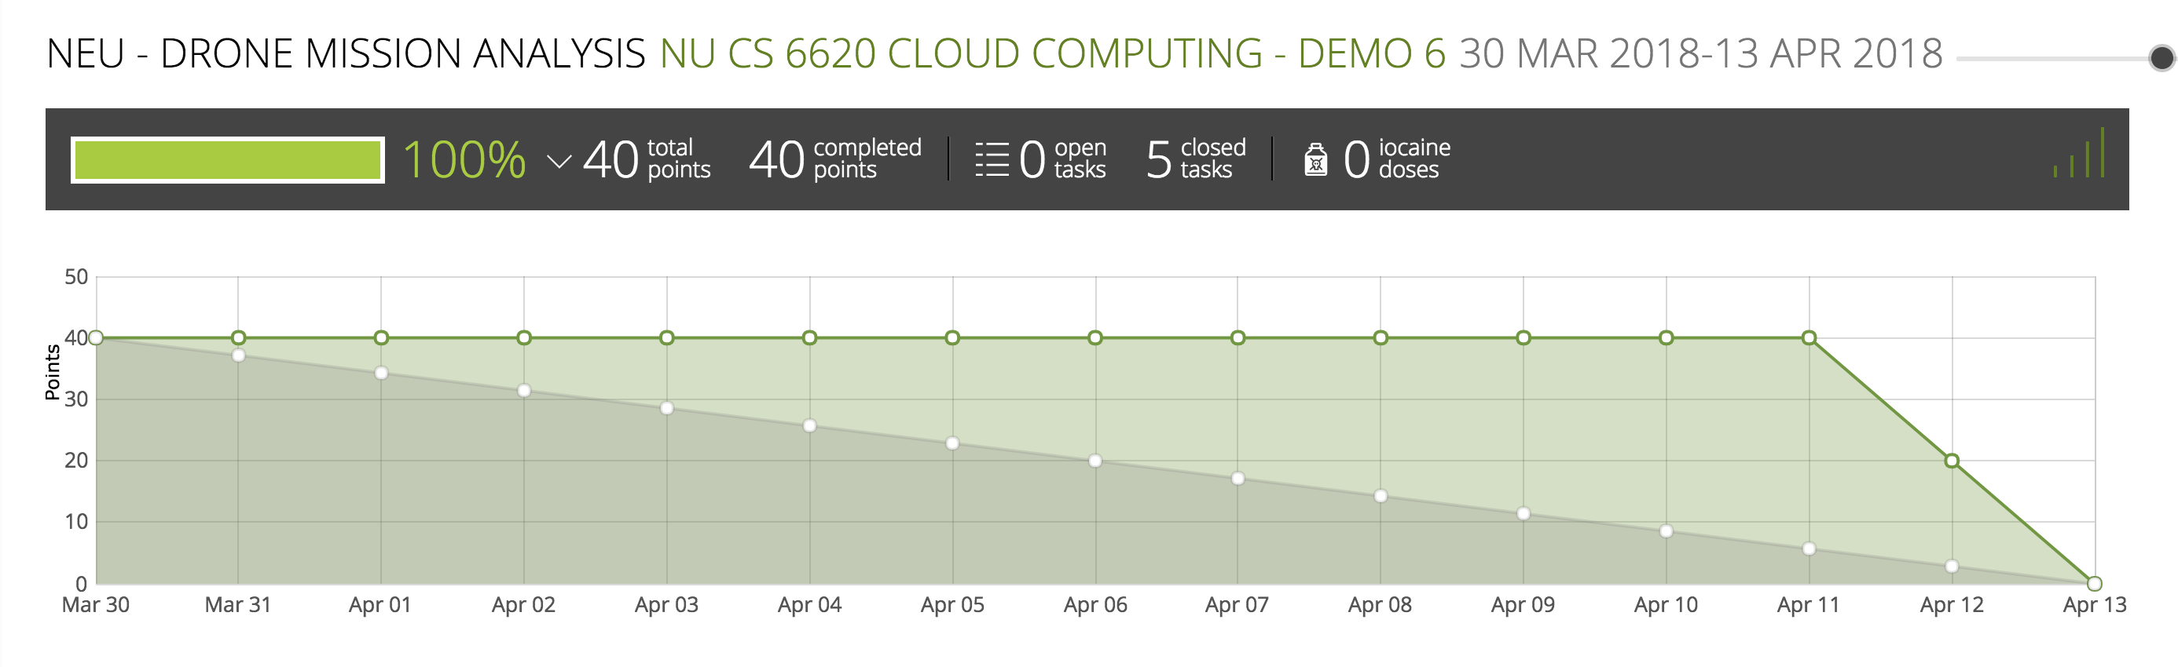
Burndown Chart
CS 6620 - Drone Mission Analysis

Slide 18
Iteration 2
Tasks
Researching efficient ways of extracting image metadata.
Setting up the AWS backend services.
Brainstorming comparison algorithm.
Learning curves for React-native, Image processing and metadata
understanding and AWS technology.
Deliverables
UI mock-ups for the mobile application.
Application architecture.
CS 6620 - Drone Mission Analysis

Slide 19
Iteration 3
Tasks
Pseudo code for the comparison algorithm
Create UI for the app
Integrate Login into the app
Deliverables
UI wireframes for mobile application in react-native
Extracting data from the image using NPM module
Login functionality
CS 6620 - Drone Mission Analysis

Slide 20
Iteration 5
Tasks
Dry run of the comparison algorithm.
Rigorous system testing.
Application handover.
Deliverables
Mission status generation functionality.
CS 6620 - Drone Mission Analysis

Slide 21
Thank You!

