Slide 1
Drone Mission Analysis
Gaurav Nitin Gandhi
Rachana Tondare
Siddhesh Salgaonkar
Taashi Priya Khurana

Slide 2
Background
Commercial drone operators can contact the company and download pre-program inspection missions, then visit the inspection site and fly the mission i.e. capture photos
Operators upload photos to the mobile application to double check whether the mission was successful or not.
This is done by validating the metadata extracted from the images taken during inspection against input data.
Metadata in this case is the EXIF/XMP data (Geolocation information) along with the thumbnail.
CS 6620 - Drone Mission Analysis

Slide 3
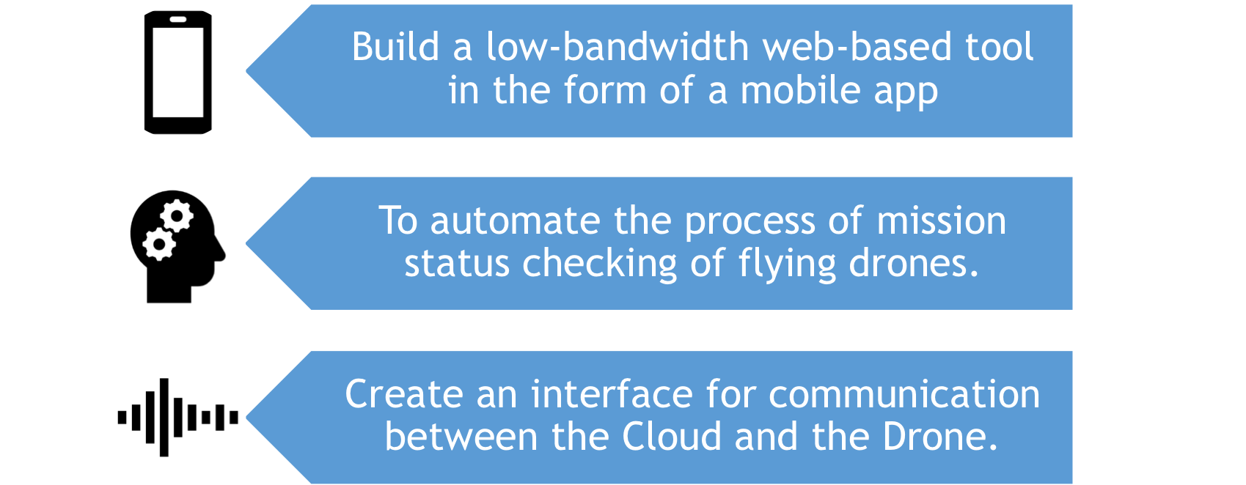
Vision and Goals
CS 6620 - Drone Mission Analysis

Slide 4
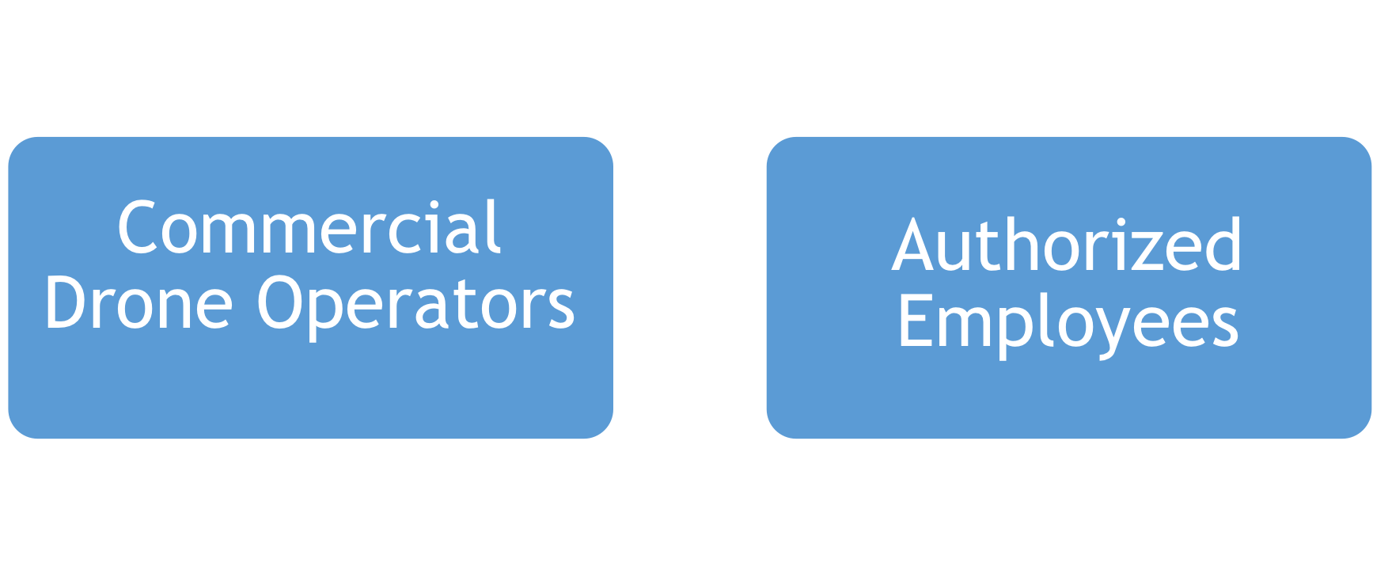
Users/Personas
CS 6620 - Drone Mission Analysis

Slide 5
Scope & Features
A simple, low bandwidth yet compelling web-based interface.
Authentication mechanism to access the system.
Extract metadata like XMP, EXIF and thumbnails from the drone-taken images for analysis.
Upload the meta data for validation against the mission plan.
Provide a result as either ‘Mission Complete’ or ‘Mission Fail’.
Visualization of the plan using Google Maps.
CS 6620 - Drone Mission Analysis

Slide 6
Acceptance criteria
The mobile device gets a mission plan from the cloud.
After the mission is flown the application reads the image data from the SD card.
The mobile device extracts and then uploads the image metadata to the cloud for analysis.
The mobile application will display the status of the mission after the analysis is complete.
CS 6620 - Drone Mission Analysis

Slide 7
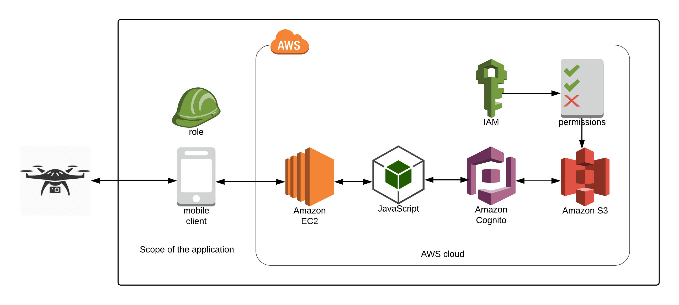
Solution Concept
CS 6620 - Drone Mission Analysis

Slide 8
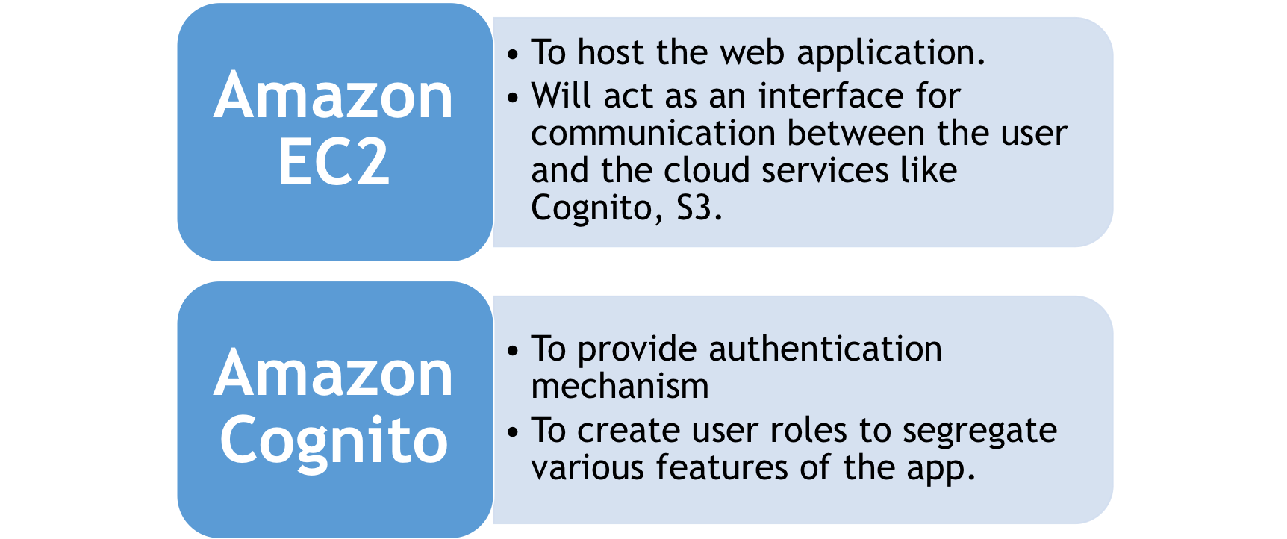
Continued…
CS 6620 - Drone Mission Analysis

Slide 9
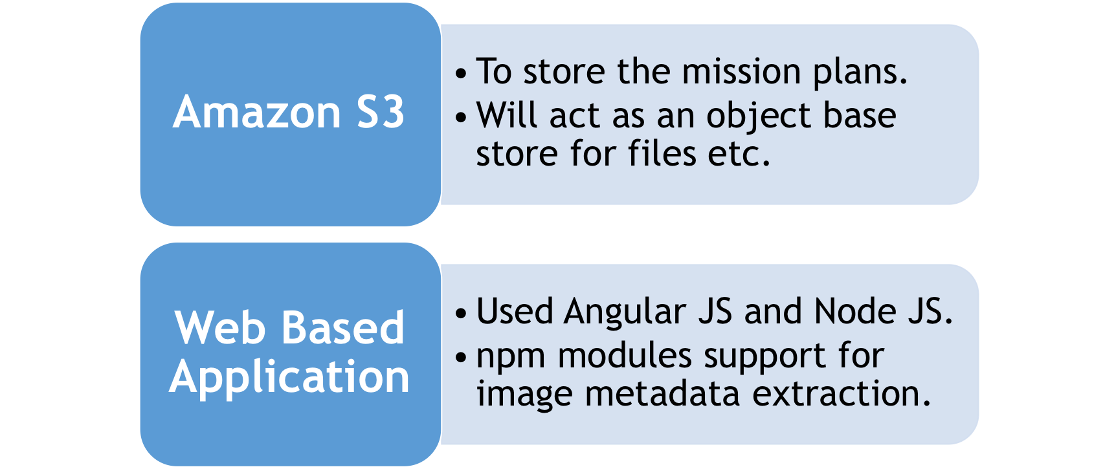
Continued…
CS 6620 - Drone Mission Analysis

Slide 10
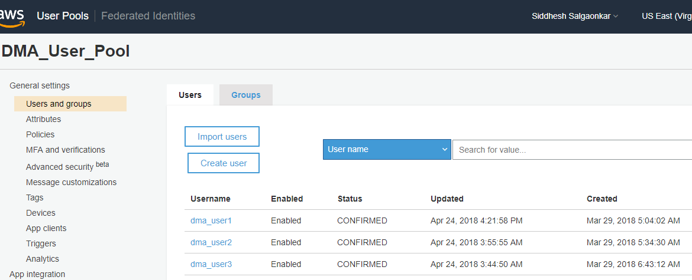
Login Backend Functionality
CS 6620 - Drone Mission Analysis

Slide 11
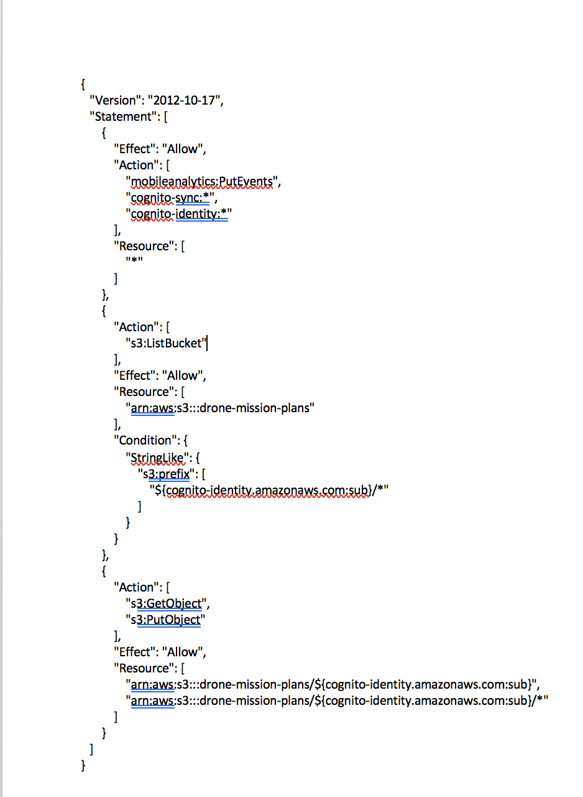
IAM POLICY
CS 6620 - Drone Mission Analysis

Slide 12
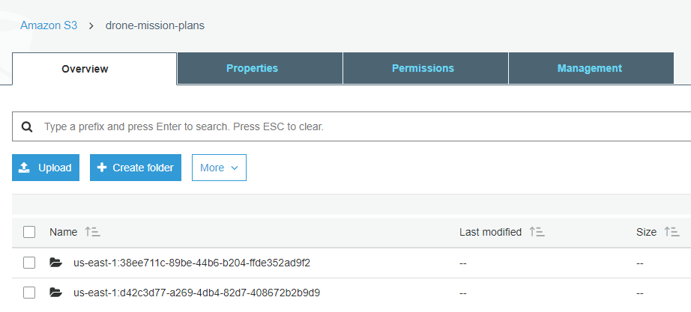
Amazon S3
CS 6620 - Drone Mission Analysis

Slide 13
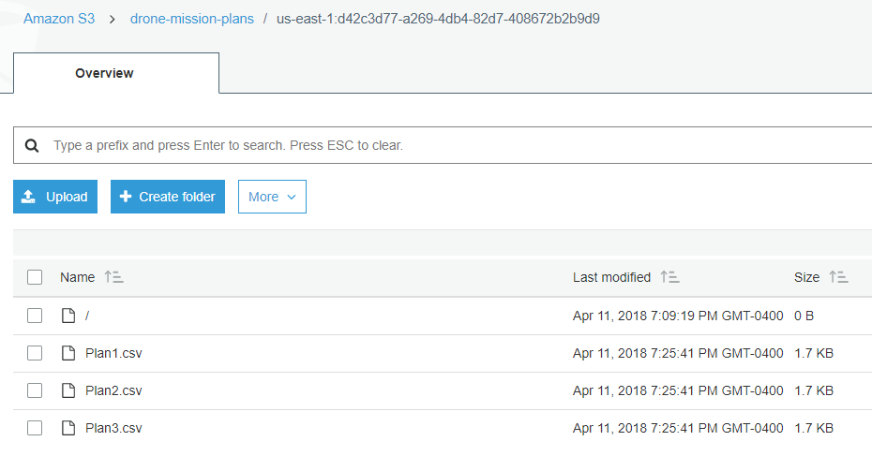
Amazon S3 –Plans for the user
CS 6620 - Drone Mission Analysis

Slide 14
Comparison Algorithm
Match the mission waypoints with the metadata of the images.
Determine whether metadata is within the error margins of the mission waypoints.
Identify mission status, Pass if metadata of all images are within the error margins of corresponding waypoints. Fail otherwise and display the waypoints not covered by the drone.
CS 6620 - Drone Mission Analysis

Slide 15
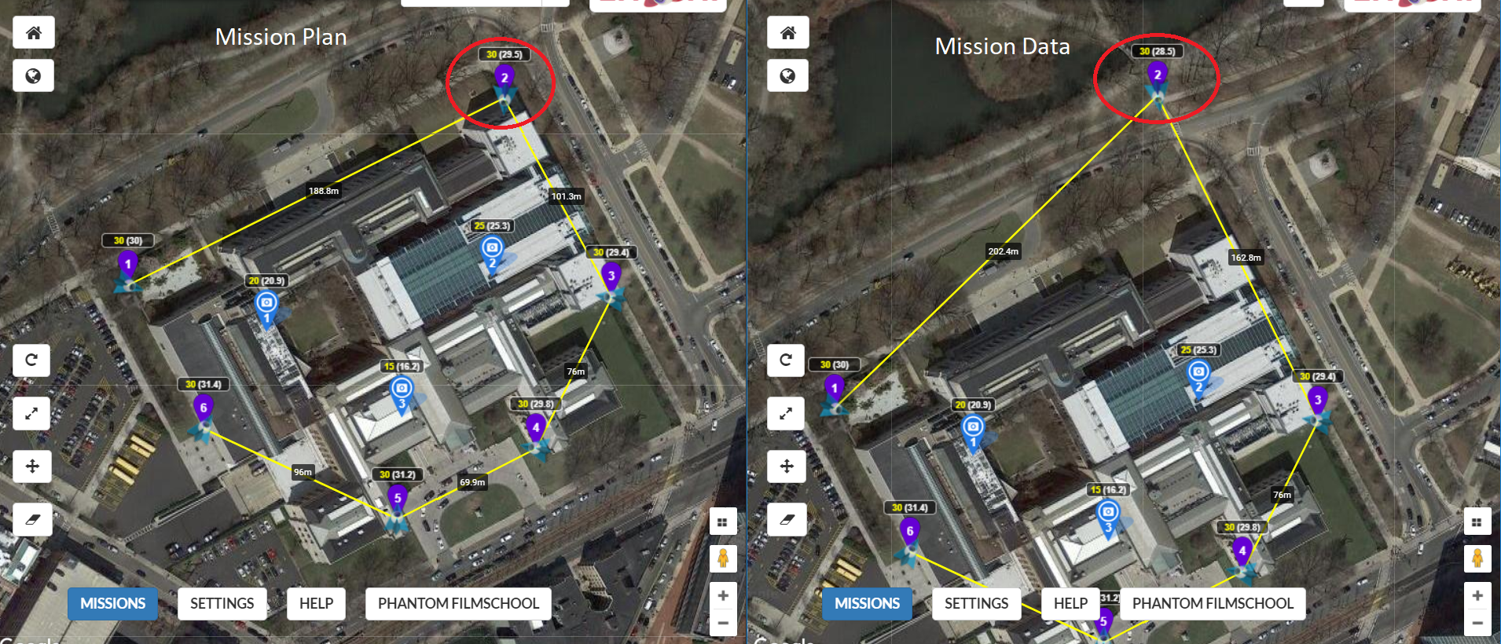
Comparison Algorithm (Contd.)
CS 6620 - Drone Mission Analysis

Slide 16
Iteration 1
Tasks
Gathering the requirements.
Deciding the technologies to be used.
Project proposal documentation.
Role assignment.
Learning curves for Node JS, Angular JS, Image processing and metadata understanding and AWS technology.
CS 6620 - Drone Mission Analysis

Slide 17
Iteration 2
Tasks
Researching efficient ways of extracting image metadata.
Setting up the AWS backend services.
Brainstorming comparison algorithm.
Learning curves for Angular JS, Image processing and metadata
understanding and AWS technology.
Deliverables
UI mock-ups for the web based mobile application.
Application architecture.
CS 6620 - Drone Mission Analysis

Slide 18
Iteration 3
Tasks
Pseudo code for the comparison algorithm
Deliverables
UI wireframes for the application
Extracting data from the image using npm module
Login functionality
CS 6620 - Drone Mission Analysis

Slide 19
Iteration 4
Tasks
Implementing the comparison algorithm.
Deliverables
Plan download functionality.
Multiple Image upload functionality.
CS 6620 - Drone Mission Analysis

Slide 20
Iteration 5
Tasks
Dry run of the comparison algorithm.
Application Testing.
Application handover.
Deliverables
Mission status generation functionality.
CS 6620 - Drone Mission Analysis

Slide 21
Iteration 6
Deliverables
Rigorous system testing
Application handover
Visualization of mission plan using Google Maps
CS 6620 - Drone Mission Analysis

Slide 22
Project Handover Deliverables
Link to project Git Repository
Project installation and set-up instructions
AWS setup instructions
Developer Contact
Test data verification
CS 6620 - Drone Mission Analysis

Slide 23
Future Scope
Registering a new user and creating login credentials for the user on native mobile application.
Functionality of uploading a new mission plan to the cloud application using a web interface.
CS 6620 - Drone Mission Analysis

Slide 24
Application Demo
Click Here:
Drone Mission Analyzer
CS 6620 - Drone Mission Analysis

Slide 25
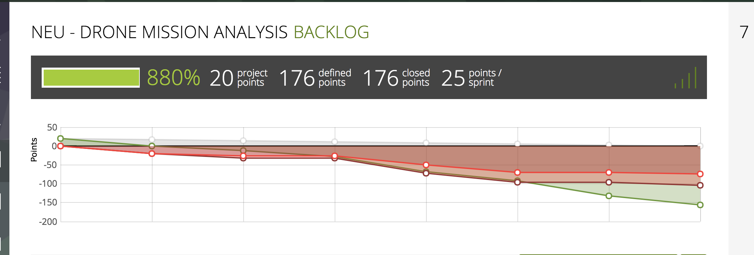
Burndown Chart for Project
CS 6620 - Drone Mission Analysis

Slide 26
Thank You!

