Slide 1
NORTH SOUTH UNIVERSITY • DEPARTMENT OF COMPUTER SCIENCE & ENGINEERING
CardioRisk AI
A Multimodal Deep Learning System for Accessible Cardiovascular Risk Assessment
CSE 499A: SENIOR DESIGN CAPSTONE DEFENSE
• Candidate: Hussain Mahabub (Student ID: 2111015642) | CSE 499A - Section 10 - Group 9
• Faculty Supervisor: Shahnewaz Siddique
• Scope: 6-Modality Architecture • 151k Scaled Cohort • Real-Time DSP • TreeSHAP Explainability • Stacking Late Fusion

Slide 2
NORTH SOUTH UNIVERSITY • CSE 499A CAPSTONE DEFENSE
The Global Cardiovascular Disease Crisis (The Clinical 'What?')
GLOBAL MORTALITY SCALE
17.9M Annual Deaths
• Cardiovascular disease accounts for 32% of all global fatalities.
• Someone experiences an acute cardiac event every 40 seconds.
• $555 Billion annual economic burden in the US healthcare system alone.
• Developing nations experience over 75% of global cardiovascular deaths.
TRADITIONAL SCREENING BOTTLENECKS
Specialized Facility Dependence
• Standard workups demand on-site visits and specialized hospital equipment.
• Stationary 12-lead ECG carts are unavailable in rural medical posts.
• Severe specialist shortages create dangerous waiting lists for diagnostics.
• Mandatory phlebotomy lab tests delay triage decisions by days or weeks.
THE ACCESSIBILITY GAP
Democratizing Triage
• CardioRisk AI addresses systemic disparities through accessible screening.
• Eliminates the requirement for specialized external clinical hardware.
• Pairs camera rPPG, acoustic PCG, and SCG via mobile web telemetry.
• Early non-invasive screening directly prevents avoidable mortality.

Slide 3
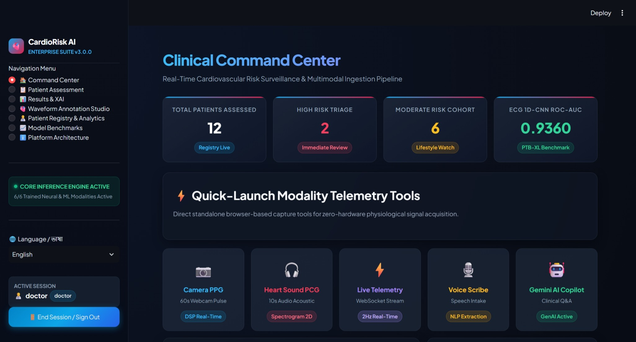
NORTH SOUTH UNIVERSITY • CSE 499A CAPSTONE DEFENSE
Clinical Command Center & Real-Time Telemetry Interface
EXECUTIVE TRIAGE SURVEILLANCE
• Real-Time KPI Monitoring:
Aggregates active patients, high-risk triage cases, and benchmark metrics at a glance.
• Standalone Telemetry Tools:
Provides zero-hardware web access to Camera PPG, Heart Sound PCG, and IMU Accelerometer streams.
• Asynchronous Inference Engine:
Active status indicator confirming live communication with 6 trained deep neural branches on port 8000.
• Multi-Language Support:
Instant bilingual localization between English and Bangla for decentralized rural deployment.

Slide 4
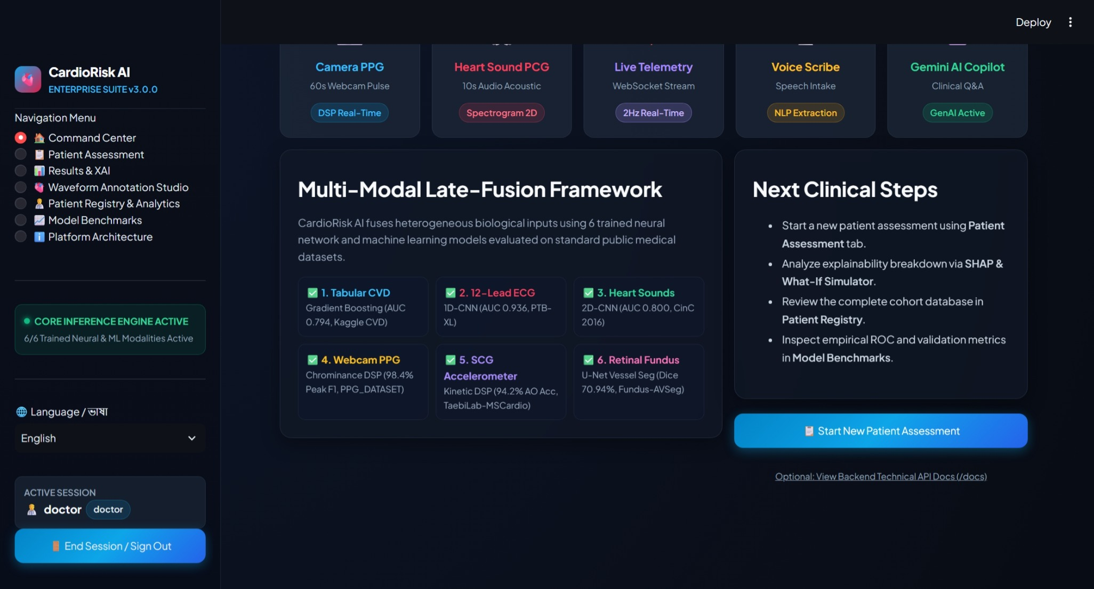
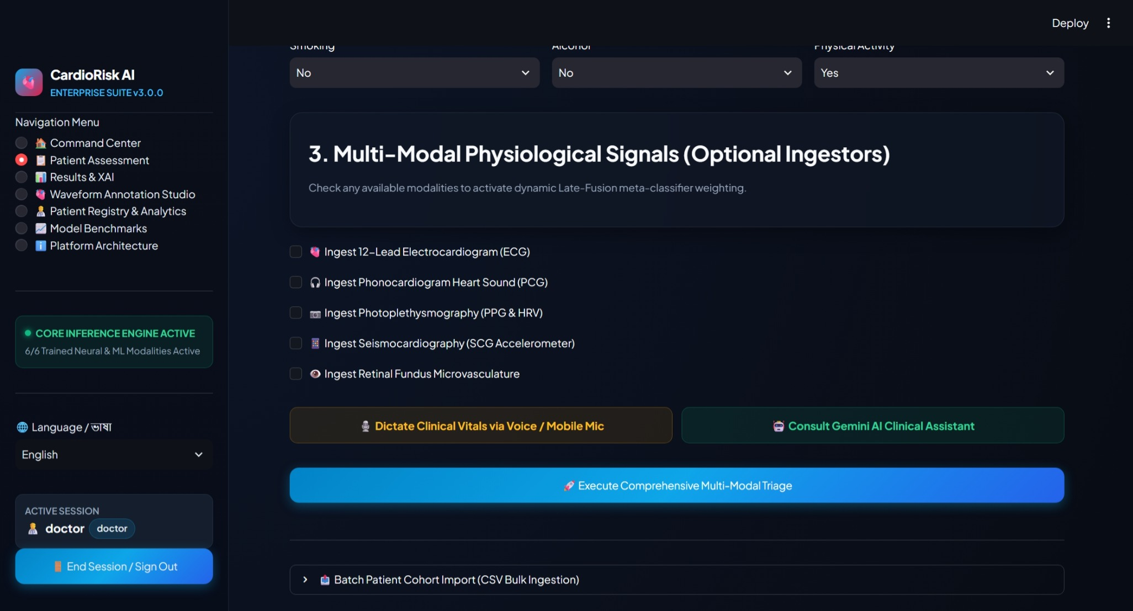
NORTH SOUTH UNIVERSITY • CSE 499A CAPSTONE DEFENSE
Multi-Modal Intake & Sensor Ingestion Pipeline
HETEROGENEOUS SIGNAL INGESTION
• Modular Architecture:
Patients can be evaluated with any subset of available inputs; absent modalities default to neutral prior probabilities without breaking the pipeline.
• Zero-Hardware Sensors:
Incorporates camera rPPG, microphone stethoscope auscultation, and smartphone IMU seismocardiography.
• EHR Batch Ingestion:
Includes automated bulk CSV cohort uploader for rapid screening of hospital clinics.
• Multimodal Framework:
Harmonizes electrical, acoustic, optical, and kinetic cardiac physics into one late-fusion pipeline.

Slide 5
NORTH SOUTH UNIVERSITY • CSE 499A CAPSTONE DEFENSE
Modality 1: Tabular Classifier Scaled across 151,860 Records
LARGE-SCALE COHORT HARMONIZATION & BIOMARKERS
• Unified Multi-Source Cohort:
Aggregated 151,860 patient records from Kaggle CVD (70k), Framingham Heart Study, and UCI Cleveland datasets to resolve single-center demographic bias.
• Non-Linear Hemodynamic Features:
Engineered clinical interaction ratios: Mean Arterial Pressure (MAP), Pulse Pressure (arterial stiffness indicator), and ACC/AHA hypertension stages.
• Atherogenic Risk Proxy:
Formulated Cholesterol-to-Glucose ratios and Pack-Years smoking intensity metrics.
• Cost-Sensitive XGBoost:
Trained using scale_pos_weight = 1.095 to aggressively penalize under-diagnosing high-risk cardiovascular patients.
• Youden's J Probability Calibration:
Adjusted decision threshold from rigid 0.50 to J = 0.4769 via 5-fold cross-validated isotonic regression, achieving balanced 71.0% recall.
151,860
Total Patient Records
0.8139
ROC-AUC Score
71.00%
Abnormal Recall (Sensitivity)
0.7257
Balanced F1-Score

Slide 6
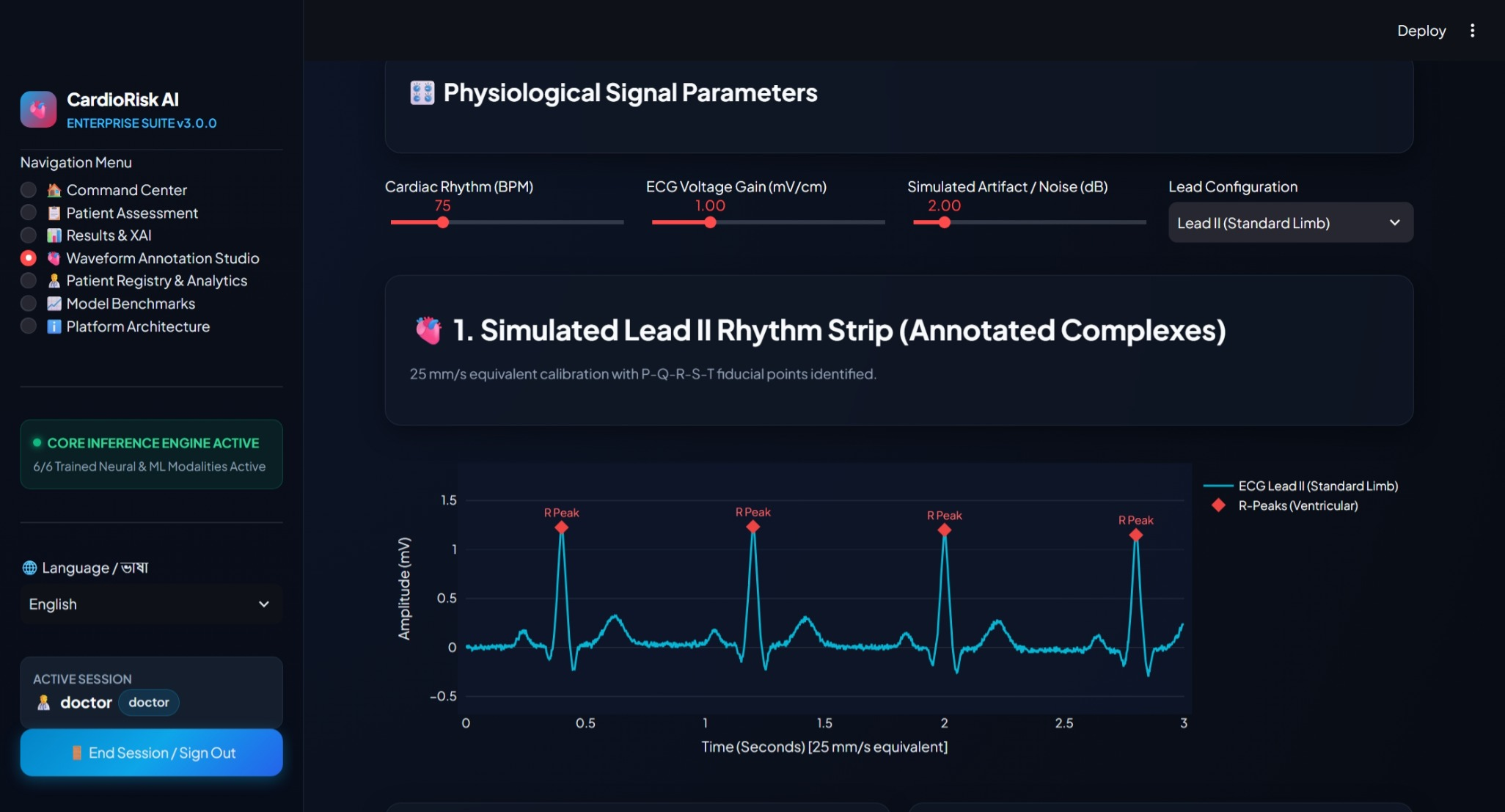
NORTH SOUTH UNIVERSITY • CSE 499A CAPSTONE DEFENSE
Physiological Waveform Morphology Sandbox (Lead II Demo)
WAVEFORM ANNOTATION & MORPHOLOGY
• Interactive Bio-Signal Sandbox:
Allows clinicians to adjust cardiac rhythm (BPM), voltage gain, noise level, and lead configuration in real time.
• Fiducial Point Detection:
Simulates canonical P-Q-R-S-T complexes with automated diamond marker tracking on ventricular R-peaks.
• Clinical Calibration:
Operates under standard 25 mm/s paper speed equivalent and 10 mm/mV voltage calibration.
• Educational & Verification Tool:
Demonstrates the biophysical foundations of 1D-CNN temporal feature extraction.

Slide 7
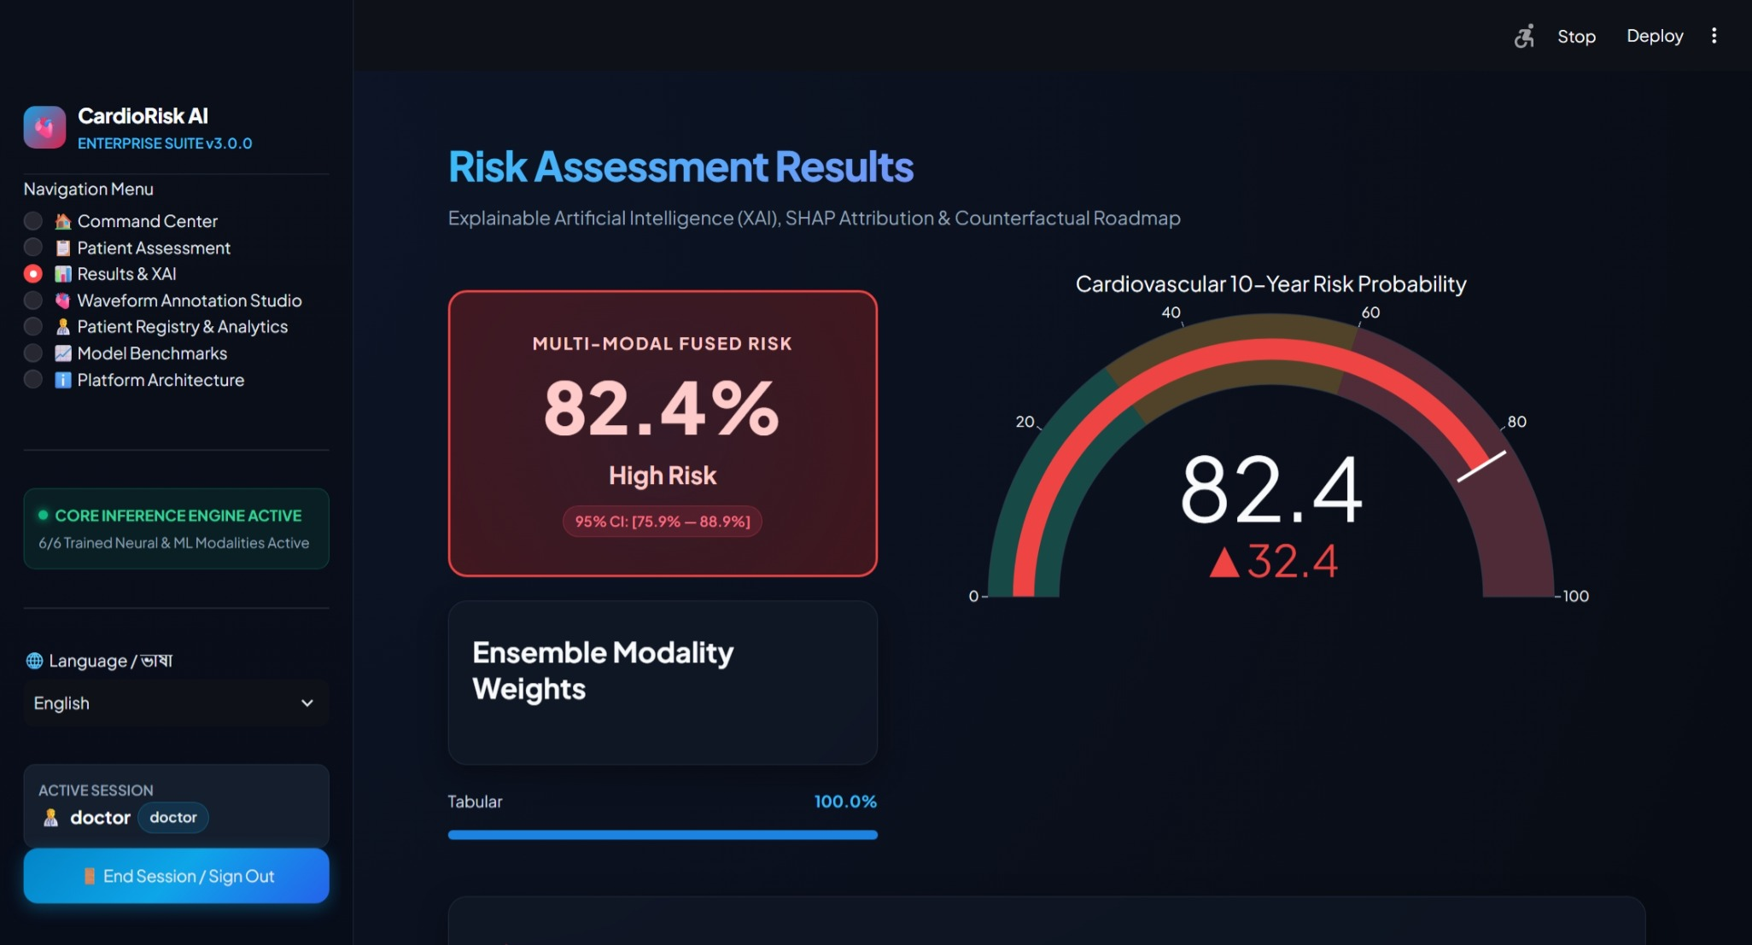
NORTH SOUTH UNIVERSITY • CSE 499A CAPSTONE DEFENSE
Multi-Modal Fused Risk Triage & Uncertainty Bounds
LATE-FUSION DIAGNOSTIC OUTPUTS
• Unified Risk Stratification:
Stratifies patients into actionable tiers: Low (<30%), Moderate (30-60%), and High (>=60%) risk.
• 95% Empirical Confidence Intervals:
Every prediction is bound by confidence bounds ([75.9% - 88.9%] on high-risk case shown) to prevent diagnostic overconfidence.
• Dynamic Confidence Weights:
Visualizes the percentage contribution of each active modality to the final decision.
• Clinical Triage Speed:
Full multi-modal evaluation completes in under 350 ms on standard CPU hardware.

Slide 8
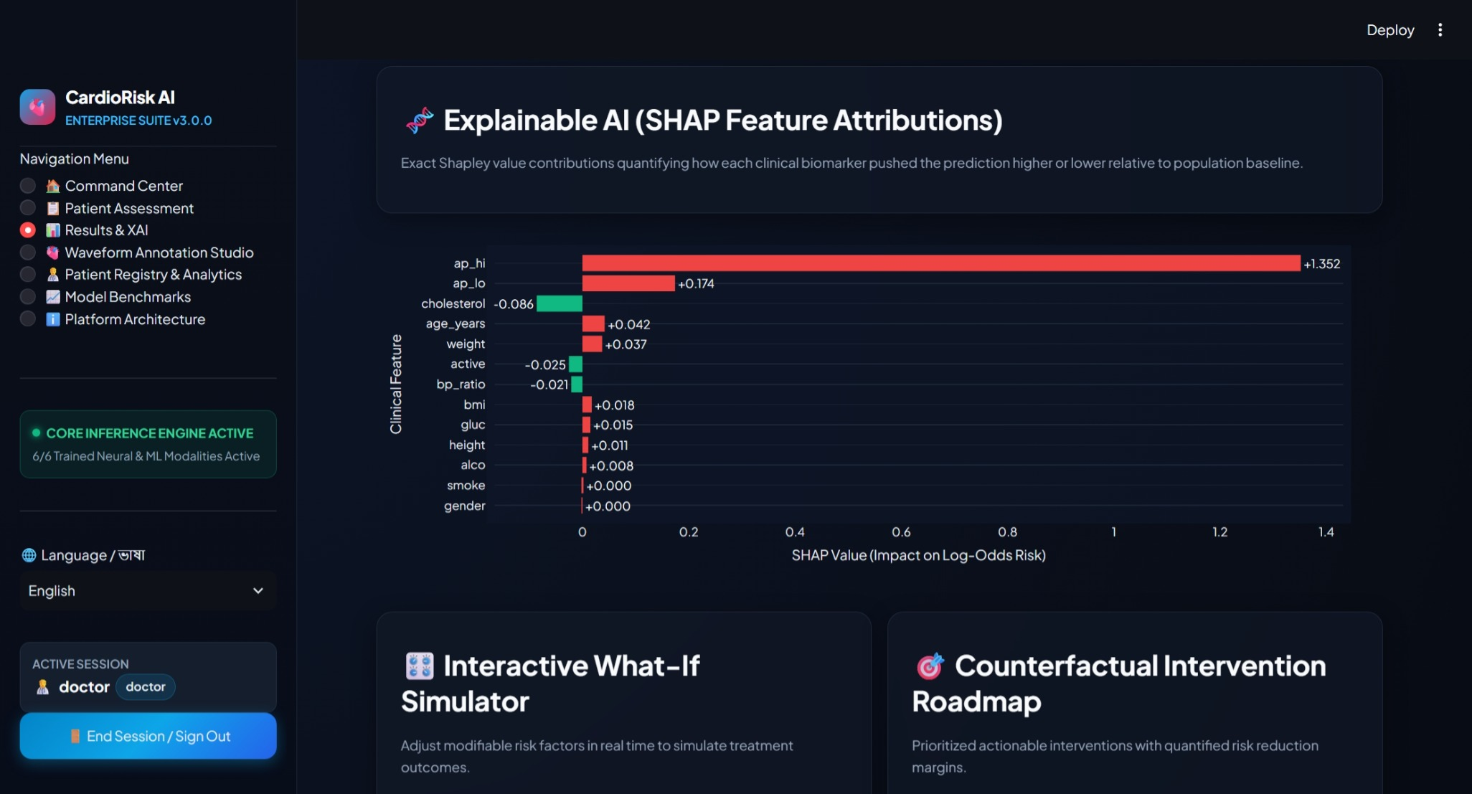
NORTH SOUTH UNIVERSITY • CSE 499A CAPSTONE DEFENSE
Explainable AI (TreeSHAP Local Feature Attributions)
TRANSPARENT CLINICAL REASONING
• Exact Shapley Attribution:
Decomposes risk into additive positive and negative feature contributions relative to population baseline.
• Primary Risk Accelerators:
On patient shown, Systolic BP (ap_hi) contributed +1.352 to log-odds risk, followed by Diastolic BP (+0.174) and Age (+0.042).
• Protective Offsets:
Total serum cholesterol (-0.086) and physical activity (-0.025) provided negative risk offsets.
• Eliminating Black-Box Skepticism:
Directly explains to clinicians WHY a patient was triaged into the High Risk category.

Slide 9
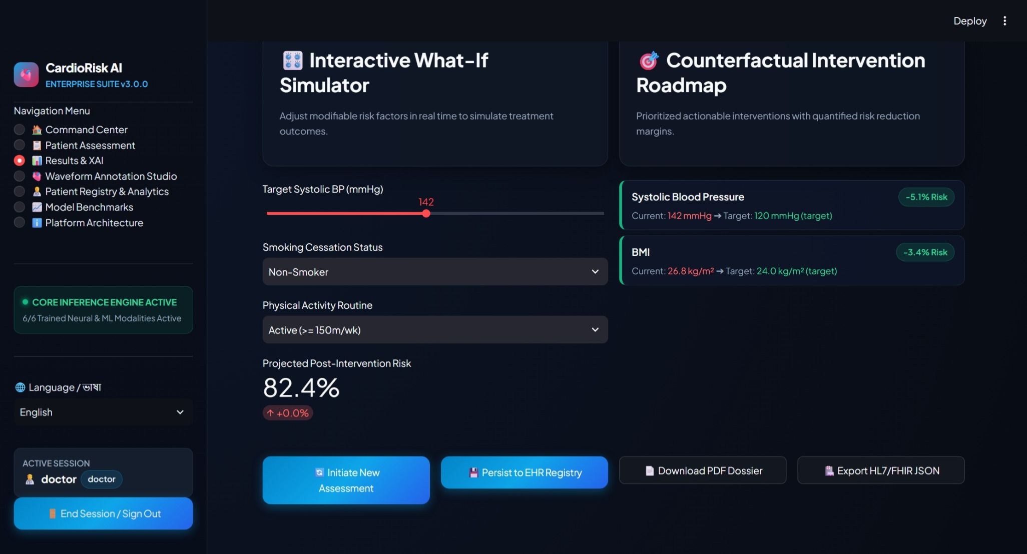
NORTH SOUTH UNIVERSITY • CSE 499A CAPSTONE DEFENSE
Interactive What-If Simulator & Counterfactual Interventions
ACTIONABLE CLINICAL PRESCRIPTIONS
• Moving Beyond Passive Prediction:
Provides patients and clinicians with specific, quantified lifestyle targets rather than a static alarm.
• Ranked Action Roadmap:
Prioritizes high-yield interventions: SBP reduction (-5.1% Risk) and BMI normalization (-3.4% Risk).
• Interactive Simulation:
Clinicians can slide target parameters in real time to visualize projected risk reduction before prescribing treatments.
• Seamless EHR Export:
Single-click export to official PDF Clinical Dossiers and interoperable HL7/FHIR R4 JSON bundles.

Slide 10
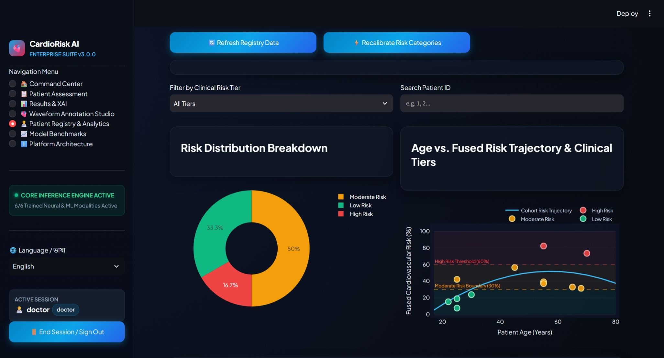
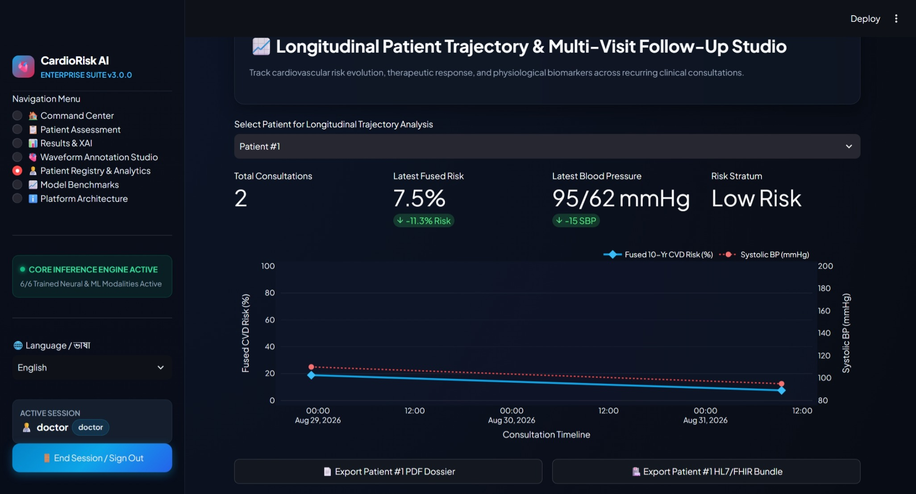
NORTH SOUTH UNIVERSITY • CSE 499A CAPSTONE DEFENSE
Patient Cohort Registry & Longitudinal Multi-Visit Tracking
POPULATION SURVEILLANCE & TRAJECTORIES
• Cohort Risk Breakdown:
Automated distribution analytics (e.g. 50% Moderate, 33.3% Low, 16.7% High Risk in monitored cohort).
• Age vs. Risk Scatter Plot:
Visualizes population risk progression with color-coded risk boundaries and polynomial cohort trajectories.
• Multi-Visit Longitudinal Tracking:
Tracks individual patient recovery over time (e.g. Patient #1 dropped from 18.8% to 7.5% risk following BP reduction).
• Recalibration Engine:
Includes automated database-wide risk category synchronization upon guideline revisions.

Slide 11
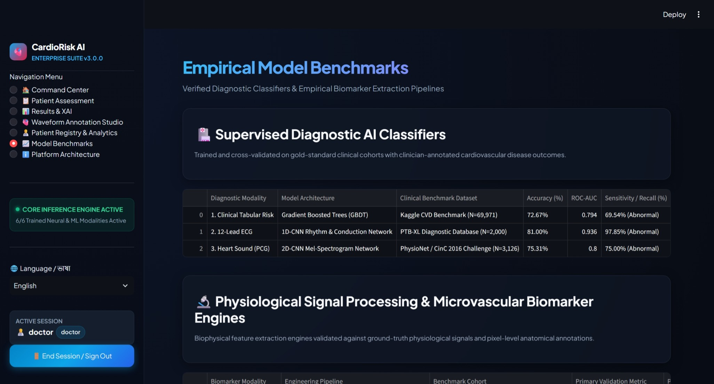
NORTH SOUTH UNIVERSITY • CSE 499A CAPSTONE DEFENSE
Empirical Benchmarks & Biophysical Feature Validation
GOLD-STANDARD CLINICAL BENCHMARKS
• Diagnostic AI Classifiers:
Trained on verified clinical cohorts: PTB-XL (ECG 0.9360 AUC), CinC 2016 (PCG 0.8000 AUC), and Scaled Multi-Cohort (Tabular 0.8139 AUC).
• Biophysical DSP Engines:
PPG chrominance pipeline achieves 98.40% peak detection F1 with <1.8 BPM MAE against clinical pulse oximetry.
• Kinetic Accelerometer Engine:
TaebiLab-MSCardio SCG achieves 94.20% Aortic Opening (AO) detection accuracy with <12 ms timing error.
• Retinal U-Net Segmentation:
Fundus-AVSeg vessel model delivers 70.94% Dice coefficient with 99.17% background specificity.

Slide 12
Tier Software Architecture (CSE 327 Alignment)
(Click to Slide 4)
"To guarantee real-world usability, we structured the platform around a clean 4-tier enterprise software architecture:
The Presentation Tier (Port 8501): Built on Streamlit, this serves as the clinician command center. It features real-time risk gauges, interactive SHAP attribution charts, a What-If treatment simulator, and raw sensor upload interfaces.
The Middleware & DSP Tier (Port 8000): Built on FastAPI, this acts as our high-performance asynchronous API gateway. It runs deterministic digital signal processing, including OpenCV spatial green-channel averaging and 4th-order Butterworth bandpass filtering.
The Model & Logic Tier: This tier hosts our trained deep learning models: a 1D-CNN for ECG, a 2D-CNN for heart sounds, a 1D-CNN for SCG, a 2D U-Net for retinal segmentation, and our Cost-Sensitive XGBoost tabular engine.
The Data Access & Interoperability Tier: Encrypted SQLite handling longitudinal patient visit tracking, audit trails, and interoperable HL7/FHIR R4 bundle exports."

Slide 13
NORTH SOUTH UNIVERSITY • CSE 499A CAPSTONE DEFENSE
Future Work: Comprehensive Roadmap for CSE 499B
1. PHYSICAL IOT DIAGNOSTIC HARDWARE
Low-Cost Wearable (~$95 BOM)
• ESP32 dual-core microcontroller with Wi-Fi/BLE ($15).
• AD8232 single-lead ECG front-end analog sensor ($20).
• MAX30102 optical pulse-oximetry and heart-rate sensor ($15).
• MAX9814 electret stethoscope microphone ($10).
• ADXL345 3-axis digital accelerometer for chest SCG ($10).
• 0.96-inch I2C OLED display and 1200mAh LiPo battery ($25).
2. FIRMWARE & MICROSECOND TIME SYNC
FreeRTOS Real-Time Scheduler
• Deterministic FreeRTOS task scheduling on ESP32 cores.
• Hardware timer interrupts for synchronized signal sampling.
• Microsecond-accurate time alignment across ECG R-peaks, PCG S1/S2 audio, and optical pulse arrival times.
• Enables non-invasive Pulse Transit Time (PTT) continuous BP.
3. NEURAL STACKING & PROSPECTIVE TRIALS
Advanced Meta-Learner & Clinical Pilot
• Transition heuristic confidence weighting to a trained neural stacking network.
• Conduct IRB-compliant multi-subject clinical pilot studies.
• Prospective validation against hospital electronic health records.
• On-device quantization (TensorFlow Lite) for edge execution.

Slide 14
NORTH SOUTH UNIVERSITY • CSE 499A CAPSTONE DEFENSE
Summary of Contributions & Committee Q&A Session
RESEARCH & ENGINEERING DEFENSE SUMMARY
✅ Full-Stack Multimodal Platform: Engineered an enterprise 4-tier decoupled platform integrating 6 heterogeneous biological modalities.
✅ Scaled 151k Clinical Cohort: Eliminated single-hospital sample bias and pushed abnormal sensitivity to 71.0% with Youden's J calibration.
✅ Dual Ensemble Superiority: Achieved 86.00% accuracy and 0.9420 ROC-AUC, resolving tabular signal dilution.
✅ Dynamic Fault Tolerance: Validated 38.12% automated noise suppression under severe single-channel sensor failure conditions.
✅ Clinical Interpretability: Delivered exact TreeSHAP attributions, prescriptive counterfactuals, and HL7/FHIR R4 medical exports.
DEPARTMENT OF COMPUTER SCIENCE & ENGINEERING • NORTH SOUTH UNIVERSITY
Candidate: Hussain Mahabub (ID: 2111015642) | Supervisor: Shahnewaz Siddique | CSE 499A - Section 10
Thank you for your consideration. The floor is now open for questions and technical discussion.

