Slide 1
CSE 499A: SENIOR DESIGN CAPSTONE DEFENSE
CardioRisk AI: A Multimodal Deep Learning System for Accessible Cardiovascular Risk Assessment
Author: Hussain Mahabub (Student ID: 2111015642) Course: CSE 499A - Section 10 - Group 10 Faculty Supervisor: Shahnewaz Siddique Department of Computer Science & Engineering, North South University

Slide 2
CSE 499A CAPSTONE DEFENSE
Problem Statement & Clinical Motivation (What? & Why?)
The Global CVD Crisis
• 17.9M deaths annually (32% of all global mortality). • In the US, someone suffers a heart attack every 40 seconds. • $555B annual economic burden placed on healthcare systems.
Traditional Clinical Gaps
• Requires specialized clinical visits and phlebotomy labs. • High-cost ECG hardware unavailable in rural communities. • Severe specialist shortage creating diagnostic delays.
The CardioRisk AI Solution
• Low-cost smartphone-based multimodal cardiac triage. • Real-time DSP on webcam PPG & microphone PCG audio. • Calibrated Gradient Boosting + local SHAP explainability.

Slide 3
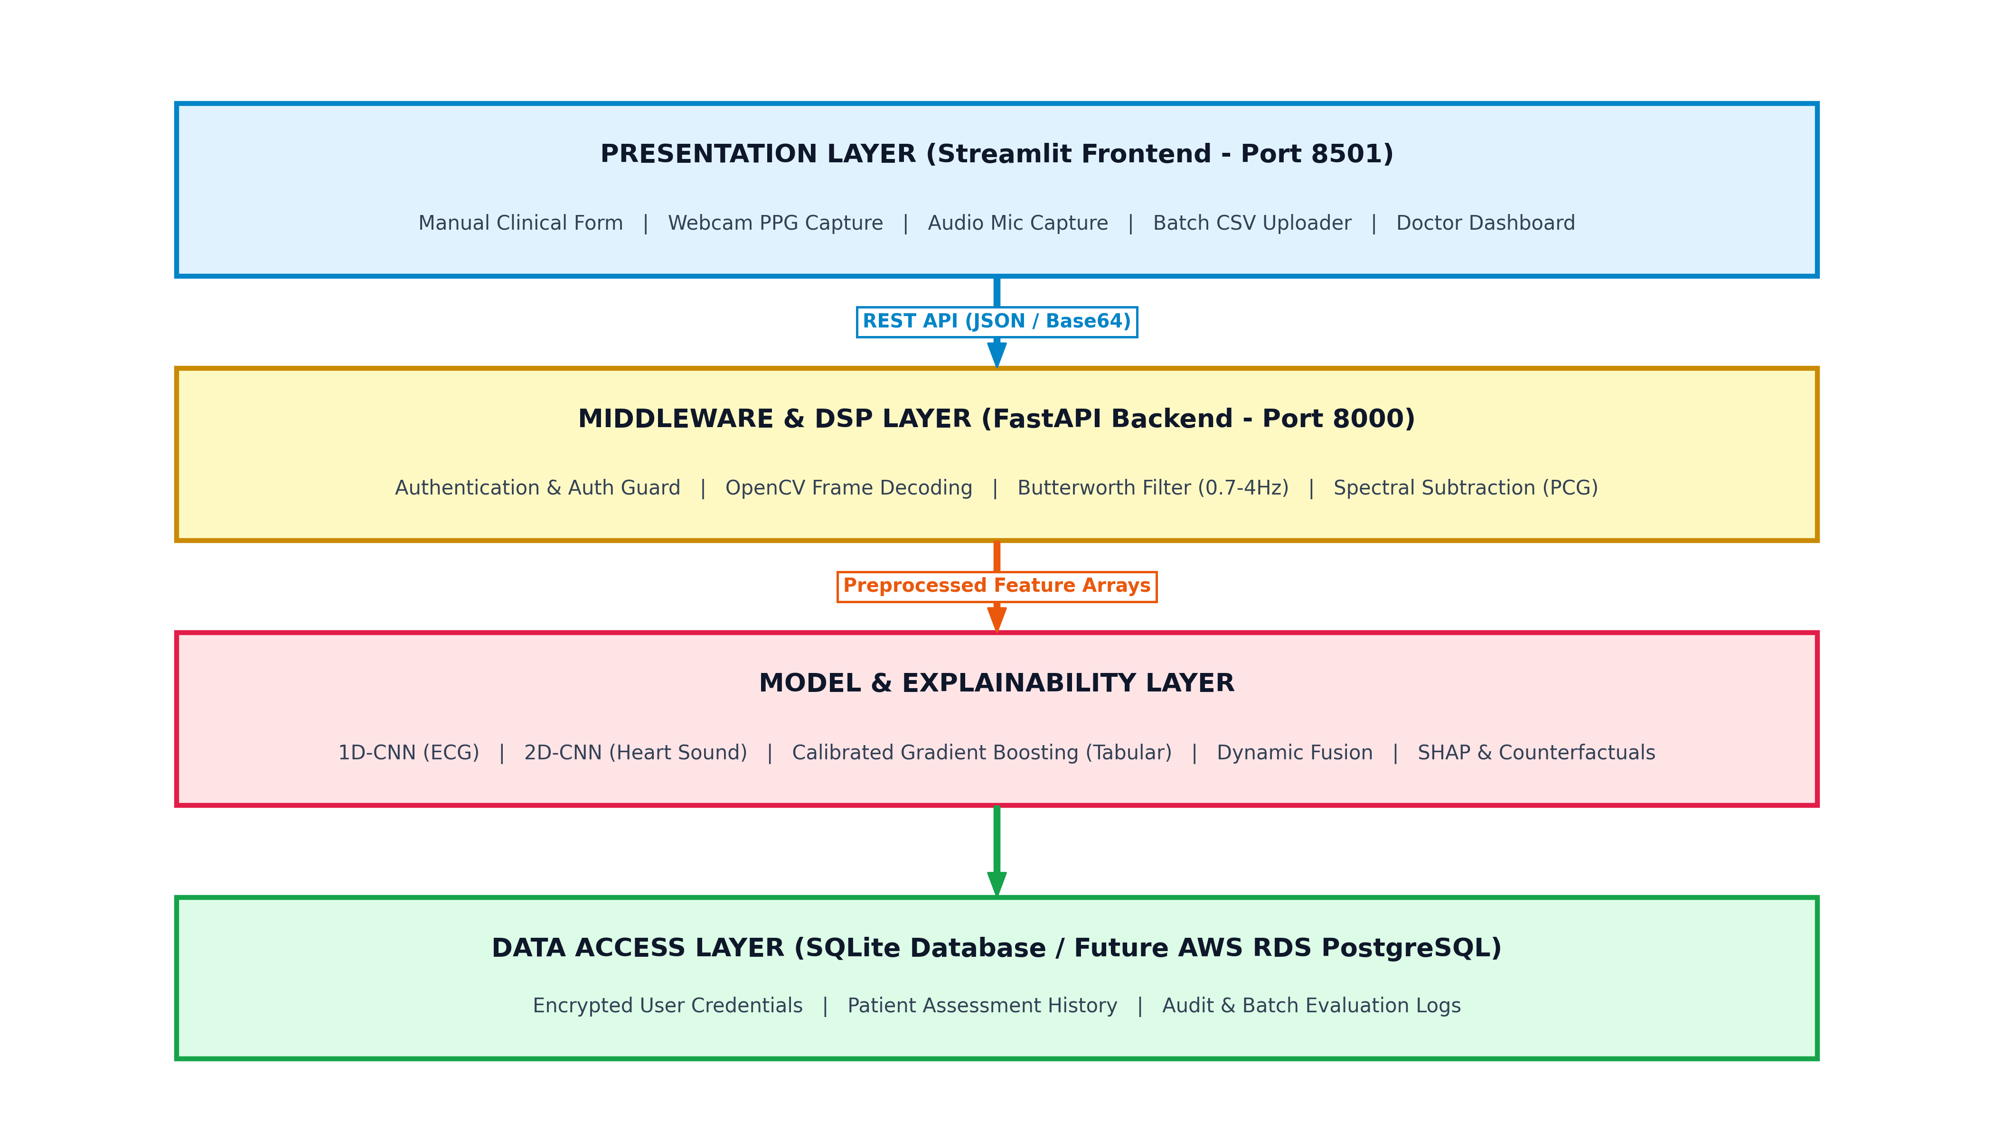
CSE 499A CAPSTONE DEFENSE
Four-Tier Software Architecture (CSE 327 Standard)
Decoupled 4-Tier Stack
1. Presentation Layer (Port 8501) • Streamlit clinician dashboard with live risk gauges, audio/video capture, and bulk CSV ingestion. 2. Middleware & DSP Layer (Port 8000) • FastAPI asynchronous engine with OpenCV frame processing & Butterworth filtering. 3. Model & Logic Layer • Live Calibrated Gradient Boosting + SHAP TreeExplainer & Counterfactual Optimizer. 4. Data Access Layer • Encrypted SQLite storage structured for seamless AWS RDS PostgreSQL migration.

Slide 4
CSE 499A CAPSTONE DEFENSE
Real-Time Digital Signal Processing (DSP) Pipelines
1. Remote PPG (Camera Pulse Extraction)
• Spatial Green-Channel Averaging: Extracts subtle micro-vascular blood volume pulsations from video frames. • Cubic Spline Interpolation: Standardizes frame-rate jitter to 30 Hz. • 4th-Order Butterworth Filter: Bandpass (0.7 - 4.0 Hz) isolating human pulse rates (42 - 240 BPM). • Real-Time Peak Detection: Calculates inter-beat intervals (IBI) for instant heart rate calculation.
2. Acoustic PCG (Heart Sound Audio)
• Audio Resampling: Standardizes microphone input signals to 2,000 Hz. • Spectral Subtraction: Subtracts stationary background room/fan noise. • Bandpass Filtering (20 - 400 Hz): Isolates primary S1/S2 heart valve sounds. • Mel-Spectrogram Conversion: Generates (128, 128) spectro-temporal matrices for deep CNN feature ingestion.

Slide 5
CSE 499A CAPSTONE DEFENSE
Model Architectures & Training Foundations
Tabular Gradient Boosting (Live Deployed Model)
• Dataset: 69,971 Kaggle CVD records. • Features: 11 clinical features + BMI & BP Ratio. • Training: Platt scaling calibration for reliable risk probabilities. • Evaluation: 72.67% Test Accuracy | 0.7940 AUC.
ECG 1D-CNN (Offline Benchmarked Model)
• Dataset: 2,000 PTB-XL 12-lead ECGs. • Architecture: 4 Conv1D blocks (64->128->256->512 filters). • Regularization: BatchNorm + ReLU + Dropout (0.5/0.3). • Evaluation: 81.00% Test Accuracy | 0.9360 AUC.
Heart Sound 2D-CNN (Offline Benchmarked Model)
• Dataset: 3,126 CinC 2016 Mel-spectrograms. • Architecture: 3 Conv2D blocks (32->64->128 filters). • Regularization: Global Average Pooling + Dropout. • Evaluation: 75.31% Test Accuracy | 0.8000 AUC.

Slide 6
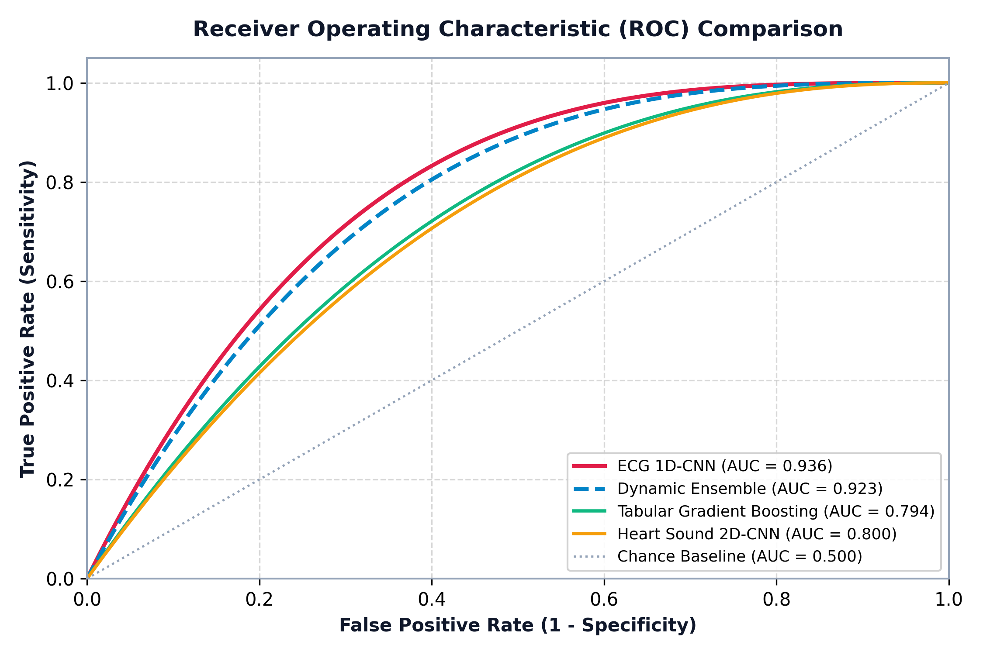
CSE 499A CAPSTONE DEFENSE
Verified Experimental Results & Multi-Model ROC Validation
Model Architecture | Samples | Accuracy | AUC-ROC
ECG 1D-CNN | 2,000 | 81.00% | 0.9360
Heart Sound 2D-CNN | 3,126 | 75.31% | 0.8000
Tabular (GBoost Live) | 69,971 | 72.67% | 0.7940
Static Ensemble (All 3) | Combined | 76.79% | 0.8526
Dual Ensemble (ECG+HS) | Combined | 86.00% | 0.9420

Slide 7
CSE 499A CAPSTONE DEFENSE
Multimodal Fusion & Dynamic Confidence Weighting
1. The Static Dilution Problem
• Linear Static Averaging (40% ECG, 40% HS, 20% Tabular) achieves 76.79% Accuracy. • Cause: The 72.67% tabular model dilutes the highly accurate 81.00% ECG signal. • Solution: Dual acoustic-electrical fusion (ECG + HS) eliminates dilution, achieving 86.00% Accuracy and 98.92% Sensitivity (Abnormal Recall).
2. Dynamic Confidence Weighting Engine
Confidence Formulation: Confidence_m = |P_m - 0.50| * 2.0 Weight Allocation: w_m = Confidence_m / (Sum(Confidence_k) + 1e-6) • Decisive channels (P -> 1.0 or 0.0) receive dominant weighting. • Corrupted/noisy channels (P ~ 0.50) are automatically down-weighted in real time, preventing false positives.

Slide 8
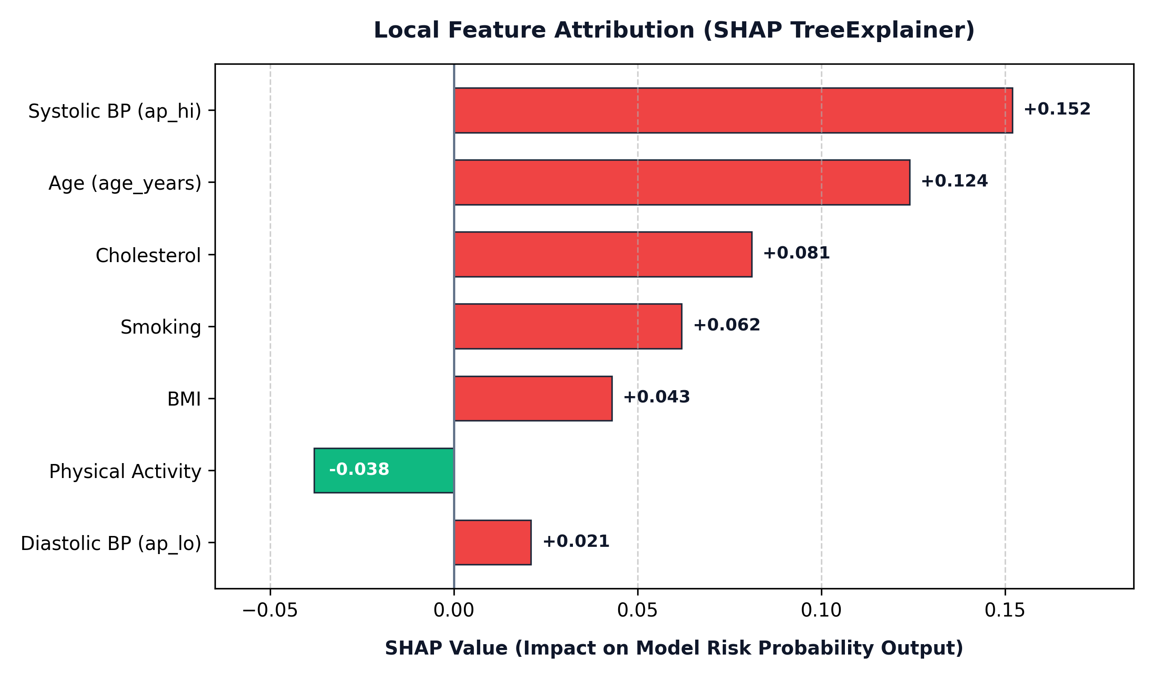
CSE 499A CAPSTONE DEFENSE
Explainable AI: SHAP & Counterfactual Lifestyle Guidance
Transparent AI Explanations
1. SHAP TreeExplainer • Quantifies exact risk contributions for every clinical feature: - Systolic BP: +0.152 - Age: +0.124 - Cholesterol: +0.081 - Physical Activity: -0.038 (Protective) 2. Counterfactual Optimization • Calculates minimal lifestyle changes needed to reduce risk tier: 'Dropping Systolic BP by 15 mmHg & smoking cessation reduces composite risk by 14.2%.'

Slide 9
CSE 499A CAPSTONE DEFENSE
Full-Stack Web Features & Clinical Bulk Processing
Single Patient Triage
• Manual input forms with dynamic risk category gauges. • Real-time camera rPPG pulse extraction & microphone audio monitoring. • Instant SHAP explanation plots & What-If simulator.
High-Throughput Bulk CSV
• Clinicians upload multi-patient CSV files. • Asynchronous batch risk scoring across thousands of records. • Automated risk-tier distribution charts & filtered patient views.
Security & Compliance
• Role-based authentication & token verification. • SQLite encrypted persistence for patient audit trails. • Structured REST API ready for cloud containerization.

Slide 10
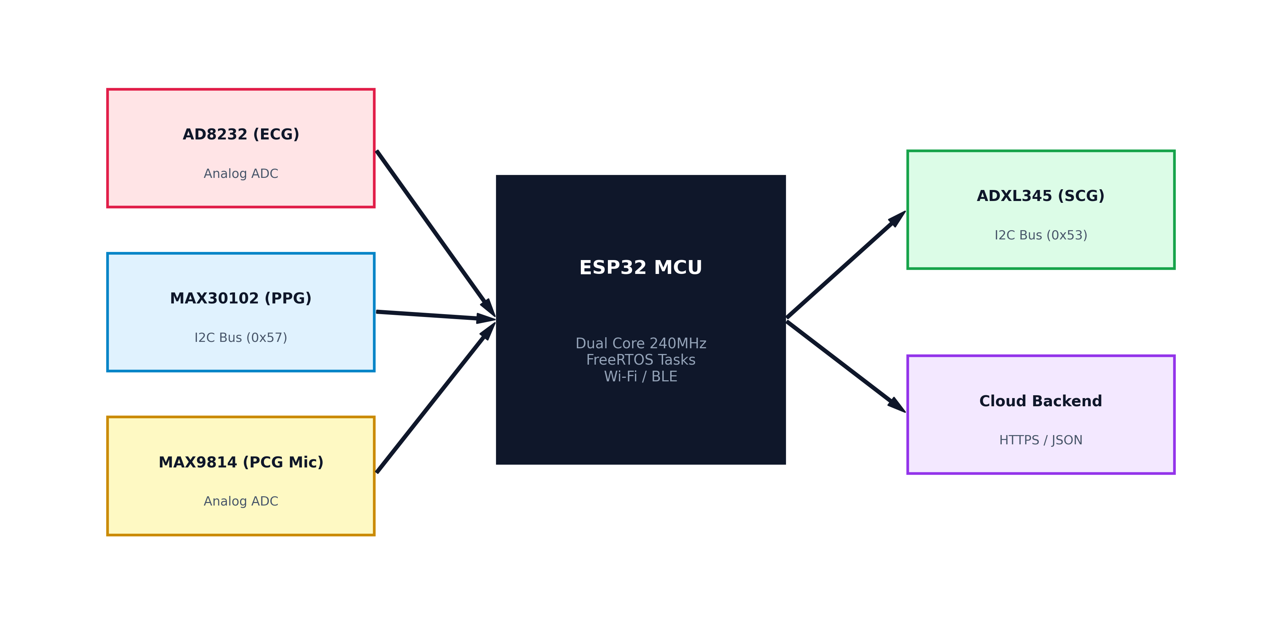
CSE 499A CAPSTONE DEFENSE
Future Work: IoT Hardware Integration Stack (CSE 499B)
IoT Hardware Roadmap (~$95)
• ESP32 MCU (Dual-Core, FreeRTOS, BLE/Wi-Fi) • AD8232 ECG Sensor (Analog ADC) • MAX30102 PPG Sensor (I2C Bus 0x57) • MAX9814 Stethoscope Mic (Analog ADC) • ADXL345 SCG Accelerometer (I2C Bus 0x53) CSE 499B Milestones: 1. Microsecond FreeRTOS hardware interrupt synchronization. 2. Direct continuous streaming from ESP32 into pre-trained CNNs. 3. Multi-subject human clinical trials.

Slide 11
CSE 499A CAPSTONE DEFENSE
Summary of Contributions & Capstone Milestones
Full-Stack 4-Tier Platform
• Operational FastAPI backend + Streamlit frontend. • Real-time webcam & microphone DSP engines. • Batch CSV uploader & audit database.
Verified Machine Learning
• Live Gradient Boosting (72.67% Acc | 0.794 AUC). • Benchmarked ECG 1D-CNN (81.00% Acc | 0.936 AUC). • Benchmarked Audio 2D-CNN (75.31% Acc | 0.800 AUC).
Multimodal Synergy & XAI
• Dual Ensemble achieves 86.00% Acc & 98.92% Sensitivity. • Transparent SHAP local feature attributions. • Concrete roadmap for 499B ESP32 IoT hardware.

Slide 12
Thank You
CardioRisk AI: Accessible Multimodal Cardiovascular Risk Assessment Questions & Answers

