Slide 1
Loan Default Issue
-Neeraj Agrawal

Slide 2
Agenda:
Business Problem Statement
Rationale behind Data Science approach
Info about raw data
Data Dictionary Info & Issues
Data Science Flow Chart
Quick Recommendations
Additional Questions & Answers

Slide 3
Business Statement
Find the correlation between countries GDP and CO₂ emission
Explore data and generate graphs for data visualization

Slide 4
Rationale
Data Science approach helps, not limited, with following aspects:
Helps study the data patterns of different indicators
Generate data visualization to see patterns of GDP for developed and developing countries
Machine learning models helps predicts the future GDP and CO₂
Helps take preventive measures. For example, develop a green planet plan and get the agreements from top CO₂ emission countries. Paris Climate Agreement is a good example to note
List any indicators for future study

Slide 5
Data Info & Issues
Data includes for total 247 countries
Some of the indicators include CO₂ emissions, Birth Rate, Arms Export, GDP Per Capita etc.
Data range from the year 1960 to 2015
Issues:
Data set does not have any NULL values
Data is missing some indicators samples. For example, out of total 247 countries CO₂ samples exist for only 232 countries

Slide 6
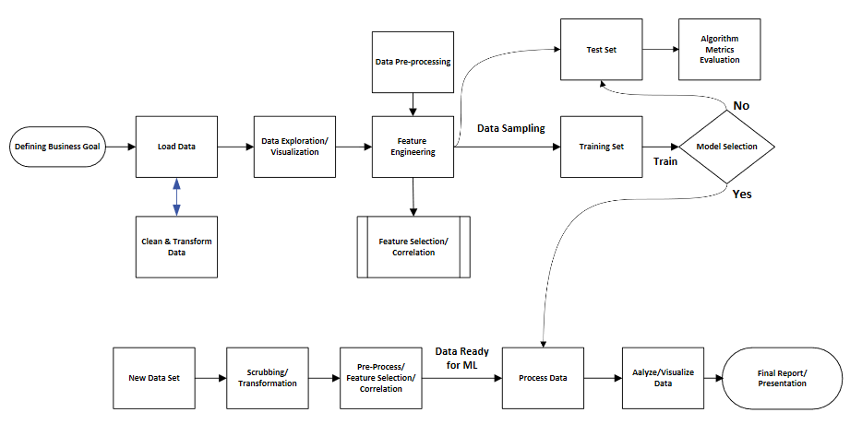
Data Science Flow Chart

Slide 7
Additional Questions & Answers
Q. Was it straightforward to install Python and all of the libraries?
Installing Python software was straightforward. Basically, Anaconda software installation came with other widely used libraries such as Numpy, Pandas, SciKit etc.
Q. Was the tutorial useful? Would you recommend it to others?
Tutorial is very useful and provides step-by-step direction to install the software and web links to troubleshoot any issues.
Q. What are the main lessons you've learned from this experience?
Installation of Anaconda software is easy
Python is similar to R programming, an object oriented tool. The amount of code required is less when compared with C programming language.
Inbuilt libraries are very useful to compute Math functions, for example.

