Slide 1
Credit Card Assignment – Data Exploration
-Neeraj Agrawal

Slide 2
Agenda
Goal
Data Visualization

Slide 3
Goal
Learn Python
Visualize data to understand the behavior of customers on defaulting the payment
Slice and Dice data to see the impact of variables such as education or marital status of customers on defaulting the payment

Slide 4
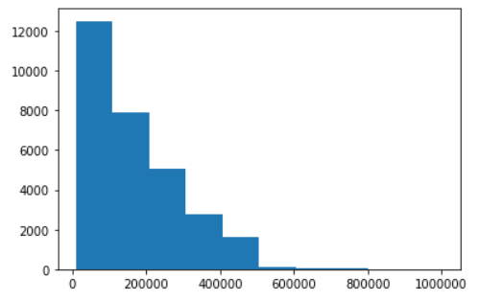
Histogram
Notes:
Approx. 8,000 customers have credit limit $20,000 or more
Approx. 40% of customers have credit limit less than $10,000

Slide 5
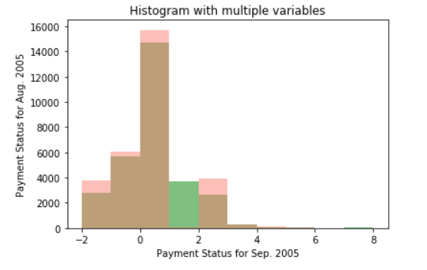
Histogram with two variables (subplot)
Notes:
Use subplot feature to build histograms for two variables
Above graph shows payment status for Sep. 2005 in green color
Above graph shows payment status for Aug. 2005 in salmon color
Although color contrast is not that great, the objective here is to show the subplot feature

Slide 6
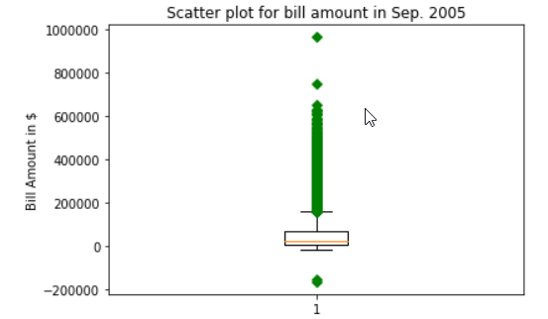
Box plot
Notes:
Box plots quickly shows the distribution of data
Above chart shows box plot for bill amounts in Sep. 2005
Majority of customers have amount less than $5,000
Box charts show some outliers where the bill amount is over $50,000. Perhaps, these customers have business account or customers are celebrities who like spending money

Slide 7
Data Visualization
Fig. 1 – Default payments based on Gender and Marital status

Slide 8
Data Visualization
Story of Fig. 1
Current data set shows that female customers are defaulting the payment more than the male customers
Total Female customers with default payments = 3,763
Total male customers with default payments = 2,873
Similarly, female customers with married and single status have higher default rate when compare to male customers with equivalent marital status

Slide 9
Data Visualization
Fig. 2 – Default payments based on payments

Slide 10
Data Visualization
Story of Fig. 2
Customers paying full payments are less risky for defaulting the payment.
The total number of customers who have revolving credit and have payment defaults is highest i.e.1,888.
The total number of customers who are delayed in payments by 2 months is second highest i.e. 1,844

