Slide 1
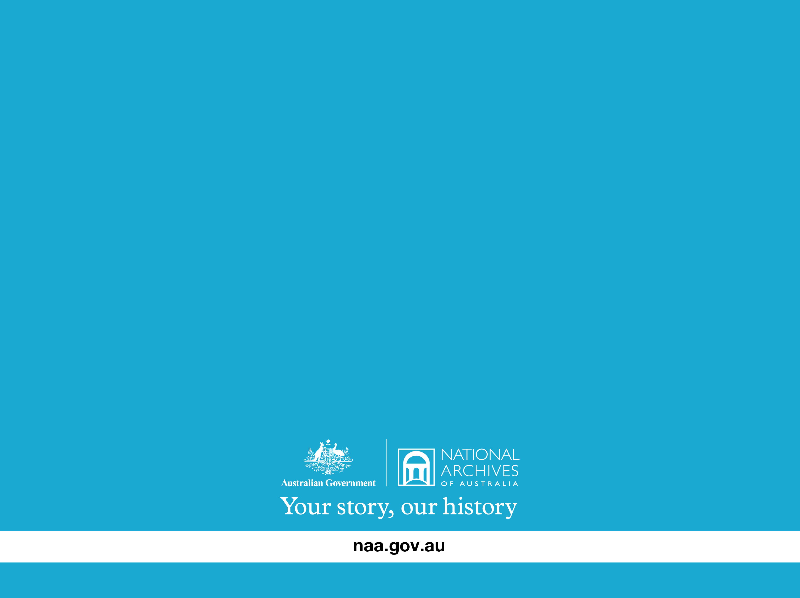
Digital Preservation
Chris Smart
Notes:
Introduction.
National Archives mandate to preserve and make available the resources of the commonwealth. We have no say in the formats we receive, but we need to preserve them long-term. We can't take chances.
Apologies for the technical nature, not sure of the audience.

Slide 2
Why bother?

Slide 3
Why bother?
Paper – human readable
Digital – not human readable
Notes:
Humans can already process the information on a piece of paper, because we understand the language (i.e. English).
We know when something is a photo, we know when there's a table, we understand the context.
Digital files are in “computer format”. We need a computer to interpret the file and then use some program to display it to us in a human readable manner. Once we have this, we are at the “paper stage” and can understand the document.
Microsoft Word might be used to display a Word document, but without Microsoft Word, the computer cannot (necessarily) interpret the file. Ever had someone send you a file and you couldn't open it?
You need a program/machine to read the format, i.e. Betamax. If there's no machine, the information is lost.
Here's something that might shock you...

Slide 4
Computers are dumb.

Slide 5
Computers are dumb.
Really.
Notes:
It's true. For example, they only know two things, on or off. They have no imagination, they cannot think for themselves, they can only manipulate data and do what they are told.
But they have one saving grace....

Slide 6
They are fast.
Notes:
Computers can do mathematics faster than you. Faster than anyone, even though they are just manipulating ones and zeros to get the answer!

Slide 7
Everything is ones and zeros.
(010101100101100101010111001...)
Notes:
If you remember just one thing from this presentation, remember this:
Everything digital is just ones and zeros.
That's all computers process, bunches and bunches of ones and zeros.
Everything that sits on your hard drive is written to the disk as ones and zeros. When you browse the Internet, it's all ones and zeros.
You don't see the ones and zeros though, you see what they represent because the computer translates them for you.
Example: Using Microsoft Word to create a document. You type in “The quick brown fox jumps over the lazy dog” but what actually gets written to disk is not those letters, it's zeros and ones which represent those letters.

Slide 8
Every little one or zero is called a “bit”
0 = a bit
1 = a bit
Notes:
zero = off
one = on

Slide 9
A group of 8 bits is called a “byte”
01010110 = a byte
Notes:
And so we have kilobytes - one thousand (and 24) bytes
Megabytes - one thousand (and 24) kilobytes, etc.
Why 1024?
Computers are binary, so everything is measured in powers of two.
2 ^ 0 = 1
2 ^ 1 = 2
2 ^ 2 = 4
2 ^ 3 = 8
2 ^ 4 = 16
….
2 ^ 9 = 512
2 ^ 10 = 1024

Slide 10
This system is called binary (base-2)
We count in denary (decimal, base-10)
Notes:
You're all familiar with counting in base-10. The first “ones” column can go up to 9, after which we put a one in the “tens” column and start again at zero in the ones column.
Computers count in base-2, so they can only go up to a 1 in the first column, then they have to populate the next column.
Demo – looking at files in binary.

Slide 11
Here's the problem:
Bits mean nothing on their own.
Notes:
Because computers do lots of different things, there is no single meaning behind any one combination of bits.

Slide 12
01100001
= ?
Notes:
Here's a byte.
What does it mean? Anyone?

Slide 13
01100001
= 97
Notes:
It would equal 97 in the decimal system.
What else?

Slide 14
01100001
= “a”
Notes:
In ASCII, this means the lower-case letter “a”.

Slide 15
01100001
= absolutely anything
Notes:
It could be a musical note, a symbol, my whole name, anything.

Slide 16
Digital files are binary.
How do you know what the
ones and zeros mean?
Notes:
So then if a clump of binary could mean anything, how do you know what it means?
You need something that tells you.

Slide 17
Without a specification, there is no way to know what the binary data means.
(No way to know what is in the file!)
Notes:
You need a specification which outlines what the combinations of ones and zeros mean.

Slide 18
File formats are specifications.
Notes:
They specify how data is constructed and stored within a digital file. Each file format is unique.
Proprietary file formats.
Microsoft Office (inc OOXML < ISO Strict)
Open file formats.
OOXML
ODF (ISO Strict)
Free file formats.
ODF

Slide 19
ASCII file format
01100001
= “a”
Notes:
The ASCII file format specification says, that 097 in decimal (written as 01100001 in binary) is the lower case letter a. So if you ever have an ASCII file, you know how to interpret the data!

Slide 20
Microsoft Word can read your documents because it knows the specification.
What if you didn't have Microsoft Word?

Slide 21
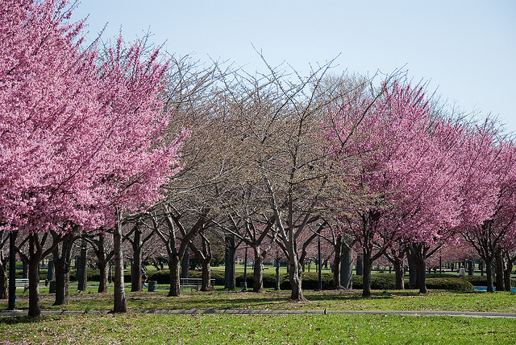
http://www.flickr.com/photos/janoma/4472147302/
Notes:
What happens if you spill a cup of coffee on a paper record?
You can still read and make sense of the document.
What happens if you change just a few of those bytes in a digital file?..

Slide 22

http://www.flickr.com/photos/janoma/4472147302/
Notes:
..the file is lost.
In this example, you can still open the file, but you see the file is very damaged. In the majority of cases, you simply cannot open the file at all!

Slide 23
Choose your file formats carefully.
Notes:
You need to know what the ones and zeros mean, and not rely on a current software..
It makes sense to store your data in a file format which you can have access to in the future.
Not all file formats are created equal.
Open file formats which allow proprietary extensions, or are tied to other proprietary technology, are not truly open (e.g. OOXML < ISO Strict).
Putting your data in a free and open file format, means that even if there is no software that can read it in the future, you can at least write some.
Compare this to reverse engineering a proprietary format, which is far too time consuming and costly (not to mention it isn't guaranteed).

Slide 24
So, why bother?
Because digital records are easily lost.
Forever.
Notes:
Microsoft Works, Microsoft Money, Microsoft Mix, Wordstar, Ami pro, Clarisworks, AppleWorks, Leafnote..

Slide 25
Microsoft Office 2003 Service Pack 3 disabled dozens of file formats.
http://support.microsoft.com/kb/938810
Notes:
Including:
Corel Draw
Lotus Notes
PowerPoint pre 1997
Word 1 & 2
Word <= 5 for Mac
“Legacy Binary Files”
Reliant on one vendor much?

Slide 26
Relying on a single vendor for file format support is bad, mmm'k.

Slide 27
Proprietary formats (like Microsoft .DOC) make you a slave.
You have no control, no power,
no freedom.

Slide 28
Using free and open formats
avoids this problem.
Gives you power, puts you in control, grants you freedom.
Notes:
Supported by more products, because able to implement freely.
Only way to achieve true interoperability.

Slide 29
Migration
The approach we take.
Notes:
The NAA approach is about risk mitigation. If we can read the proprietary file, great. If not, we have another in an open format.
Like for like format, i.e. Microsoft Office to ODF (not PDF).
It's good to know when a file might become obsolete, but in a way, free and open files never become obsolete, because they are always accessible.
Issues with migration:
Quality assurance – migrating from proprietary files.
Platform specific components (macros).
These issues would disappear if agencies would use a truly open format in the first place!

Slide 30
How to chose a target format?
Introducing the five golden rules...

Slide 31
Rule number one:
“Open standards based.”
This means unrestricted access to the format specification.

Slide 32
Rule number two:
“Community developed.”
Designed and controlled by more than one entity, preferably non-commercial.

Slide 33
Rule number three:
“Multiple implementations.”
Must have a wide choice of software implementing the format, preferably open source.

Slide 34
Rule number four:
“Maintains significant properties of source formats.”
Essential characteristics maintained.

Slide 35
Rule number five:
“No patent or license restrictions.”
No risk of paying to use the format.

Slide 36
Our choices
Office: Open Document Format
Image: Portable Network Graphic
Audio: Free Lossless Audio Codec
Email: XML

Slide 37
No target format yet for:
Computer Aided Drawings (CAD)
Databases (other than SQL)
Video

Slide 38
Digital Preservation Tools
Xena
Preserves digital files by migrating to open formats
Free Open Source software (GPLv3)
Plug-in based (support new formats)
Notes:
Free and open source Java application (GPLv3).
Free for anyone to implement, study and modify.
Easy to use graphical interface, call as a back end, or use as a library (must be GPL compatible).
City of Perth interfaces with TRIM, Archives of New Zealand contributed to code (command line interface), State Records in Sydney implementing Xena, lots of others that we don't know about!
Thousands of downloads every month.

Slide 39
Xena
Detects file format
Extracts metadata
Migrates to open format
Encodes binary into base64
Wraps in XML
Creates text searchable version
Notes:
Free and open source Java application (GPLv3).
Free for anyone to implement, study and modify.
Easy to use graphical interface, call as a back end, or use as a library (must be GPL compatible).
City of Perth interfaces with TRIM, Archives of New Zealand contributed to code (command line interface), State Records in Sydney implementing Xena, lots of others that we don't know about!
Thousands of downloads every month.
Encoding in Bsae64 is important – makes the file human readable and allows wrapping of XML. No binary blogs!

Slide 40
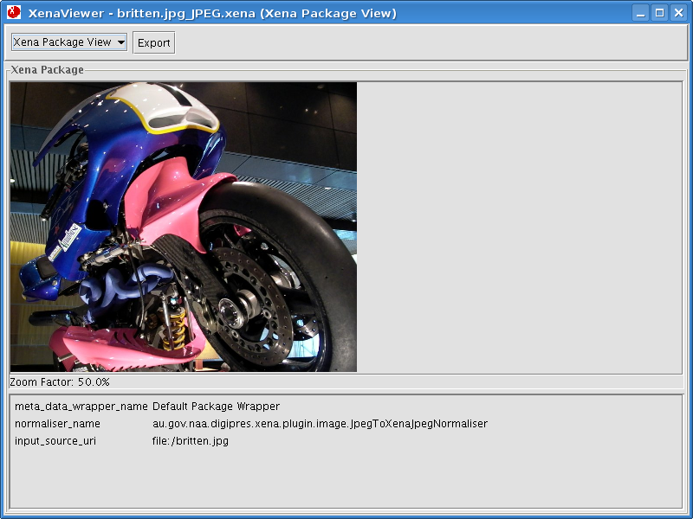
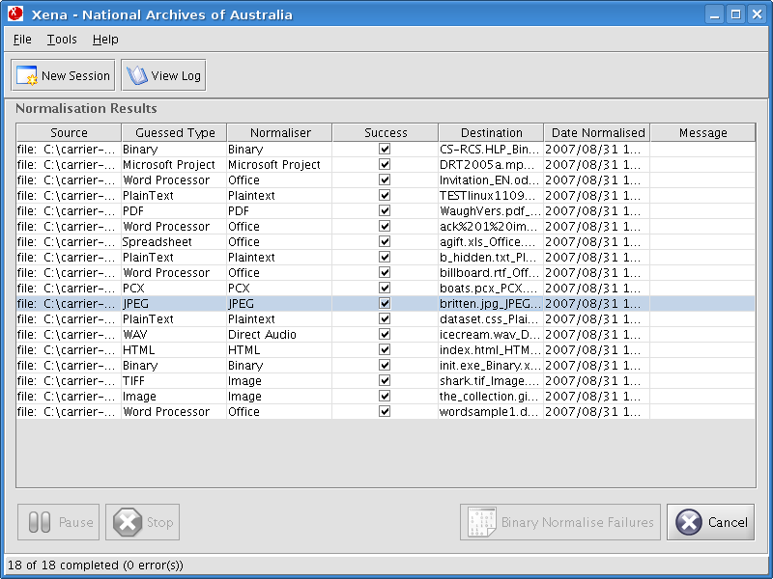
Notes:
Xena screenshot, processing in the front, Xena viewer in the back.

Slide 41
Who else uses Xena?
Hard to know because it's free!
City of Perth
Archives of New Zealand
State Records of NSW in Sydney
Thousands of downloads each month

Slide 42
That's only half the story.
Notes:
Once you have your data in a secure open format, you need to do the other important preservation step, manage the records.

Slide 43
Management Tools
Manifest Maker
DPR (Digital Preservation Recorder)
Checksum Checker
Notes:
All open source software, like Xena.
Needs external cataloguing system (e.g. RecordSearch).

Slide 44
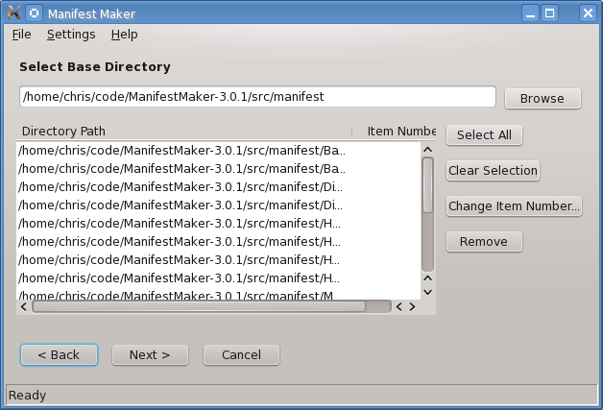
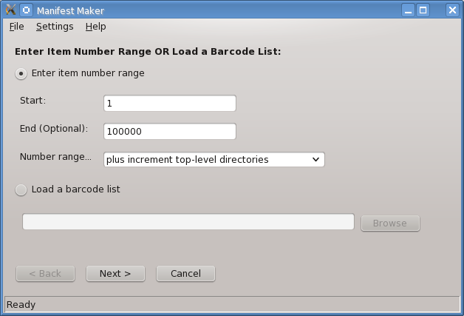
Notes:
Manifest Maker takes a bunch of files and creates a list of them (including their name, location and checksum), to prepare for digital preservation work.

Slide 45
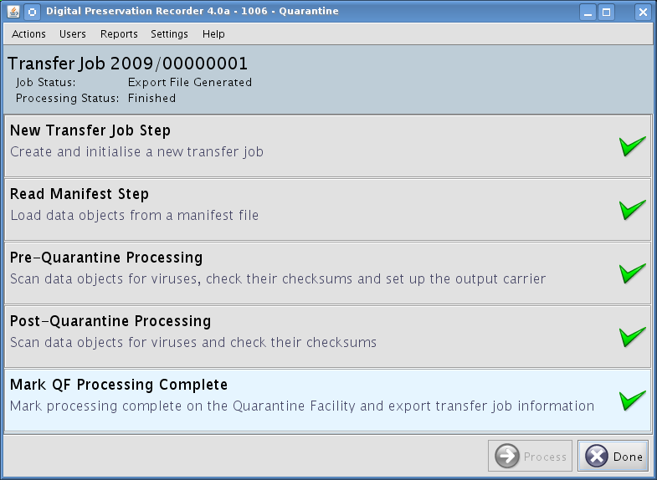
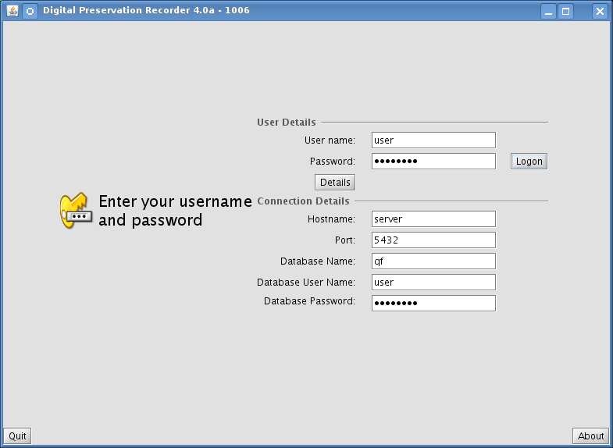
Notes:
DPR is a workflow tool that initiates a digital preservation job. It imports a manifest list and tracks the records over their life time, records preservation treatments, stores it in the digital archive, exports files for access.

Slide 46
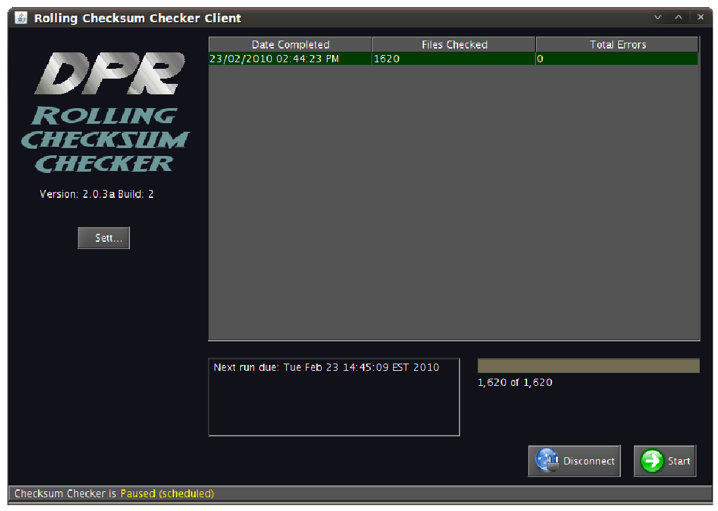
Notes:
Checksum Checker constantly checks for file corruption – it is important to replace corrupt files immediately.

Slide 47
Digital Preservation Software Platform (DPSP)
Free open source software (GPLv3)
Single installer (get set up in 10 min)
Includes digital preservation software
Includes all third party software
Runs on a laptop
Notes:
Want to test your own Digital Archive? It's as easy as installing the DPSP.

Slide 48
Resources
We want to collaborate.
Notes:
Everything is open source, but often geared to our needs. Don't be frightened off if something isn't exactly what you want, talk to us! You can build on what we’ve already done.

Slide 49
Digital Archive
Runs on open source software
Vendor agnostic hardware and software
Refreshed every few years
Notes:
Digital Archive hardware is vendor agnostic, built on open source technology. Migrated to new contemporary storage every few years to avoid physical media obsolescence.

Slide 50
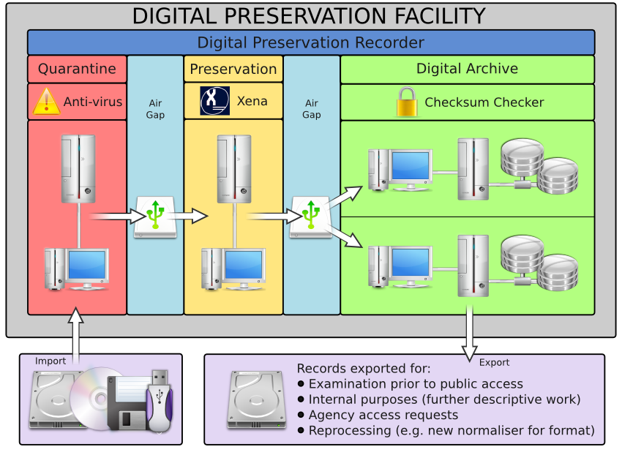
Notes:
Current model is archaic, based on air gaps. Plan to move to a more modern system in the near future.

Slide 51
Future Directions
Support custom target formats
Guess and migrate only options
Scaling up the digital archive (clustering)
Notes:
Capacity to expand the digital archive's capacity is of high importance. Developing an architecture which is (practically) infinitely scalable.

Slide 52
Questions?
ODF made with Linux and LibreOffice (OpenOffice.org).
Licensed under Creative Commons Attribution 3.0 Australia License.

Slide 53
Resources
http://dpsp.sourceforge.net
christopher.smart@naa.gov.au
csmart@identi.ca
cdsmart@twitter

Slide 54
