Slide 1
What factors can lead to higher prevalence of diabetes?

Slide 2
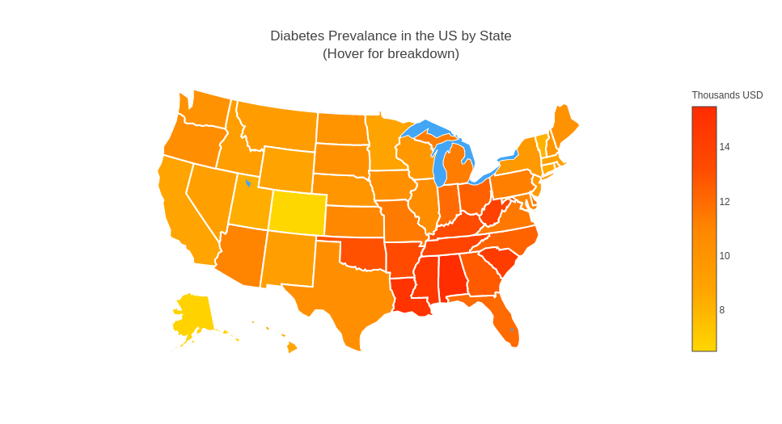
Higher prevalence diabetes across Southern States

Slide 3
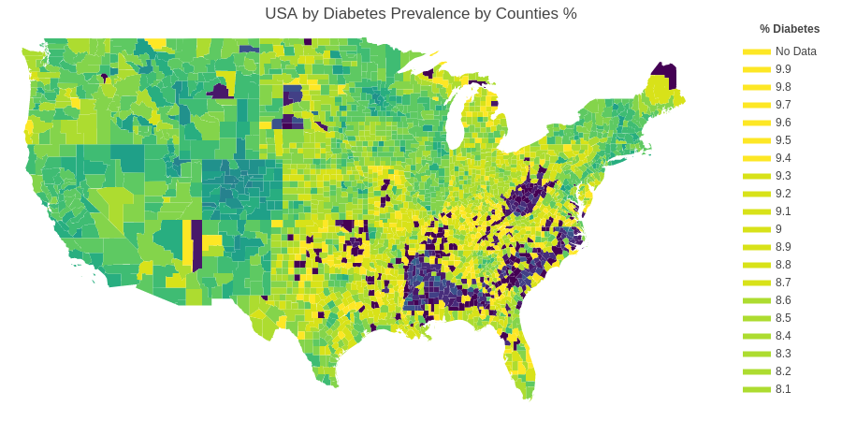
High concentrations of diabetes prevalence within state counties

Slide 4
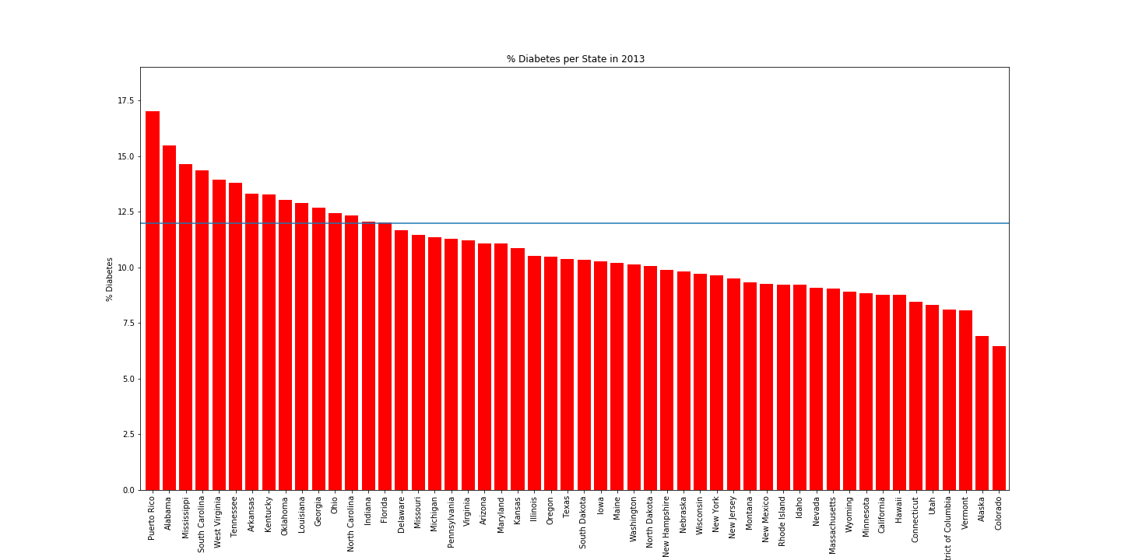
Prevalence Diabetes % by State

Slide 5
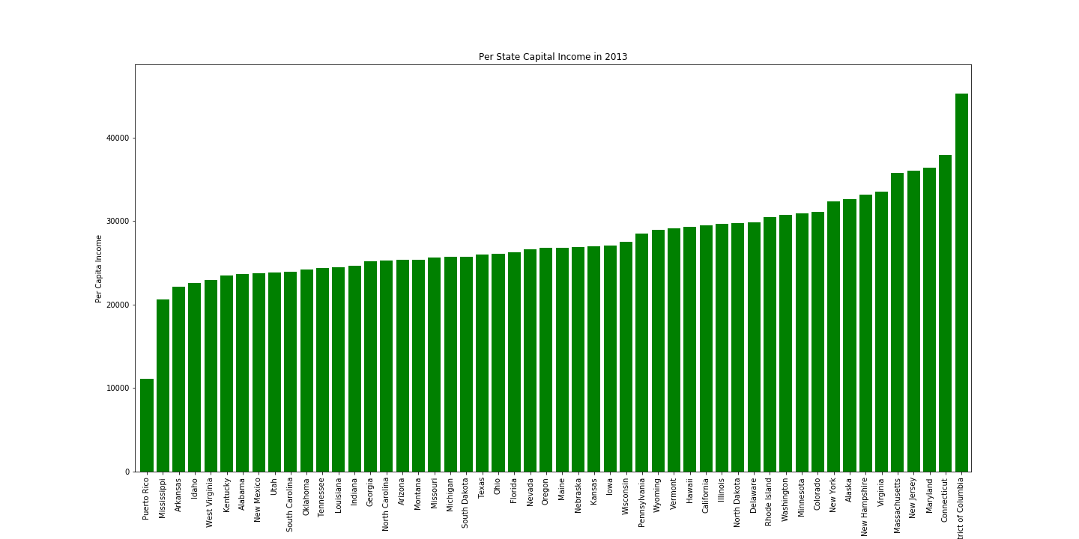
Per Capital Income by State/Territories
- No a good correlation along state
- Except for Puerto Rico

Slide 6
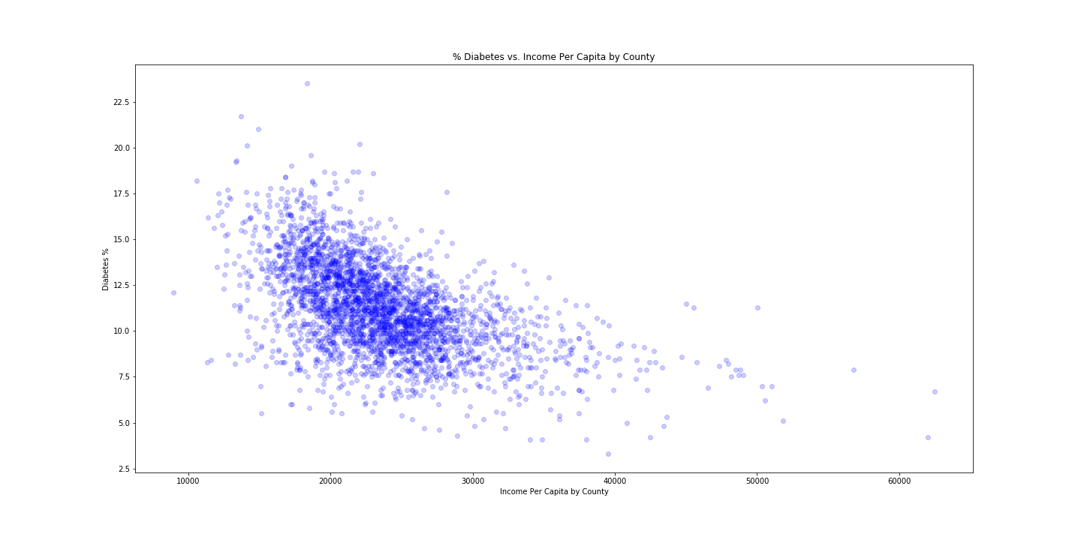
Per Capital Income by Counties vs % Diabetes

Slide 7
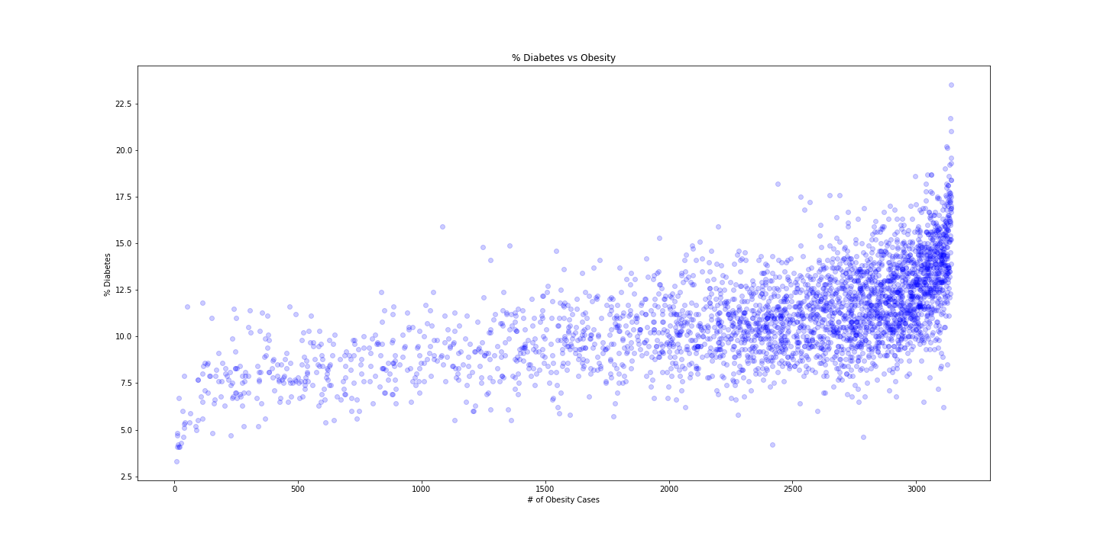
% Diabetes vs Obesity Cases by County
Obesity Cases vs % Diabetes
- High correlation between Obesity and Diabetes

Slide 8
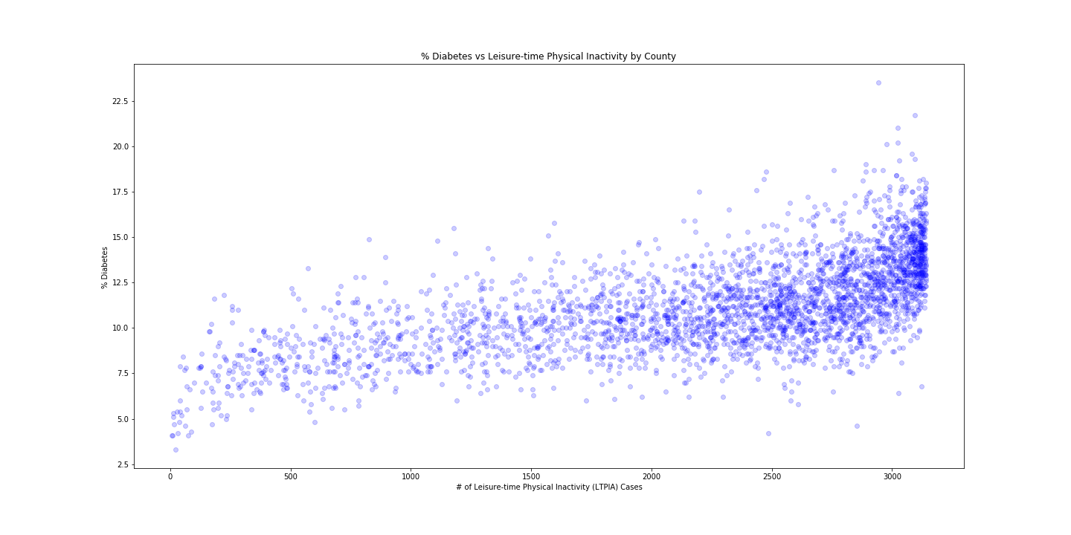
In-activities Cases vs % Diabetes
- High correlation between In-activities and Diabetes

Slide 9
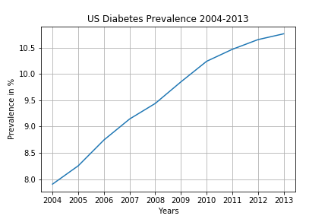
Trend – diabete rate continues upward

