Slide 1
Diabetes : A Look a Prevalence trends and contributing factors in the US

Slide 2
What factors can lead to higher prevalence of diabetes?
Income
Fitness
Obesity

Slide 3
Data Collections:
CDC Gov
Measurement of Prevalence of diabetes by County
Level of In-Activities
Obesity
Census Gov
Income by the Counties
Income by the States

Slide 4
Analysis:
Distributions of Diabetes Rate:
Map of States
Map of Counties
Looking at States/Counties
Income
Obesity
Level of In-Activities
Trend of Diabetics

Slide 5
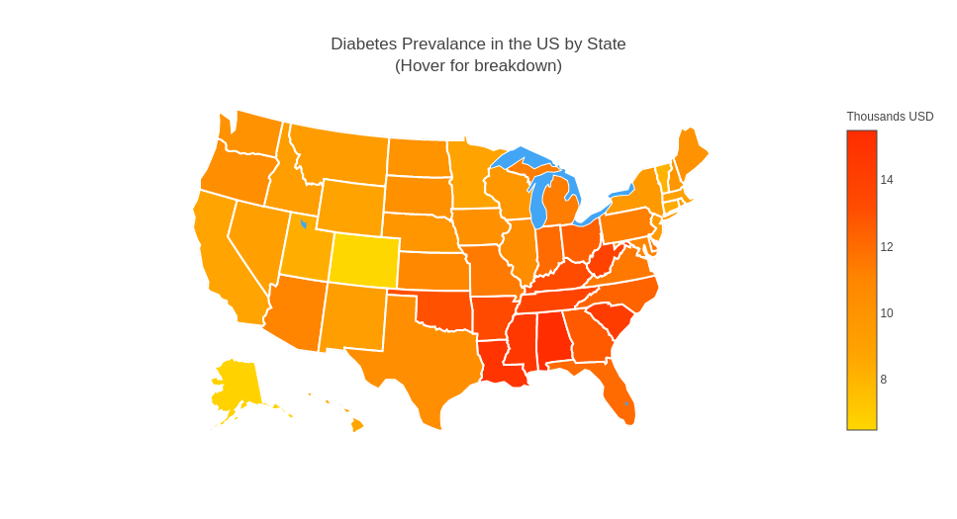
Higher prevalence diabetes across Southern States

Slide 6
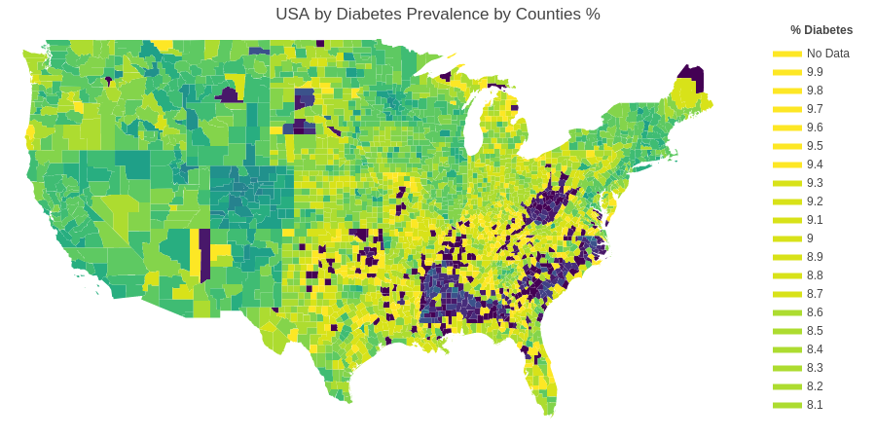
High concentrations of diabetes prevalence within state counties

Slide 7
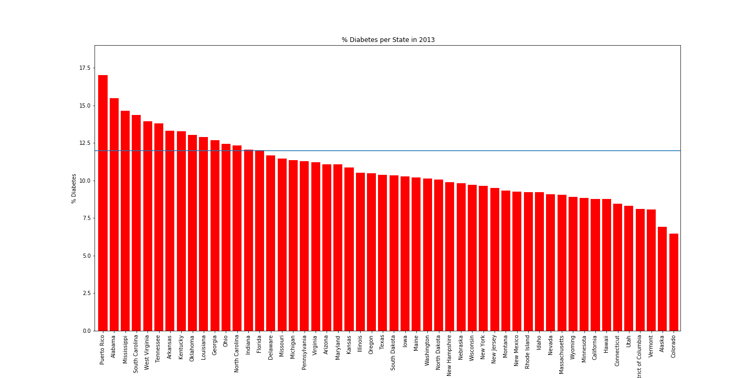
Prevalence Diabetes % by State

Slide 8
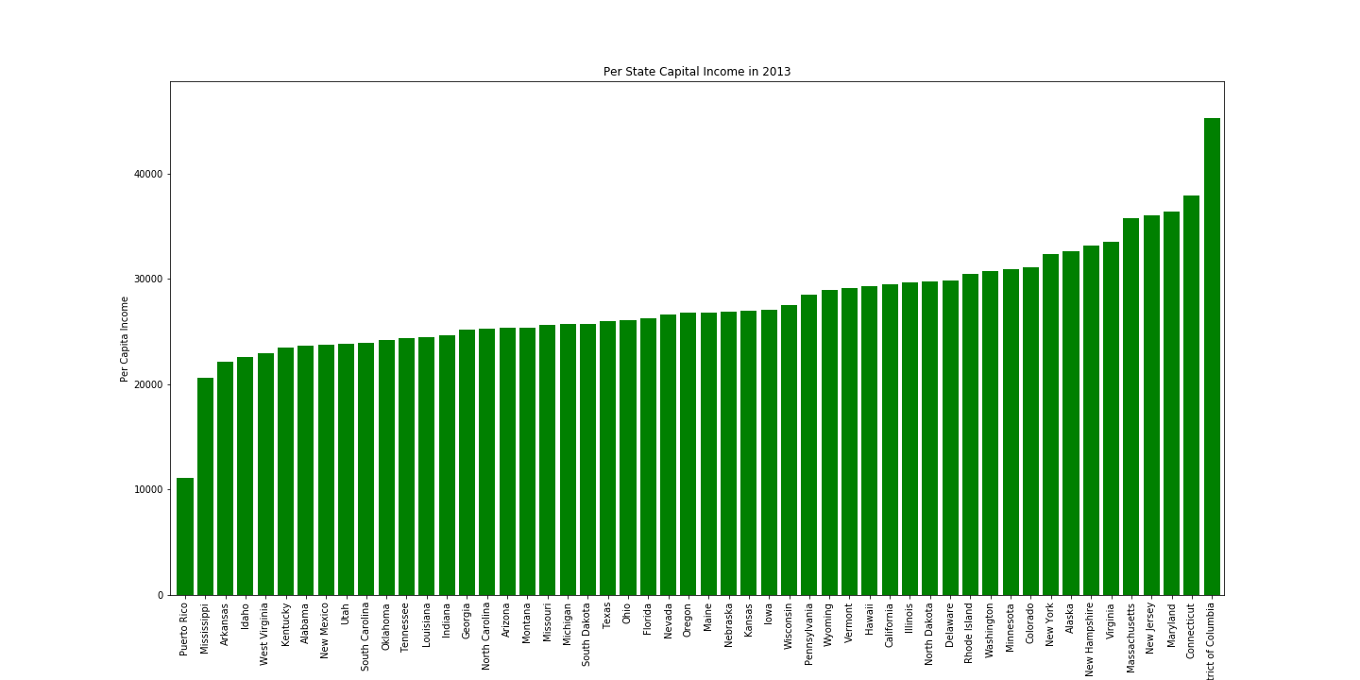
Per Capital Income by State/Territories
- No a good correlation along state
- Except for Puerto Rico

Slide 9
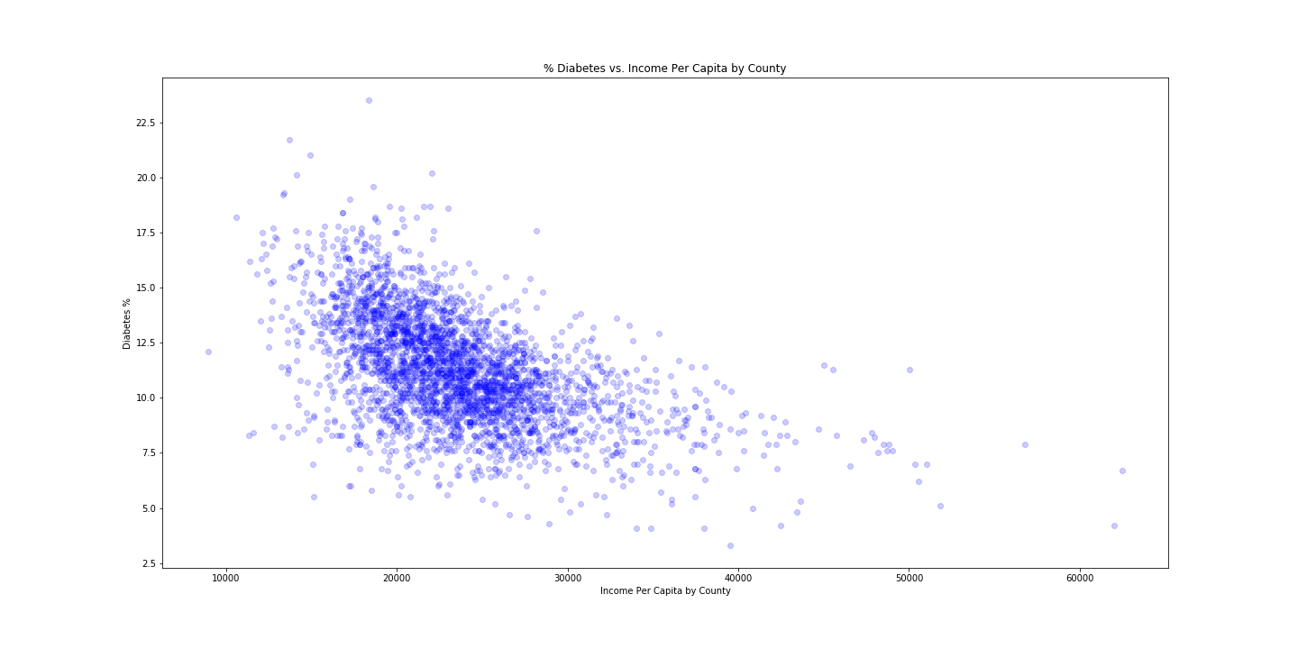
Per Capital Income by Counties vs % Diabetes

Slide 10
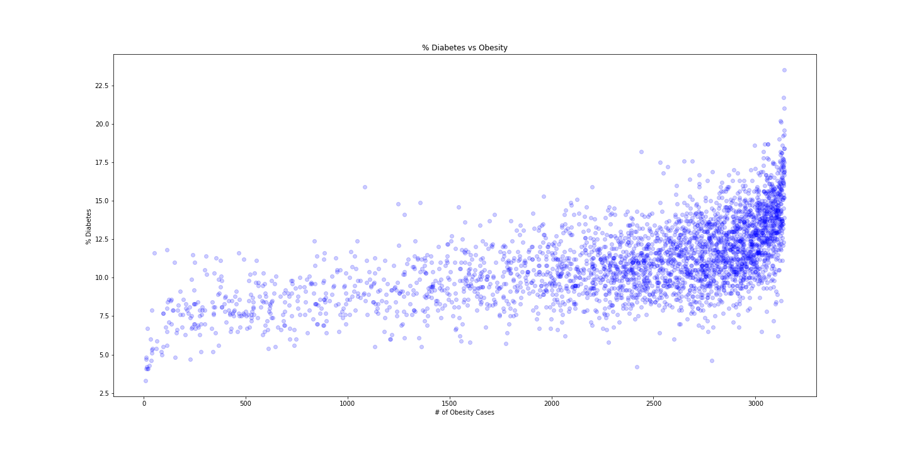
% Diabetes vs Obesity Cases by County
Obesity Cases vs % Diabetes
- High correlation between Obesity and Diabetes

Slide 11
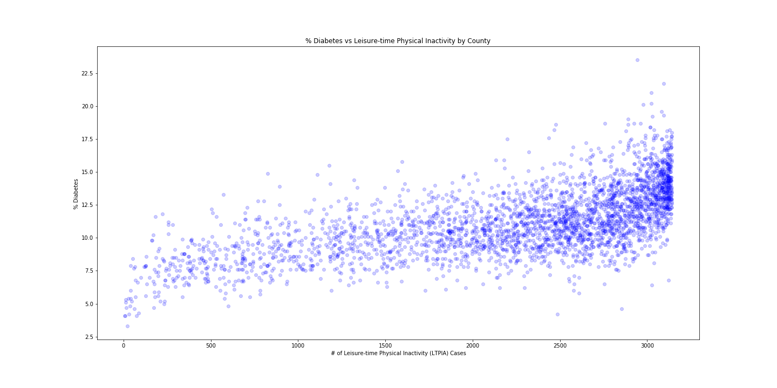
In-activities Cases vs % Diabetes
- High correlation between In-activities and Diabetes

Slide 12
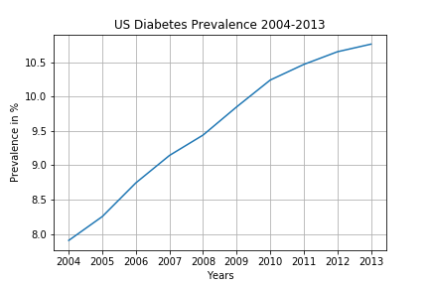
Trend – diabete rate continues upward

Slide 13
Conclusion & Findings:
Puerto Rico has the highest prevalence at 17% followed by the southern states, particularly in Alabama, Mississippi and Louisiana.
There is a group states where the income is higher Michigan , Arizona, Pennsylvania but the diabetes prevalence is still somewhat high (around 11%).
Our data clearly shows a correlation between obesity and levels of inactivity.
Also that there are other factors at play with outliners: diet.
The data also shows that the diabetes prevalence is rising year after year.

Slide 14
Some interesting links:
Data visualization: https://evergreen.data.socrata.com/

