Slide 1
Sentimental analysis on Amazon’s product reviews

Slide 2

Sentimental Analysis

Slide 3
What:
Sentimental analysis = opinion mining.
Is an opinion: positive, neutral, and negative?
Why:
Opinion is the voice of the customer.
Reviews, responses, online/social media, healthcare surveys
How:
Through: natural language processing, text analysis, computational linguistics, and biometrics
Source: Wikipedia.

Slide 4
Sentimental analysis against product previews
Does not cover Bias or Topics Modeling

Slide 5
Data Source:
Amazon product reviews
http://cseweb.ucsd.edu/~jmcauley/datasets.html#amazon_reviews

Slide 6
NLP Terminologies:
Corpus = typically a collection of documents
A document = refer to a sentence or paragraph
Tokenize = reduce a document into words, sentences
Padding = inserting 0s into vectorized
Stop words = words do not add much meaning such as determiners (a, an, the) etc.
Lemmatize = reduce a word to its base (is, was, were => be)
Stemming = reduce pre/post suffixes (worked => work)

Slide 7
Text Preprocessing
Remove numbers
Expansion of Contradiction words (I’ll => I will)
NLTK tokenize
Remove punctuations
Padding = inserting 0s into vectorized

Slide 8
Supervised Learning Models:
Neural network predicts and returns a sentimental probability of
RNN (Recurrent Neural Network)
Memory state…
CNN (Convolution Neural Network)
Filter
TextBlob library

Slide 9
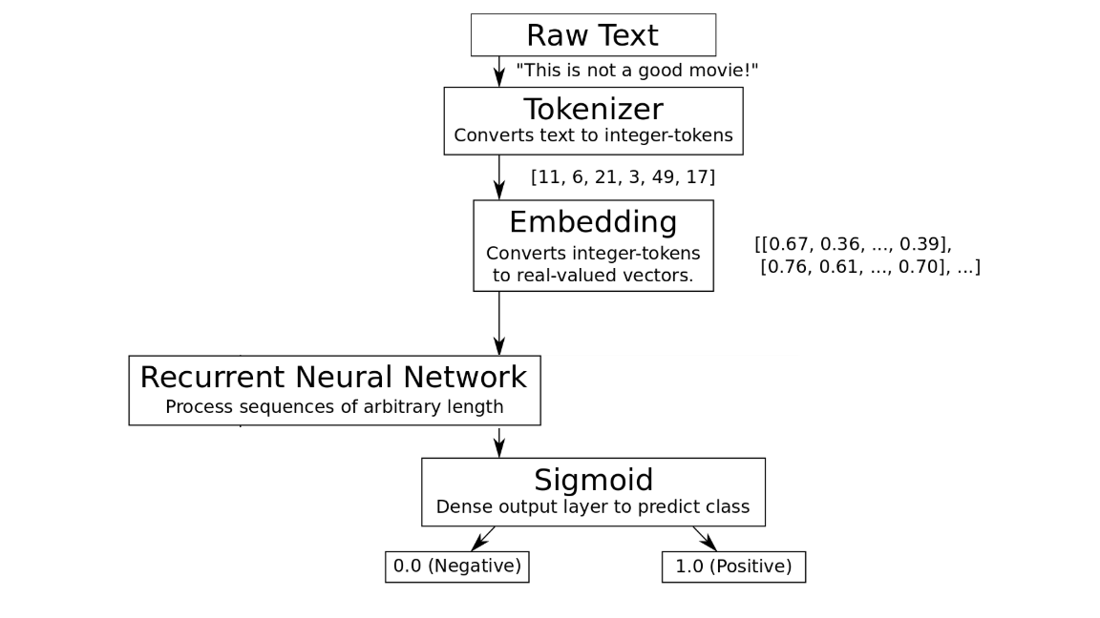

Slide 10
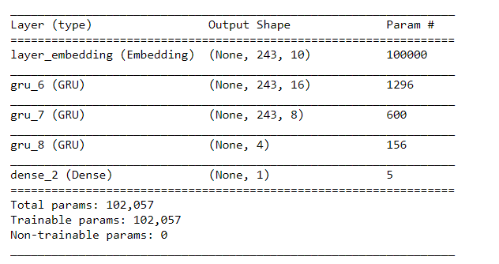
RNN

Slide 11
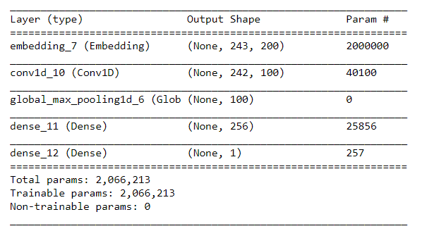
CNN

Slide 12
Performance Comparison
It is rather limited in what it can cut. Worst thng is that the depth is not adjustable. So many other options and I made a mistake and bought this.
Amazon Rating | RNN | CNN | TextBlob
1.0 | Positive | Negative | Negative
 | 1 | 0 | -0.8839285714285714
Amazon Rating | RNN | CNN | TextBlob

Slide 13
Conclusion & Findings:
TextBlob can
There is a group states where the income is higher Michigan , Arizona, Pennsylvania but the diabetes prevalence is still somewhat high (around 11%).
Our data clearly shows a correlation between obesity and levels of inactivity.
Also that there are other factors at play with outliners: diet.
The data also shows that the diabetes prevalence is rising year after year.

Slide 14
Citations:
Ups and downs: Modeling the visual evolution of fashion trends with one-class collaborative filtering R. He, J. McAuley WWW, 2016
RNN Sentimental Analysis
Pedersen, MEH. “Natural Language Processing" Sentimental Analysis. 13 Feb 2018
CNN Sentimental Analysis
Kim, Ricky. “Another Twitter sentimental analysis with Python" Medium: Toward Data Science. 22 Feb 2018.
TextBlob Library Usage
https://stackoverflow.com/questions/19790188/expanding-english-language-contractions-in-python

