Slide 1
Sentimental analysis on Amazon’s product reviews TDN

Slide 2

Sentimental Analysis

Slide 3
What:
Sentimental analysis = opinion mining.
Is an opinion: positive, neutral, and negative?
Why:
Opinion is the voice of the customer.
Reviews, responses, online/social media, healthcare surveys.
How:
Through: natural language processing, text analysis, computational linguistics, and biometrics.
Source: Wikipedia.

Slide 4
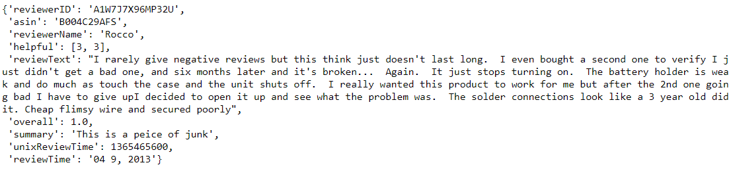
Focus
Opinion mining on product previews.
Does not cover Bias or Topics Modeling.
Data Source:
Amazon product reviews:
http://cseweb.ucsd.edu/~jmcauley/datasets.html#amazon_reviews

Slide 5
Supervised Learning Models on Classification:
RNN (Recurrent Neural Network)
Memory state…
CNN (Convolutional Neural Network)
Filter..
TextBlob library
Each model predicts and returns a probability value. Base on that probability value, we will classify: positive or negative review.

Slide 6
NLP Terminologies:
Corpus = typically a collection of documents.
A document = refer to a sentence or paragraph.
Tokenize = reduce a document into sentences, words, map words to unique integers.
Stop words = words do not add much meanings such as determiners (a, an, the) etc.
Lemmatize = reduce a word to its base (is, was, were => be).
Stemming = reduce pre/post suffixes (worked => work).
Embedding = vectorized words(mapped into ints) to represent relationship similarities in semantic meanings.
Padding = inserting 0s into pre/post pads to data-set enforce the same length across all data-set.

Slide 7
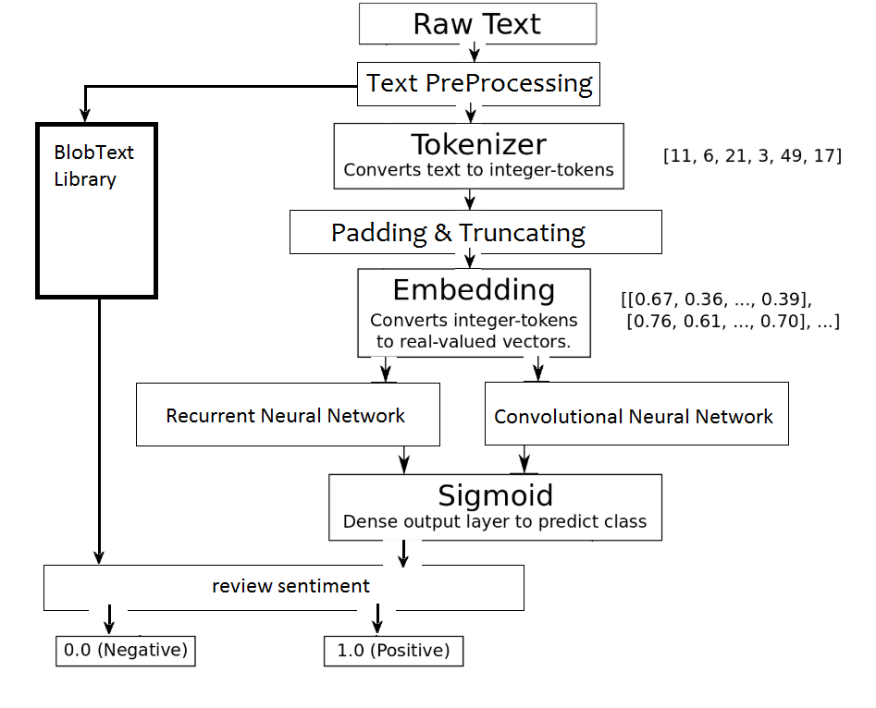
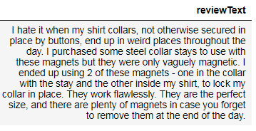
Text Preprocessing
Expansion of short notation words (I’ll => I will) .
NLTK tokenize words and sentences
Remove numbers
Remove punctuations
Source: Modified and updated MEH Pedersen’s original RNN diagram to my ML flows.

Slide 8
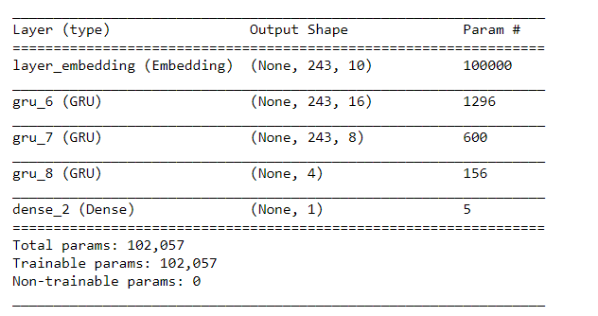
RNN
MEH Pedersen’s RNN model

Slide 9
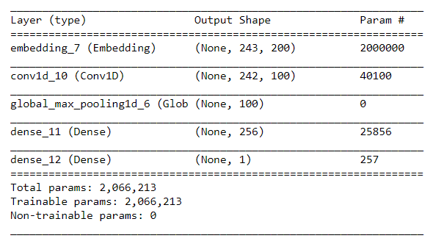
CNN
Ricky Kim’s CNN model

Slide 10
Performance Comparison
It is rather limited in what it can cut. Worst thng is that the depth is not adjustable. So many other options and I made a mistake and bought this. False Positive for RNN.
Amazon Rating | RNN | CNN | TextBlob
Negative | Positive | Negative | Negative
1 star rating | 1 | 0 | 0
I have had this router about a year before buying this plunge base. This base was the only thing I needed to make this compact router my go to for every day use. adjustments and control rival the big routers but handling this small one is very precise and easy. Love it!! False Negative with TextBlob.
Amazon Rating | RNN | CNN | TextBlob
Positive | Positive | Positive | Negative
3 star rating | 1 | 1 | 0

Slide 11
Performance Comparison
Accuracy: 93.94%
In [282]:
#rating = lambda x: 1 if x > 2.0 else 0
#sample size = 10261
#model accuracy ~ 93.94%
Based on 1000 test samples after training/validation
Data: reviews_Musical_Instruments_5.json.gz
tn, fp, fn, tp
(0, 46, 0, 954) RNN
(4, 38, 5, 953) CNN
(14, 28, 57, 901) TextBlob
(14, 32, 46, 908) TextBlob

Slide 12
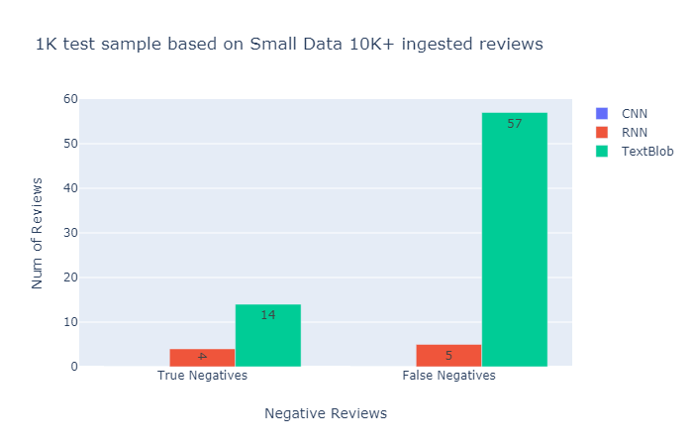
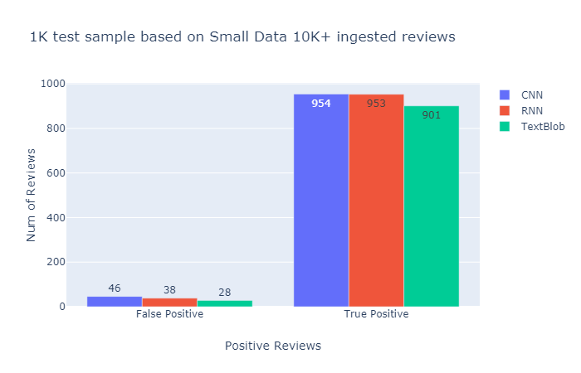
Data: reviews_Musical_Instruments_5.json.gz

Slide 13
Performance Comparison
#rating = lambda x: 1 if x > 2.0 else 0
#sample size = 134476
#model accuracy ~ 94%
Based on 1000 test samples after training/validation
Data: reviews_Tools_and_Home_Improvement_5.json.gz
tn, fp, fn, tp
(31, 30, 18, 921) CNN
(35, 26, 25, 914) RNN
(21, 40, 93, 846) TextBlob

Slide 14
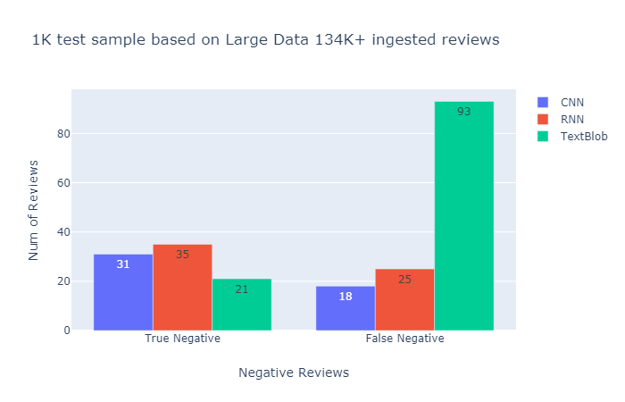
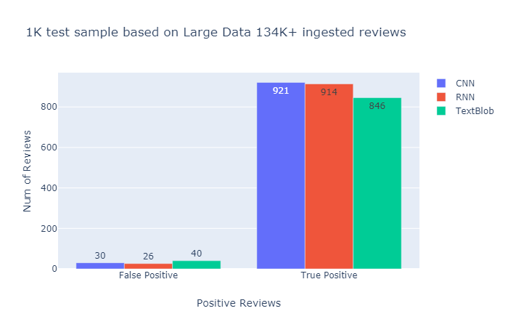
Data: reviews_Tools_and_Home_Improvement_5.json.gz

Slide 15
Performance Comparison
#rating = lambda x: 1 if x > 3.0 else 0
#sample size = 10261
#model accuracy ~ 84%
Based on 1000 test samples after training/validation
Data: reviews_Musical_Instruments_5.json.gz
tn, fp, fn, tp
(14, 121, 63, 802) RNN
(33, 102, 34, 831) TextBlob

Slide 16
Conclusion & Findings:
For small data set (10K), TextBlob performs better than CNN and RNN models.
For large data set (100K), CNN and RNN models perform better than TextBlob.
Neutral rating (~3.0 star) can skew the models…
It is much easier to use TextBlob library…then trying with Deep Learning/ML models.
ML’s Sentimental Analysis != Human’s critical reading/thinking…

Slide 17
Citations:
Ups and downs: Modeling the visual evolution of fashion trends with one-class collaborative filtering R. He, J. McAuley WWW, 2016
RNN Sentimental Analysis
Pedersen, MEH. “Natural Language Processing" Sentimental Analysis. 13 Feb 2018
CNN Sentimental Analysis
Kim, Ricky. “Another Twitter sentimental analysis with Python" Medium: Toward Data Science. 22 Feb 2018.
TextBlob Library Usage
Zhao, Alice. “Sentiment Analysis with TextBlob in Python” Youtube: Natural Language Processing Part 4. Jan 5, 2019.
Other docs:
https://stackoverflow.com/questions/19790188/expanding-english-language-contractions-in-python

Slide 18
TextBlob Sentimental Analysis:
!pip install TextBlob
from textblob import TextBlob
sample = 'This test sample is not great! It was disappointing. However you should try it to learn something from it.'
TextBlob(sample).sentiment.polarity
-0.5 Want to get fancy?
from nltk.tokenize import sent_tokenize
paragraph = sent_tokenize(sample)
for eachSent in paragraph:
print(eachSent, TextBlob(eachSent).sentiment.polarity)
!pip install TextBlob
from textblob import TextBlob
sample = 'This test sample is not great! It was disappointing. However you should try it to learn something from it.'
TextBlob(sample).sentiment.polarity
-0.5 Want to get fancy?
from nltk.tokenize import sent_tokenize
paragraph = sent_tokenize(sample)
for eachSent in paragraph:
print(eachSent, TextBlob(eachSent).sentiment.polarity)
-0.29090909090909095
This test sample is not great! -0.5
It was disappointing. -0.6
But there is something positive to learn something from it. 0.22727272727272727

