Slide 1
Starz University ART 277 Final Project (Restaurant website) Submitted To: Philip Bargain
Date: January 11, 2020
Prepared By: Section 6 Group 4

Slide 2
Group Member’s name: id # Boniface t. jasper ------------- 5211 Toney Bracewell ------------- 5334 senguala smith ------------- 5447 Jonathan tiepo ------------- 4931

Slide 3
Project Overview
This work is a theoretical description of our project. We group 4 was asked to build a restaurant website. This website is compose of four navigation pages: home, about, chef, contact and also a form page.
This site was build for a sample restaurant called Splendid_Resto, which enable it’s customers to view the kinds of dishes they got there, the prices of each item, the chef that cook the food, setting reservation online etc.

Slide 4
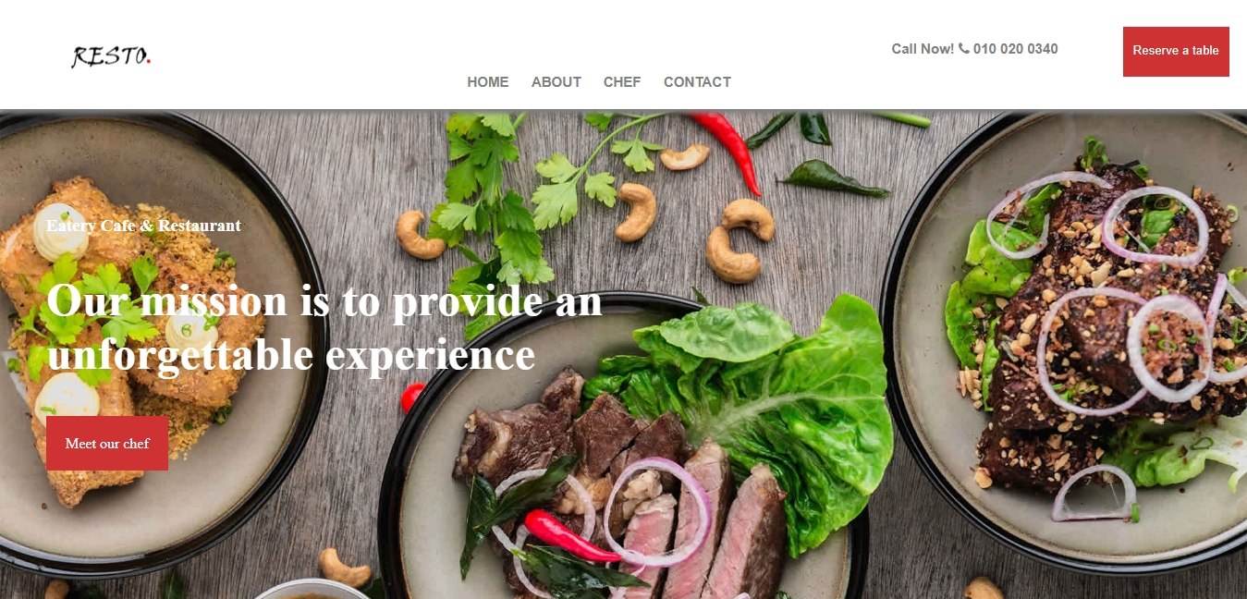
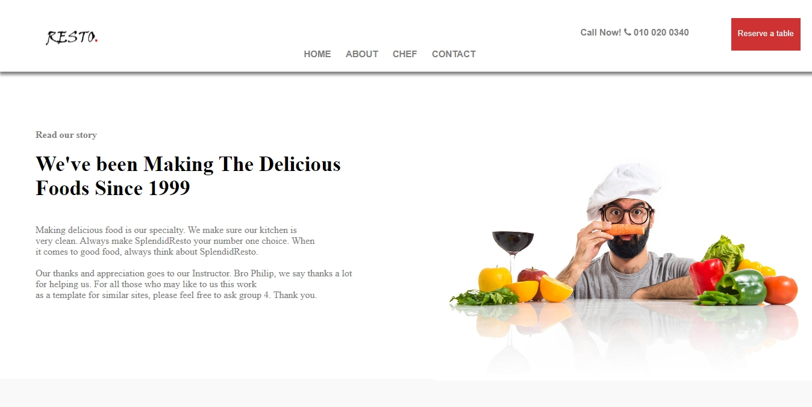
Project overview con’t
Home page
About page

Slide 5
Project approach
Splendid_Resto was build with 98% strictly HTML and CSS, the remaining 2% is just a little JavaScript and font awesome to make the site look good. While working on this project we thought of ourselves as restaurant owner’s, that way we saw almost all the needs of customers and the doubts they have against restaurant, we try solving them by giving them details of our daily activities.

Slide 6
Project constraints
While building this website we came across few difficulties, imagine building a responsive website without using frameworks. With framework like bootstrap you can easily style your work instead of writing it line by line in CSS which take a lot of time. We also face problems with things to add on the site, since none of us never own a cook bowl shop neither a restaurant so it was hard for us.

Slide 7
Project future scope
In the future, if this splendid_resto website is being visited by more customer’s we will like to add online buy and delivery services to help bring in more profit by carrying customer’s favorite dishes to their door.
As business improve we can extend to other countries.

Slide 8
recommendation
We recommend that restaurant owner’s should come and negotiate with section 6 group 4 members for websites similar to splendid_resto for a better business experience, don’t see it as something that is unnecessary, it is very necessary especially the online delivery services, we can add it if you want. Feel free to reach us, thank you.

