Slide 1
Behavioral Design
Topics in Behavioral Design
Based on Material in [Rosenblum94][Budgen94] [Ghezzi91] [Harel88]

Slide 2
Behavioral Design Topics
State Transition Diagrams
Petri Nets
Higraphs and Statecharts

Slide 3
State Transition Diagrams

Slide 4
State Transition Diagrams (STD)
Systems exist in a finite set of possible states. External events are triggers that lead to transitions between the states.
Since most systems have many states, a partial model of the system may be a good compromise.
STDs are the cornerstone of more powerful diagrams for specifying system behavior, such as Petri Nets and State Charts.

Slide 5
Partial Unix vi STD
o
i
Command
Mode
l
Text
Insertion
Mode
ZZ
ESC
return
:
/
Line
Command

Slide 6
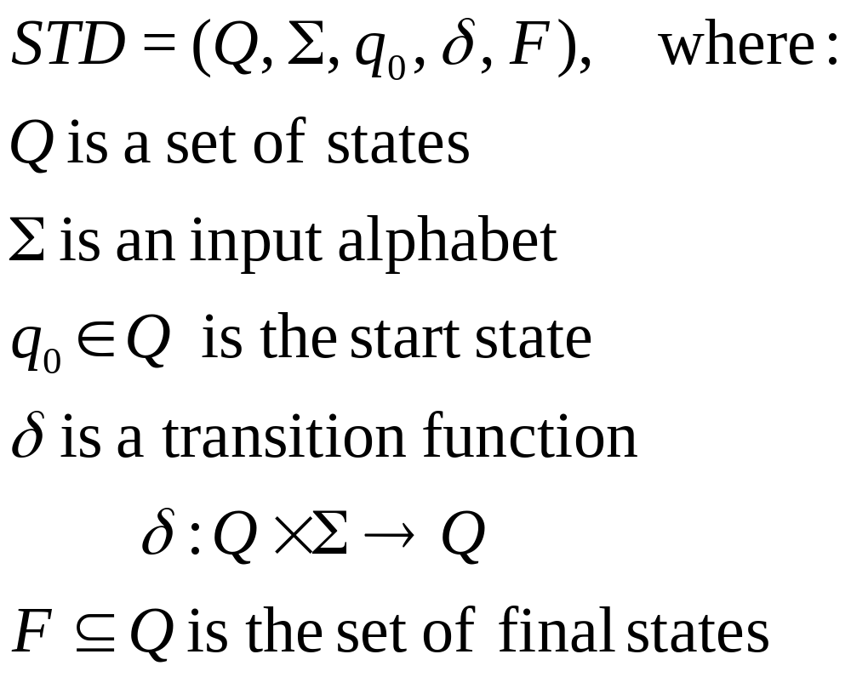
Formal Definition of an STD

Slide 7
Combination Safe STD
Safe Locked
1/3 Unlocked
2/3 Unlocked
Safe
Unlocked
1L
3R
2L
any other dial
movement
any other dial
movement
any other dial
movement
Sound Alarm

Slide 8
IDE STD
Compiling
stop
run
Compiled
error
events
Start
stop
success
finished
stop
Running
Pausing
pause
resume
hiccup
events
no events
events
Executing

Slide 9
Petri Nets

Slide 10
A Simple Petri Net
P1
t1
P2
t2
t3
P3
P4

Slide 11
A Marked Petri Net
P1
t1
P2
t2
t3
P3
P4

Slide 12
A Marked Petri Net
After Firing t1
P1
t1
P2
t2
t3
P3
P4

Slide 13
Definition of a Petri Net
PNet = (P, T, A, M0)
  P is a finite set of places (labeled circles), where a place holds tokens .
  T is a finite set of transitions (bars), where a transition represents an activity.
  A is a finite set of directed arcs, where an arc connects a place and a transition.
  M0 is the initial marking of PNet, where a marking is an arrangement of tokens in places representing state.

Slide 14
Petri Net Execution Model
Input Place: Place P is an input place for transition T if there is an arc from P to T.
Output Place: Place P is an output place for transition T if there is an arc from T to P.
Enabled Transition: A transition is enabled if there is at least one token at each of its input places.

Slide 15
Petri Net
Execution Model (Cont’d)
Firing a Transition: An enabled transition is non deterministically selected and fired by removing one token from each of its input places and depositing one token at each of its output places.
Firing Sequence: A firing sequence <t0,t1, …, tn> such that t0 is enabled and fired in M0, t1 is enabled and fired in M1, ...

Slide 16
Petri Net Firing

Slide 17
A Petri Net Describing an ATM
Valid Card
Machine
Ready
Card
Accepted
Notes in
Dispenser
Valid
Request
Correct
Pin
Sufficient
Funds
Card in
Slot
Sufficient
ATM Cash

Slide 18
A Marked Petri Net Semaphore
IN1
IN2
IN = Input of Process
OUT = Output of Process
CR = Critical Region
SEM = Semaphore
CR1
SEM
CR2
OUT1
OUT2

Slide 19
Enabled Transitions
IN1
IN2
CR1
CR2
SEM
OUT1
OUT2

Slide 20
After Non-Deterministic Firing
IN1
IN2
CR1
SEM
CR2
OUT1
OUT2

Slide 21
Enabled Transition
IN1
IN2
CR1
SEM
CR2
OUT1
OUT2

Slide 22
After Firing
IN1
IN2
CR1
CR2
SEM
OUT1
OUT2

Slide 23
Petri Net Static Analysis
Invariants are properties of a Petri net that hold (are true) in all markings.
For example, the sum of all tokens in CR1, CR2, and SEM are equal to 1 in all reachable markings. That is, |CR1| + |CR2| + |SEM| = 1

Slide 24
Deadlock and Starvation
A Petri Net with a given marking is in deadlock iff no transition is enabled in that marking.
A Petri Net with a given marking is in starvation iff one or more transitions have been permanently disabled.
A Petri Net is live if every transition can eventually be fired.

Slide 25
A Deadlocked Petri Net

Slide 26
A Petri Net that can Enter a Deadlocked State

Slide 27
A Deadlocked Petri Net

Slide 28
Modification into a
Live Petri Net

Slide 29
A Petri Net that can go into Starvation
t1
t2
t3
t4

Slide 30
Starving Transitions t2 and t4
t1
t2
t3
t4

Slide 31
Shortcoming of Basic Petri Nets
The Simplicity of building blocks leads to complexity in nets.
For example, a semaphore of N processes requires 2N transitions and 3N+1 places.
Would like:
  Enable and fire as computations.
  Tokens as data, not just control.
  Ability to reduce high-level Petri nets to basic Petri nets for analysis.

Slide 32
Higher-Level Net Semaphore
19
p
71
s
s > 0
transition
predicate
s-1
p
token
value
3
p
s
arc
expression
true
s+1
p

Slide 33
Enabled Transition
19
p
71
s
s > 0
transition
predicate
s-1
p
token
value
3
p
s
arc
expression
true
s+1
p

Slide 34
After Firing
19
p
s
s > 0
transition
predicate
s-1
p
token
value
71
2
p
s
arc
expression
true
s+1
p

Slide 35
Enabled Transitions
19
p
s
s > 0
transition
predicate
s-1
p
token
value
71
2
p
s
arc
expression
true
s+1
p

Slide 36
After Firing
p
s
s > 0
transition
predicate
s-1
p
token
value
19
1
71
p
s
arc
expression
true
s+1
p

Slide 37
Enabled Transition
p
s
s > 0
transition
predicate
s-1
p
token
value
19
1
71
p
s
arc
expression
true
s+1
p

Slide 38
After Firing
p
s
s > 0
transition
predicate
s-1
p
token
value
2
71
p
s
arc
expression
true
s+1
p
19

Slide 39
A Software Change Process
New MRs
Approved MRs
19
33
true
(MR)
7
8
11
(Developer)
(MR)
(MR, Developer)
(Developer)
Olga
Tom
Tony
true
Maria
(MR,
Developer)
(MR,
Developer)
(MR,
Developer)
true
Assigned MRs
Completed MRs

Slide 40
After Firing (New Assigned MR)
New MRs
Approved MRs
19
33
true
(MR)
8
11
(Developer)
(MR)
(MR, Developer)
(Developer)
Olga
Tony
true
Maria
(MR,
Developer)
(MR,
Developer)
(MR,
Developer)
7,Tom
true
Assigned MRs
Completed MRs

Slide 41
After Firing (New Assigned MR)
New MRs
Approved MRs
19
33
true
(MR)
11
(Developer)
(MR)
(MR, Developer)
(Developer)
Tony
true
Maria
(MR,
Developer)
(MR,
Developer)
(MR,
Developer)
8,Olga
true
7,Tom
Assigned MRs
Completed MRs

Slide 42
After Firing
(New Completed MR)
New MRs
Approved MRs
19
33
true
(MR)
11
(Developer)
(MR)
(MR, Developer)
(Developer)
Tony
true
Maria
(MR,
Developer)
(MR,
Developer)
(MR,
Developer)
true
8,Olga
7,Tom
Assigned MRs
Completed MRs

Slide 43
After Firing (New Assigned MR)
New MRs
Approved MRs
19
33
true
(MR)
(Developer)
(MR)
(MR, Developer)
(Developer)
true
Maria
(MR,
Developer)
(MR,
Developer)
(MR,
Developer)
11,Tony
true
8,Olga
7,Tom
Assigned MRs
Completed MRs

Slide 44
After Firing (New Approved MR)
New MRs
Approved MRs
19
33
true
8
(MR)
(Developer)
(MR)
(MR, Developer)
(Developer)
Olga
true
Maria
(MR,
Developer)
(MR,
Developer)
(MR,
Developer)
11,Tony
true
7,Tom
Assigned MRs
Completed MRs

Slide 45
Higraphs and Statecharts

Slide 46
Higraphs
Higraphs are based on:
  Euler graphs
  hypergraphs
  Venn diagrams
Graph
Hypergraph
Q
Q^R
R
P^Q^R
P^Q
P^R
P

Slide 47
Higraphs Supports
Cartesian Products.
A
B
D
C
F
G
J
H
P
K
I
O
Q
S
L
T
R
N
M
E

Slide 48
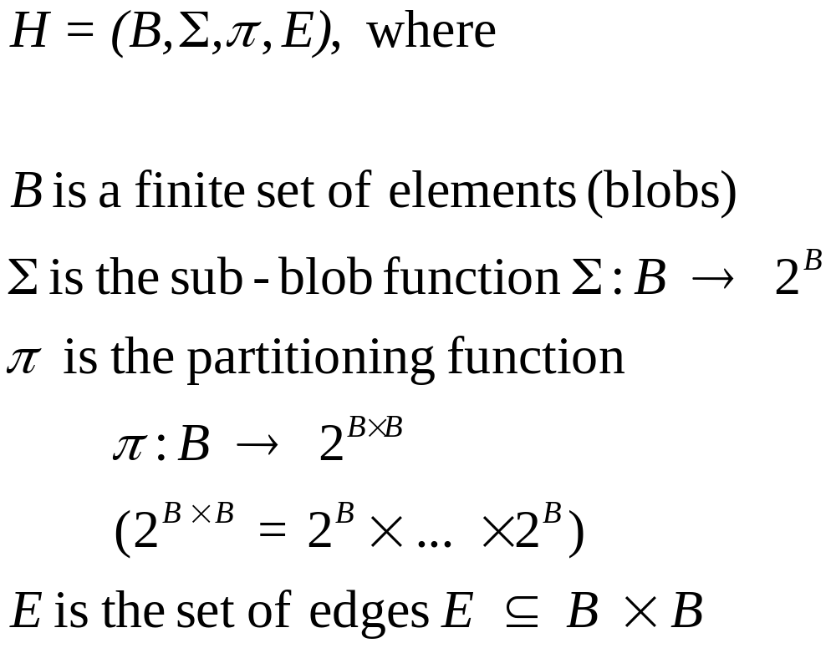
Formal Definition of a Higraph

Slide 49
Specialized Higraphs:
State Charts
State Charts are a higraph-based extension of standard state-transition diagrams, where blobs represent states and arrows represent transitions.
State Charts = state diagrams + depth + orthogonality + broadcast communication

Slide 50
Depth of State Charts
e, f, g, h: events that trigger the transitions
g(c): is the transition by event g when condition c is true.
Being in state D means being in one of states A or C.
The f arrow leaving D applies to both A and C.
A is the default state.
C is the default state when in D.
D
A
A
e
e
f
B
g(c)
f
B
g(c)
f
C
h
h
C

Slide 51
Orthogonality of State Charts
Y
k
B,F
h
A
D
B
E
k
B,E
B,G
g
e
f
[in{G}]
e
e
g
h
F
m or p
e
f
g
C,E
C,G
C
G
e
m
k
h
C,F
e
p
n
p
n
e
e
I
m or p
H
p
H
I

Slide 52
Broadcasting of State Charts
Y
A
D
B
E
k
F
e
f/g
n
g
C
G
e
H
m/e
I
J
n/f

Slide 53
State Chart Describing ATC
in flight
take off
cruising
on ground
parked
stacked
taxiing
landing
approach
touch down

Slide 54
State Chart Describing a Computer
Computer
CPU Main Memory
Fetching
Instruction
Waiting
for Request
instr.
cmpl.
instr.
avail.
Put
Addr.
Data
Written
Data
Read
Get
Addr.
Execution
Instruction
Memory
Write Cycle
Memory
Read Cycle
getAddr
putAddr

Slide 55
Display State of Digital Watch
displays
update
date
hour
min
b
c
d
c
d
c
sec
c
time
date
c
a
a
alarm
stopwatch
a
b
c
up-alarm
c
c c
hour
sec
2-min
[not in(stopwatch)]
min

Slide 56
Stopwatch State of Digital Watch
time
a
stopwatch
d
[in(off)]
zero
b b
disp run
reg
on
d
[in(on)]
d
b
b
lap
off

Slide 57
High-Level Description of Digital Watch
dead
alive
main power
displays
weak
strong
bt-weak
b
light
on
off
b-up
alarm-state
beep-rt
t-hits-tm
[in(enable)]
d[in(alarm)]
beep
enable
disable
d[in(alarm)]

Slide 58
State Chart of Digital Watch
dead
bat-in
bat-rn
alive
main
2-min
[not in(stopwatch)]
power
displays
update
weak
strong
date
hour
c
min
b
d
bt-weak
c
c
d
sec
c
time
light
date
c
a
b
on
off
stopwatch
a
alarm
d
zero
b
c
b b
b-up
disp run
up-alarm
c
c c
reg
on
d
d
b
b
hour
sec
alarm-state
d[in(alarm)]
lap
off
min
enable
disable
t-hits-tm
[in(enable)]
d[in(alarm)]
beep-rt
beep

Slide 59
References
[Rosenblum94] D. Rosenblum, A. L. Wolf, Formal Software Engineering, Tutorial SIGSOFT’94 FSE, New Orleans, Dec., 1994.
[Budgen94] D. Budgen, Software Design, Addison-Wesley, 1994.
[Ghezzi91] C. Ghezzi, M. Jazayeri, D. Mandrioli, Fundamentals of Software Engineering, Prentice-Hall, 1991.
[Harel88] D. Harel, On Visual Formalisms, CACM, Vol. 31, No. 5, 1988.

