Slide 1
CS360
Introduction to Database
Soon J. Hyun
School of Computing, KAIST
2018

Slide 2
Computer Science Dept., KAIST
IBM701
Intel 4004
Linux
Future Internet
ENIAC
UNIVAC
ARPA Net
MOSAIC
Apple
IBM PC
1876
1945
89
93
2010
46
47
51
52
57
69
71
80
81
94
95
Telephone
stored- program computer
program
MS-DOS
Web
smart-phone
FORTRAN
Windows95
ER
SNS
transistor
OODB
IMS
RDB
ubiquitous computing
Transaction
Distributed
NewDBs
NewDBs
Multidatabase
client-server
web
ubiquitous

Slide 3
Why DB?

Slide 4
Data, Information and Knowledge
Data constitute building blocks of information
Information produced by processing data
Information reveals meaning of data
Good, timely, relevant information key to decision making
Knowledge

Slide 5
1950
1960
1970
1980
1990
IBM701
File System
ARPANET
OO Database
Relational Database
OR Database
ENIAC
Network Database
Transaction Distributed
Hierarchical Database
Hypertext Web
ER Model
XML Database
SIGMOD
VLDB Conf.

Slide 6
Business (traditional) database
Mobile database
Multimedia database
Real-time database
Spatial database
XML database
Sensor Network database
Temporal database
…

Slide 7
Memory
Control Unit
Arithmetic Logic Unit
Accumulator
Input
Output
Eckert and Mauchly (1943/1944): ENIAC, EDVAC
Von Neumann (1945): EDVAC

Slide 8
Stored-program computer
Processing unit
Input
Output
Memory
Storage
Programs, data

Slide 9
processing data
Transient data
intermediate results
transaction process
query
output
database
(base data)
Persistent data

Slide 10
Historical Development
1950
1960
1970
1980
1990
t
IBM701
File System
ARPANET
Hypertext
Relational Database:
Ted Codd
ENIAC
Network Database
Object-oriented Database
Hierarchical Database
ER Model: Peter Chen
SIGMOD
VLDB Conf.

Slide 11
Functional Development
OS
Application
Application
…
…
Application
Early 1960’s: Application programs directly (thru OS) access and manage their own files.
Mid 1960’s: Sort/merge programs
Late 1960’s: Generalized File Management Systems (IMS development by IBM based on
Hierarchical Data Model)
In 1971: CODASYL’s DBTG Report proposed DBMS architecture.
(CODASYL DBTG:COnference on DAta SYstems Languages DataBase Task Group)

Slide 12
OS
Application
Application
DBMS
Application
…
Application
Application
Late 1970’s ~ early 1980’s: Relational DBMS began to appear.
(commercial relational DBMS: DB2, Oracle, Sybase, Informix, etc.)
Integrated, shared data
High-level modeling and access of data
Data independence
Controlled redundancy
Centralized control of database: security and integrity

Slide 13
OS
Application
Application
Object-oriented DBMS
Application
…
Application
Application
Late 1980’s ~ : OO concepts were applied in the area of databases.
Object creation, store and share among applications
Data abstraction
Object identification
Encapsulation of operational behavior of data objects
Inheritance, etc.

Slide 14
OS
Application
Object-oriented
Knowledge Base
Management System
(KBMS)
Application
Application
…
Application
Application
In 1990’s ~ : Integration of DB, AI, and PL concepts
Databases become more active and intelligent.

Slide 15
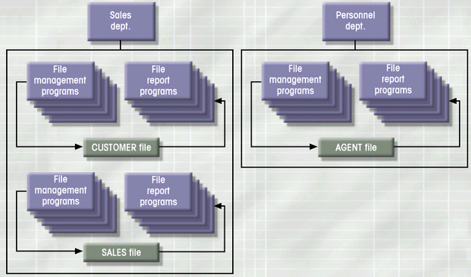
Simple File System

Slide 16
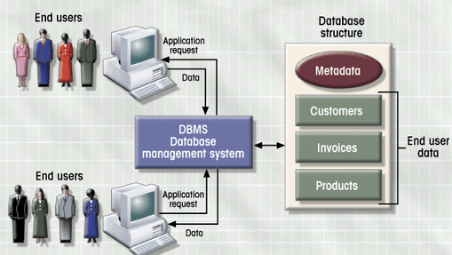
DBMS Manages Interaction

Slide 17
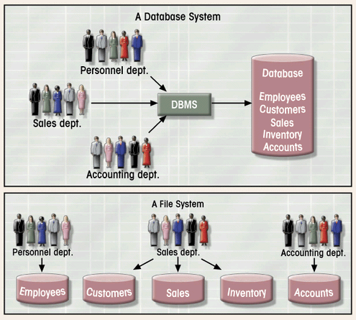
Database vs. File Systems

Slide 18
File System
File System Data Management
  Requires extensive programming in third-generation language (3GL)
  Time consuming
  Makes ad hoc queries impossible
  Leads to islands of information

Slide 19
File System
Data Dependence
  Change in file’s data characteristics requires modification of data access programs
  Must tell program what to do and how
  Makes file systems cumbersome from programming and data management views
Structural Dependence
  Change in file structure requires modification of related programs

Slide 20
File System
Field Definitions and Naming Conventions
  Flexible record definition anticipates reporting requirements
  Selection of proper field names important
  Attention to length of field names
  Use of unique record identifiers

Slide 21
File System
Data Redundancy
  Different and conflicting versions of same data
  Results of uncontrolled data redundancy
    Data anomalies
      Modification
      Insertion
      Deletion
    Data inconsistency
      Lack of data integrity

Slide 22
Database Systems
Database consists of logically related data stored in a single repository
Provides advantages over file system management approach
  Eliminates inconsistency, data anomalies, data dependency, and structural dependency problems
  Stores data structures, relationships, and access paths

Slide 23
File System
User
Data manager
Appl. programs
Appl. analyst
OS
User
files
User
System Analyst
Auditor
Application programmer

Slide 24
Database System
DBA
Appl. programmer
Appl. programs
DBMS
OS
Manager
Base Data
Analyst
Auditor
Users

Slide 25
Topic map on database study
Introduction
Database Architecture
Relational Database
ER Model
Other Models
Transaction Concurrency
Relational
Algebra
FD
SQL
Normalization
Query Processing
Transaction Recovery
Database Design
Distributed
database
Security
Ad hoc Databases

Slide 26
Database
A database consists of some collection of persistent data that is used by the application systems of some given enterprise.
A database is a collection of integrated and persistent data used by application systems.
A database system is a computerized data-keeping system.
A DBMS is a software package that provides all the data management facilities for creation, retrieval, manipulation and maintenance of data.

Slide 27
Database Models
Collection of logical constructs used to represent data structure and relationships within the database
  Conceptual models: logical nature of data representation
  Implementation models: emphasis on how the data are represented in the database

Slide 28
Database Models (con’t.)
Relationships in Conceptual Models
  One-to-one (1:1)
  One-to-many (1:M)
  Many-to-many (M:N)
Implementation Database Models
  Hierarchical
  Network
  Relational
  Object-oriented
Notes:
31

Slide 29
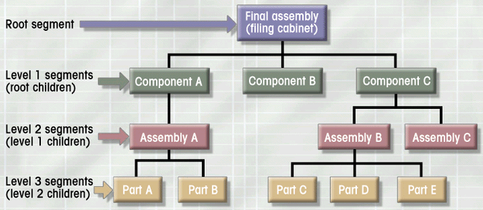
Hierarchical Database Model
Logically represented by an upside down tree
  Each parent can have many children
  Each child has only one parent

Slide 30
Hierarchical Database Model
Advantages
  Conceptual simplicity
  Database security and integrity
  Data independence
  Efficiency
Disadvantages
  Complex implementation
  Difficult to manage and lack of standards
  Lacks structural independence
  Applications programming and use complexity
  Implementation limitations

Slide 31
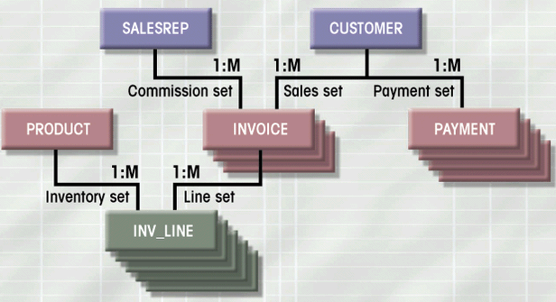
Network Database Model
Each record can have multiple parents
  Composed of sets
  Each set has owner record and member record
  Member may have several owners

Slide 32
Network Database Model
Advantages
  Conceptual simplicity
  Handles more relationship types
  Data access flexibility
  Promotes database integrity
  Data independence
  Conformance to standards
Disadvantages
  System complexity
  Lack of structural independence

Slide 33
Relational Database Model
Perceived by user as a collection of tables for data storage
Tables are a series of row/column intersections
Tables related by sharing common entity characteristic(s)

Slide 34
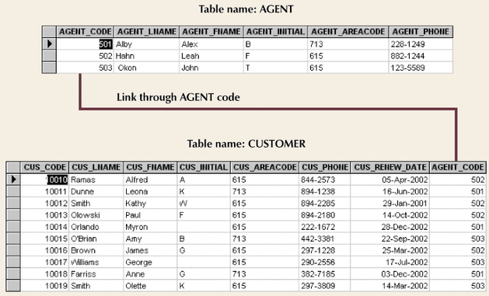
Relational Database Model (con’t.)

Slide 35
Relational Database
Advantages
  Structural independence
  Improved conceptual simplicity
  Easier database design, implementation, management, and use
  Ad hoc query capability with SQL
  Powerful database management system

Slide 36
Relational Database Model
Disadvantages
  Substantial hardware and system software overhead
  Poor design and implementation is made easy
  “islands of information” problems

