Slide 1
Architecture for Database System

Slide 2
Client/Server Architecture
End users
End users
…
Clients
Applications
Applications
DBMS
Server
Applications
- Built-in applications: “Vendor-provided” applications allow end-users
to create applications and query the database (called DBMS Tools).
>>without using conventional languages
- User-written applications: “third-party vendor-provided” applications
use conventional languages and data sublanguage.
- Utilities: “vendor-provided” special-purpose applications for DBA to
touch upon the physical data.

Slide 3
Distributed Database System
Application Systems
Global Query Global Model
Distributed DBMS
Local Query
Appl.
DBMS 1
DBMS 2
...
DBMS n
Homogeneous, Heterogeneous, Federated
Database service for larger community: location transparency
Two-layer transaction : global/local transaction
Translation of query and data conversion

Slide 4
Functional Architecture
Applications
Data/Schema Modifications
Queries
Query Processor
Transaction Manager
Storage Manager
Metadata Data

Slide 5
User’s Inputs
Queries: questions about data thru either generic query interface or application
program interface.
Data modifications: requests for changing the (values of) data.
Schema modifications: requests for changing the database schema from DBAs
Query Processor
Receives user’s database query and requests for data or metadata.
Asks the Storage Manager for requested data to be used in operations.
Storage Manager
Retrieval and modification by the requests of Query Processor.
Uses indexes.
Transaction Manager
Assures database integrity when concurrent data access and system failure.
Deals with the Query Manager to arbitrate database requests.
Deals with the Storage Manager to protect data from accidental system
failure; logging

Slide 6
DBMS Functions
Database definition facility
- DDL and Graphical interface
Database manipulation facility
- DML + sublanguage
Query processing and Optimization facilities
- User query
- System query
Integrity and security control
Concurrency control and Recovery
Utilities
- Report generation
- Dictionary handling
- Database re-organization (Schema modification,…)

Slide 7
Application
Users
Queries
Interface
Data Definition
Data Manipulation
Transaction Manager
Meta Data
Query Optimizer
Storage System
DB

Slide 8
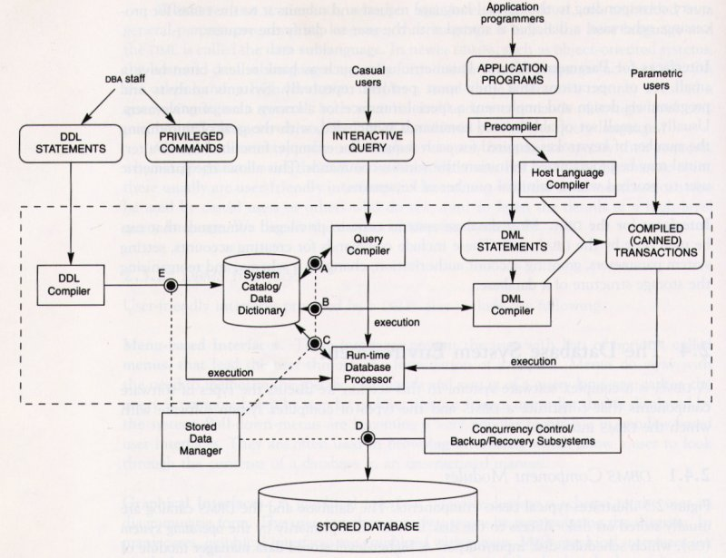

Slide 9
DBMS-OS Interaction
Applications
Request set of records
Set of records returned
DBMS
Request stored record
Stored record returned
File manager
Request stored page
Stored page returned
OS
Disk Manager
Disk I/O Operation
Data read from disk
Stored Database

Slide 10
Simplified structure of a database
Auxiliary
data
Metadata
Base data
Base Data: actual data, operational data, persistent
Metadata: semantic description of a database, definition, schema
Auxiliary Data: access path description, index

Slide 11
Base Data, Auxiliary Data, Metadata
Example:
PROF_INDEX
COURSE
PROF_NAME. POINTER
Prof.Tou 1, 4
Prof.Lee 2
Prof.Adams 3
...
C# DEPT. PROF. PERIOD ROOM
EE702 EE Prof.Tou 2 316
IC755 CIS Prof. Lee 3 318
IC509 CIS Prof.Adams 4 334
IC611 CIS Prof.Tou 5 316
...
1
2
3
4
ROOM_INDEX
ROOM POINTER
316 1, 4
318 2
334 3
...
CREATE DOMAIN C# CHAR (5) ;
CREATE DOMAIN DEPT CHAR (2) ;
CREATE DOMAIN PROF CHAR (20) ;
...
CREATE BASE RELATION COURSE
( C# DOMAIN ( S# ),
DEPT DOMAIN ( DEPT ),
… )
PRIMARY KEY ( C# );

Slide 12
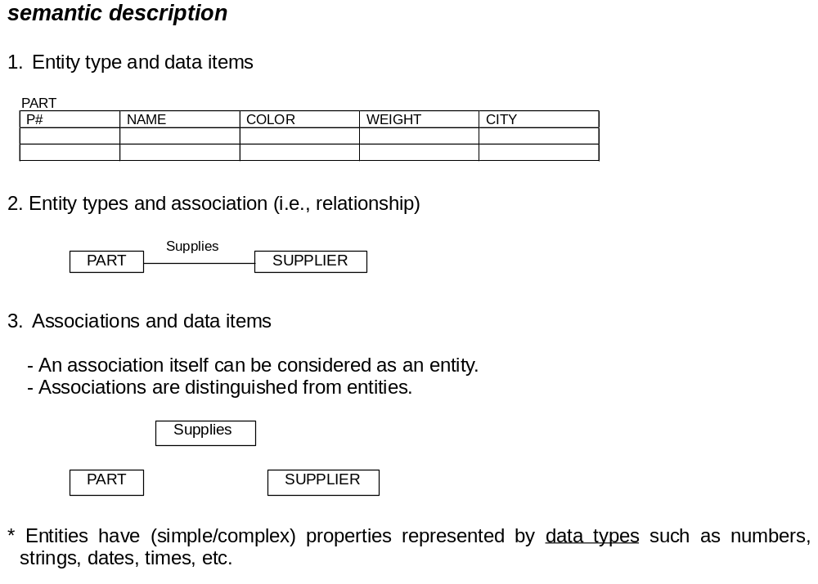

Slide 13

Three-level Architecture
ANSI/X3/SPARC Study Group on Database Management Systems (1972)
User’s view:
External Schema
Mapping statements
External Schema
Mapping statements
External Schema
Mapping statements
External Level:
. . .
Conceptual Level:
Conceptual Schema
Mapping statements
Internal Level:
Internal Schema
Design process: External views >> conflicts and ambiguities >> Conceptual views
Application: Conceptual view >> define external views for different applications

Slide 14
Data Mapping
High-level Data Model: part of the database, and hiding the rest
. . .
Data Definition: Entities, data types, relationships, user operations, security/integrity constraints, workflows
Physical Data Model: storage and access paths (stored records, pointers, indexes, hashes, etc.)
Data mapping: view interface, data transforming, changes
In many cases, the level-separations are not complete.

Slide 15
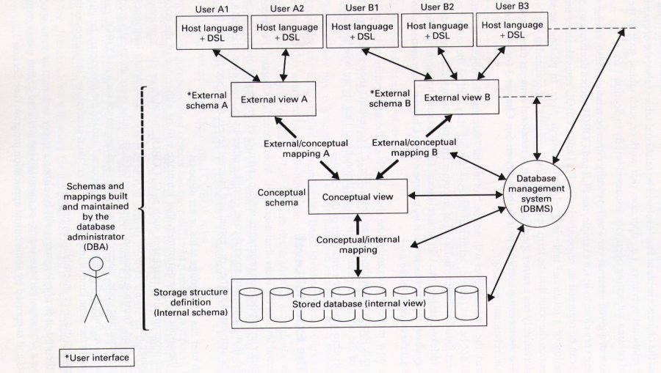

Slide 16
An example of the three-level representation
External 1 :
SELECT Employee Number
FROM EMPLOYEE
External 2 :
SELECT Salary
FROM EMPLOYEE
Conceptual:
EMPLOYEE
EMPLOYEE_NUMBER CHARACTER (6)
DEPARTMENT_NUMBER CHARACTER (4)
SALARY NUMERIC (5)
Internal:
STORED_EMP LENGTH = 20
PREFIX TYPE = BYTE (6), OFFSET = 0
EMP# TYPE (6), OFFSET = 6, INDEX = EMPX
DEPT# TYPE = BYTE (4), OFFSET = 12
PAY TYPE = FULLWORD, OFFSET = 16

Slide 17
Structural and Data Independence
Working on application logic does not require the knowledge of underlying data organization and access path structure of the data.
The user is allowed to retrieve and manipulate data based on his/her knowledge about data at the logical level rather than lower level data representation.
Modification made in the access path structure and physical storage structure should not affect the application programs.
Database growth does not affect the application programs.

Slide 18
Database Languages
Classifying by function
Data definition language (DDL): conceptual-internal mapping at the conceptual schema
level Storage definition language (SDL): specifying internal schema
View definition language (VDL): external-conceptual mapping
Data manipulation language (DML): manipulation of the database; retrieve, insert, delete,
update, etc.
It is common that a comprehensive language (such as SQL relational database language)
represents the combination
Classifying by user types
End user: Query language (e.g., SQL, OQL, etc.) or Graphical interfaces
Database administrator:
- Host language or proprietary language (e.g., Delpfi, 4GL, Powerbuilt, etc.)
- Data sublanguage (e.g., embedded SQL)
- Integrated in an object-oriented system (e.g., C++, SmallTalk)

