Slide 1
Relational Database
We will discuss:
basic components: entities, their attributes, and
relationships among entities
How entities and their attributes are organized into tables
Relational database operators, the data dictionary, and
the system catalog
How data redundancy is handled in the relational
database model
Why indexing is important

Slide 2
Network/DBTG Data Model
CODASYL: COnference on DAta SYstems Language
DBTG: Data Base Task Group
DBTG’s Final Report in 1971 >> DBTG Model
Some Commercial Systems
- DMS 1100 UNIVAC
- EDMS Xerox
- TOTAL CINCOM
- IDMS Cullinet Software Inc.
- DMS II Burroughs

Slide 3
Data Elements (Basic Constructs)
Data Item: the smallest unit of named data
Data aggregate
- Vector: a one-dimensional, ordered collection of data items with identical characteristics
- Repeating group: a collection of data that occurs an arbitrary number of items within a record
occurrence. The collection may consist of data-items, vectors, and repeating groups.
Record: a named collection of data items and/or data aggregates
(owner-coupled) Set: a named collection of two record types, owner record types and member record
type
Area: a named sub-division of the addressable storage apace in the database. It is used to control the
placement of records and sets for access efficiency.
Record Type: a collection of records
Format: data types for data items
In this model, database is a collection of records, sets and areas defined by a schema.

Slide 4
Architecture
Application
Application
. . .
Application
Subschema
Mapping to schema
Subschema
Mapping to schema
. . .
Subschema
Mapping to schema
External Model
Conceptual Model
Schema
Mapping to storage
Internal Model (storage structure)
Network Access Structure

Slide 5
The schema consists of definitions of the various types of records and the set types into which
they are grouped.
A record occurrence is defined by a collection of data items.
A collection of record occurrences forms a record types.
A set type is defined to have a certain type of record as its owner and some other record type
as its member.
A set occurrence (instance) is formed by one owner occurrence and zero or more occurrences of
its member.
D1 London 30
DEPT
Dept# Loc # of EMP
owner
D-E(1:N)
Set type (link type)
E30 30K 35
DEPT-EMP
EMP
EMP# SAL AGE
member
E42 35K 40
E33 45K 36
* No member occurrence may belong to more than one occurrence of the
set at any time.

Slide 6
The owner can be the system (DBMS); singular set having one occurrence.
It can be regarded that all instances of a given root as children of the system.
A singular set allows sequential access of all occurrence of a record type.
System
DEPTSET; SYSTEM LINK
root record type
DEPT
D-E
EMP
1:1 relationship is not automatically supported by Network DBMS >> Programmer’s responsibility
Each set instance should have only one member record !

Slide 7
Representation of Sets
- Linked List
- Each record type is automatically assigned a pointer field for each set type.
D1 London 30
D-E (First)
D-E (Next)
D-E (Next)
E30 30K 35
E30 30K 35
E-X (Next)
E-X (Next)
- For programming efficiency, different systems implement ad hoc pointer structure, such as
double linked list, owner pointer, pointer array, indexed representation, etc. can be used.

Slide 8
DEPT EMP
D1 E1
D1 E3
D1 E4
D4 E1
D5 E3
DEPT
EMP
Dept#
N:M
EMP#
D-W
E-W
Work_On
Link
D1
D4
D5
D-W
E-W
E1
E3
E4

Slide 9
Network/DBTG DDL
Record type declaration
ex: SCHEMA NANE IS COMPANY
RECORD NAME IS DEPT
DUPLICATES ARE NOT ALLOWED FOR DNAME
DUPLICATES ARE NOT ALLOWED FOR DNUM
DNAME TYPE IS CHAR 20
DNUM TYPE IS INTEGER
OFFICE TYPE IS CHAR 20
Set type declaration
ex: SET NAME IS DEPT_SET
OWNER IS SYSTEM
ORDER IS SORTED BY DEFINED KEYS
MEMBER IS DEPT
KEY IS ASCENDING DNAME
SET NAME IS WORK_FOR
OWNER IS DEPT
ORDER IS SORTED BY DEFINED KEYS
MEMBER IS EMPLOYEE
INSERTION IS MANUAL
RETENTION IS OPTIONAL
KEY IS ASCENDING DNAME

Slide 10
Operational property
Insertion and retention constraints for member sets
- Insertion: automatic/manual insert
- Retention: optional/mandatory/fixed existence
Set ordering
- Sorting
- System default
- First and last
- Next and prior
: declared in the data definition language

Slide 11
Network/DBTG Data Manipulation (DML)
DML is based on record-at-a-time commands, therefore, identifying current records by means of
currency indicator is needed.
Currency indicator: Current of record type; Current of set type, current of run unit (CRU)
i.e., current position, position holder, current of cursor, database pointer, record pointer
User Work Area (UWA): a set of program variables declared in the host program
DML commands are embedded in a general-purpose programming language
- Navigation to set the currency indicators to specific records and set occurrences in the database.
FIND
- Retrieval commands retrieve the current record of the run unit.
GET
- Update commands update records and set occurrences.
STORE, ERASE, MODIFY
CONNECT, DISCONNECT, RECONNECT(move)

Slide 12
ex1: EMPLOYEE.NAME: = ‘John Smith’;
FIND ANY EMPLOYEE USING NAME;
if DB_STATUS = 0 then
begin
GET EMPLOYEE;
writeln ( EMPLOYEE.SALARY )
end
else writeln (‘no record found’);
ex2: DEPT.NAME: = ‘Sales’;
FIND ANY DEPT USING NAME;
if DB_STATUS = 0 then
begin
FIND FIRST EMPLOYEE WITHIN WORK_FOR;
while DB_STATUS = 0 do
begin
GET EMPLOYEE;
writeln ( EMPLOYEE.SALARY )
FIND NEXT EMPLOYEE WITHIN WORK_FOR
end
end;
* Try currency indicators !

Slide 13
Comparison with Relational Model
Network Model
various access path and physical arrangement (hash-function, sequencing, various FIND, etc.)
user controls the access path thru DML
distinction between entity and relationship (record, set, repeating group, ordering, singular set, etc.)
more basic operations with link pointers
processing record-at-a-time
programmer has to know set selection, database key and currency data to use proper DML statements. type reference to storage constructs
Higher modeling capability with explicit relationship expression (set type)
Relational Model
uniform access path by candidate/primary keys
optimization of access strategy done automatically
uniform data representation with relation(table)
less basic operations with set theoretics
processing a set of records(tuples)
programmers are free from physical database. SQL is operated on the logical database
implicit foreign key concept makes the corresponding expression (JOIN)

Slide 14
Hierarchical Data Model
Good for modeling hierarchical relationships.
Problem with nonhierarchical relationships.
No original document as for Relational/network models
Some commercial implementations:
- MARS VI Control Data Co.
- IMS IBM (1968)
- System-2000 MRI

Slide 15
Hierarchical Data Structure
A hierarchical database consists of an ordered set of trees.
Two major constructs are records and parent-child relationships.
Record type
Data item (or field) and data type
A PCR type is 1:N relationship between two record types; ( DEPT, STUDENT )...
Instance (occurrence) of a PCR type; one record of the parent record type plus a
number of records of the child record type.
DEPT
CE
“node”
“edge”
(DEPT, STUDENT)
(DEPT, PROJ)
STUDENT
PROJ
John
Chris
. . .
Jason
DB
. . .
PL
IEEE
ACM
PUBLICATION
“leaf”
M:N relationships between record types can not be directly represented. How to?

Slide 16
Storage Structure: Hierarchical Sequence
Hierarchical sequence is efficient for retrieval from storage.
Hierarchical DML(HDML) is based on the hierarchical sequence.
Record indicator is needed.
Hierarchical Path specifies a sequence of nodes n1, N2, …, Ni, where N1 is the root of a tree and
Nj is a child of Nj-1 for j = 2, 3, …, i.
A1
A2
B1
B2
A3
B3
C1
C2
B4
A4
Complete Path: ( A, B, C )
( A1, A2, {B1, B2}, A3, … )

Slide 17
Modeling problems
M:N relationships
A record type as a child participate in more than one PCR types.
Relationships with more than two participating record types (n-ary relationships)
>> Virtual PCR (VPCR) by using virtual record type; VP, AC and pointers.
DEPT
CE
(D, S)
(D, P)
STUDENT
PROJ
John
Chris
. . .
Jason
DB
. . .
PL
M:N
Chris
Chris
PROJ
STUDENT
PROJ
STUDENT
VP
VP
pointer
pointer
VC
VC
pointer
pointer

Slide 18
Some Modeling Constraints
A child record can not be inserted unless it is linked to an existing parent record.
A child record may be deleted independently except for VPCR.
Deletion of a parent record automatically delete all its descendent records.
The virtual parent of more than one VPCR types is not allowed (IMS).
Other constraints are possible to be enforced by different implementation.
>> programmer’s attention with programs (e.g., update of duplicated copies)
Note:
- The model has many options for representing the same ER schema.
. single or multi-hierarchy mapping from ER schema
. Record duplication or VPCR for representing M:N relationships
. 1:N relationship types must be in the same direction
. A record type can have at most one real record type
. A record type can have at most two parents-one real and the other virtual.
. N-ary mapping in different ways
- Record redundancy and efficient retrieval are decision issues
Therefore, this model is regarded inferior in its modeling capability to both relational model and network model.

Slide 19
Hierarchical Data Definition by HDDL
SCHEMA NANE IS COMPANY
HIERACHIES H1;H2
RECORD
NAME IS DEPT; TYPE IS ROOT OF H1;
DATA ITEMS
DNAME CHAR 20
DNUM INTEGER
OFFICE CHAR 20
KEY IS DNUM
RECORD
NAME IS EMPLOYEE; TYPE IS ROOT OF H2;
DATA ITEMS
ENAME CHAR 20
SEX CHAR 1
ADDR CHAR 40
KEY IS ENAME
RECORD
NAME IS DEMPLOYEE; PARENT IS DEPT;
CHILD NUMBER IS 1;
DATA ITEMS
EPOINTER TO EMPLOYEE
RECORD
NAME IS PROJ; PARENT IS DEPT;
CHILD NUMBER IS 2
DATA ITEMS
JNAME CHAR 20
JNUM INTEGER
FUND INTEGER
KEY IS JNUM
….

Slide 20
Hierarchical Data Manipulation by HDML
Similar to the Network DML
Based on record-at-a-time commands, therefore, identifying current records by means of
currency indicator is needed.
Currency indicator: current of schema; current of hierarchy; current of record type
User Work Area (UWA): a set of program variables declared in the host program
HDML is based on the concept of hierarchical sequence.
DML commands are embedded in a general-purpose programming language
- Search for specific record; make it the current record and retrieve into the corresponding UWA.
GET
- Update commands update record w.r.t currency indicator.
INSERT, DELETE, REPLACE
- Mark the current record for the subsequent operations.
GET HOLD

Slide 21
Ex : Find the names and ages of employees whose salaries are greater than 35K.
GET FIRST EMPLOYEE WHERE SALARY < 35K;
while DB_STATUS = 0 do
begin
writeln ( P_EMPLOYEE.NAME, P_EMPLOYEE.AGE );
GET NEXT EMPLOYEE WHERE SALARY < 35K;
end;
GET ( FIRST | NEXT ) PATH hierarchical path [ WHERE condition ];
GET [ VIRTUAL ] PARENT parent record type name;
GET NEXT type name WHITIN PARENT;
GET NEXT PATH record type WHININ PARENT record type WHERE condition;
INSERT record type;
GET HOLD ( FIRST | NEXT ) record type [ WHERE condition ];
DELETE record type; deletes all the records in its subtree except for virtual child records
GET HOLD ( FIRST | NEXT ) record type [ WHERE condition ];
REPLACE record type;

Slide 22
Comparing with other Models
Good for hierarchical data but problematic with nonhierarchical relationships
Multiple hierarchies causes data redundancy problem; restructuring is required
No theory is available for problem-solving; programmer/end-user’s burden to take care of
arbitrary restrictions and interdependencies
Physical structure is powerful for certain applications
No clear line between logical and physical levels

Slide 23
Relational View of Data
Designer focuses on logical representation rather than physical
Use of table advantageous
      Structural and data independence
      Related records stored in independent tables
      Logical simplicity
Allows for more effective design strategies

Slide 24
Entities and Attributes
  Entity is a person, place, event, or thing about which data is collected
  Attributes are characteristics of the entity
Tables
  Holds related entities or entity set
  Also called “relations”
  Comprised of rows and columns

Slide 25
Table Characteristics
  Two-dimensional structure with rows and columns
  Rows (tuples) represent single entity
  Columns represent attributes
  Row/column intersection represents single value
  Tables must have an attribute to uniquely identify each row

Slide 26
Table Characteristics (cont.)
  Column values all have same data format
  Each column has range of values called attribute domain
  Order of the rows and columns is immaterial to the DBMS

Slide 27
Keys
One or more attributes that determine other attributes
  Key attribute
  Composite key: multi-attribute key
Full functional dependence
  Dependent on a composite key, but not on any subset of the composite key
Entity integrity
  Uniqueness
  No ‘null’ value in key
Time-invariant: e.g., SName is not

Slide 28
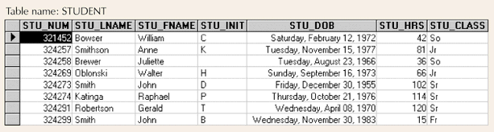
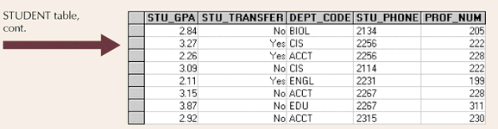
Example Tables

Slide 29
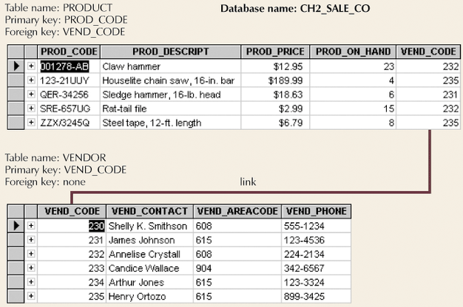
Simple Relational Database

Slide 30
Keys (cont.)
Superkey
  Uniquely identifies each entity; contains at least one candidate key
Candidate key
  Minimal superkey; irreducible superkey
Primary key
  Candidate key to uniquely identify all other attributes in a given row: the remainder are alternate key
Secondary key
  Used only for data retrieval;no uniqueness enforced
Foreign key
  Values must match primary key in another table

Slide 31
Relational Database Integrity Constraints
Domain Constraint: value(A) from dom(A)
- On attribute
2. Key Constraints: t1[SK] =/ t2[SK]
- On relation
3. Entity Integrity Constraint: PK=/ null
- On relation
4. Referential integrity: t1[FK] = t2[PK] or t1[FK] = null
- On interrelation
5. Data Dependency Constraints
- On inter-attribute
6. Semantic Integrity Constraints
- triggers, assertions

Slide 32
Integrity for Database Update
Insert may violate:
- 1 to 4
Delete may violate:
- 4
Modify (update) may violate:
- 2 and 4

Slide 33
Null
Not applicable
Unknown
Known but missing
* May cause problems with aggregate functions
* Referential integrity problem
* Flags can be used

Slide 34
Relational Database Operators
Relational algebra determines table manipulations
Key operators
  SELECT
  PROJECT
  JOIN
Other operators
  INTERSECT
  UNION
  DIFFERENCE
  PRODUCT
  DIVIDE

Slide 35
Data Dictionary and System Catalog
Data dictionary
  Provides detailed account of all tables found within database
  Metadata
  Attribute names and characteristics
System catalog
  Detailed data dictionary
  System-created database
  Stores database characteristics and contents
  Tables can be queried just like any other tables
  Automatically produces database documentation

Slide 36
Relationships within Relational Database
Relationship classifications
  1:1
  1:M
  M:N
E-R Model
  ERD Maps E-R model
  Chen
  Crow’s Feet

Slide 37
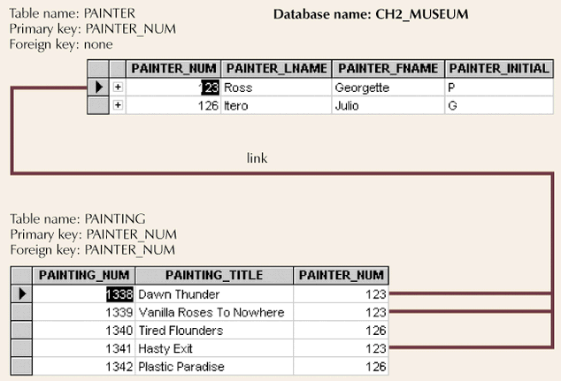
1:M Relationship

Slide 38
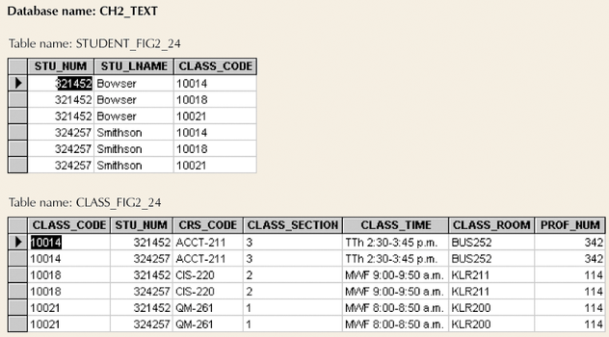
M:N Relationship

Slide 39
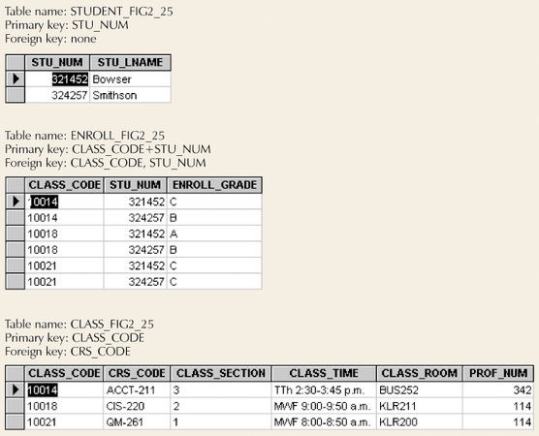
Converting M:N Relationship to Two 1:M Relationships

Slide 40
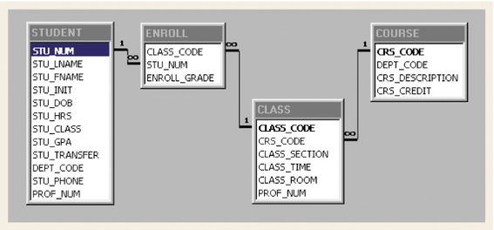
Converting M:N Relationship to Two 1:M Relationships (con’t.)

Slide 41
Data Redundancy Revisited
Foreign keys can reduce redundancy
Some redundancy is desirable
  Called controlled redundancy
  Speed
  Information requirements

Slide 42
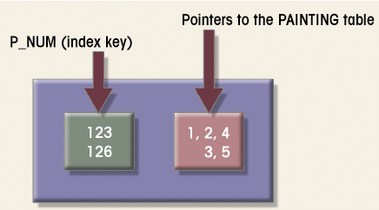
Indexes
Points to location
Makes retrieval of data faster

