Slide 1
FD and Normalization
We will discuss:
Semantic relationships among attributes in an entity as functional dependency
Update anomalies
How functional dependency can be used to normalize relations
How normal forms can be transformed from lower normal forms to higher normal forms

Slide 2
Functional Dependencies (FD)
Codd first defined in 1972
Many-to-one value-mapping from one set of attributes to another within a given relation
R: a relation X, Y: subsets of the set of attributes of R
X --> Y: Y is functionally dependent on X, iff each X-value in R is associated with exactly one Y-value in R. That is, if T1[X] = T2[X], then T1[Y] = T2[Y]
X called determinant; Y called dependent
e.g., EMP ( EMP_NUM, EMP_NAME, JOB_CLASS)
PROJ_EMP ( PROJ_NUM, PROJ_NAME, EMP_NUM )

Slide 3
Functional Dependencies (cont.)
Time-invariant dependency i.e., for all time (or for all possible legal values of the relation)
A set S of FDs are irreducible iff
- single attribute on the right-hand side, and
- left-irreducible: no attribute is discarded from the left-hand side >> candidate key
- No FD in S can be discarded from S
Trivial vs. non-trivial dependence
An FD is trivial iff the right-hand side is a subset of the left-hand side, such as { S#, P# } --> S# and { S#, P# } --> P#

Slide 4
Functional Dependencies (cont.)
If FDs are not irreducible, the relation will involve some redundancy >> A is not a candidate key in A → B
The normalization procedure can be characterized as a procedure for eliminating arrows that do not come out of candidate keys
A very special kind of data integrity. As such, FDs are a semantic notion >> use intuition as much as you can

Slide 5
Teacher | course | textbook
Smith | Data structure | Bartram
Smith | Database | Martin
Hall | Compiler | Hoffman
Brown | Data structure | Horowitz
Teacher → Course
Course → Teacher
Teacher → Text
Text → Course
Course → Text
Text → Teacher
A | B | C | D
a1 | b1 | c1 | d1
a1 | b2 | c2 | d2
a2 | b2 | c2 | d3
a3 | b3 | c4 | d3
B → C, C → B, {A, B} → C, {A, B} → D, {C, D} → B
A → B, B → A, D → C

Slide 6
Normalization
Normalization is process for assigning attributes to entities
  Reduces data redundancies to achieve a database design goal, “one fact in one place”
  Helps eliminate data anomalies
  Produces controlled redundancies to link tables
Codd defined 1NF, 2NF, and 3NF (1972)
BCNF (Boyce/Codd Normal Form) is an improvement of 3NF and came up with stronger definition.
Normalization is a formalization of semantics on relations.
Based on functional dependencies among sets of attributes in relation R.

Slide 7
Normalization (cont.)
Normalization in stages
{ 1NF { 2NF { 3NF { BCNF { 4NF { 5NF } } } } } }
Normalization is a decomposition process on a nonloss basis, i.e., reversible
A relation is said to be in a certain normal form

Slide 8
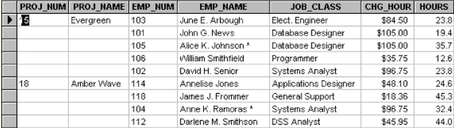
Need for Normalization

Slide 9
Update Anomalies
PRO_NUM intended to be primary key
Data inconsistencies
Update anomalies
  Deletion
    When delete, some other facts are destroyed
    If employee deleted, other vital data lost
  Insertion
    To insert, we need more information
    New employee must be assigned project
  Update
    Redundancy causes searching problem for every tuple.
    Modifying JOB_CLASS

Slide 10
1NF
Repeating groups must be eliminated
  Proper primary key defined
    Uniquely identifies attribute values (rows)
    Combination of PROJ_NUM and EMP_NUM
  Dependencies can be identified
    Desirable dependencies based on primary key
    Less desirable dependencies
      Partial
        based on part of composite primary key
      Transitive
        one nonprime attribute depends on another nonprime attribute

Slide 11
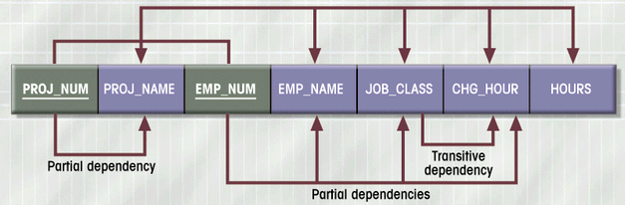
FD Diagram (1NF)

Slide 12
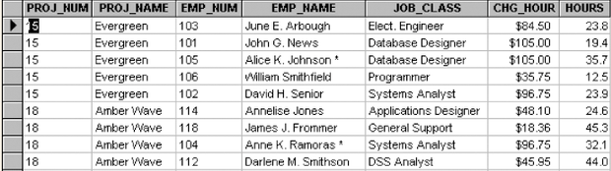
Data Organization: 1NF

Slide 13
1NF Summarized
All key attributes defined
No repeating groups in table
All attributes dependent on primary key

Slide 14
2NF
Start with 1NF format:
Write each key component on separate line
Write original key on last line
Each component is new table
Write dependent attributes after each key
PROJECT (PROJ_NUM, PROJ_NAME)
EMPLOYEE (EMP_NUM, EMP_NAME, JOB_CLASS, CHG_HOUR)
ASSIGN (PROJ_NUM, EMP_NUM, HOURS)

Slide 15
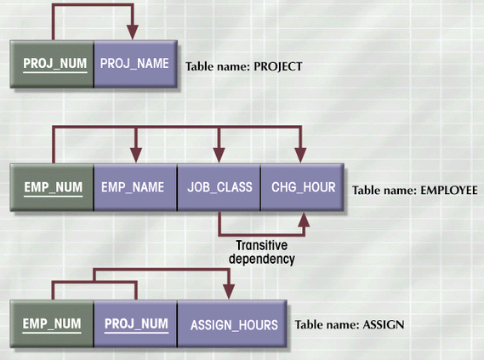
FD Diagram: 2NF

Slide 16
2NF Summarized
In 1NF
Includes no partial dependencies
  No attribute dependent on a portion of primary key
Still possible to exhibit transitive dependency
  Attributes may be functionally dependent on nonkey attributes

Slide 17
Non-loss Decomposition and Reversibility
Breaking down a relation into relations >> projection
No information should be lost when join them together >> join reversible
e.g., 1. (EMP_NUM, ENP_NAME, CHG_HOUR), (EMP_NUM, JOB_CLASS)
2. (EMP_NUM, ENP_NAME, CHG_HOUR), (JOB_CLASS, CHG_HOUR)
In (2), information of “which employee has which job_class” is lost !
How to guarantee reversibility ?
>> By use of functional dependency (FD).
FD diagrams help visualize functional dependencies.

Slide 18
3NF
Create separate table(s) to eliminate transitive functional dependencies
PROJECT (PROJ_NUM, PROJ_NAME)
ASSIGN (PROJ_NUM, EMP_NUM, HOURS)
EMPLOYEE (EMP_NUM, EMP_NAME, JOB_CLASS)
JOB (JOB_CLASS, CHG_HOUR)

Slide 19
3NF Summarized
In 2NF
Contains no transitive dependencies

Slide 20
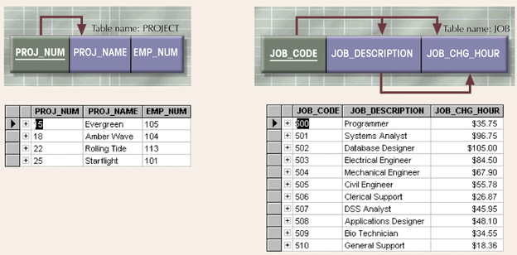
Additional DB Enhancements

Slide 21
Boyce-Codd Normal Form (BCNF)
Every determinant in the table is a candidate key
  Determinant is attribute whose value determines other values in row
  3NF table with one candidate key is already in BCNF

Slide 22
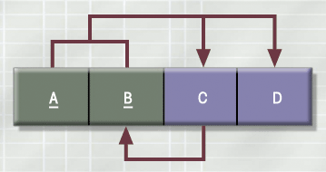
3NF Table but not in BCNF
No partial dependency

Slide 23
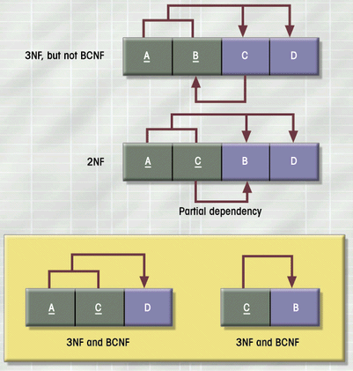
Decomposition of Table
Structure to Meet BCNF

Slide 24
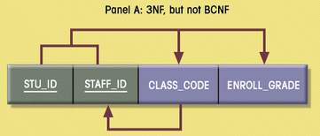
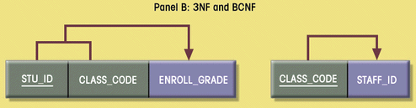
Decomposition into BCNF

Slide 25
Decomposition into BCNF(cont.)
S
T
S
T
J
T
J
OR
S#
S#
SNAME
S#
SNAME
P#
QTY
S#
SNAME
QTY
QTY
SNAME
P#
P#
S
?
J
R

Slide 26
Higher-Level Normal Forms
Fourth Normal Form (4NF)
  Table is in 3NF
  Has no multiple sets of multivalued dependencies

Slide 27
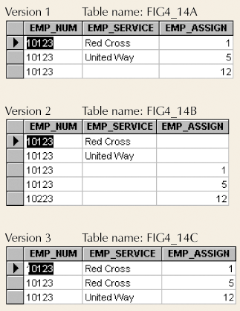
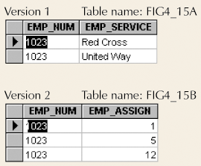
Conversion to 4NF
Set of Tables in 4NF
Multivalued Dependencies

Slide 28
4NF
4NF is an improvement over BCNF to further remove redundancy.
Multivalued dependency (MVD): put in theory by Fagin (1977)
- R ( A, B, C )
A → B iff the set of B-values matching a given A-C-value pair depends only on
the A-value and is independent of the C-value.
- R ( A, B, C )
A → B holds iff A → C holds
A → B | C

Slide 29
4NF (cont.)
Fagin’s theorem
- R ( A, B, C ) = ( A, B ) join ( A, C ), iff A → B | C is true.
e.g., CPX ( COURSE, PROFESSOR, TEXT )
Physics Green Basic Mechanics
Physics Brown Principles of Mechanics
Physics Green Principles of mechanics
Physics Brown Basic Mechanics
COURSE → PROFESSOR | TEXT
* Test update anomalies and redundancy

Slide 30
4NF (cont.)
R is in 4NF if it is in BCNF and all MVDs in R are in fact trivial (I.e., FDs out of candidate keys).
e.g., Fig 11.1, 11.2 and 11.3
When entities depend on all the participating entities, such as SPJ; no nontrivial MVDs >> 4NF
e.g., CTX ( COURSE, PROFESSOR, TEXT )
>> CT ( COURSE, PROFESSOR ), CX ( COURSE, TEXT )

Slide 31
5NF
5NF is based on join dependency (JD) constraint.
No practical significance nor hard to detect.
Some relation is possible to get decomposed into 3 (or more) relations and reconstructed by 3-way (or more) join.
- R satisfies the JD iff R = X JOIN Y JOIN … JOIN Z, where X, Y, Z are arbitrary subsets of the set of attributes in R.
“When supplier s supplies part p, a project j uses part p, and the supplier s supplies at least one part to project j, then s will also supply p to j.”
>> JD * ( R1, R2, R3 ) among the three projections R1 ( S, P ), R2 ( S, J ), and R3 ( P, J )

Slide 32
5NF (cont.)
A relation R is in 5NF iff every join dependency in R is implied by the candidate keys of R (i.e., no JDs).
Finding JD in practical databases is difficult !
* Double check your relations.

Slide 33
Denormalization
Normalization is one of many database design goals
Normalized relations require
  Additional processing
  Loss of system speed
Normalization purity is difficult to sustain due to conflict in:
  Design efficiency
  Information requirements
  Processing

Slide 34
Unnormalized Table Defects
Data updates less efficient
Indexing more cumbersome
No simple strategies for creating views

