Slide 1
Entity Relationship Modeling
We will discuss:
ER modeling concepts
Diagramming convention
Entity types and relationship types

Slide 2
Database Modeling
Real-world applications onto computer systems to be manipulated by DBMSs
Collection of logical constructs used to represent data structure and relationships within the database
  Conceptual models: logical nature of data representation
  Implementation models: emphasis on how the data are represented in the database

Slide 4
The Entity Relationship (E-R) Model
Represents conceptual view
Main Components
  Entities
    Corresponds to entire table, not row
    Represented by rectangle
  Attributes
  Relationships

Slide 5
E-R Modeling Symbols
Alternate styles developed to enable easier use of CASE tools
Chen
  Moved conceptual design into practical database design arena
Crow’s Foot
  Cannot detail all cardinalities
Rein85
  Similar to Crow’s Foot
  Operates at higher level of abstraction
IDEF1X
  Derivative of ICAM studies in the late 1970’s
  Uses fewer symbols

Slide 6
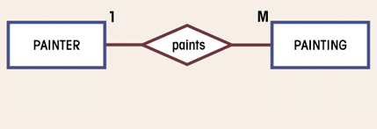
Entity Relationship Database Model
Complements the relational data model concepts
Represented in an entity relationship diagram (ERD): Chen’s model, craw’s foot model
Based on entities, attributes, and relationships

Slide 7
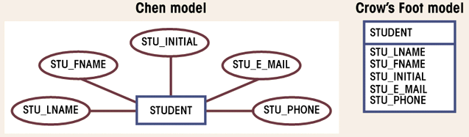
Attributes
Characteristics of entities
Domain is set of possible values
Primary keys underlined

Slide 8
Attributes (con’t.)
Simple
  Cannot be subdivided
  Age, sex, marital status
Composite
  Can be subdivided into additional attributes
  Address into street, city, zip
Single-valued
  Can have only a single value
  Person has one social security number
Multi-valued
  Can have many values
  Person may have several college degrees
Derived
  Can be derived with algorithm
  Age can be derived from date of birth

Slide 9
Relationships
Association between entities
Connected entities are called participants
Operate in both directions
Connectivity describes relationship classification
  1:1, 1:M, M:N
Cardinality
  Expresses number of entity occurrences associated with one occurrence of related entity

Slide 10
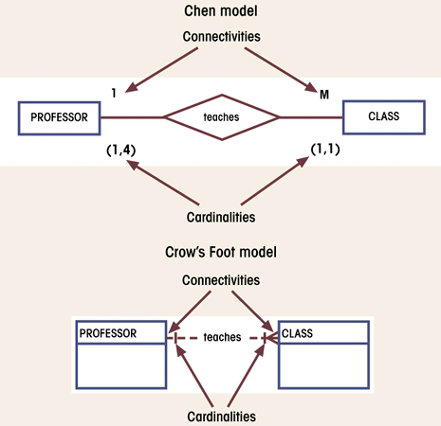
Connectivity and Cardinality

Slide 11
Relationship Strength
Existence dependence
  Entity’s existence depends on existence of related entities
  Existence-independent entities can exist apart from related entities
  EMPLOYEE claims DEPENDENT, CLASS cannot exist without a COURSE
Weak (non-identifying)
  One entity is existence-independent on another
  PK of related entity doesn’t contain PK component of parent entity
Strong (identifying)
  One entity is existence-dependent on another (→ weak entity)
  PK of related entity contains PK component of parent entity

Slide 12
Relationship Participation
Partial (optional)
  Entity occurrence does not require a corresponding occurrence in related entity
  Shown by drawing a small circle on side of optional entity on ERD
Total (mandatory)
  Entity occurrence requires corresponding occurrence in related entity
  If no optionality symbol is shown on ERD, it is mandatory
Depending on the business rules

Slide 13
Weak Entity
Existence-dependent on another entity
(→ strong/identifying relationship)
Has primary key that is partially or totally derived from parent entity
Database designer determines whether or not an entity is described as weak

Slide 14
Relationship Degree
Indicates number of associated entities
Unary
  Single entity
  Recursive
  Exists between occurrences of same entity set
Binary
  Two entities associated
Ternary
  Three entities associated

Slide 15
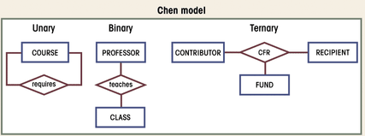
Three Types of Relationships

Slide 16
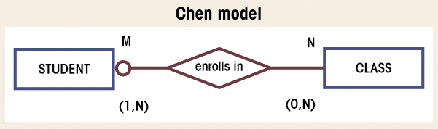
Composite Entities
Used to ‘bridge’ between M:N relationships
Bridge entities composed of primary keys of each entity needing connection

Slide 17
Entity Supertypes and Subtypes
Generalization hierarchy
  Depicts relationships between higher-level supertype and lower-level subtype entities
  Supertype has shared attributes
  Subtypes have unique attributes
  Disjoint relationships
    Unique subtypes
    Non-overlapping
    Indicated with a ‘G’
  Overlapping subtypes use ‘Gs’ Symbol

Slide 18
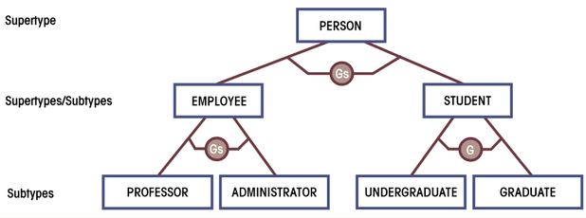
Generalization Hierarchy with Overlapping Subtypes

Slide 19
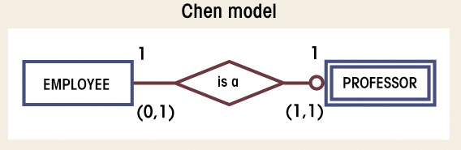
Supertype/Subtype Relationship in ERD

Slide 20
Developing an E-R Diagram
Iterative Process
  Step1: General narrative of organizational operations developed
  Step2: Basic E-R Model graphically depicted and reviewed
  Step3: Modifications made to incorporate newly discovered E-R components
Repeat process until designers and users agree E-R Diagram complete

Slide 21
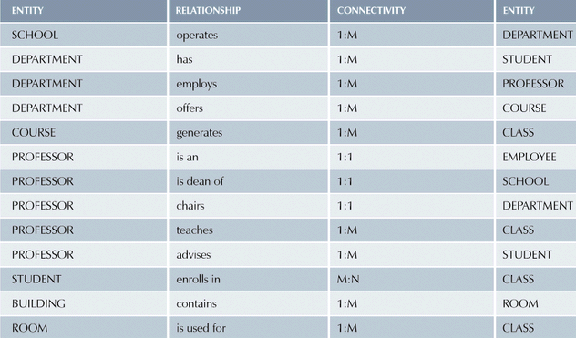
Components of E-R Model

Slide 22
Completed ERD
Do it yourself as a HW to submit.

Slide 23
Entity Relationship Database Model
Advantages
  Exceptional conceptual simplicity
  Visual representation
  Effective communication tool
  Integrated with the relational database model
Disadvantages
  Limited constraint representation
  Limited relationship representation
  No data manipulation language
  Loss of information content (only intensional)

Slide 24
Challenge of Database Design: Conflicting Goals
Database must be designed to conform to design standards
High-speed processing may require design compromises
Quest for timely information may be the focus of database design
Other concerns
  Security
  Performance
  Shared access
  Integrity

Slide 25
Object-Oriented Database Model
Objects or abstractions of real-world entities are stored
  Attributes describe properties
  Collection of similar objects is a class
    Methods represent real world actions of classes
    Classes are organized in a class hierarchy
  Inheritance is ability of object to inherit attributes and methods of classes above it

Slide 26
OO Data Model
Advantages
  Adds semantic content
  Visual presentation includes semantic content
  Database integrity
  Both structural and data independence
Disadvantages
  Lack of OODM
  Complex navigational data access
  Steep learning curve
  High system overhead slows transactions

Slide 27
Database Models and the Internet
Characteristics of “Internet age” databases
  Flexible, efficient, and secure Internet access
  Easily used, developed, and supported
  Supports complex data types and relationships
  Seamless interfaces with multiple data sources and structures
  Simplicity of conceptual database model
  Many database design, implementation, and application development tools
  Powerful DBMS GUI make DBA job easier

Slide 28
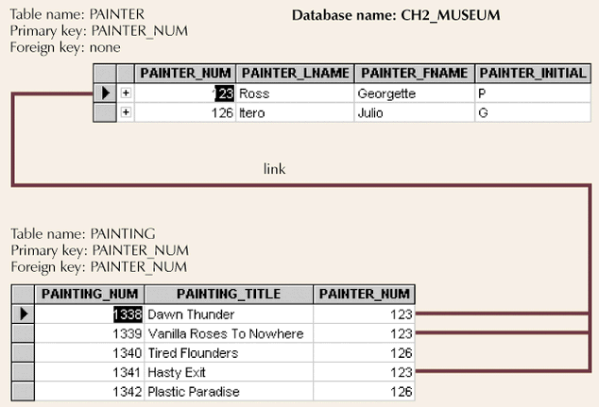
1:M Relationship

Slide 29
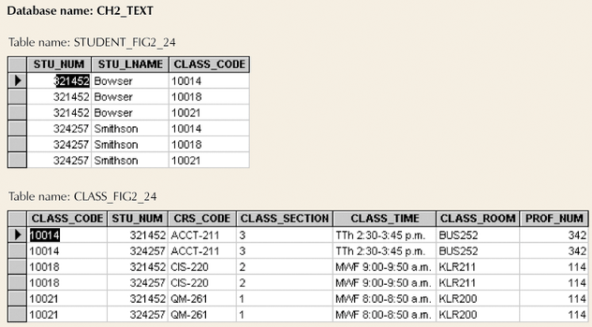
M:N Relationship

Slide 30
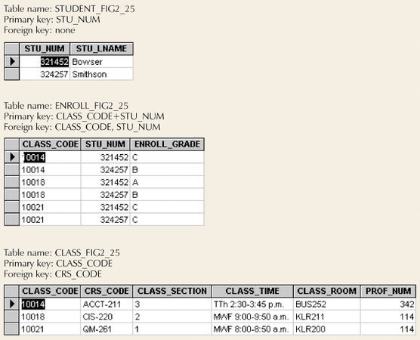
Converting M:N Relationship to Two 1:M Relationships

Slide 31
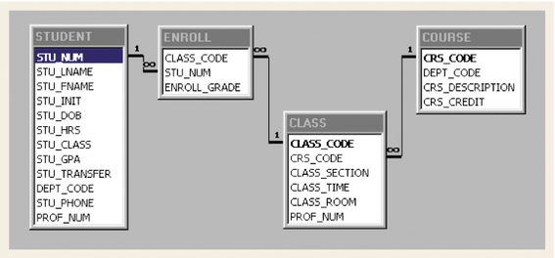
Converting M:N Relationship to Two 1:M Relationships (con’t.)

Slide 32
Data Redundancy Revisited
Foreign keys can reduce redundancy
Some redundancy is desirable
  Called controlled redundancy
  Speed
  Information requirements

Slide 33
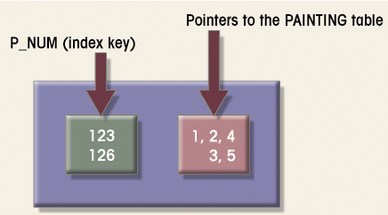
Indexes
Points to location
Makes retrieval of data faster

