Slide 1
Repetition
Keep on doing something until the condition is NO longer satisfied

Slide 2
Three types of repetition statements
while-statement
for-statement
do-while statement

Slide 3
while-statement
Initialization of variable used in condition;
As long as condition is satisfied, run statementToRepeat.
If there are more than one statement, put them inside a pair of { and }.
while (condition) //while-head
statementToRepeat; //while-body
Notes:
Do an illustration with

Slide 4
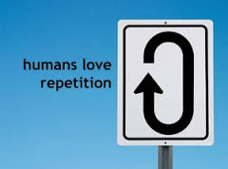
Illustration of while-statement
Initialization
while-statement
false
Condition
true
StatementToRepeat
Next statement

Slide 5
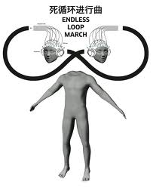
Warning: no ; right after condition unless you know what you do
int num = 1;
while (num <= 5) ;
{
cout << num << endl;
num++;
}
You are in big, big trouble.
The rest code is inaccessible.

Slide 6
Details for while-statement
What is the minimum number the statementToRepeat will run?
What is the maximum number the statementToRepeat will run?
What if the condition is always satisfied?
Common sense: the variable used in condition should be updated by statementToRepeat.

Slide 7
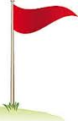

Keep on running until reaching a goal
In view of distance:
Where do we start? Mile mark 1
Where is our goal? Mile mark 5
How fast do we go in each step? Jump 1 mile
What do we do in each step? Leave a paw mark
start
goal

Slide 8




Keep on working until reaching a goal
In view of timeline:
When do we start? Freshman or Transfer junior?
What is our goal? Associate or Bachelor degree?
How fast do we go in each step? Take 9 or 18 credits a semester?
What do we do in each step? Take necessary courses or play?
start
goal

Slide 9
Repeat printing a sentence
//Round 1
cout << "There is no dumb questions" << endl;
//Round 2
cout << "There is no dumb questions" << endl;
…
//Round 5
cout << "There is no dumb questions" << endl;

Slide 10
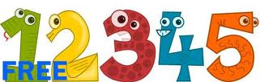
Repeat printing a sentence
cout << "There is no dumb questions" << endl;
cout << "There is no dumb questions" << endl;
cout << "There is no dumb questions" << endl;
cout << "There is no dumb questions" << endl;
cout << "There is no dumb questions" << endl;
counting

Slide 11
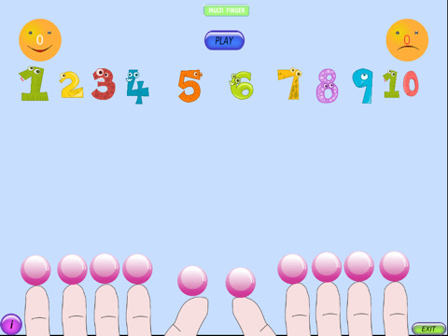

Repeat printing a sentence
cout << "There is no dumb questions" << endl;
cout << "There is no dumb questions" << endl;
cout << "There is no dumb questions" << endl;
cout << "There is no dumb questions" << endl;
cout << "There is no dumb questions" << endl;
Notes:
Teachwithyouripad has the above figures.
http://t0.gstatic.com/images?q=tbn:ANd9GcQ-MXfX9hAPq07BrMubeeQ-P4s-s3JZjtaoqm3cgGbGwuo_mH7D

Slide 12
Repeat printing a sentence
int count = ;
cout << "There is no dumb questions" << endl;
count = ;
cout << "There is no dumb questions" << endl;
count = ;
cout << "There is no dumb questions" << endl;
count = ;
cout << "There is no dumb questions" << endl;
count = ;
cout << "There is no dumb questions" << endl;
Notes:
Teachwithyouripad has the above figures.
http://t0.gstatic.com/images?q=tbn:ANd9GcQ-MXfX9hAPq07BrMubeeQ-P4s-s3JZjtaoqm3cgGbGwuo_mH7D

Slide 13
Repeat printing a sentence
int count = 1; //count is the label of next statement to write
Is count <= 5? Yes.
cout << "There is no dumb questions" << endl;
count++; //count = 2; prepare for the next round
Is count <= 5? Yes.
cout << "There is no dumb questions" << endl;
count++; //count = 3; prepare for the next round
Notes:
Teachwithyouripad has the above figures.
http://t0.gstatic.com/images?q=tbn:ANd9GcQ-MXfX9hAPq07BrMubeeQ-P4s-s3JZjtaoqm3cgGbGwuo_mH7D

Slide 14
Repeat printing a sentence: II
Is count <= 5? Yes.
cout << "There is no dumb questions" << endl;
count++; //count = 4; prepare for the next round
Is count <= 5? Yes.
cout << "There is no dumb questions" << endl;
count++; //count = 5; prepare for the next round
Notes:
Teachwithyouripad has the above figures.
http://t0.gstatic.com/images?q=tbn:ANd9GcQ-MXfX9hAPq07BrMubeeQ-P4s-s3JZjtaoqm3cgGbGwuo_mH7D

Slide 15
Repeat printing a sentence: III
Is count <= 5? Yes.
cout << "There is no dumb questions" << endl;
count++; //count = 6; prepare for the next round
Is count <= 5? No.
Stop the while loop.
Notes:
Teachwithyouripad has the above figures.
http://t0.gstatic.com/images?q=tbn:ANd9GcQ-MXfX9hAPq07BrMubeeQ-P4s-s3JZjtaoqm3cgGbGwuo_mH7D

Slide 16
Repeat printing a sentence 5 times
int count = 1;
while-statement
false
count <= 5?
true
Print out the sentence;
count++;
Count is the label of next statement to print.
Once the above while loop is finished, what is the value of count?
Next statement

Slide 17
Repeat printing a sentence 5 times: II
int count = 0;
while-statement
false
count < 5?
true
Print out the sentence;
count++;
Count is the number of statements printed.
Once the above while loop is finished, what is the value of count?
Next statement

Slide 18
Repeat printing a sentence
Where do we start?
Where do we stop?
How fast do we move from one step to the next?
What do we do in each step?
Hint: each step can be a mark for time (1st, 2nd hour, …) or distance (1st, 2nd mile, …)
Illustrate step-to-step in Eclipse.

Slide 19
Repeat something for 5 times
int counter = 0;
while (counter < 5)
{
counter++;
}
Warning: can be as simple as a print-statement, but maybe complicated also!
When counter starts at 0, the condition to continue is (counter < 5).
When counter starts at 1, the condition to continue is (counter <= 5).
This is called “shift by 1”
that something
that something

Slide 20
Print out numbers 1--100
1
2
3
…
100
Where to start?
Where to end?
What to do in each step?
What is the gap between adjacent steps?

Slide 21
Print out odd numbers in [1, 100]
1
3
5
…
99
Where to start?
Where to end?
What to do in each step?
What is the gap between adjacent steps?

Slide 22
Question: print odd #s in 1--100
Start from the minimum odd number: 1
while ( the number is less than or equal to 100 )
begin
Check whether the number is odd (one divided by 2 and the remainder is 1), if so, print it out; otherwise, do nothing.
Move to the next adjacent number
end
print
print
print

Slide 23
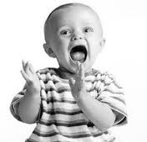
A joke: count from 1 to 10000
A kid is asked to count from 1 to 10000.
Rational of the story: how to update variable is important.
Come back to our problem: print out all the odd numbers from 1 to 100.
1, 3, 5, 7, …, 99
1, 10, 100, 1000, 10000.

Slide 24
Question: print odd #s in 1--100
Where to start is also important. Can we start at 2 for this problem?
Start from the minimum odd number: 1
while ( the number is less than or equal to 100 )
begin
Print out the number
Move to the next two number
end

Slide 25
Print out even numbers in [1, 100]
2
4
6
…
100
Where to start?
Where to end?
What to do in each step?
What is the gap between adjacent steps?

Slide 26
for-statement
❶
❷
❹
for (initialization; condition; update-loop-variable) {
statement-to-repeat;
}
statement-after-loop;
❸
initialization
condition
no
❺
true
statement-to-repeat
statement-after-loop
update-loop-variable
Notes:
Students may ask what if there is more than one loop variable?
int numPreSpaces = 0;

Slide 27
for-statement example
Q: Do something for 100 times
int i = 0;
while ( i < 100 )
{
do something;
i++;
}
for (int i = 0; i < 100; i++)
do something;

Slide 28
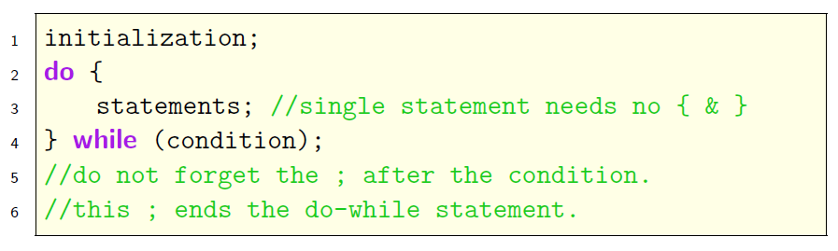
do-while statement
Structure
Purpose: run statements as long as condition holds.

Slide 29
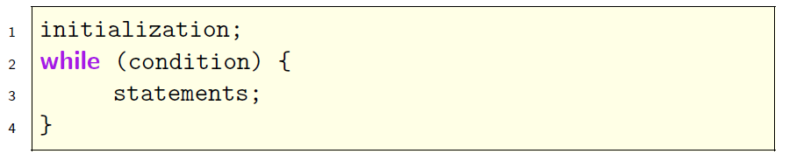
do-while vs. while statement
do-while statement (first time free)
while statement (check condition first)

Slide 30
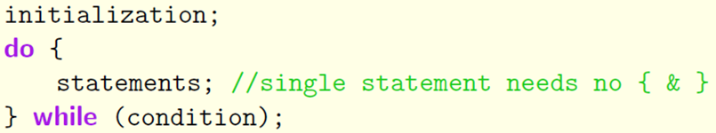
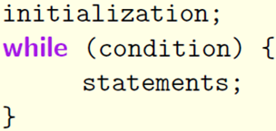
do-while vs. while statement: II
Do while statement: the statements needed to run at least once (can be many times)
While statement: the statements may run zero, one or many times.

Slide 31
Summary
Initialization states when/where to start.
Condition in while head implies when/where to stop.
For example, while (counter < 5) means to continue until counter >= 5.
Update the variable used in condition inside while-body. It tells how fast we move towards the goal.
Statements need to repeated are put inside while-body.

Slide 32
for- and do-while statement
for-statement is a succinct way to write while-statement, which puts initialization into for-head.
for-statement is used in case when number of repetitions can be represented by an int.
while- and for-statement do entry check, the repetition body may not run at all.
do-while statement does exit check, its repetition body will run at least once.

