Slide 1
Introduction to if and if-else statements

Slide 2
A story
Ann: If you have $1000, will you please give me a half?
Bob: Of course.
Ann: If you have $100, will you please give me a half?
Bob: Sure.
Ann: If you have $10, will you please give me a half?
Bob: No way!
Ann: Why?
Bob: I do not have $100 or more, but I do have $10.

Slide 3
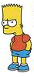

find the max’m int
Given two integers, say i and j, respectively,
find out which one is bigger.
i > j?
j > i?
i == j?
i
j

Slide 4

Who will win the competition?
Suppose we have runners: Alice and Bob. Who may win the competition?

Slide 5
If-statement
Who finishes first: Alice or Bob? The result depends on the runners’ status.
(1) Possibility 1: Alice runs faster than Bob.
(2) Possibility 2: Bob runs faster than Alice.
(3) Possibility 3: There is a tie.
For results with uncertainty, we use if-statement.

Slide 6
if-statement
If the condition holds, then execute the statement.
If the condition does not hold, then do nothing.
Three parts of if-statement:
Keyword if
condition enclosed in ()
statement-to-run-when-condition-is-true
if (condition)
statement-run-only-if-condition-is-true;
Notes:
//Warning: do not use green color in the slides other than comments,
//students may be confused.
Scanner inp = new Scanner(System.in);
i = inp.nextInt();

Slide 7
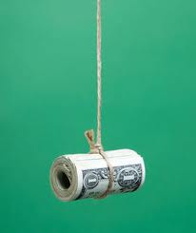
if-statement
If the condition holds, then execute the statement.
If the condition does not hold, then do nothing.
statement-to-run-when-condition-is-true may or may not be executed, depending on whether the condition is satisfied or not.
if (condition)
statement-run-only-if-condition-is-true;
Notes:
Scanner inp = new Scanner(System.in);
i = inp.nextInt();

Slide 8
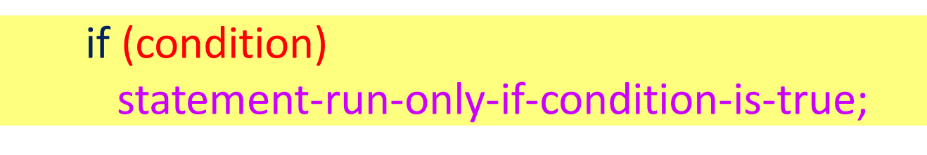
if-statement
condition
false
true
statement-run-only-if-condition-is-true

Slide 9
Condition
Simplest form: compare between two items
== (equal)
!= (not equal)
>
<
>=
<=

Slide 10
Comparison: equality
if (expression1 == expression2)
cout << “The expressions are equal.”;
Warning:
expression1 == expression2 compares whether the two expressions have the same value, if yes, then the comparison returns true, otherwise, the comparison returns false.
Neither expression1 nor expression2 is changed.

Slide 11
Compare two expressions
if (5*5 == 6*5)
cout << "5 * 5 == 6 * 5" << endl;
== (equality comparison) vs. = (assignment)
5*5 == 6*5; //invalid syntax: 5*5 == 6*5 is an expression, not an independent statement.
5*5 = 6*5; // = is assignment operator
// invalid syntax: the left-hand side of an assignment expression
//must be a variable name.

Slide 12
Compare two expressions
(1) (6*5 == 6*5) returns true;
(2) 6*5 = 6*5; is wrong in syntax: the left-hand side of an assignment expression must be a variable name.
(3) int j = 5;
cout << (j == 5) << endl;
//print out 1 (true).
cout << (j = 6) << endl;
//() cannot be omitted. Print out 6.

Slide 13
Warning: if-statement ends with ;
An if-statement has three parts:
if
condition enclosed in parentheses ()
statement-to-run-only-if-condition-is-true
An if-statement ends with a semicolon ;
semicolon ; follows statement-to-run-only-if-condition-is-true.
Notes:
Scanner inp = new Scanner(System.in);
i = inp.nextInt();

Slide 14
Warning, warning: If-statement
So …
(1) A ; follows an if-statement.
(2) indent statement-to-run-only-if-condition-is-true with if (condition) part.
if (condition)
statement-to-run-only-if-condition-is-true;
Here ; end the whole if-statement.
Notes:
Scanner inp = new Scanner(System.in);
i = inp.nextInt();

Slide 15
Warning, warning: If-statement
What is the output?
(3’) if (the sun rises from the west) ;
cout <<
“You will give me one million.”;
The above code are in fact TWO statements:
(3’’) if (the sun rises from the west)
;
cout << “You will give me one million.”;
Notes:
Scanner inp = new Scanner(System.in);
i = inp.nextInt();

Slide 16
if-else statement
If the condition holds, then execute the statement-run-only-if-condition-is-true
If the condition does not hold, then do nothing.
Execute statement-run-only-if-condition-is-false
if (condition)
statement-run-only-if-condition-is-true;
else statement-run-only-if-condition-is-false;

Slide 17
Flow chart of if-else statement
if (condition)
statement-run-only-if-condition-is-true;
else statement-run-only-if-condition-is-false;
condition
false
true
statement-run-only-if-condition-is-true
statement-run-only-if-condition-is-false

Slide 18
Summary
if or if-else statement can answer questions like yes or no.
Is this a number a multiple of 3 or not?
Do not put ; right after condition unless you are absolutely sure. Otherwise, an empty statement ; runs when the condition is satisfied. This means that the statement followed ; is run whether the condition holds or not.

