Slide 1

Chapter Three: Decisions

Slide 2
Chapter Goals
To be able to implement decisions using if statements
To learn how to compare integers, floating-point numbers, and strings
To understand the Boolean data type
To develop strategies for validating user input
Big C++ by Cay Horstmann
Copyright © 2018 by John Wiley & Sons. All rights reserved

Slide 3
Topic 1
The if statement
Comparing numbers and strings
Multiple alternatives
Nested branches
Problem solving: flowcharts
Problem solving: test cases
Boolean variables and operators
Application: input validation
Chapter summary

Slide 4
The if Statement
The if statement is used to implement a decision.
When a condition is fulfilled, one set of statements is executed.
Otherwise, another set of statements is executed.
Like a fork in the road
Big C++ by Cay Horstmann
Copyright © 2018 by John Wiley & Sons. All rights reserved

Slide 5
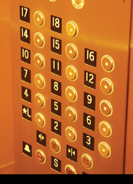
The if Statement: Elevator Example
We must write the code to control the elevator.
How can we skip the 13th floor?
Big C++ by Cay Horstmann
Copyright © 2018 by John Wiley & Sons. All rights reserved

Slide 6
if() Elevator Example Code
If the user inputs 20, the program must set the actual floor to 19.
Otherwise, we simply use the supplied floor number.
We need to decrement the input only under a certain condition:
cin >> floor;
int actual_floor;
if (floor > 13) //never put a semicolon after the parentheses!!
{
actual_floor = floor - 1; //
}
else
{
actual_floor = floor;
}
Big C++ by Cay Horstmann
Copyright © 2018 by John Wiley & Sons. All rights reserved

Slide 7
Syntax of the if() Statement
if (condition)//never put a semicolon after the parentheses!!
{
statement1; //executed if condition is true
}
else //the else part is optional
{
statement2; //executed if condition false
} //braces are optional but recommended

Slide 8
The if Statement, Example without an else
Here is another way to write this code:
We only need to decrement when the floor is greater than 13.
We can set actual_floor before testing:
int actual_floor = floor;
if (floor > 13)
{
actual_floor--;
} // No else needed
(And you’ll notice we used the decrement operator this time.)
Big C++ by Cay Horstmann
Copyright © 2018 by John Wiley & Sons. All rights reserved

Slide 9
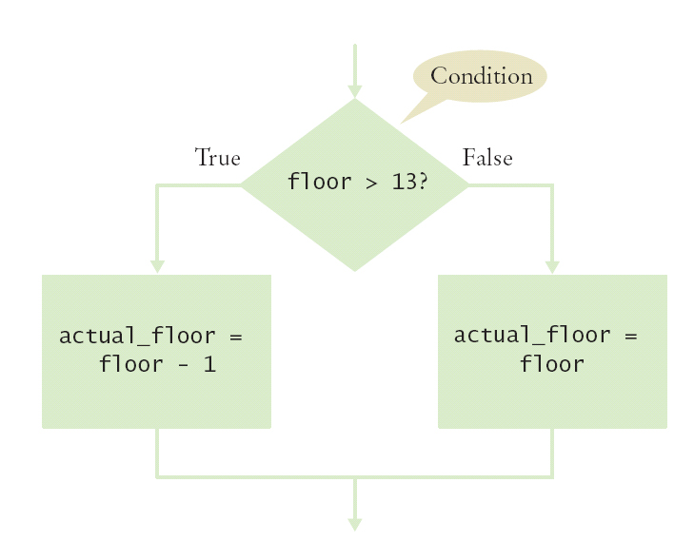
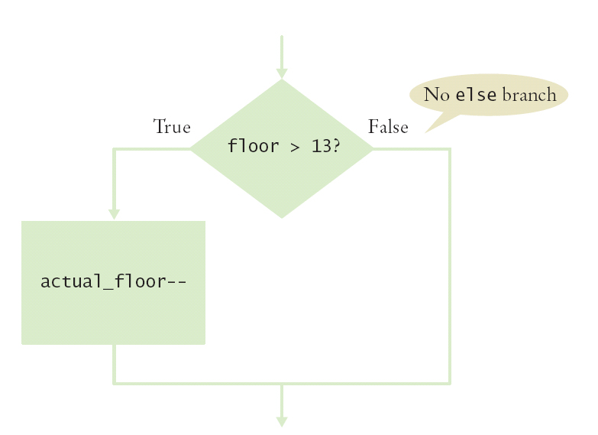
The if Statement Flowcharts
With else Without else
Big C++ by Cay Horstmann
Copyright © 2018 by John Wiley & Sons. All rights reserved

Slide 10
The if Statement – A Complete Elevator Program
#include <iostream>
using namespace std;
int main()
{
int floor;
cout << "Floor: ";
cin >> floor;
int actual_floor;
if (floor > 13)
{
actual_floor = floor - 1;
}
else
{
actual_floor = floor;
}
cout << "The elevator will travel to the actual floor "
<< actual_floor << endl;
return 0;
}
ch03/elevator1.cpp
Big C++ by Cay Horstmann
Copyright © 2018 by John Wiley & Sons. All rights reserved

Slide 11
The if Statement – Brace Layout
Making your code easy to read is good practice.
Lining up braces vertically helps.
if (floor > 13)
{
floor--;
}
Big C++ by Cay Horstmann
Copyright © 2018 by John Wiley & Sons. All rights reserved

Slide 12
The if Statement – Brace Layout, continued
As long as the ending brace clearly shows what it is closing, there is no confusion.
if (floor > 13) {
floor--;
}
Some programmers prefer this style—it saves a physical line in the code.
Big C++ by Cay Horstmann
Copyright © 2018 by John Wiley & Sons. All rights reserved

Slide 13
The if Statement – Always Use Braces
When the body of an if statement consists of a single statement, you need not use braces:
if (floor > 13)
floor--;
However, it is a good idea to always include the braces:
the braces makes your code easier to read, and
you are less likely to make errors such as …
Big C++ by Cay Horstmann
Copyright © 2018 by John Wiley & Sons. All rights reserved

Slide 14
The if Statement – Common Error – The Do-nothing Statement
if (floor > 13) ; // ERROR ?
{
floor--;
}
This is not a compiler error.
The compiler does not complain.
It interprets this if statement as follows:
If floor is greater than 13, execute the do-nothing statement. (semicolon by itself is the do nothing statement)
Then execute the code enclosed in the braces.
Any statements enclosed in the braces are no longer a part of the if statement.
Big C++ by Cay Horstmann
Copyright © 2018 by John Wiley & Sons. All rights reserved

Slide 15
The if Statement – Indent when Nesting
Block-structured code has the property that nested statements are indented by one or more levels.
int main()
{
int floor;
...
if (floor > 13)
{
floor--;
}
...
return 0;
}
0 1 2
Indentation level
Big C++ by Cay Horstmann
Copyright © 2018 by John Wiley & Sons. All rights reserved

Slide 16
Indent when Nesting
Using the tab key is a way to get this indentation
but …
not all tabs are the same width!
Luckily most development environments have settings to automatically convert all tabs to spaces.
The IDE may also automatically indent your nested statements.
Big C++ by Cay Horstmann
Copyright © 2018 by John Wiley & Sons. All rights reserved

Slide 17
?: The Conditional Operator
C++ has the conditional operator of the form
condition ? value1 : value2
The value of that expression is either value1 if the test passes or value2 if it fails.
Big C++ by Cay Horstmann
Copyright © 2018 by John Wiley & Sons. All rights reserved

Slide 18
The Conditional Operator vs. an if()
For example, we can compute the actual floor number as
actual_floor = floor > 13 ? floor - 1 : floor;
which is equivalent to
if (floor > 13)
{
actual_floor = floor - 1;
}
else
{
actual_floor = floor;
}
Big C++ by Cay Horstmann
Copyright © 2018 by John Wiley & Sons. All rights reserved

Slide 19
The if Statement – Removing Duplication
if (floor > 13)
{
actual_floor = floor - 1;
cout << "Actual floor: " << actual_floor << endl;
}
else
{
actual_floor = floor;
cout << "Actual floor: " << actual_floor << endl;
}
Do you find anything redundant in this code?
Big C++ by Cay Horstmann
Copyright © 2018 by John Wiley & Sons. All rights reserved

Slide 20
The if Statement – Duplication Removed
if (floor > 13)
{
actual_floor = floor - 1;
}
else
{
actual_floor = floor;
}
cout << "Actual floor: " << actual_floor << endl;
You can remove the duplication by moving the two identical cout statements outside of and after the braces, and of course deleting one of the two.
Big C++ by Cay Horstmann
Copyright © 2018 by John Wiley & Sons. All rights reserved

