Slide 1
Topic 3
The if statement
Comparing numbers and strings
Multiple alternatives
Nested branches
Problem solving: flowcharts
Problem solving: test cases
Boolean variables and operators
Application: input validation
Chapter summary

Slide 2
Multiple Alternatives Need Multiple Nested if() Statements
Table 3 Richter Scale
Value | Effect
8 | Most structures fall
7 | Many buildings destroyed
6 | Many buildings considerably damaged, some collapse
4.5 | Damage to poorly constructed buildings
In the case of the Richter Scale for earthquake magnitude, there are five branches:
one each for the four descriptions of damage, and a "default" fifth one for no destruction (not shown).
Big C++ by Cay Horstmann
Copyright © 2018 by John Wiley & Sons. All rights reserved

Slide 3
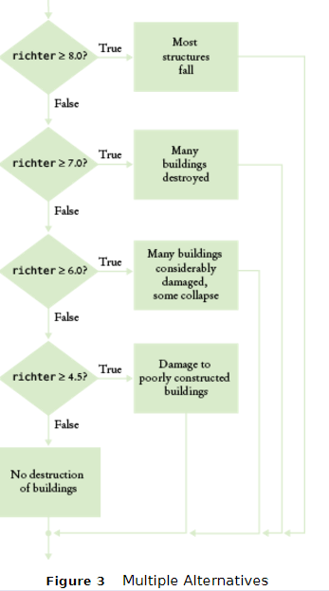
Flowchart for the Richter Scale Code

Slide 4
Multiple Alternatives (Richter Scale Code)
if (richter >= 8.0)
{
cout << "Most structures fall";
}
else if (richter >= 7.0)
{
cout << "Many buildings destroyed";
}
else if (richter >= 6.0)
{
cout << "Many buildings considerably damaged, some collapse";
}
else if (richter >= 4.5)
{
cout << "Damage to poorly constructed buildings";
}
else
{
cout << "No destruction of buildings";
}
. . .
Big C++ by Cay Horstmann
Copyright © 2018 by John Wiley & Sons. All rights reserved

Slide 5
Multiple Alternatives – Order of Tests
Because of this execution order, when using multiple if statements, pay attention to the order of the conditions.
Big C++ by Cay Horstmann
Copyright © 2018 by John Wiley & Sons. All rights reserved

Slide 6
Multiple Alternatives – Wrong Order of Tests
if (richter >= 4.5) // Tests in wrong order
{
cout << "Damage to poorly constructed buildings";
}
else if (richter >= 6.0)
{
cout << "Many buildings considerably damaged, some collapse";
}
else if (richter >= 7.0)
{
cout << "Many buildings destroyed";
}
else if (richter >= 8.0)
{
cout << "Most structures fall";
}
Suppose the value of richter is 7.1. Because we tested small first with a >=, the first statement is (wrongly) printed.
Big C++ by Cay Horstmann
Copyright © 2018 by John Wiley & Sons. All rights reserved

Slide 7
The switch Statement vs. the if statement
Below is a complicated if() statement to choose a text string to assign based on the value of an int variable:
int digit;
… //digit variable gets set here by some code
if (digit == 1) { digit_name = "one"; }
else if (digit == 2) { digit_name = "two"; }
else if (digit == 3) { digit_name = "three"; }
else if (digit == 4) { digit_name = "four"; }
else if (digit == 5) { digit_name = "five"; }
else if (digit == 6) { digit_name = "six"; }
else if (digit == 7) { digit_name = "seven"; }
else if (digit == 8) { digit_name = "eight"; }
else if (digit == 9) { digit_name = "nine"; }
else { digit_name = ""; }
Big C++ by Cay Horstmann
Copyright © 2018 by John Wiley & Sons. All rights reserved

Slide 8
The switch Statement
The switch statement is an alternative to nested if() else statements. But switch is at least as awkward to code as nested if() else:
int digit; //switch can only test int and char types
… //digit variable gets set here by some code
switch(digit)
{
case 1: digit_name = "one"; break;
case 2: digit_name = "two"; break;
case 3: digit_name = "three"; break;
case 4: digit_name = "four"; break;
case 5: digit_name = "five"; break;
case 6: digit_name = "six"; break;
case 7: digit_name = "seven"; break;
case 8: digit_name = "eight"; break;
case 9: digit_name = "nine"; break;
default: digit_name = ""; break; //taken if none of the above
}
Big C++ by Cay Horstmann
Copyright © 2018 by John Wiley & Sons. All rights reserved

Slide 9
break statements in the switch statement
Every branch of the switch must be terminated by a break statement. And each branch must terminate with a semicolon.
break tells the machine to skip down to the end of the switch statement, because a match was found.
If the break is missing, execution falls through to the next branch, and so on, until finally a break or the end of the switch is reached.
In practice, this fall-through behavior is rarely useful, and
it is a common cause of errors.
If you accidentally forget the break statement, your program compiles but executes unwanted code. Try it and see!
Big C++ by Cay Horstmann
Copyright © 2018 by John Wiley & Sons. All rights reserved

Slide 10
Topic 4
The if statement
Comparing numbers and strings
Multiple alternatives
Nested branches
Problem solving: flowcharts
Problem solving: test cases
Boolean variables and operators
Application: input validation
Chapter summary

Slide 11
Nested Branches – Taxes
In the United States different tax rates are used depending on the taxpayer’s marital status – single rates are higher.
Married taxpayers add their income together and pay taxes on the total. See the IRS table below from a recent year:
Table 4 Federal Tax Rate Schedule
If your status is Single and if the taxable income is | the tax is | of the amount over
at most $32,000 | 10% | $0
over $32,000 | $3,200 + 25% | $32,000
If your status is Married and if the taxable income is | the tax is | of the amount over
at most $64,000 | 10% | $0
over $64,000 | $6,400 + 25% | $64,000
Big C++ by Cay Horstmann
Copyright © 2018 by John Wiley & Sons. All rights reserved

Slide 12
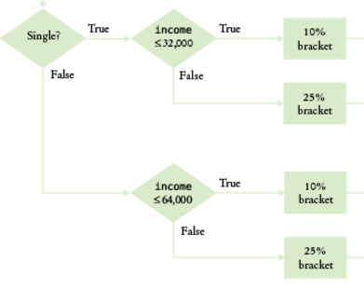
Flowchart for Tax Table Decisions

Slide 13
Nested Branches – Taxes – Complete Code part 1
#include <iostream>
#include <string>
using namespace std;
int main()
{
const double RATE1 = 0.10;
const double RATE2 = 0.25;
const double RATE1_SINGLE_LIMIT = 32000;
const double RATE1_MARRIED_LIMIT = 64000;
double tax1 = 0;
double tax2 = 0;
double income;
cout << "Please enter your income: ";
cin >> income;
cout << "Please enter s for single, m for married: ";
string marital_status;
cin >> marital_status;
Big C++ by Cay Horstmann
Copyright © 2018 by John Wiley & Sons. All rights reserved

Slide 14
Nested Branches – Taxes (Code part 2)
if (marital_status == "s")
{
if (income <= RATE1_SINGLE_LIMIT)
{
tax1 = RATE1 * income;
}
else
{
tax1 = RATE1 * RATE1_SINGLE_LIMIT;
tax2 = RATE2 * (income - RATE1_SINGLE_LIMIT);
}
}
else
Big C++ by Cay Horstmann
Copyright © 2018 by John Wiley & Sons. All rights reserved

Slide 15
Nested Branches – Taxes (Code part 3)
{
if (income <= RATE1_MARRIED_LIMIT)
{
tax1 = RATE1 * income;
}
else
{
tax1 = RATE1 * RATE1_MARRIED_LIMIT;
tax2 = RATE2 * (income - RATE1_MARRIED_LIMIT);
}
}
double total_tax = tax1 + tax2;
cout << "The tax is $" << total_tax << endl;
return 0;
}
Big C++ by Cay Horstmann
Copyright © 2018 by John Wiley & Sons. All rights reserved

Slide 16
Hand-Tracing
A very useful technique for understanding whether a program works correctly is called hand-tracing.
You simulate the program’s activity on a sheet of paper.
You can use this method with pseudocode or C++ code.
Big C++ by Cay Horstmann
Copyright © 2018 by John Wiley & Sons. All rights reserved

Slide 17
Hand-Tracing, How to
Looking at your pseudocode or C++ code,
Use a marker, such as a paper clip, (or toothpick from an olive) to mark the current statement.
“Execute” the statements one at a time.
Every time the value of a variable changes, cross out the old value, and write the new value below the old one.
Big C++ by Cay Horstmann
Copyright © 2018 by John Wiley & Sons. All rights reserved

Slide 18
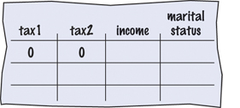
Hand-Tracing the Tax Program
int main()
{
const double RATE1 = 0.10;
const double RATE2 = 0.25;
const double RATE1_SINGLE_LIMIT = 32000;
const double RATE1_MARRIED_LIMIT = 64000;
double tax1 = 0;
double tax2 = 0;
Big C++ by Cay Horstmann
Copyright © 2018 by John Wiley & Sons. All rights reserved

Slide 19
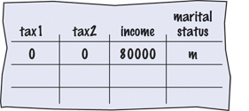
Hand-Tracing, Filling in the Trace Table
double income;
cout << "Please enter your income: ";
cin >> income;
Assume user typed 80000.
cout << "Please enter s for single, m for married: ";
string marital_status;
cin >> marital_status;
The user typed m
Big C++ by Cay Horstmann
Copyright © 2018 by John Wiley & Sons. All rights reserved

Slide 20
Hand-Tracing #2
if (marital_status == "s")
{
if (income <= RATE1_SINGLE_LIMIT)
{
tax1 = RATE1 * income;
}
else
{
tax1 = RATE1 * RATE1_SINGLE_LIMIT;
tax2 = RATE2 * (income - RATE1_SINGLE_LIMIT);
}
}
else //this branch is taken because marital_status != "s"
Big C++ by Cay Horstmann
Copyright © 2018 by John Wiley & Sons. All rights reserved

Slide 21
Hand-Tracing #3
else
{
if (income <= RATE1_MARRIED_LIMIT)
{
tax1 = RATE1 * income;
}
else
{
tax1 = RATE1 * RATE1_MARRIED_LIMIT;
tax2 = RATE2 * (income - RATE1_MARRIED_LIMIT);
}
}
double total_tax = tax1 + tax2;
Big C++ by Cay Horstmann
Copyright © 2018 by John Wiley & Sons. All rights reserved

Slide 22
Hand-Tracing #4
else
{
if (income <= 64000) //this branch is skipped, false
{
tax1 = RATE1 * income;
}
else //this branch is taken
{
tax1 = RATE1 * RATE1_MARRIED_LIMIT;
tax2 = RATE2 * (income - RATE1_MARRIED_LIMIT);
}
}
double total_tax = tax1 + tax2;
Big C++ by Cay Horstmann
Copyright © 2018 by John Wiley & Sons. All rights reserved

Slide 23
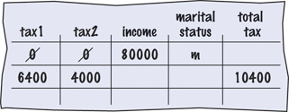
Hand-Tracing #5
else
{
if (income <= RATE1_MARRIED_LIMIT)
{
tax1 = RATE1 * income;
}
else //executed
{
tax1 = RATE1 * RATE1_MARRIED_LIMIT;
tax2 = RATE2 * (income - RATE1_MARRIED_LIMIT);
}
}
double total_tax = tax1 + tax2; //always executed
Big C++ by Cay Horstmann
Copyright © 2018 by John Wiley & Sons. All rights reserved

