Slide 1

Chapter Four: Loops

Slide 2
Chapter Goals
To implement while, for and do…while loops
To avoid infinite loops and off-by-one errors
To understand nested loops
To implement programs that read and process data sets
To use a computer for simulations

Slide 3
Topic 1
The while loop
Problem solving: hand-tracing
The for loop
The do loop
Processing input
Problem solving: storyboards
Common loop algorithms
Nested loops
Problem solving: solve a simpler problem first
Random numbers and simulations
Chapter summary

Slide 4
What Is the Purpose of a Loop?
A loop is a statement that is used to:
execute one or more statements repeatedly until a goal is reached.
Sometimes these statements will not be executed at all
—if that’s the way to reach the goal

Slide 5
The Three Loops in C++
C++ has three looping statements:
while()
for()
do {} while()

Slide 6
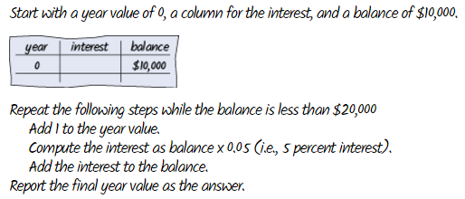
The while Loop
Chapter 1 had an example of an algorithm needing a loop
"repeat … while the balance is less…"

Slide 7
The while Loop template
while (condition) {
statements
}
The condition is some kind of test (just like the if statement)
The statements are repeatedly executed until the condition is false

Slide 8
Using a Loop to Solve an Investment Problem
An investment problem:
Starting with $10,000, how many years until we have at least $20,000, at 5% interest?
The algorithm:
1. Start with a year value of 0 and a balance of $10,000.
2. Repeat the following steps while the balance is less than $20,000:
Add 1 to the year value.
Compute the interest by multiplying the balance value by 0.05 (5 percent interest) (will be a const, of course).
Add the interest to the balance.
3. Report the final year value as the answer.

Slide 9

The Complete Investment Program
#include <iostream>
using namespace std;
int main()
{
const double RATE = 5;
const double INITIAL_BALANCE = 10000;
const double TARGET = 2 * INITIAL_BALANCE;
double balance = INITIAL_BALANCE;
int year = 0;
while (balance < TARGET)
{
year++;
double interest = balance * RATE / 100;
balance = balance + interest;
}
cout << "The investment doubled after "
<< year << " years." << endl;
return 0;
}
sec01/doublinv.cpp

Slide 10
Program Run
before entering while's body |  | at the end of while's body
balance | year | interest | balance | year
10000.00 | 0 | 500.00 | 10500.00 | 1
10500.00 | 1 | 525.00 | 11025.00 | 2
11025.00 | 2 | 551.25 | 11576.25 | 3
11576.25 | 3 | 578.81 | 12155.06 | 4
12155.06 | 4 | 607.75 | 12762.82 | 5
12762.82 | 5 | 638.14 | 13400.96 | 6
13400.96 | 6 | 670.05 | 14071.00 | 7
14071.00 | 7 | 703.55 | 14774.55 | 8
14774.55 | 8 | 738.73 | 15513.28 | 9
15513.28 | 9 | 775.66 | 16288.95 | 10
16288.95 | 10 | 814.45 | 17103.39 | 11
17103.39 | 11 | 855.17 | 17958.56 | 12
17958.56 | 12 | 897.93 | 18856.49 | 13
18856.49 | 13 | 942.82 | 19799.32 | 14
19799.32 | 14 | 989.97 | 20789.28 | 15
20789.28 | 15 | while statement is over
…the values are updated for 15 iterations…
…until the balance is finally(!) over $20,000 and the while() test becomes false.

Slide 11
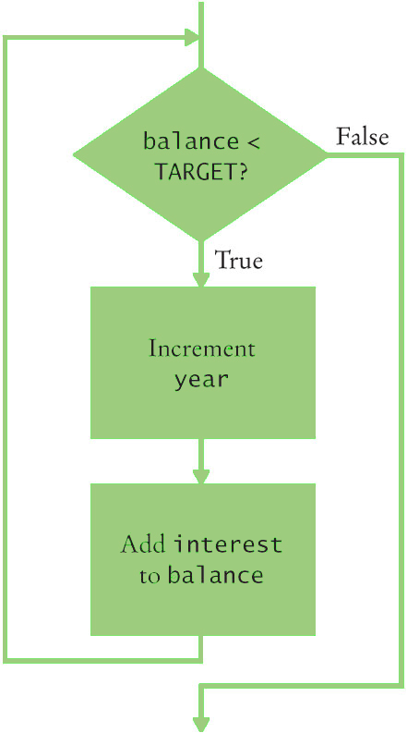
Flowchart of the Investment Calculation while Loop

Slide 12
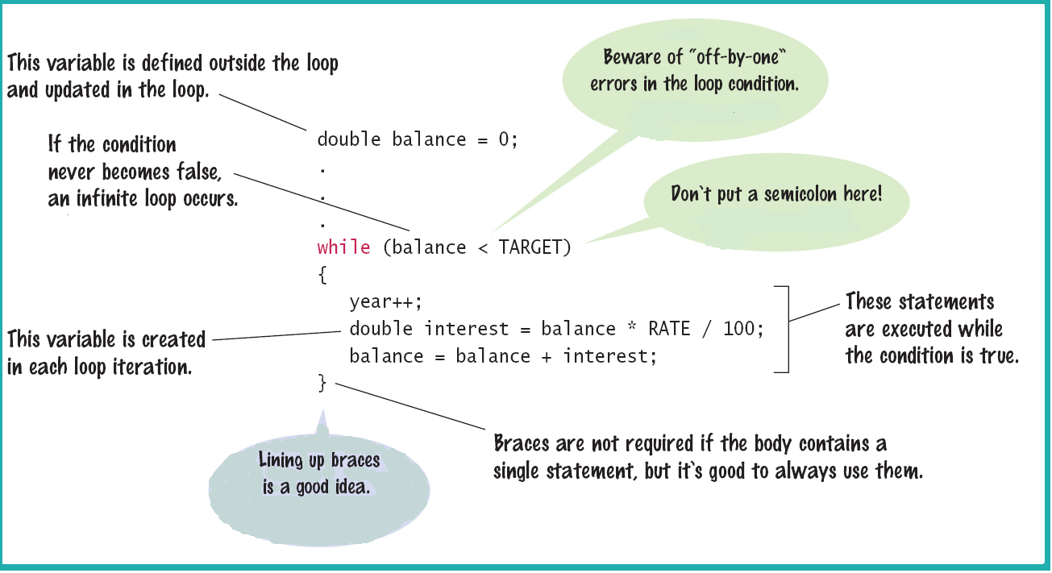
The while Statement

Slide 13
while Loop Examples: Table 1
Loop (all preceded by i=5; ) | Output | Explanation
while (i > 0) { cout << i << " "; i--; } | 5 4 3 2 1 | When i is 0, the loop condition is false, and the loop ends.
while (i > 0) { cout << i << " "; i++; } | 5 6 7 8 9 10 11 ... | The i++ statement is an error causing an “infinite loop” (see Common Error 4.1).
while (i > 5) { cout << i << " "; i--; } | (No output) | The statement i > 5 is false, and the loop is never executed.
while (i < 0) { cout << i << " "; i--; } | (No output) | The programmer probably thought, “Stop when i is less than 0”. However, the loop condition controls when the loop is executed, not when it ends (see Common Error 4.2).
while (i > 0); { cout << i << " "; i--; } | (No output, program does not terminate) | Note the semicolon before the {. This loop has an empty body. It runs forever, checking whether i > 0 and doing nothing in the body.

Slide 14
Example of Normal Execution
while loop to hand-trace
What is the output?
i = 5;
while (i > 0)
{
cout << i << " ";
i--;
}

Slide 15
Example of a Problem – An Infinite Loop
i is set to 5
The i++; statement makes i get bigger and bigger
the condition will never become false –
an infinite loop
i = 5;
while (i > 0)
{
cout << i << " ";
i++;
}
The output never ends
5 6 7 8 9 10 11…

Slide 16
Common Error – Infinite Loops
Forgetting to update the variable used in the condition is common.
In the investment program, it might look like this:
year = 1;
while (year <= 20)
{
balance = balance * (1 + RATE / 100);
}
The variable year is not updated in the body

Slide 17
Another Programmer Error
What is the output?
i = 5;
while (i < 0)
{
cout << i << " ";
i--;
}

Slide 18
A Very Difficult Error to Find (especially after looking for hours and hours!)
i = 5;
while (i > 0);
{
cout << i << " ";
i--;
}
What is the output?

Slide 19
Another infinite loop – caused by the semicolon after the parentheses.
The Answer: Difficult Error to Find
That semicolon causes the while loop to have an “empty body” which is executed forever.
The i in (i > 0) is never changed.
while loop
There is no output!
i = 5;
while (i > 0);
{
cout << i << " ";
i--;
}

Slide 20
Common Error – Off-by-One Errors
In the code to find when we have doubled our investment: Do we start the variable for the years at 0 or 1 years? Do we test for < TARGET
or for <= TARGET?

Slide 21
Off-by-One Errors
Maybe if you start trying some numbers and add +1 or -1 until you get the right answer you can figure these things out.
It will most likely take a very long time to try ALL the possibilities.
No, just try a couple of “test cases” (while thinking).

Slide 22
Think to Decide!
Consider starting with $100 and a RATE of 50%.
We want $200 (or more).
At the end of the first year, the balance is $150 – not done yet
At the end of the second year, the balance is $225 – definitely over TARGET and we are done.
We made two increments. What must the original value be so that we end up with 2?
Zero, of course.

Slide 23
Topic 2
The while loop
Problem solving: hand-tracing
The for loop
The do loop
Processing input
Problem solving: storyboards
Common loop algorithms
Nested loops
Problem solving: solve a simpler problem first
Random numbers and simulations
Chapter summary

Slide 24
Problem Solving: Hand-Tracing
Hand-tracing is a method of checking your work.
To do a hand-trace, write your variables on a sheet of
paper and mentally execute each step of your code…
writing down the values of the variables as they are changed in the code.
Cross out the old value and write down the new
value as they are changed – that way you can also
see the history of the values.

Slide 25

Hand-Tracing
To keep up with which statement is about to be executed
you should use a marker.
Preferably something that doesn’t obliterate the code:
Like a paper clip.

Slide 26
while() Loop Hand-Tracing Example
Consider this example. What value is displayed?
int n = 1729;
int sum = 0;
while (n > 0) {
int digit = n % 10;
sum = sum + digit;
n = n / 10;
}
cout << sum << endl;
There are three variables: n, sum, and digit.
So we make a table with a column for each variable, and fill in one iteration of the loop per row.
The first two variables are initialized with 1729 and 0 before the loop
n | sum | digit
1729 | 0

Slide 27
Hand-Tracing Example, continued #2
n | sum | digit
1729 | 0 | 9
 | 9
Because n is greater than zero, enter the loop.
The variable digit is set to 9 (the remainder of 1729 %10).
The variable sum is set to 0 + 9 = 9, in the 2nd row of the table.
When updating variable values, cross off the obsolete values, such as sum=0 above.

Slide 28
Hand-Tracing Example, continued #3
Keep filling in the table as you move the clip, cycling through the loop.
After the 4th time through the loop, n=0, so the loop is not entered again…
… and execution ends with the completion of the cout statement printing the final sum=19.
n | sum | digit
1729 | 0
172 | 9 | 9
17 | 11 | 2
1 | 18 | 7
0 | 19 | 1

Slide 29
Topic 3
The while loop
Problem solving: hand-tracing
The for loop
The do loop
Processing input
Problem solving: storyboards
Common loop algorithms
Nested loops
Problem solving: solve a simpler problem first
Random numbers and simulations
Chapter summary

Slide 30
The for Loop vs. the while loop
Often you will need to execute a sequence of statements a given number of times.
You could use a while loop:
counter = 1; // Initialize the counter
while (counter <= 10) // Check the counter
{
cout << counter << endl;
counter++; // Update the counter
}

Slide 31
The for Loop
C++ has a statement custom made for this sort of processing:
the for loop.
for (counter = 1; counter <= 10; counter++)
{
cout << counter << endl;
}

Slide 32
The for Loop Is Better than while for Certain Things
Doing something a known number of times or causing a variable to take on a sequence of values is so common, C++ has a statement just for that:
for (int count = 1; count <= 10; count++)
{
cout << count << endl;
}
initialization condition statements update

Slide 33
for() loop execution
for (initialization; condition; update)
{ statements; }
The initialization is code that happens once, before the check is made, to set up counting how many times the statements will happen. The loop variable may be created here, or before the for() statement.
The condition is a comparison to test if the loop is done. When this test is false, we skip out of the for(), going on to the next statement.
The update is code that is executed at the bottom of each iteration of the loop, immediate before re-testing the condition. Usually it is a counter increment or decrement.
The statements are repeatedly executed until the condition is false. These also are known as the "loop body".

Slide 34
Scope of the Loop Variable – Define it in the for or earlier?
The “loop variable” can be defined inside the for parentheses:
int strlen_error(string s) {
for(int i=0; s[i]!=0; i++);
return i; //syntax error: unknown identifier "i"
}
But then it cannot be used before or after the for statement – it only exists as part of the for statement and should not need to be used anywhere else in a program.
A for statement can use variables that were previously defined
(In an earlier example, counter was defined before the loop – so it could be accessed after the loop exited.)

Slide 35
The for Can Count Up or Down
A for loop can count down instead of up:
for (counter = 10; counter >= 0; counter--)…
The increment or decrement need not be in steps of 1:
for (cntr = 0; cntr <= 10; cntr +=2)…
Notice that in these examples, the loop variable is
defined in the initialization (where it really should be!).

Slide 36
for Loop Examples, Index Values: Table 2
Loop | Values of i | Comment
for (i = 0; i <= 5; i++) | 0 1 2 3 4 5 | Note that the loop is executed 6 times. (See Programming Tip 4.3)
for (i = 5; i >= 0; i--) | 5 4 3 2 1 0 | Use i-- for decreasing values.
for (i = 0; i < 9; i = i + 2) | 0 2 4 6 8 | Use i = i + 2 for a step size of 2.
for (i = 0; i != 9; i += 2) | 0 2 4 6 8 10 ... (infinite loop) | You can use < or <= instead of != to avoid this problem.
for (i = 1; i <= 20; i = i * 2) | 1 2 4 8 16 | You can specify any rule for modifying i, such as doubling it in every step.
for (i = 0; i < str.length(); i++) | 0 1 2 … until the last valid index of the string str | In the loop body, use the expression str.substr(i, 1)to get a string containing the ith character.

Slide 37
Solving a Problem with a for Statement
Earlier we determined the number of years it would take to (at least) double our balance.
Now let’s see the interest in action:
We want to print the balance of our savings account over a five-year period.
The “…over a five-year period” indicates that
a for loop should be used.
Because we know how many times the statements must be executed, we choose a for loop.

Slide 38
Solving a Problem with a for: Desired Output
The output should be a table with columns for year and balance, something like this:
Year | Balance
1 | 10500.00
2 | 11025.00
3 | 11576.25
4 | 12155.06
5 | 12762.82

Slide 39
The Modified Investment Program Using a for Loop
#include <iostream>
#include <iomanip>
using namespace std;
int main()
{
const double RATE = 5;
const double INITIAL_BALANCE = 10000;
double balance = INITIAL_BALANCE;
int nyears;
cout << "Enter number of years: ";
cin >> nyears;
cout << fixed << setprecision(2);
for (int year = 1; year <= nyears; year++)
{
balance = balance * (1 + RATE / 100);
cout << setw(4) << year << setw(10) << balance << endl;
}
return 0;
}
ch04/invtable.cpp

Slide 40
Infinite Loops Can Occur in for Statements
= = and != are best avoided in the check of a for statement
for loop
The output never ends
0 2 4 6 8 10 12…
for (int i = 0; i != 9; i += 2)
cout << i << " ";

Slide 41
Topic 4
The while loop
Problem solving: hand-tracing
The for loop
The do loop
Processing input
Problem solving: storyboards
Common loop algorithms
Nested loops
Problem solving: solve a simpler problem first
Random numbers and simulations
Chapter summary

Slide 42
The do{ } while() Loop
The while() loop’s condition test is the first thing that occurs in its execution.
The do loop (or do-while loop) has its condition tested only after at least one execution of the statements. The test is at the bottom of the loop:
do
{
statements
}
while (condition);

Slide 43
The do Loop
This means that the do loop should be used only when the statements must be executed before there is any knowledge of the condition.
This also means that the do loop is the least used loop.

Slide 44
do{ } Loop Code: getting user input Repeatedly
Code to keep asking a user for input until it satisfies a condition, such as non-negative for applying the sqrt():
double value;
do
{
cout << "Enter a number >= 0: ";
cin >> value;
}
while (value < 0);
cout << "The square root is " << sqrt(value) << endl;

Slide 45
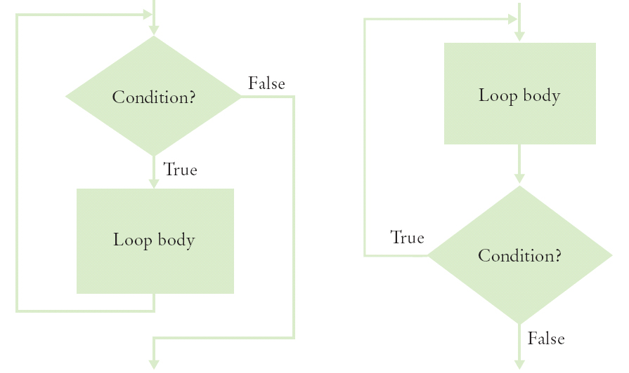
Flowcharts for the while Loop and the do Loop

Slide 46
Practice It: Example of do…while
What output does this loop generate?
int j = 1;
do
{
int value = j * 2;
j++;
cout << value << ", ";
} while (j <= 5);

Slide 47
Topic 5
The while loop
Problem solving: hand-tracing
The for loop
The do loop
Processing input
Problem solving: storyboards
Common loop algorithms
Nested loops
Problem solving: solve a simpler problem first
Random numbers and simulations
Chapter summary

Slide 48
Processing Input – When and/or How to Stop?
We need to know, when getting input from a user, when they are done.
One method is a sentinel (a value whose meaning is STOP!)
For example, when user is entering salary values, a negative number would indicate the end (since legitimate salaries cannot be negative)

Slide 49
Sentinel and a Salary Average Program (part 1)
#include <iostream>
using namespace std;
int main()
{
double sum = 0;
int count = 0;
double salary = 0;
// get all the inputs
cout << "Enter salaries, -1 to finish: ";
while (salary != -1)
{
cin >> salary;
if (salary != –1)
{
sum = sum + salary;
count++;
}
}
ch04/sentinel.cpp

Slide 50
The Salary Average Program (part 2)
// process and display the average
if (count > 0)
{
double average = sum / count;
cout << "Average salary: " << average << endl;
}
else
{
cout << "No data" << endl;
}
return 0;
}
A program run:
Enter salaries, -1 to finish: 10 10 40 -1
Average salary: 20

Slide 51
Using Failed Input for Processing
Sometimes it is easier to ask the user to “Hit Q to Quit” instead of requiring the input of a sentinel value.
In the previous chapter, we used cin.fail() to test if the most recent input failed.
Note that if you intend to take more input from the keyboard after using failed input to end a loop, you must reset the keyboard with cin.clear().
Use a bool variable to keep track of the status, and use cin.fail() to test for the input of a non-numeric when expecting a number:

Slide 52
Code Example: Testing cin.fail()
cout << "Enter values, Q to quit: ";
int value;
bool more = true;
while (more)
{
cin >> value;
if (cin.fail())
{
more = false;
}
else
{
// process value here
}
}
cin.clear(); // reset if more input needed

Slide 53
The Loop and a Half Problem
Those same programmers who dislike loops that are controlled by a bool variable have another reason: the actual test for loop termination is in the middle of the loop. Again it is not really a top or bottom test.
This is called a loop-and-a-half.

Slide 54
The Loop and a Half Problem and the break Statement
If we test for a failed read, we can stop the loop at that point:
while (true)
{
cin >> value;
if (cin.fail())
{ break; }
// process value here
}
cin.clear() // reset if more input is to be taken
The break statement breaks out of the enclosing loop, independent of the loop condition.

Slide 55
Using Failed Input in the Loop Test
Using a bool variable in this way is disliked by many programmers.
Why?
cin.fail is set when >> fails It is not really a top or bottom test. If only we could use the input itself to control the loop – we can!
An input >> operation that does not succeed returns false, so it can be used in the while’s test.

Slide 56
Failed Input Loop Control – No cin.fail() needed
To avoid the need for break and testing cin.fail, you can use the input statement as the condition of the while() loop:
cout << "Enter values, Q to quit: ";
while (cin >> value)
{
// process value here
}
cin.clear();

Slide 57
Redirection of Input and Output to Files
To avoid having to type all the input to your program every time you re-test it, you can save the input in a text file, and run your program with "input redirection" via the < sign, as:
myprogram < myinput.txt
This assumes you have compiled an ".exe" file from your code called myprogram.exe, and have typed the above in a command line window
Likewise, to store the output from your program, you can redirect it to a file instead of the screen by using >
myprogram > myoutput.txt
And you can do both input and output from files:
myprogram < myinput.txt > myoutput.txt

Slide 58
Topic 6
The while loop
Problem solving: hand-tracing
The for loop
The do loop
Processing input
Problem solving: storyboards
Common loop algorithms
Nested loops
Problem solving: solve a simpler problem first
Random numbers and simulations
Chapter summary

Slide 59

Problem Solving: Storyboards for User Interaction
To plan the user interface of your program, you can use a series of pictures or pseudocode showing the sequence of user output/input
This process forces you to think through possible scenarios
It leads to a better program that is less likely to require a re-write after user testing.
Below is a storyboard for an app or game, but since our programs so far are only text, your storyboards will be words only

Slide 60
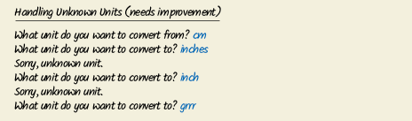

Storyboarding
Ask yourself:
What inputs does the program need?
How will it ask the user for the inputs?
What outputs will the program display?
What is the best way to display the outputs?
Below are example storyboards (before and after) for a program to convert values from one unit (such as inch) to another (such as cm).
Based on the storyboard, the programmer decided to display a list of possible units rather than assume the user knows them a priori.

Slide 61
Topic 7
The while loop
Problem solving: hand-tracing
The for loop
The do loop
Processing input
Problem solving: storyboards
Common loop algorithms
Nested loops
Problem solving: solve a simpler problem first
Random numbers and simulations
Chapter summary

Slide 62
Common Loop Algorithms
These examples provide a starting point for your code
Total and average of user inputs:
double total = 0;
int count = 0;
double input;
while (cin >> input)
{
total = total + input; //compute running total
count++;
}
double average = 0;
if (count > 0)
{
average = total / count;
}

Slide 63
Common Loop Algorithms: Counting Matches
//Counting chars in a string
int spaces = 0;
for (int i = 0; i < str.length(); i++)
{
if (str.substr(i, 1)== " ")
{ spaces++; }
}
//Counting words in a user input sequence
int short_words = 0;
string input;
while (cin >> input)
{
if (input.length() <= 3)
{ short_words++; }
}

Slide 64
Common Loop Algorithms: Finding First Location
//Find the location in a string of first space char
bool found = false; //flag=false says "not found yet"
int position = 0;
while (!found && position < str.length())
{
string ch = str.substr(position, 1);
if (ch == " ")
{ found = true; }
else
{ position++; }
}

Slide 65
Common Loop Algorithms: Prompting Until Matched
//Repeat prompt until user enters valid value
bool valid = false; //input not valid yet
double input; //declare input var outside loop,
//so it will persist after loop exit
while (!valid)
{
cout << "Please enter a positive value < 100: ";
cin >> input;
if (0 < input && input < 100)
{ valid = true; }
else
{ cout << "Invalid input." << endl; }
}

Slide 66
Common Loop Algorithms: Min and Max
//Save the min and max values of user input list
// This is a merger of the min and max loops from book
double largest, smallest;
double input;
cin >> largest; //get first value to use in loop
smallest = largest; // copy it.
// If only 1 entry, it is both smallest and the largest
while (cin >> input)
{
if (input > largest)
{ largest = input; }
else if (input < smallest)
{ smallest = input; }
}

Slide 67
Common Loop Algorithms: Comparing Adjacent Values
//Find adjacent duplicates of user input list
// In a later chapter, we'll show how to use arrays to
// find non-adjacent duplicates
double input;
double previous; //to keep track of prior entry
cin >> previous; //first entry becomes first previous
while (cin >> input)
{
if (input == previous)
{
cout << "Duplicate input" << endl;
}
previous = input; //save it to compare to next input
}

Slide 68
How to Write a Loop
These are the steps to follow when turning a problem description into a code loop:
Decide what work must be done inside the loop
For example, read another item or update a total
Specify the loop condition
Such as exhausting a count or invalid input
Determine the loop type
Use for in counting loops, while for event-controlled
Set up variables for entering the loop for the first time
Process the result after the loop has finished
Trace the loop with typical examples
Implement the loop in C++

Slide 69
Worked Example 4.1: Loop to Remove Chars from string
// worked_example_1/ccnumber.cpp
// Removes all spaces or dashes from a string
#include <iostream>
#include <string>
using namespace std;
int main()
{
string credit_card_number = "4123-5678-9012-3450";
int i = 0;
while (i < credit_card_number.length())
{ string ch = credit_card_number.substr(i, 1);
if (ch == " " || ch == "-") //must remove char
{
string before = credit_card_number.substr(0, i);
string after = credit_card_number.substr(i + 1); credit_card_number = before + after;
}
else // no need to remove it, go to next char
{ i++; }
}
cout << credit_card_number << endl;
return 0;
}

Slide 70
Topic 8
The while loop
Problem solving: hand-tracing
The for loop
The do loop
Processing input
Problem solving: storyboards
Common loop algorithms
Nested loops
Problem solving: solve a simpler problem first
Random numbers and simulations
Chapter summary

Slide 71
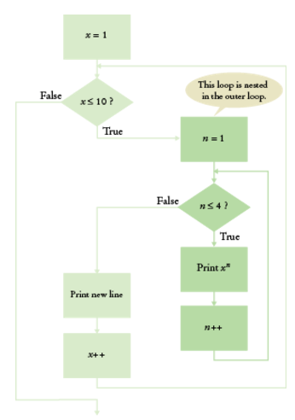
Nested Loops
Nested loops are used mostly for data in tables as rows and columns.
The processing across the columns is a loop, as you have seen before, “nested” inside a loop for going down the rows.
Each row is processed similarly. After writing a loop to process a generalized row (across the columns), that loop, called the “inner loop,” is placed inside an “outer loop” that does successive rows
The flowchart shows a diamond decision box for each loop.

Slide 72
Nested Loop Example: Table of Powers
Write a program to produce a table of powers. The output should be something like this:
1 | 2 | 3 | 4
X | X | X | X
1 | 1 | 1 | 1
2 | 4 | 8 | 16
3 | 9 | 27 | 81
4 | 16 | 64 | 256
5 | 25 | 125 | 625
6 | 36 | 216 | 1296
7 | 49 | 343 | 2401
8 | 64 | 512 | 4096
9 | 81 | 729 | 6561
10 | 100 | 1000 | 10000

Slide 73
Nested Loop Inner Loop
There are four columns and in each column we display the power. Using x to be the number of the row we are processing, we have (in pseudo-code) for the "inner" loop:
For n from 1 to 4 //table row
Print x^{n}
You should test that this works in your code before continuing. If you can’t correctly print one row, why try printing lots of them?

Slide 74
Nested Loop Outer Loop
We add the outer loop to count the rows, and include the inner loop to print each row:
Print table header.
For x from 1 to 10
For n from 1 to 4 //table row
Print x^{n}
Print endl.

Slide 75
Nested Loop Program for Table of Powers
#include <iostream>
#include <iomanip>
#include <cmath>
using namespace std;
void main() //print a table of powers, x to the nth
{
const int NMAX = 4;
const double XMAX = 10;
for (int n = 1; n <= NMAX; n++) // Print table header
cout << setw(10) << n;
cout << endl;
for (int n = 1; n <= NMAX; n++)
cout << setw(10) << "x ";
cout << endl << endl;
for (double x = 1; x <= XMAX; x++) // Print table row
{
for (int n = 1; n <= NMAX; n++) //print each column
cout << setw(10) << pow(x, n);
cout << endl;
}
}
ch04/powtable.cpp

Slide 76
More Nested Loop Examples
The loop variables can have a value relationship. In this example the inner loop depends on the value of the outer loop.
for (i = 1; i <= 4; i++)
for (j = 1; j <= i; j++)
cout << "*";
cout << endl;
The output will be:
*
**
***
****

Slide 77
Nested Loop Example: Triangle
for (i = 1; i <= 4; i++)
for (j = 1; j <= i; j++)
cout << "*";
cout << endl;
j is each line’s length, which is different for each line. and depends on the current line number, i. Having j count up to i in the inner loop results in a longer line at each row.
Output:*
* *
* * *
* * * *

Slide 78
Nested Loop: Array of Numbers (Practice It #3)
What does the following code print?
for (int i = 1; i <= 4; i++)
{
for (int j = 0; j < 4; j++)
{
cout << " " << 10 * i + j;
}
cout << endl;
}
The answer is below, in small font. Enlarge it to check your answer:
10 11 12 13
20 21 22 23
30 31 32 33
40 41 42 43

Slide 79

Worked Example 4.2: Pixels in an Image
A digital image is made up of pixels.
Each pixel is a tiny square of one color
They are arranged in a 2D array of rows
and columns
A pixel color is 3 bytes: one each for Red, Green, Blue intensity
We will use a Picture type library (a class, to be covered in a later chapter)
It has functions for loading an image and accessing its pixels.
Problem Statement:
Convert an image into its negative, turning white (255,255,255) to black (0,0,0), cyan to red, and so on.
To do so, we subtract the color values from 255 (the max possible color value)
We need nested loops to process the 2D array of pixels

Slide 80
Worked Example 4.2: Code
#include "picture.h"
int main()
{
Picture pic("queen-mary.png"); //load the image
for (int x = 0; x < pic.width(); x++) //outer, row loop
{
for (int y = 0; y < pic.height(); y++)//inner column loop
{
int red = pic.red(x, y); //get individual RGB values
int green = pic.green(x, y);
int blue = pic.blue(x, y);
pic.set(x, y, 255 - red, 255 - green, 255 - blue);
}
}
pic.save("out.png");
return 0;
}

Slide 81
Topic 9
The while loop
Problem solving: hand-tracing
The for loop
The do loop
Processing input
Problem solving: storyboards
Common loop algorithms
Nested loops
Problem solving: solve a simpler problem first
Random numbers and simulations
Chapter summary

Slide 82
Problem Solving: Solving a Simpler Problem First
When you face a complex task:
simplify the problem
solve the simpler problem first
Apply what you learned to build the complete, complex task solution
This methodology helps you get started, and your success on the simpler problem will help motivate you to solve the harder one.

Slide 83

Solving a Simpler Problem
The Task:
Arrange pictures, aligned at the top edges, separated with small gaps. Start a new row once the arrangement reaches a certain width.
Solve these simpler problems to build towards a final solution:
1. Draw one picture.
2. Draw two pictures next to each other.
3. Draw two pictures with a gap between them.
4. Draw all pictures in a long row.
5. Draw a row of pictures until you run out of room, then put one more picture in the next row.
See the textbook Section 4.9 for details!

Slide 84
Topic 10
The while loop
Problem solving: hand-tracing
The for loop
The do loop
Processing input
Problem solving: storyboards
Common loop algorithms
Nested loops
Problem solving: solve a simpler problem first
Random numbers and simulations
Chapter summary

Slide 85
Random Numbers and Simulations
A simulation program models an activity in the real world (or in an imaginary one)
Commonly used for:
predicting climate change
analyzing traffic
picking stocks
many other applications in science and business.
.

Slide 86
Simulations and the rand Function
Since things in the real world happen at random times and with random magnitudes within a certain range, we need to generate random numbers for simulations.
<cstdlib> has a random number function: rand()
rand()returns a random int between 0 and RAND_MAX
implementation-dependent constant, typically the largest valid int
Call rand() again, and you get a different number.

Slide 87
The rand Function is "Pseudorandom"
rand calculates a value from a long sequence of numbers that don’t repeat for a long time.
But they do eventually repeat, thus the name "pseudorandom numbers".
Furthermore, if you run the program again, you get the exact same sequence of pseudorandom numbers.
To prevent the repeated sequences, use the following nested function call at the top of your program once, to "seed" the rand function with a unique value:
srand(time(0)); //time of day is the seed
// time() requires #include <ctime> header

Slide 88
Simulation Example: Die Tosses
Usually we want random numbers in a certain range (1 to 6 for dice)
To get a random number value between a & b, use
int r = rand() % (b - a + 1) + a;
Complete die-toss program: sec10/dice.cpp
#include <iostream>
#include <cstdlib>
#include <ctime>
using namespace std;
int main() {
srand(time(0)); //seed the generator
for (int i = 1; i <= 10; i++) // 10 tosses
{
int d1 = rand() % 6 + 1;
int d2 = rand() % 6 + 1;
cout << d1 << " " << d2 << endl;
}
cout << endl; return 0;
}

Slide 89
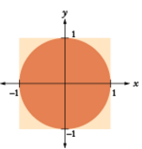
Simulations: the Monte Carlo Method for π
Named after the famous casino in Monte Carlo
For finding approximate solutions to problems that cannot be precisely solved
by doing a bunch of trials and tallying averages
Example for approximating the value of pi:
Simulate shooting a dart into a square surrounding a circle of radius 1.
generate random x and y coordinates between –1 and 1
The dart hits inside the circle if x² + y² ≤ 1
Because our shots are entirely random, the ratio of hits / tries is approximately equal to the ratio of the areas of the circle and the square, that is, π/4.
Therefore, our estimate for π is 4 × hits/tries.

Slide 90
Code for Monte Carlo Simulation of π
// sec10/montecarlo.cpp
// #includes not shown, insert here if you run this code
int main()
{
const int TRIES = 10000; //can increase TRIES for more accuracy
srand(time(0));
int hits = 0;
for (int i = 1; i <= TRIES; i++)
{
double r = rand() * 1.0 / RAND_MAX; // Between 0 and 1
double x = -1 + 2 * r; // x in range –1 to 1
r = rand() * 1.0 / RAND_MAX; //rand value for y
double y = -1 + 2 * r;
if (x * x + y * y <= 1) //hit inside circle
{ hits++; }
}
double pi_estimate = 4.0 * hits / TRIES;
cout << "Estimate for pi: " << pi_estimate << endl;
return 0;
}

Slide 91
Topic 11
The while loop
Problem solving: hand-tracing
The for loop
The do loop
Processing input
Problem solving: storyboards
Common loop algorithms
Nested loops
Problem solving: solve a simpler problem first
Random numbers and simulations
Chapter summary

Slide 92
Chapter Summary, Part 1
Explain the flow of execution in a loop.
Loops execute a block of code repeatedly while a condition remains true.
An off-by-one error is a common error when programming loops. Think through simple test cases to avoid this type of error.
Use the technique of hand-tracing to analyze the behavior of a program.
a simulation of code execution in which you step through instructions and track the values of the variables.
helps you understand how an unfamiliar algorithm works.
can show errors in code or pseudocode. Use for loops for implementing counting loops.
Choose between the while loop and the do loop.
The while loop is for loops that only should run if the condition is true at the beginning
The do loop is appropriate when the loop body must be executed at least once, such as prompting the user to enter correct input.
The for loop is used when a value runs from a starting point to an ending point with a constant increment or decrement.

Slide 93
Chapter Summary, Part 2
Implement loops that read sequences of input data.
A sentinel value denotes the end of a data set, but it is not part of the data.
You can use a Boolean variable to control a loop. Set the variable before entering the loop, then set it to the opposite to leave the loop.
Use input redirection to read input from a file. Use output redirection to capture program output in a file.
Use the technique of storyboarding for planning user interactions.
A storyboard consists of annotated sketches for each step in an action sequence.
Developing a storyboard helps you understand the inputs and outputs required for a program.
Know the most common loop algorithms.
To compute an average, keep a total and a count of all values.
To count values that fulfill a condition, check all values and increment a counter for each match.
To find a match, exit the loop when the match is found.
To find the largest value, update the largest value seen so far whenever you see a larger one.
To compare adjacent inputs, store the preceding input in a variable.

Slide 94
Chapter Summary, Part 3
Use nested loops to implement multiple levels of iteration.
When the body of a loop contains another loop, the loops are nested.
A typical use of nested loops is printing a table with rows and columns.
Design programs that carry out complex tasks.
To solve a complex problem, first solve a simpler task.
Make a plan consisting of a series of tasks, each a simple extension of the previous one, and ending with the original problem.
Apply loops to the implementation of simulations.
In a simulation, you use the computer to model an activity.
You can introduce randomness by calling the random number generator rand() after seeding the generator by calling srand(time(0))

