Slide 1

Chapter Four: Loops

Slide 2
Chapter Goals
To implement while, for and do…while loops
To avoid infinite loops and off-by-one errors
To understand nested loops
To implement programs that read and process data sets
To use a computer for simulations

Slide 3
Topic 1
The while loop
Problem solving: hand-tracing
The for loop
The do loop
Processing input
Problem solving: storyboards
Common loop algorithms
Nested loops
Problem solving: solve a simpler problem first
Random numbers and simulations
Chapter summary

Slide 4
What Is the Purpose of a Loop?
A loop is a statement that is used to:
execute one or more statements repeatedly until a goal is reached.
Sometimes these statements will not be executed at all
—if that’s the way to reach the goal

Slide 5
The Three Loops in C++
C++ has three looping statements:
while()
for()
do {} while()

Slide 6
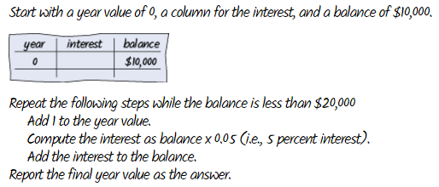
The while Loop
Chapter 1 had an example of an algorithm needing a loop
"repeat … while the balance is less…"

Slide 7
The while Loop template
while (condition) {
statements
}
The condition is some kind of test (just like the if statement)
The statements are repeatedly executed until the condition is false

Slide 8
Using a Loop to Solve an Investment Problem
An investment problem:
Starting with $10,000, how many years until we have at least $20,000, at 5% interest?
The algorithm:
1. Start with a year value of 0 and a balance of $10,000.
2. Repeat the following steps while the balance is less than $20,000:
Add 1 to the year value.
Compute the interest by multiplying the balance value by 0.05 (5 percent interest) (will be a const, of course).
Add the interest to the balance.
3. Report the final year value as the answer.

Slide 9

The Complete Investment Program
#include <iostream>
using namespace std;
int main()
{
const double RATE = 5;
const double INITIAL_BALANCE = 10000;
const double TARGET = 2 * INITIAL_BALANCE;
double balance = INITIAL_BALANCE;
int year = 0;
while (balance < TARGET)
{
year++;
double interest = balance * RATE / 100;
balance = balance + interest;
}
cout << "The investment doubled after "
<< year << " years." << endl;
return 0;
}
sec01/doublinv.cpp

Slide 10
Program Run
before entering while's body |  | at the end of while's body
balance | year | interest | balance | year
10000.00 | 0 | 500.00 | 10500.00 | 1
10500.00 | 1 | 525.00 | 11025.00 | 2
11025.00 | 2 | 551.25 | 11576.25 | 3
11576.25 | 3 | 578.81 | 12155.06 | 4
12155.06 | 4 | 607.75 | 12762.82 | 5
12762.82 | 5 | 638.14 | 13400.96 | 6
13400.96 | 6 | 670.05 | 14071.00 | 7
14071.00 | 7 | 703.55 | 14774.55 | 8
14774.55 | 8 | 738.73 | 15513.28 | 9
15513.28 | 9 | 775.66 | 16288.95 | 10
16288.95 | 10 | 814.45 | 17103.39 | 11
17103.39 | 11 | 855.17 | 17958.56 | 12
17958.56 | 12 | 897.93 | 18856.49 | 13
18856.49 | 13 | 942.82 | 19799.32 | 14
19799.32 | 14 | 989.97 | 20789.28 | 15
20789.28 | 15 | while statement is over
…the values are updated for 15 iterations…
…until the balance is finally(!) over $20,000 and the while() test becomes false.

Slide 11
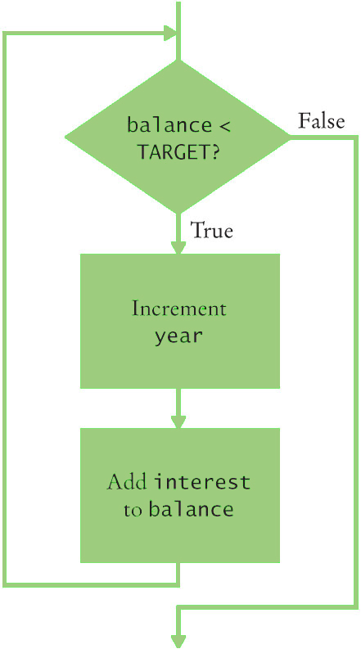
Flowchart of the Investment Calculation while Loop

Slide 12
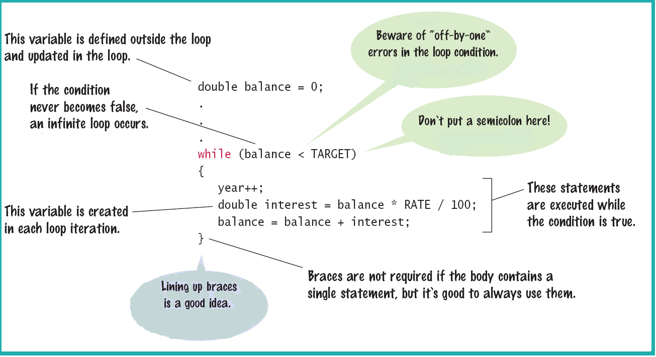
The while Statement

Slide 13
while Loop Examples: Table 1
Loop (all preceded by i=5; ) | Output | Explanation
while (i > 0) { cout << i << " "; i--; } | 5 4 3 2 1 | When i is 0, the loop condition is false, and the loop ends.
while (i > 0) { cout << i << " "; i++; } | 5 6 7 8 9 10 11 ... | The i++ statement is an error causing an “infinite loop” (see Common Error 4.1).
while (i > 5) { cout << i << " "; i--; } | (No output) | The statement i > 5 is false, and the loop is never executed.
while (i < 0) { cout << i << " "; i--; } | (No output) | The programmer probably thought, “Stop when i is less than 0”. However, the loop condition controls when the loop is executed, not when it ends (see Common Error 4.2).
while (i > 0); { cout << i << " "; i--; } | (No output, program does not terminate) | Note the semicolon before the {. This loop has an empty body. It runs forever, checking whether i > 0 and doing nothing in the body.

Slide 14
Example of Normal Execution
while loop to hand-trace
What is the output?
i = 5;
while (i > 0)
{
cout << i << " ";
i--;
}

Slide 15
Example of a Problem – An Infinite Loop
i is set to 5
The i++; statement makes i get bigger and bigger
the condition will never become false –
an infinite loop
i = 5;
while (i > 0)
{
cout << i << " ";
i++;
}
The output never ends
5 6 7 8 9 10 11…

Slide 16
Common Error – Infinite Loops
Forgetting to update the variable used in the condition is common.
In the investment program, it might look like this:
year = 1;
while (year <= 20)
{
balance = balance * (1 + RATE / 100);
}
The variable year is not updated in the body

Slide 17
Another Programmer Error
What is the output?
i = 5;
while (i < 0)
{
cout << i << " ";
i--;
}

Slide 18
A Very Difficult Error to Find (especially after looking for hours and hours!)
i = 5;
while (i > 0);
{
cout << i << " ";
i--;
}
What is the output?

Slide 19
Another infinite loop – caused by the semicolon after the parentheses.
The Answer: Difficult Error to Find
That semicolon causes the while loop to have an “empty body” which is executed forever.
The i in (i > 0) is never changed.
while loop
There is no output!
i = 5;
while (i > 0);
{
cout << i << " ";
i--;
}

Slide 20
Common Error – Off-by-One Errors
In the code to find when we have doubled our investment: Do we start the variable for the years at 0 or 1 years? Do we test for < TARGET
or for <= TARGET?

Slide 21
Off-by-One Errors
Maybe if you start trying some numbers and add +1 or -1 until you get the right answer you can figure these things out.
It will most likely take a very long time to try ALL the possibilities.
No, just try a couple of “test cases” (while thinking).

Slide 22
Think to Decide!
Consider starting with $100 and a RATE of 50%.
We want $200 (or more).
At the end of the first year, the balance is $150 – not done yet
At the end of the second year, the balance is $225 – definitely over TARGET and we are done.
We made two increments. What must the original value be so that we end up with 2?
Zero, of course.

