Slide 1
Topic 4
The while loop
Problem solving: hand-tracing
The for loop
The do loop
Processing input
Problem solving: storyboards
Common loop algorithms
Nested loops
Problem solving: solve a simpler problem first
Random numbers and simulations
Chapter summary

Slide 2
The do{ } while() Loop
The while() loop’s condition test is the first thing that occurs in its execution.
The do loop (or do-while loop) has its condition tested only after at least one execution of the statements. The test is at the bottom of the loop:
do
{
statements
}
while (condition);

Slide 3
The do Loop
This means that the do loop should be used only when the statements must be executed before there is any knowledge of the condition.
This also means that the do loop is the least used loop.

Slide 4
do{ } Loop Code: getting user input Repeatedly
Code to keep asking a user for input until it satisfies a condition, such as non-negative for applying the sqrt():
double value;
do
{
cout << "Enter a number >= 0: ";
cin >> value;
}
while (value < 0);
cout << "The square root is " << sqrt(value) << endl;

Slide 5
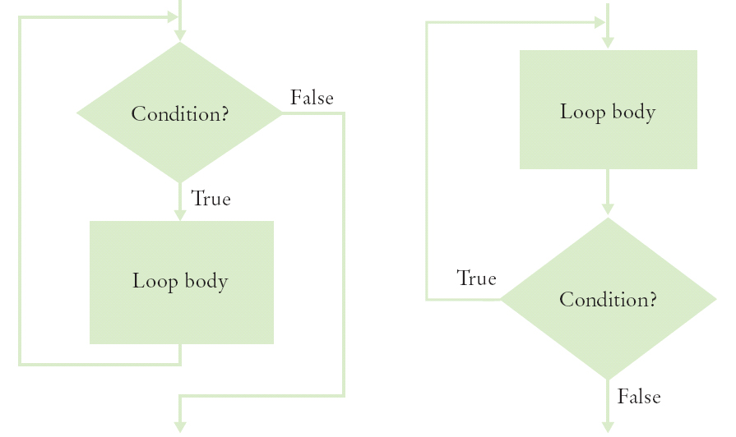
Flowcharts for the while Loop and the do Loop

Slide 6
Practice It: Example of do…while
What output does this loop generate?
int j = 1;
do
{
int value = j * 2;
j++;
cout << value << ", ";
} while (j <= 5);

Slide 7
Topic 5
The while loop
Problem solving: hand-tracing
The for loop
The do loop
Processing input
Problem solving: storyboards
Common loop algorithms
Nested loops
Problem solving: solve a simpler problem first
Random numbers and simulations
Chapter summary

Slide 8
Processing Input – When and/or How to Stop?
We need to know, when getting input from a user, when they are done.
One method is a sentinel (a value whose meaning is STOP!)
For example, when user is entering salary values, a negative number would indicate the end (since legitimate salaries cannot be negative)

Slide 9
Sentinel and a Salary Average Program (part 1)
#include <iostream>
using namespace std;
int main()
{
double sum = 0;
int count = 0;
double salary = 0;
// get all the inputs
cout << "Enter salaries, -1 to finish: ";
while (salary != -1)
{
cin >> salary;
if (salary != –1)
{
sum = sum + salary;
count++;
}
}
ch04/sentinel.cpp

Slide 10
The Salary Average Program (part 2)
// process and display the average
if (count > 0)
{
double average = sum / count;
cout << "Average salary: " << average << endl;
}
else
{
cout << "No data" << endl;
}
return 0;
}
A program run:
Enter salaries, -1 to finish: 10 10 40 -1
Average salary: 20

Slide 11
Using Failed Input for Processing
Sometimes it is easier to ask the user to “Hit Q to Quit” instead of requiring the input of a sentinel value.
In the previous chapter, we used cin.fail() to test if the most recent input failed.
Note that if you intend to take more input from the keyboard after using failed input to end a loop, you must reset the keyboard with cin.clear().
Use a bool variable to keep track of the status, and use cin.fail() to test for the input of a non-numeric when expecting a number:

Slide 12
Code Example: Testing cin.fail()
cout << "Enter values, Q to quit: ";
int value;
bool more = true;
while (more)
{
cin >> value;
if (cin.fail())
{
more = false;
}
else
{
// process value here
}
}
cin.clear(); // reset if more input needed

Slide 13
The Loop and a Half Problem
Those same programmers who dislike loops that are controlled by a bool variable have another reason: the actual test for loop termination is in the middle of the loop. Again it is not really a top or bottom test.
This is called a loop-and-a-half.

Slide 14
The Loop and a Half Problem and the break Statement
If we test for a failed read, we can stop the loop at that point:
while (true)
{
cin >> value;
if (cin.fail())
{ break; }
// process value here
}
cin.clear() // reset if more input is to be taken
The break statement breaks out of the enclosing loop, independent of the loop condition.

Slide 15
Using Failed Input in the Loop Test
Using a bool variable in this way is disliked by many programmers.
Why?
cin.fail is set when >> fails It is not really a top or bottom test. If only we could use the input itself to control the loop – we can!
An input >> operation that does not succeed returns false, so it can be used in the while’s test.

Slide 16
Failed Input Loop Control – No cin.fail() needed
To avoid the need for break and testing cin.fail, you can use the input statement as the condition of the while() loop:
cout << "Enter values, Q to quit: ";
while (cin >> value)
{
// process value here
}
cin.clear();

Slide 17
Redirection of Input and Output to Files
To avoid having to type all the input to your program every time you re-test it, you can save the input in a text file, and run your program with "input redirection" via the < sign, as:
myprogram < myinput.txt
This assumes you have compiled an ".exe" file from your code called myprogram.exe, and have typed the above in a command line window
Likewise, to store the output from your program, you can redirect it to a file instead of the screen by using >
myprogram > myoutput.txt
And you can do both input and output from files:
myprogram < myinput.txt > myoutput.txt

